Slide 1
Reproducible Research
Rob Schick
Duke University & SR Analytics
Code handouts here: http://bit.ly/2v9TE6e
https://github.com/robschick/lessonCode/blob/master/lesson1.md

Slide 2
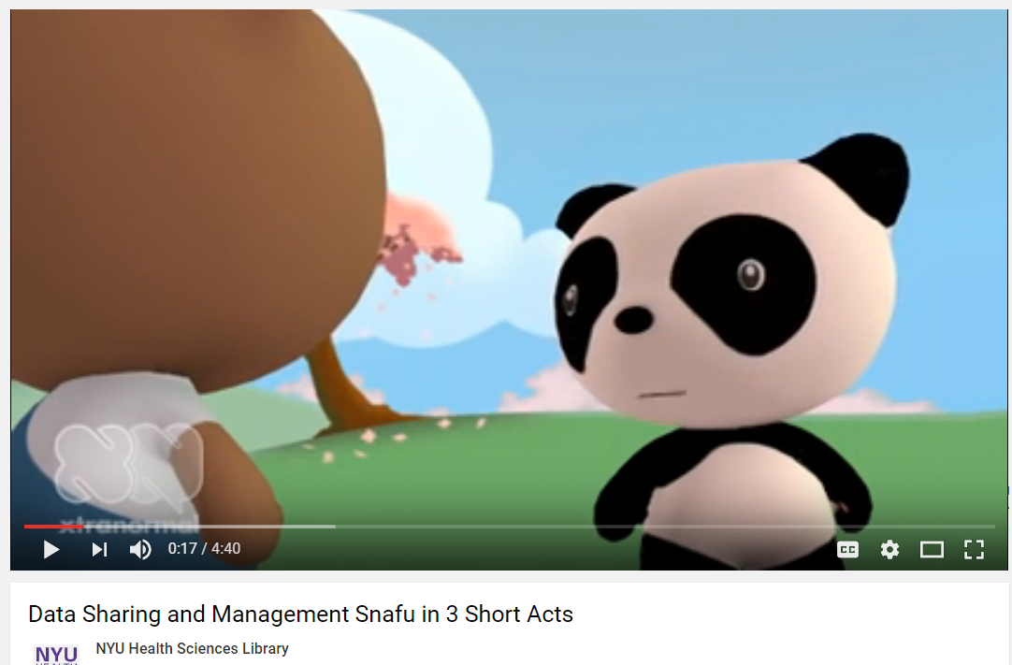
https://www.youtube.com/watch?v=N2zK3sAtr-4

Slide 3
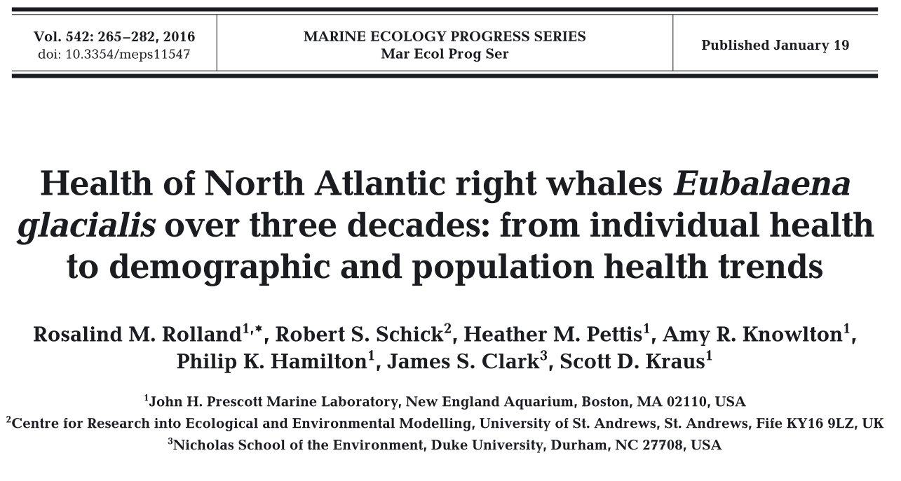
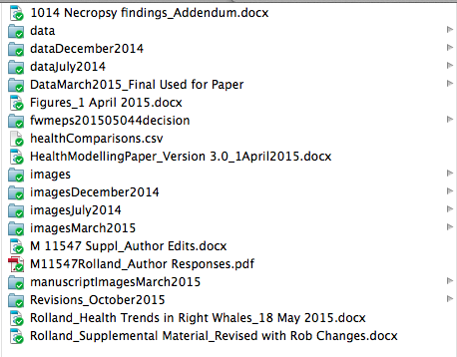
Why Rep Research? – My Motivation
Collaboration with NEAq
My Dropbox folder…ugh!

Slide 4
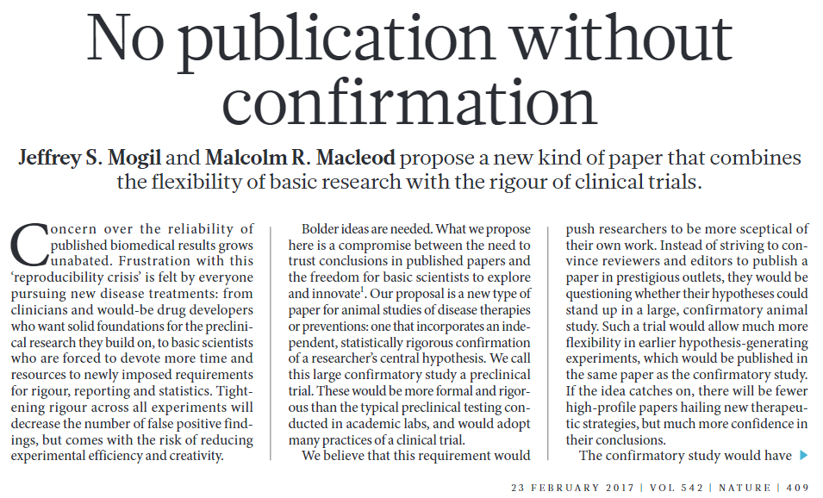
Cases I Could Make

Slide 5
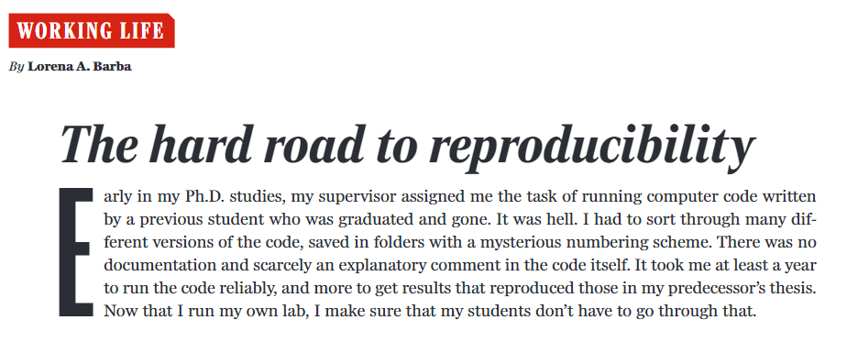
Cases I Could Make

Slide 6
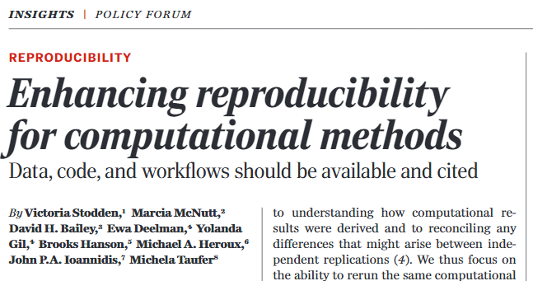
Cases I Could Make

Slide 7
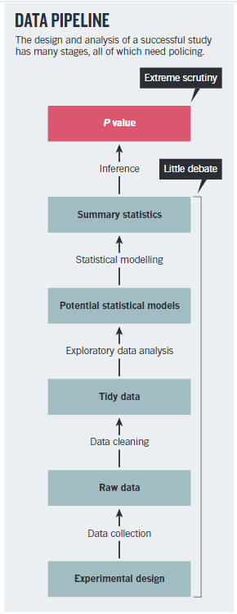
Cases I Could Make

Slide 8
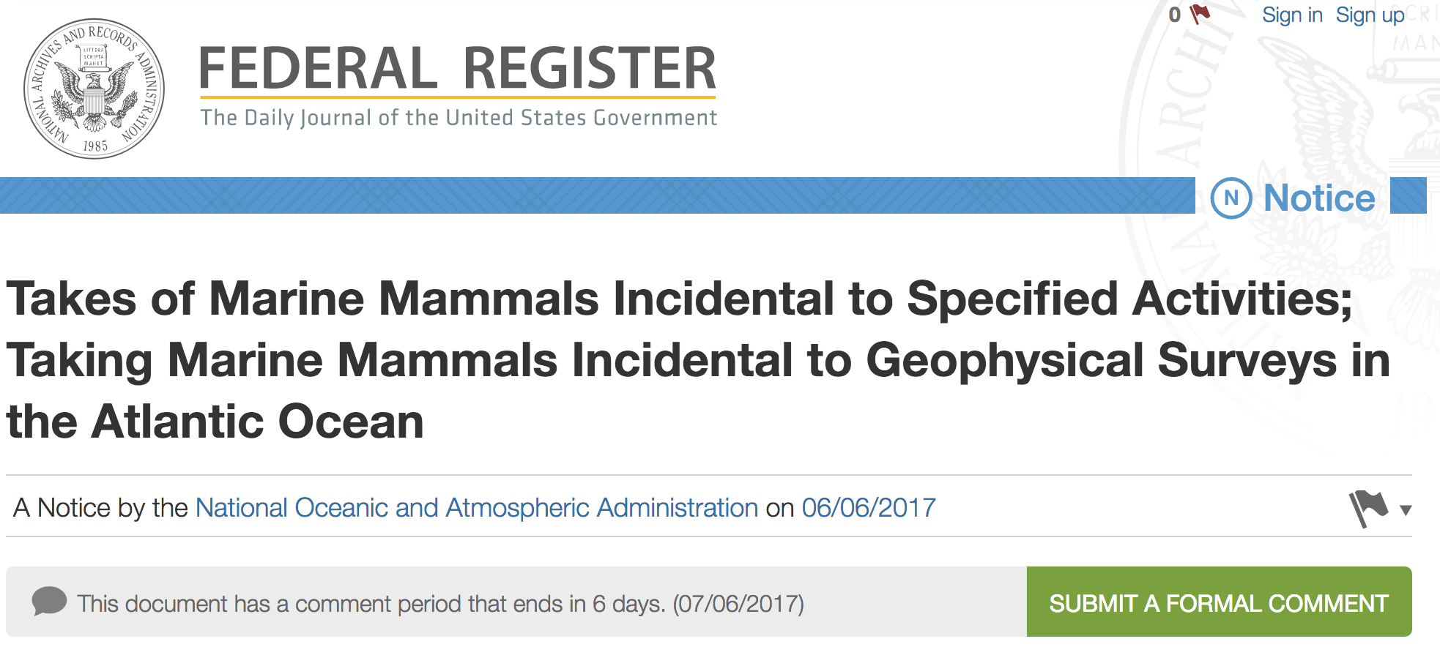
Case That Really Matters to Me

Slide 9
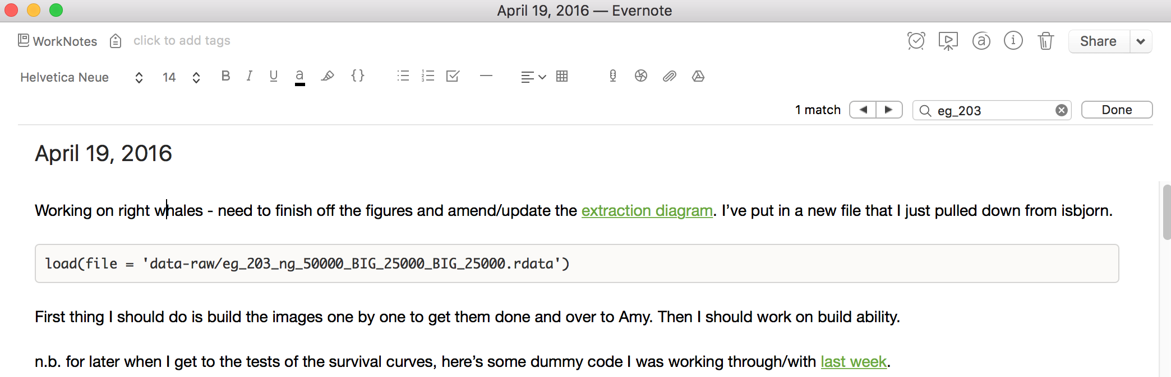
Project Notes - Evernote

Slide 10
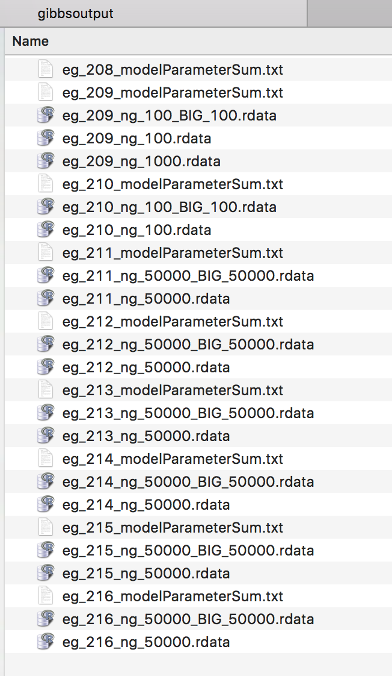
My Laptop
eg_203_*.rdata…
nowhere to be found

Slide 11
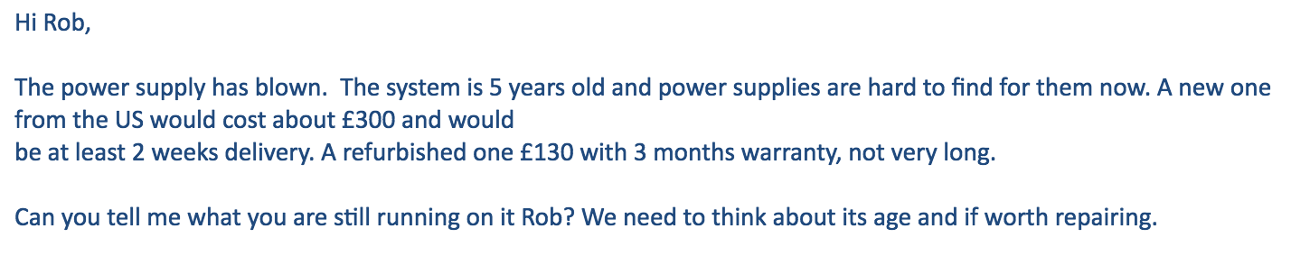
VPN to St Andrews…

Slide 12
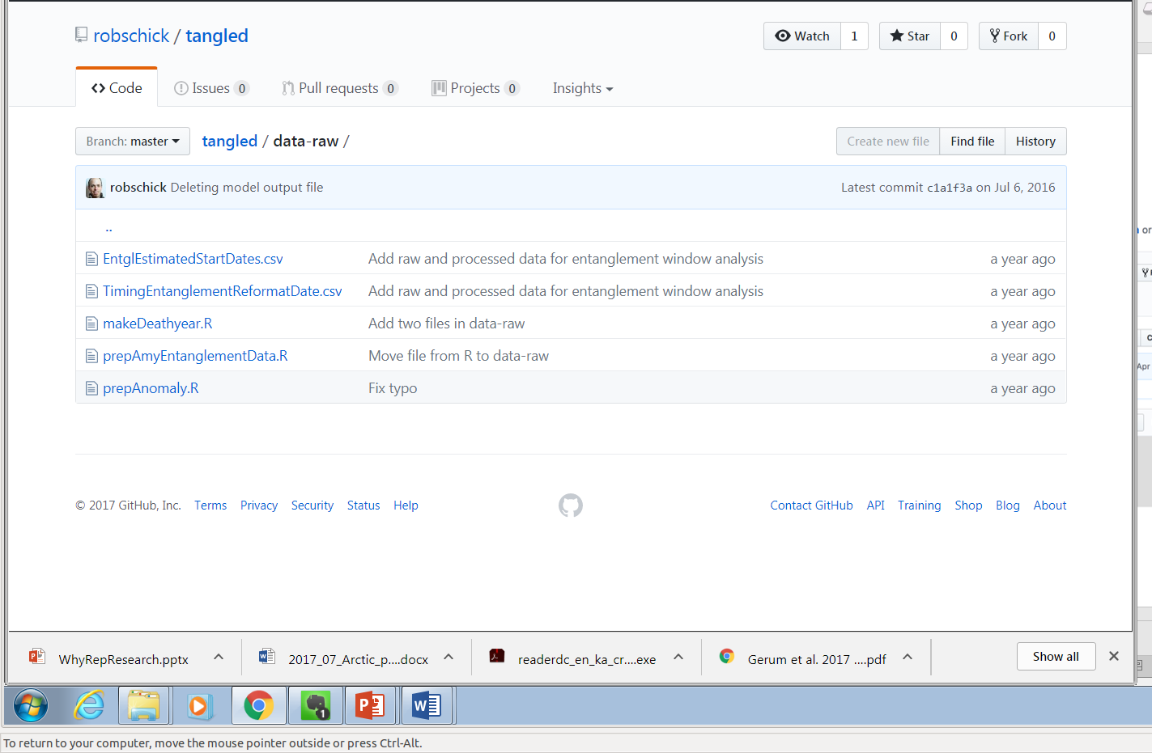
Current Repo on GitHub

Slide 13
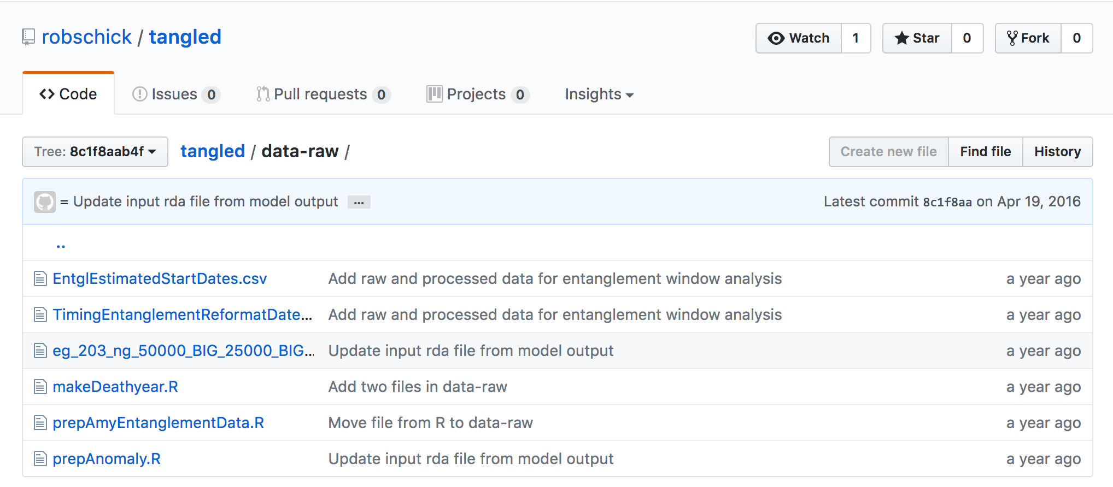
Previous Commit on Repo

Slide 14
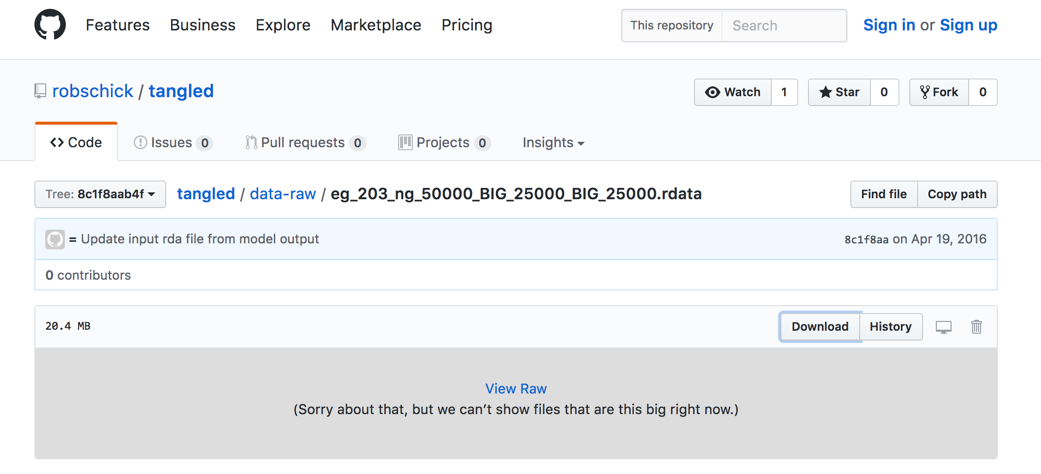
Previous Commit on Repo

Slide 15
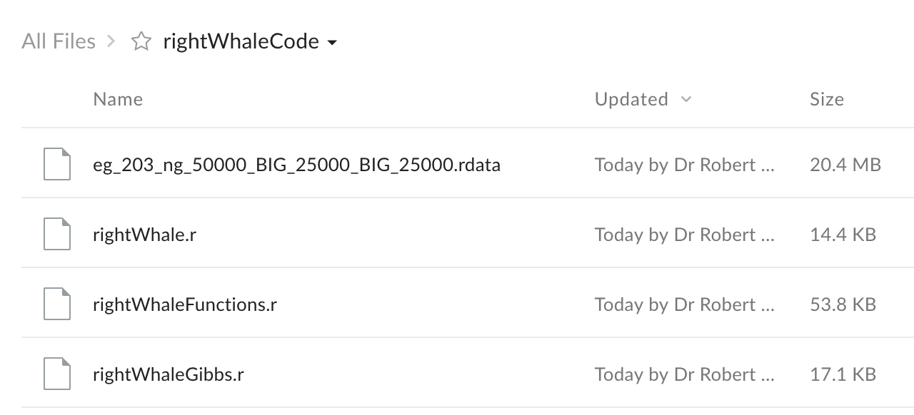
Phew!

Slide 16
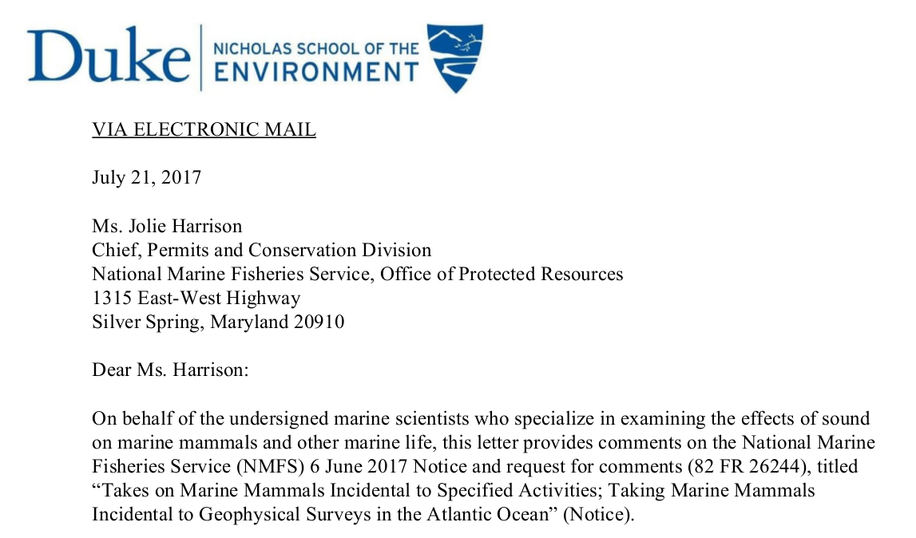
Comment in to NMFS

Slide 17
Rep Research is Good
For your future self
Just saw that one
For collaborators
Interim PCOD
For journals
Bees
For increasing impact of your work, e.g.
Jonsen et al. 2003
Morales et al. 2004

Slide 18
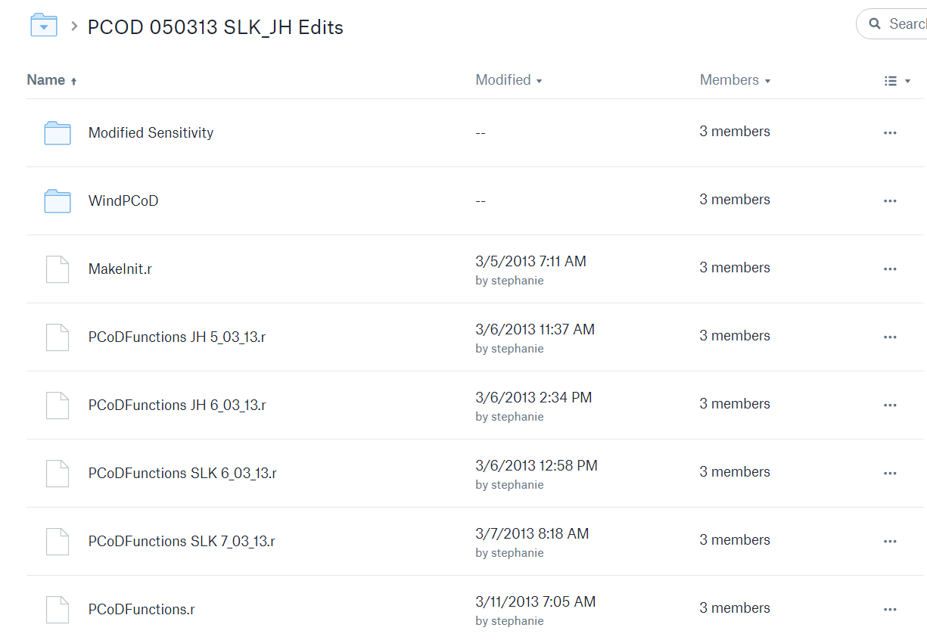
Collaborators

Slide 19
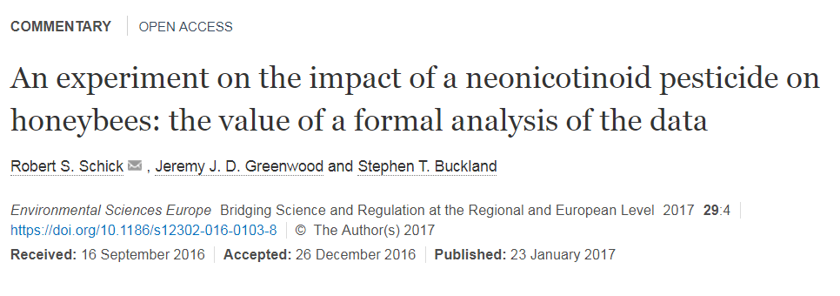
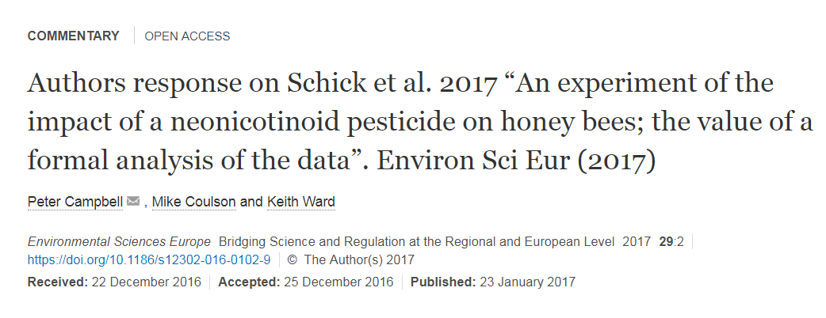
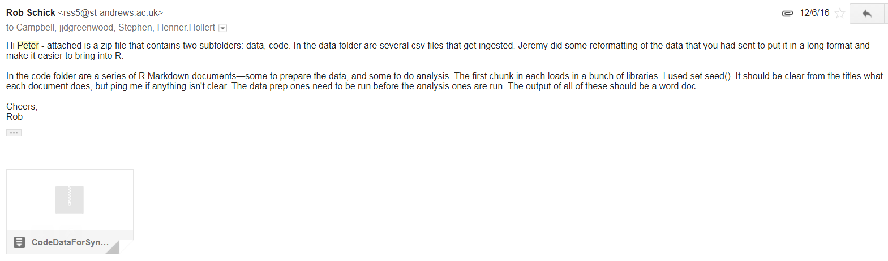
Journals

Slide 20
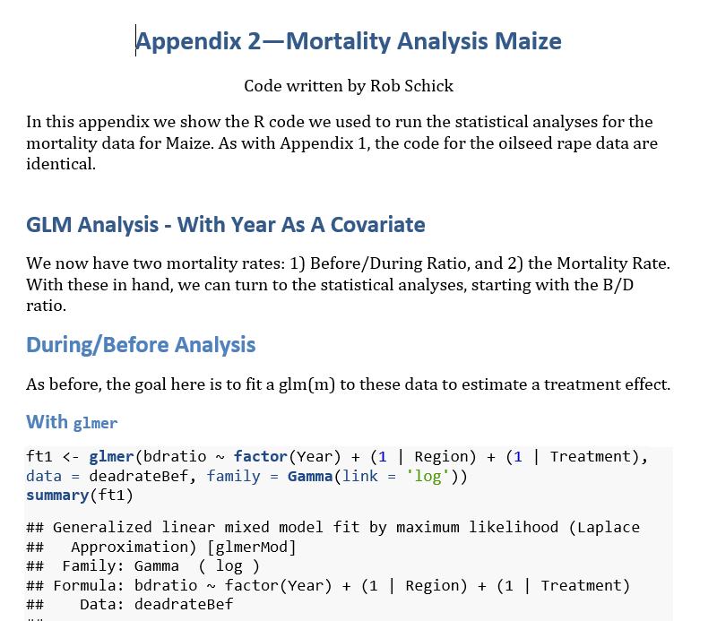
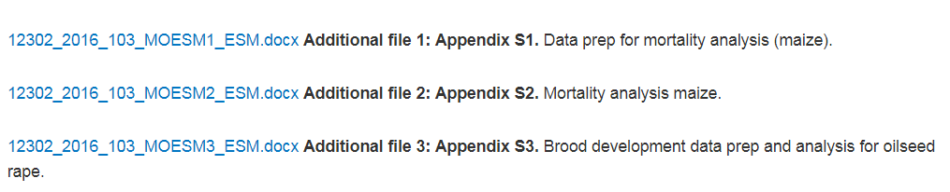
Journals

Slide 21
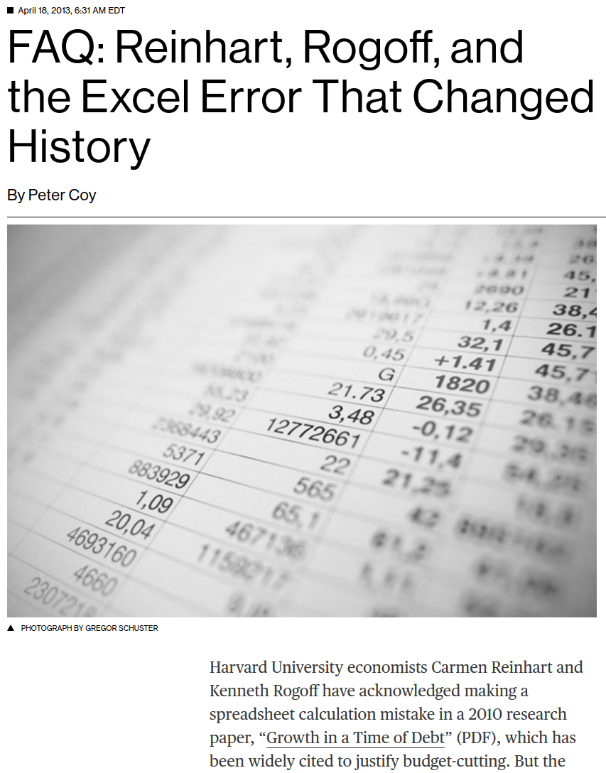
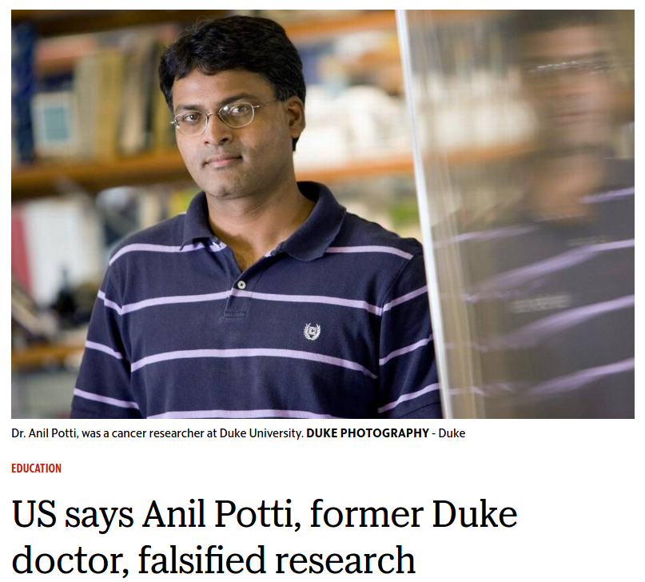
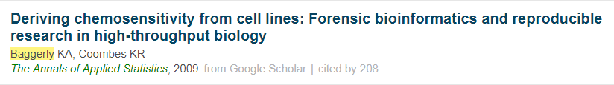
Cautionary Tales
http://bit.ly/2uNmifb
https://bloom.bg/2vl8muf

Slide 22
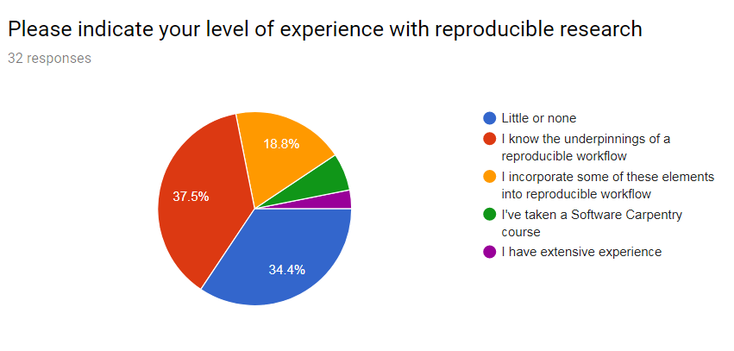
Where is Everyone At Today?

Slide 23
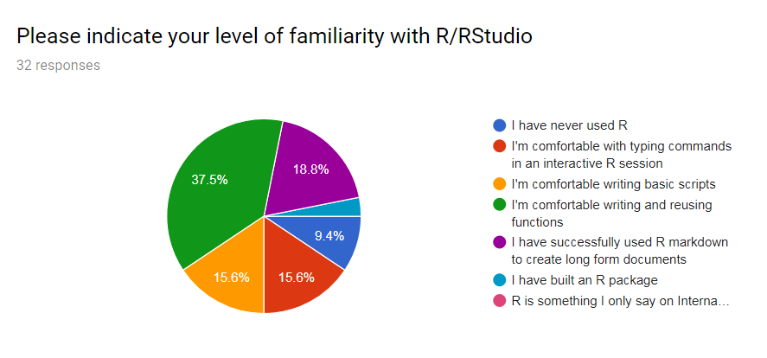
Where is Everyone At?

Slide 24
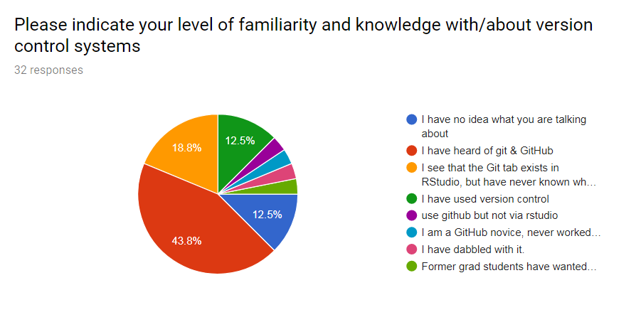
Where is Everyone At?

Slide 25
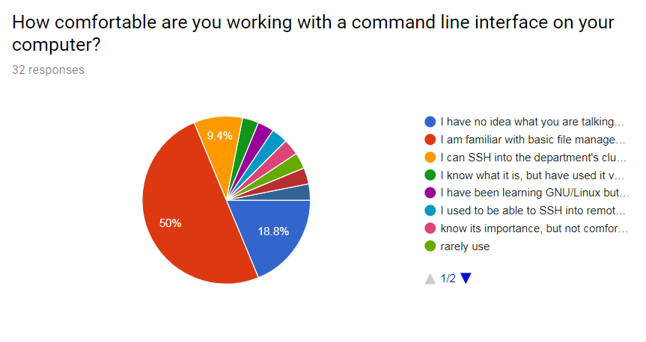
Where is Everyone At?

Slide 26
What Are We Going to Do Today?
Lesson 1 – what comprises a reproducible workflow?
Lesson 2 – what is git and why should we use it?
Lesson 3 – how has my project changed over time?
Lesson 4 – How do I work with a remote (github, node/cluster, other collaborators)
Advanced Topics (no participation required!)

