Slide 1
The Importance of Low- and Moderate-Grade Adverse Events on Patient Side-Effect Burden in Cancer Trials and Example of their use in Dose-Finding Trial Methodology.
Nathaniel O’Connell, PHD
Department of Biostatistics and Data Science

Slide 2
Outline of this Talk
Part 1: Importance of Low- and Moderate-Grade Adverse Events in Patients' Treatment Experience and Treatment Discontinuation
  O'Connell NS, Zhao F, Lee JW, Ip EH, Peipert JD, Graham N, Smith ML, Gareen IF, Carlos RC, Obeng-Gyasi S, Sparano JA, Shanafelt TD, Thomas ML, Cella D, Wagner LI, Gray R. Importance of Low- and Moderate-Grade Adverse Events in Patients' Treatment Experience and Treatment Discontinuation: An Analysis of the E1912 Trial. J Clin Oncol. 2024 Jan 20;42(3):266-272. doi: 10.1200/JCO.23.00377. Epub 2023 Oct 6. PMID: 37801678; PMCID: PMC10824381.
  Discuss and show why low- and moderate-grade AEs matter
Part 2: Implementation of low-grade AE data into dose-finding trial methodology through toxicity scores
  O'Connell NS, Wages NA, Garrett-Mayer E. Quasi-partial order continual reassessment method: Applying toxicity scores to cancer dose-finding drug combination trials. Contemp Clin Trials. 2023 Feb;125:107050. doi: 10.1016/j.cct.2022.107050. Epub 2022 Dec 16. PMID: 36529437.
  Show how the use of low- and moderate-grade AEs can be incorporated into trial design for dose-finding, and how they can improve trial performance

Slide 3
Part 1: Importance of Low- and Moderate-Grade Adverse Events in Patients' Treatment Experience and Treatment Discontinuation

Slide 4
AEs and their current use
Common Terminology Criteria for Adverse Events (CTCAE):
  100s of individually defined AEs within 26 system organ classes
  Each graded on an ordinal scale from 1 to 5
    mild, moderate, severe, life-threatening, and death due to toxicity
Documentation of AEs has historically relied on provider reporting, and grade 1 and 2 AEs have often been left unreported.
In phase 1 trials, the maximum tolerated dose (MTD) is often estimated with no consideration given to grade 1 and 2 AEs
“The majority of RAEs identified, transcribed, and entered are not clinically important. Our data suggest that reducing the number of AEs monitored will affect substantially neither overall patient safety nor compromise evaluation of regimens undergoing testing. We present several considerations for such a reduction in data collection, as well as a policy that we have used to address the deluge of RAE data.”
  Mahoney MR, Sargent DJ, O'Connell MJ, Goldberg RM, Schaefer P, Buckner JC. Dealing with a deluge of data: an assessment of adverse event data on North Central Cancer Treatment Group trials. J Clin Oncol. 2005 Dec 20;23(36):9275-81. doi: 10.1200/JCO.2004.00.0588. Erratum in: J Clin Oncol. 2006 Feb 20;24(6):1015. PMID: 16361625

Slide 5
Things have changed…
CTCAE introduced in 1982
  Most cancer treatments were cytotoxic (e.g. chemotherapy), and were given intermittently with more acutely occurring AEs
Cytotoxic therapies becoming less prevalent in new studies, while targeted agents and immunotherapies are dominating the trials landscape.
  E.g. ASCO Post in 2022 reported: 5,683 trials worldwide on PD-1/PD-L1 targeted agents, up 278% from 2017.
Toxicity profiles of targeted agents look different from conventional cytotoxic treatments
  Continuous/daily use leads to chronic AEs
  Grade 2 diarrhea lasting for 1-2 days might be acceptable, but lasting weeks (or months) may not be.
  Combinations of low-moderate grade AEs, while individually may not be too bad, can be overly burdensome when experienced simultatenously.

Slide 6
Ignoring low- and moderate-grade AEs inhibits our ability adequately characterize a patients true toxicity burden. This in turn inhibits our ability to investigate and understand tolerability and the effect of cancer treatments on a patient’s quality of life.

Slide 7
The Trial Assessed
We analyzed the ECOG-ACRIN E1912 Trial, a phase III trial for chronic lymphocytic leukemia
  2 Arms:
    A: chronic indefinite oral therapy (ibrutinib)
    B: 6-months chemoimmunotherapy.
Comprehensive captured all AE data, across grades and types, by treatment cycle
Captured questionnaire data, including FACT-G Questionnaire at baseline, and after treatment cycles 3 and 6 during induction for both treatment groups

Slide 8
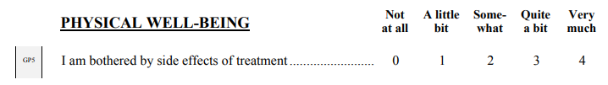
FACT-GP5, an assessment of Side-Effect Burden
Demonstrated to be associated with early treatment discontinuation and max grade AEs
  Wagner LI, Zhao F, Goss PE, et al: Patient-reported predictors of early treatment discontinuation: Treatment-related symptoms and health-related quality of life among postmenopausal women with primary breast cancer randomized to anastrozole or exemestane on NCIC Clinical Trials Group (CCTG) MA.27 (E1Z03). Breast Cancer Res Treat169:537-548, 2018
  Pearman TP, Beaumont JL, Mroczek D, et al: Validity and usefulness of a single-item measure of patient-reported bother from side effects of cancer therapy. Cancer 124:991-997, 201

Slide 9
Questions we sought to answer:
What is the relationship between the AEs a patient experiences and their self-reported side-effect burden around the time they experience those AEs?
  More specifically, how do grade 1 and grade 2 AEs affect a patient’s side-effect burden?
How to the presence of grade 1 and grade 2 impact the odds of treatment discontinuation imminent treatment discontinuation?
For both questions above, how do symptomatic vs. asymptomatic AEs effect play a role?

Slide 10
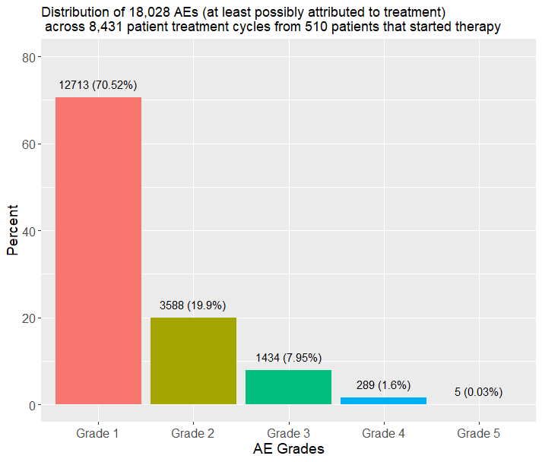
Distribution of AEs by Grade

Slide 11
Naïve assessment of AE occurrence by grade and discontinuation
Discontinuation due to AE/Side-effect/Complication by Experienced AE within treatment cycle preceding discontinuation
 | No | Yes | Chi-Square P-Value
 | (N=8347 cycles) | (N=84 cycles)
# Grade 1 AEs
Mean (SD) | 1.50 (1.87) | 2.23 (2.25) | 0.004
# Grade 2 AEs
Mean (SD) | 0.415 (0.835) | 1.56 (1.66) | <0.001
# Grade 3 AEs
Mean (SD) | 0.159 (0.468) | 1.31 (1.47) | <0.001
# Grade 4 AEs
Mean (SD) | 0.0309 (0.246) | 0.369 (0.788) | <0.001

Slide 12
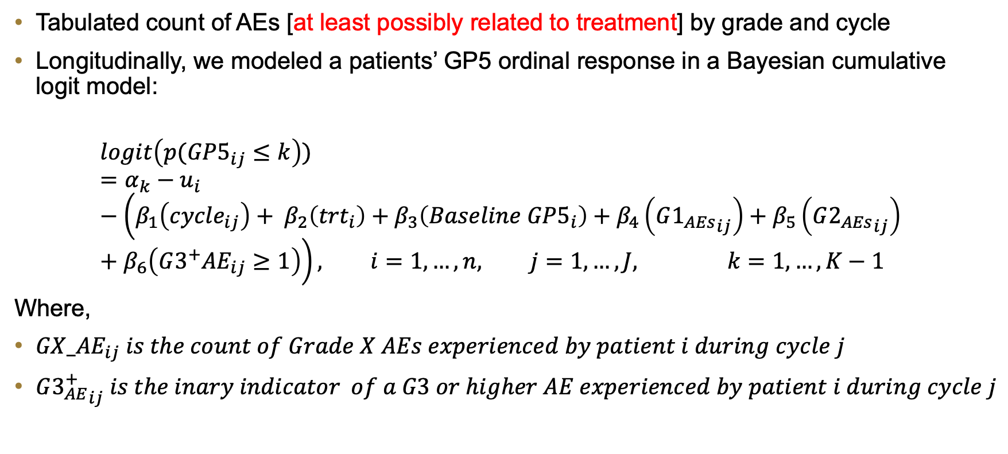
A more formal assessment..
Tabulated count of AEs [at least possibly related to treatment] by grade and cycle
Longitudinally, we modeled a patients’ GP5 ordinal response in a Bayesian cumulative logit model:
$$logit\left(p({GP5}_{ij}≤k\right))=α_{k}−u_{i} −\left(β_{1}\left({cycle}_{ij}\right)+ β_{2}\left({trt}_{i}\right)+β_{3}\left({Baseline GP5}_{i}\right)+β_{4}\left({G1_{AEs}}_{ij}\right)+β_{5}\left({G2_{AEs}}_{ij}\right)+β_{6}\left({G3^{+}AE}_{ij}≥1\right)\right), i=1,…,n, j=1,…,J, k=1,…,K−1$$
Where,
${GX_AE}_{ij} is the count of Grade X AEs experienced by patient i during cycle j$
${G3_{AE}^{+}}_{ij} is the inary indicator of a G3 or higher AE experienced by patient i during cycle j$

Slide 13
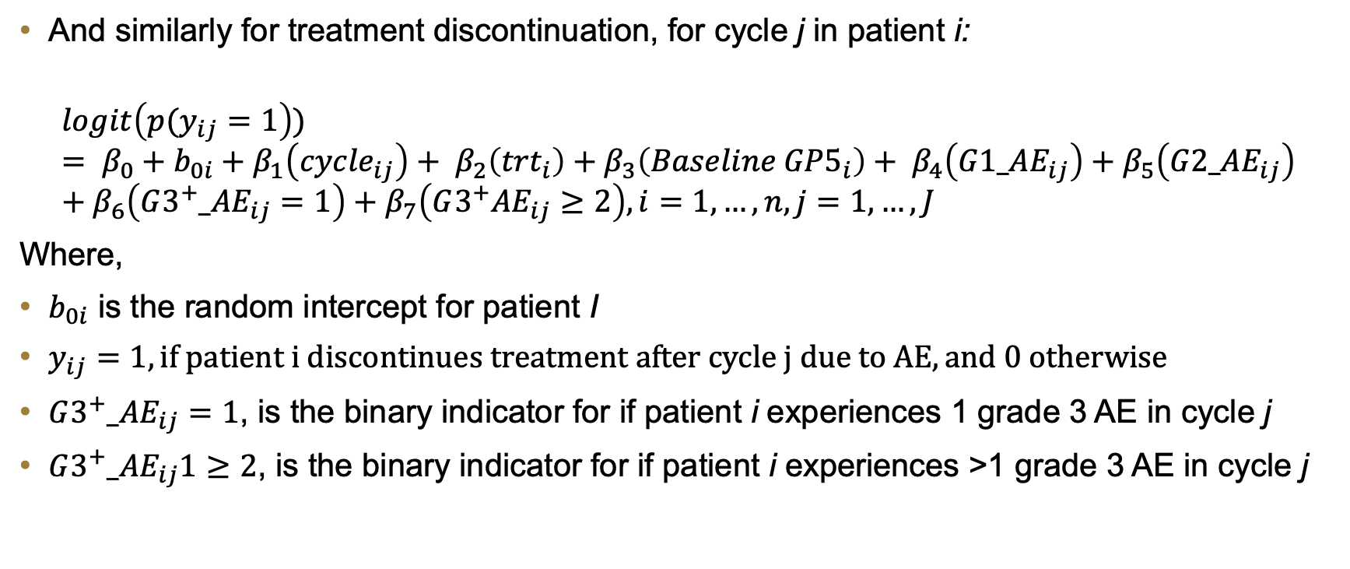
A more formal assessment…
And similarly for treatment discontinuation, for cycle j in patient i:
$$logit\left(p(y_{ij}=1\right))= β_{0}+b_{0i}+β_{1}\left({cycle}_{ij}\right)+ β_{2}\left({trt}_{i}\right)+β_{3}\left({Baseline GP5}_{i}\right)+ β_{4}\left({G1_AE}_{ij}\right)+β_{5}\left({G2_AE}_{ij}\right)+β_{6}\left({G3^{+}_AE}_{ij}=1\right)+β_{7}\left({G3^{+}AE}_{ij}≥2\right), i=1,…,n, j=1,…,J$$
Where,
$b_{0i}$ is the random intercept for patient I
$y_{ij}=1, if patient i discontinues treatment after cycle j due to AE, and 0 otherwise$
${G3^{+}_AE}_{ij}=1$, is the binary indicator for if patient i experiences 1 grade 3 AE in cycle j
${G3^{+}_AE}_{ij}1≥2$, is the binary indicator for if patient i experiences >1 grade 3 AE in cycle j

Slide 14
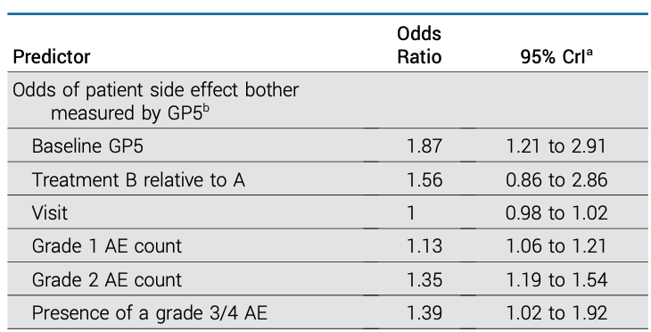
Odds of increased Patient Side-Effect Bother

Slide 15
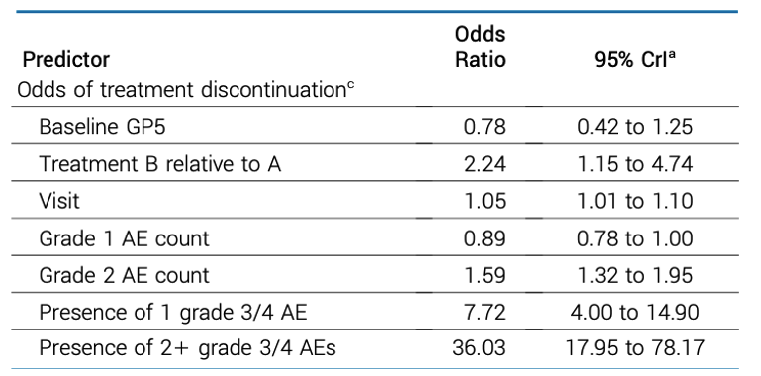
Odds of Treatment Discontinuation

Slide 16
High-level findings
Each additional grade 1 and grade 2 AE experienced increases the odds of higher self-reported side-effect burden by patients
Each additional grade 2 AE increases the odds of imminent treatment discontinuation
Interestingly, grade 1 AEs are borderline negatively associated with odds of discontinuation

Slide 17
What about symptomatology of the AEs?
Not all AEs are created equal…
Classified AEs by whether or not they were symptomatic or asymptomatic based on criteria established for defining AEs that are self-reportable for PRO-CTCAE
  Basch E, Reeve BB, Mitchell SA, et al: Development of the National Cancer Institute’s patient-reported outcomes version of the common terminology criteria for adverse events (PRO-CTCAE) adverse event reporting in oncology. J Natl Cancer Inst 106:244, 2014
Re-fit each of the models, with count of symptomatic and asymptomatic AEs as separate predictors

Slide 18
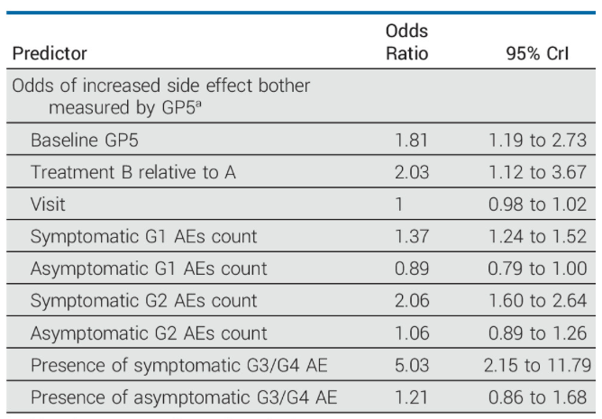
Side-Effect Bother by Symptomatology

Slide 19
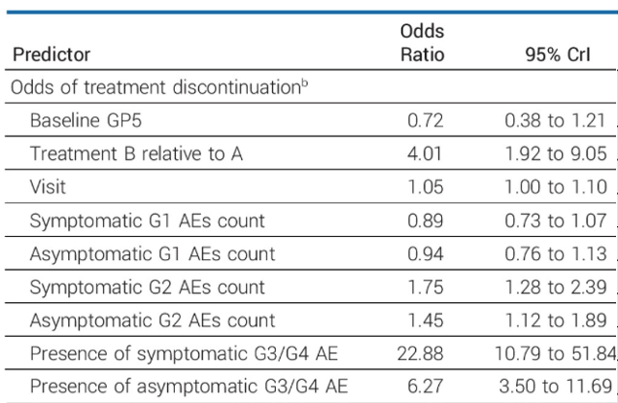
Treatment Discontinuation by Symptomology

Slide 20
Results based on Symptomatic AEs
Additional symptomatic AE of all grades (1-3+) were associated with increased odds of higher self-reported side-effect bother
Asymptomatic AEs of any grade (even Grade 3+), were not associated with higher side-effect bother reporting
For treatment discontinuation, both symptomatic and asymptomatic grade 2 and AEs were associated with higher odds of treatment discontinuation, but the symptomatic AEs had a greater effect estimate.

Slide 21
Sensitivity Analyses to AE attribution
We assessed association of treatment discontinuation based on all-cause AEs (not just those at least possibly attributable)
  Directional associations all remained the same for both side-effect bother and treatment discontinuation, but magnitude of the effects diminished
    OR for grade 1 and 2 AEs on Side-Effect Burden were 1.08 (1.03, 1.13) and 1.17 (1.08, 1.28) respectively. These are relative to 1.13 and 1.35 in the primary analysis.
    OR for grade 2 AEs on treatment discontinuation was 1.34 (1.18, 1.54), relative to 1.59 in primary analysis

Slide 22
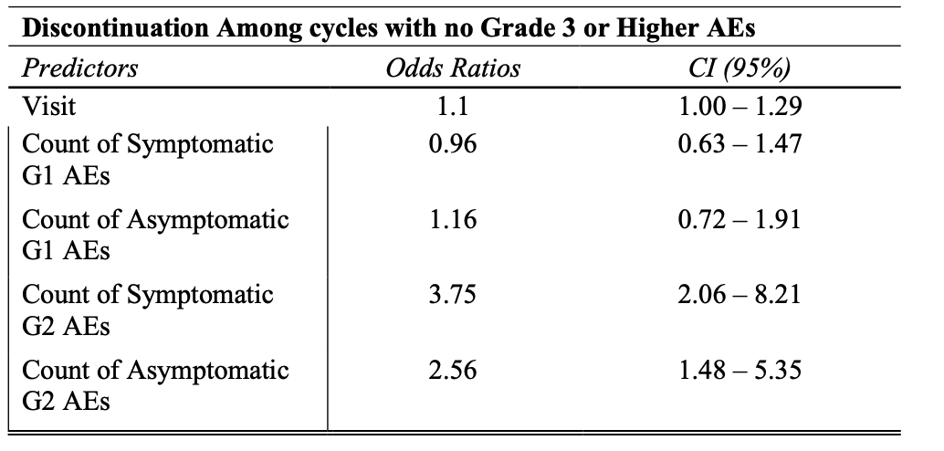
Sensitivity Analyses to Grade 3 AE presence
Treatment discontinuation may often be necessitated in the presence of some grade 3 AEs
Presence of Grade 3 AE of one type may be correlated with other AE occurrences
We re-fit the treatment discontinuation model excluding all circumstances when grade 3 AEs were present.

Slide 23
Overall Summary
Low and Moderate grade AEs are important
  They are associated with increased self-reported patient side effect burden and odds of treatment discontinuation.
  Symptomatic AE specifically, defined as those self-reportable for PRO-CTCAE purposes appear specifically to be the drivers of higher side-effect burden
    Formal mediation models still need to be assessed…

Slide 24
But that’s just one study…
We replicated these analyses in a second study - the E1Z11 ECOG-ACRIN cohort study to evaluate genetic predictors of Aromatase Inhibitor musculoskeletal symptoms
  Goal: Validate previously identified associations between 10 specific SNPs and discontinuation of AI therapy due to the development of AI-related musculoskeletal symptoms (AIMSS) among women with breast cancer
1,046 patients total, w/ PROs (GP5) assessed at baseline, 3, 6, 9, and 12 months
Like E1912, comprehensive collection of AE data across all grades

Slide 25
E1Z11 AE Data
Majority of AE data collected at 3 month intervals (i.e. 3 months, 6 months, 9 months, and 12 months)
  A “few” toxicities recorded at onset over the course of the study
In total, 4,431 AEs were recorded across 1025 patients
  2,257 of these AEs were at least possibly attributed to treatment
“Onset” toxicities were grouped into one of the 3-month categories based on day they were recorded (i.e. if recorded 45 days into study, they were grouped into 0-3 months)
0-3 Months | 3-6 Months | 6-9 Months | 9-12 Months | Onset
496 | 550 | 508 | 430 | 273

Slide 26
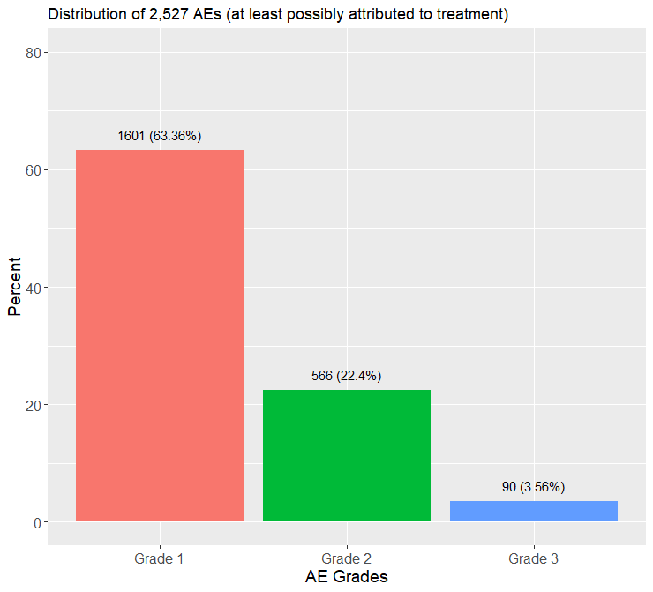
Distribution of AE data by Grade in E1Z11
 | 1 | 2 | 3 | Overall
 | (N=862) | (N=412) | (N=73) | (N=1347)
AEs
Arthralgia | 283 | 160 | 26 | 469
Arthritis | 122 | 58 | 9 | 189
Bone pain | 88 | 40 | 1 | 129
Joint range of motion decreased | 64 | 23 | 2 | 89
Myalgia | 133 | 44 | 8 | 185
Neck pain | 54 | 12 | 1 | 67
Pain in extremity | 118 | 73 | 11 | 202
Hot flashes | 0 | 1 | 2 | 3
Memory impairment | 0 | 1 | 0 | 1
Back pain | 0 | 0 | 1 | 1
Depression | 0 | 0 | 1 | 1
Dry mouth | 0 | 0 | 1 | 1
Dyspnea | 0 | 0 | 1 | 1
Fatigue | 0 | 0 | 2 | 2
Heart failure | 0 | 0 | 1 | 1
Hypertension | 0 | 0 | 1 | 1
joint/trunk/neck stiffness | 0 | 0 | 1 | 1
Pain | 0 | 0 | 1 | 1
Thromboembolic event | 0 | 0 | 1 | 1
Vaginal dryness | 0 | 0 | 1 | 1
Weight gain | 0 | 0 | 1 | 1
Red indicates symptomatic AE based on Basche et al. 2014

Slide 27
E1Z11 AE Analysis
Replicate the same models as in E1912
  Model GP5 in an ordinal regression model
  Model Imminent Discontinuation in a logistic model
  Due to low counts of asymptomatic AE data and inability to get good convergence around estimates when broken down by symptomatic or not, we fit all AEs by grade.

Slide 28
Odds of Increased Side-Effect Bother
Odds of increased self-reported side-effect bother (by GP5) from Ordinal Regression model
Predictors | Odds Ratios | CI (95%)
Baseline GP5 | 2.23 | 1.83 – 2.74
Visit | 0.99 | 0.96 – 1.02
Count of G1 AEs | 1.44 | 1.30 – 1.59
Count of G2 AEs | 2.14 | 1.83 – 2.52
Presence of at least one G3 AE | 3.91 | 1.68 – 9.06

Slide 29
Odds of Discontinuation due to AE/Side-Effects/AIMSS
 | Discontinue due to AE/Side effect/AIMSS
Predictors | Odds Ratios | CI
(Intercept) | 0 | 0.00 – 0.01
visit | 0.77 | 0.69 – 0.86
Baseline GP5 | 1.35 | 0.83 – 2.18
G1 | 1.8 | 1.34 – 2.41
G2 | 6.03 | 3.92 – 9.28
At least one G3+ | 874.85 | 95.70 – 7997.39

Slide 30
Summary of AE grade analysis
Results from a different patient population in the E1Z11 study replicate what we found in and published with the E1912 study!
Low and Moderate grade AEs are associated with increased odds of higher self-reported side-effect bother and higher odds of treatment discontinuation.

Slide 31
Where do we go from here…
To understand tolerability and the burden of side-effects on patients, we need to capture and assess AE data
  Yes, this is burdensome, but…
    Our results suggest that perhaps just symptomatic AE data could suffice
    Given that symptomatic data are based on what is considered self-reportable, perhaps this means could do more with PROs
How could this data be used statistically?
  We could develop approaches of predicting patients at high risk of dropout months before it occurs, and take measures to mitigate this.
  Use all-grade AE information starting with the process of dose-finding, when toxicity profiles (and MTDs) are first assessed…

Slide 32
Part 2: Implementation of low-grade AE data into dose-finding trial methodology through toxicity scores

Slide 33
Dose-Finding Trials: Toxicity Outcome
Goal: Find the maximum tolerated dose (MTD)
In most dose-finding trials: primary endpoint simplified to binary outcome - dose-limiting toxicity (DLT)
  Treats all non-DLT AEs as irrelevant
  Ignores the burden of multiple occurring non-DLT AEs
  Ignores the premise that lower-grade AEs in preceding dose-levels to the MTD may be a precursor to the higher rate of DLTs at/above the MTD (not using all available data to model dose-toxicity relationship!)
  Inadequately characterizes overall patient burden!

Slide 34
Toxicity scores
Continuous composite scores designed to represent a patients overall toxicity burden
Not a new concept…
  Bekele and Thall (2004) propose the Total Toxicity Burden
  Yuan et al. (2007) propose Equivalent Toxicity Score and introduce modeling scores scaled to a domain of [0,1] using a quasi-Bernoulli likelihood within the framework of the Continual Reassessment Method (quasi-CRM)
  Chen et al (2010) redefine a scoring system for ETS calculating scores algorithmically with a logistic function
  Lee et al (2012) propose a toxicity burden score and method
  Ezzalfani et al (2013) introduced the TTP (Total toxicity profiled) using quasi-CRM methodology.
  Mu et al. (2019) introduced a generalized BOIN methodology that can handle continuous toxicity responses similar to that of quasi-CRM
  O’Connell et al (2022) implement quasi-CRM methodology in drug-combination trials using Toxicity Index proposed by Rogatko et al. (2004)

Slide 35
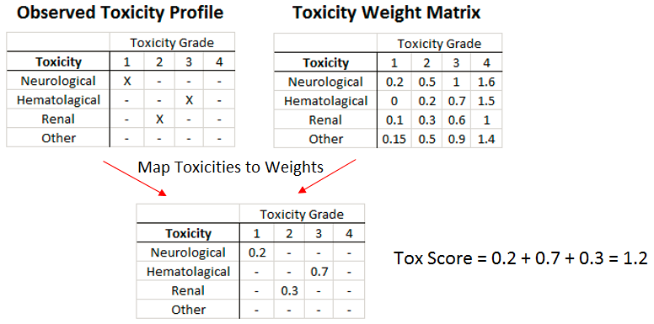
Subjective Toxicity Weights
And then standardize it to a scale from 0 to 1 by dividing toxicity score by the maximum possible score

Slide 36

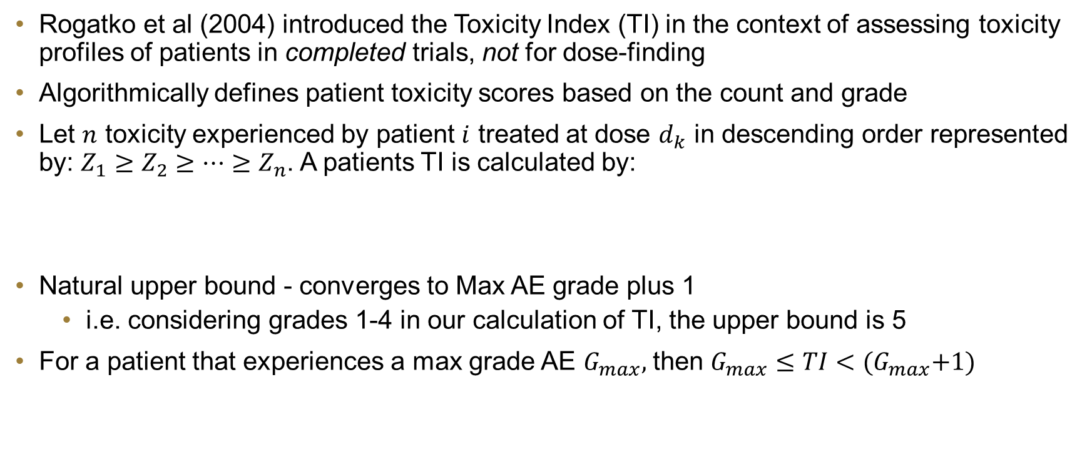
Toxicity Index
Rogatko et al (2004) introduced the Toxicity Index (TI) in the context of assessing toxicity profiles of patients in completed trials, not for dose-finding
Algorithmically defines patient toxicity scores based on the count and grade
Let $n$ toxicity experienced by patient $i$ treated at dose $d_{k}$ in descending order represented by: $Z_{1}≥Z_{2}≥…≥Z_{n}$. A patients TI is calculated by:
Natural upper bound - converges to Max AE grade plus 1
  i.e. considering grades 1-4 in our calculation of TI, the upper bound is 5
For a patient that experiences a max grade AE $G_{max},$ then $G_{max}≤TI<{(G}_{max}+1)$

Slide 37
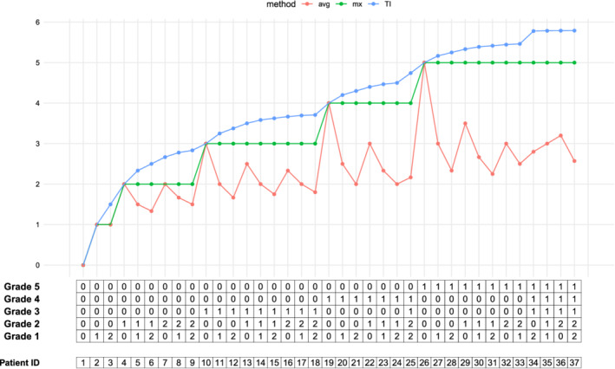
Toxicity Index Figure (Razaee et al. 2021)
Razaee, Zahra S., et al. "On the properties of the toxicity index and its statistical efficiency." Statistics in Medicine 40.6 (2021): 1535-1552.

Slide 38
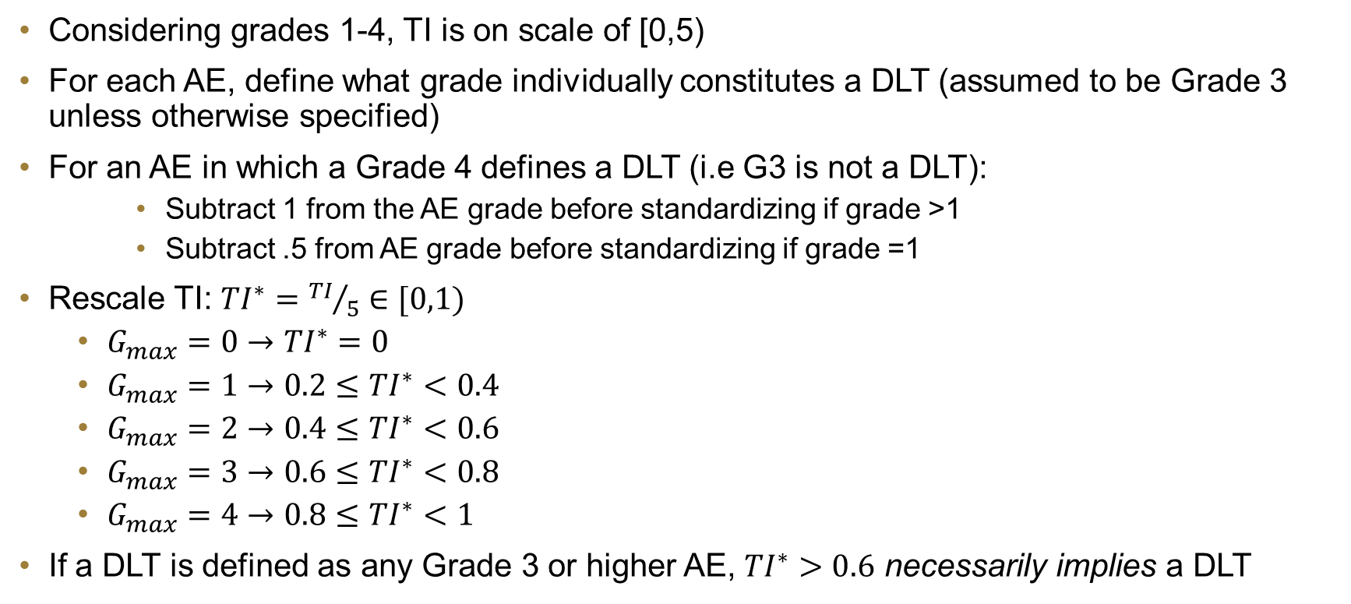
Standardized Toxicity Index
Considering grades 1-4, TI is on scale of [0,5)
For each AE, define what grade individually constitutes a DLT (assumed to be Grade 3 unless otherwise specified)
For an AE in which a Grade 4 defines a DLT (i.e G3 is not a DLT):
    Subtract 1 from the AE grade before standardizing if grade >1
    Subtract .5 from AE grade before standardizing if grade =1
Rescale TI: ${TI}^{∗}={TI}/5$ $∈[0,1)$
  $G_{max}=0$ $→$ ${TI}^{∗}=0$
  $G_{max}=1$ $→$ $0.2≤{TI}^{∗}<0.4$
  $G_{max}=2$ $→$ $0.4≤{TI}^{∗}<0.6$
  $G_{max}=3$ $→$ $0.6≤{TI}^{∗}<0.8$
  $G_{max}=4$ $→$ $0.8≤{TI}^{∗}<1$
If a DLT is defined as any Grade 3 or higher AE, ${TI}^{∗}>0.6$ necessarily implies a DLT

Slide 39
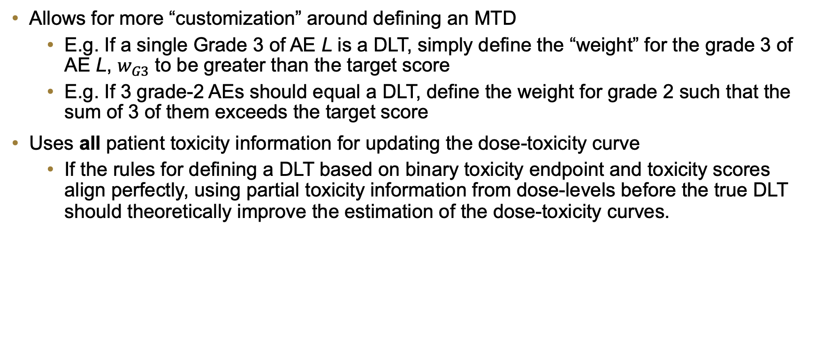
Benefits of the Toxicity Score Paradigm
Allows for more “customization” around defining an MTD
  E.g. If a single Grade 3 of AE L is a DLT, simply define the “weight” for the grade 3 of AE L, $w_{G3}$ to be greater than the target score
  E.g. If 3 grade-2 AEs should equal a DLT, define the weight for grade 2 such that the sum of 3 of them exceeds the target score
Uses all patient toxicity information for updating the dose-toxicity curve
  If the rules for defining a DLT based on binary toxicity endpoint and toxicity scores align perfectly, using partial toxicity information from dose-levels before the true DLT should theoretically improve the estimation of the dose-toxicity curves.

Slide 40
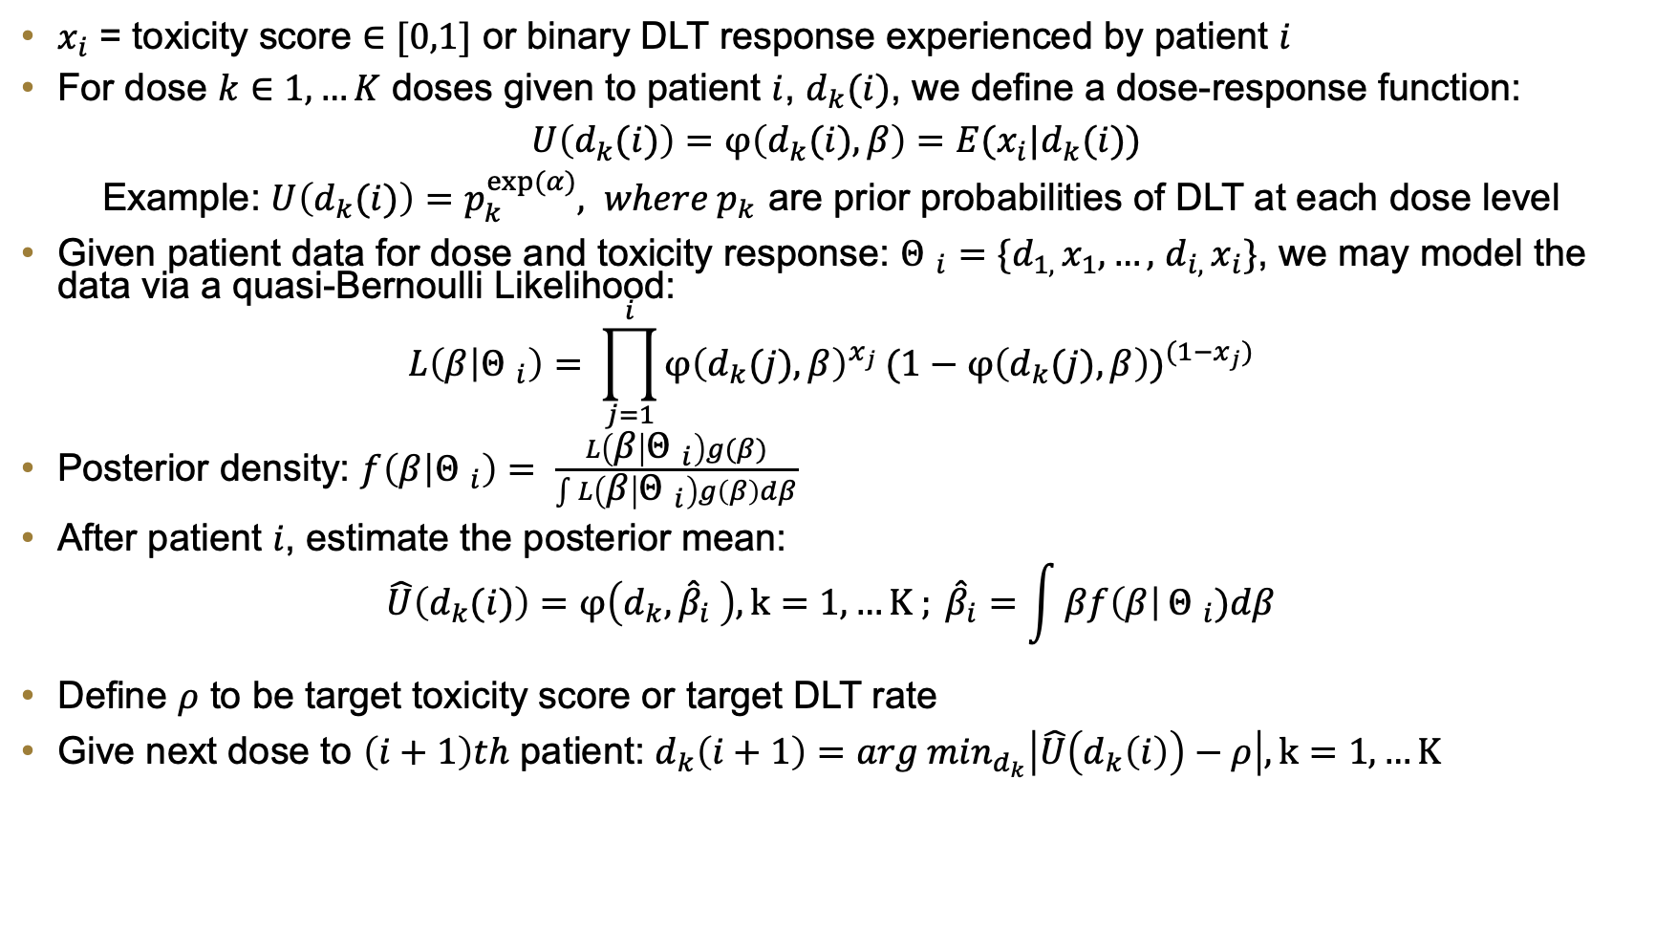
CRM and Quasi-CRM
$x_{i}$ = toxicity score $∈[0,1]$ or binary DLT response experienced by patient $i$
For dose $k∈1,…K$ doses given to patient $i$, $d_{k}(i)$, we define a dose-response function:
$U\left(d_{k}(i)\right)=φ\left(d_{k}(i),β\right)=E(x_{i}|d_{k}(i))$
Example: ${U\left(d_{k}(i)\right)=p}_{k}^{exp⁡(α)}, where p_{k }$are prior probabilities of DLT at each dose level
Given patient data for dose and toxicity response: ${Θ }_{i}=\{d_{1, }x_{1},…,$ $d_{i, }x_{i}\}$, we may model the data via a quasi-Bernoulli Likelihood:
$$L\left(β | {Θ }_{i}\right)= \prod_{j=1}^{i}{{φ\left(d_{k}(j),β\right)}^{x_{j}}}{(1−φ\left(d_{k}(j),β\right))}^{(1−x_{j})}$$
Posterior density: $f\left(β | {Θ }_{i}\right)= \frac{L\left(β | {Θ }_{i}\right)g(β)}{\int{L\left(β | {Θ }_{i}\right)g\left(β\right)dβ}}$
After patient $i$, estimate the posterior mean:
$$\hat{U}\left(d_{k}(i)\right)=φ\left(d_{k}, {\hat{β}}_{i} \right), k=1,…K ; {\hat{β}}_{i}=\int{βf\left(β\right|}{Θ }_{i})dβ$$
Define $ρ$ to be target toxicity score or target DLT rate
Give next dose to $\left(i+1\right)th$ patient: $d_{k}\left(i+1\right)={arg min}_{d_{k}}\left|\hat{U}\left(d_{k}\left(i\right)\right)−ρ\right|, k=1,…K$

Slide 41
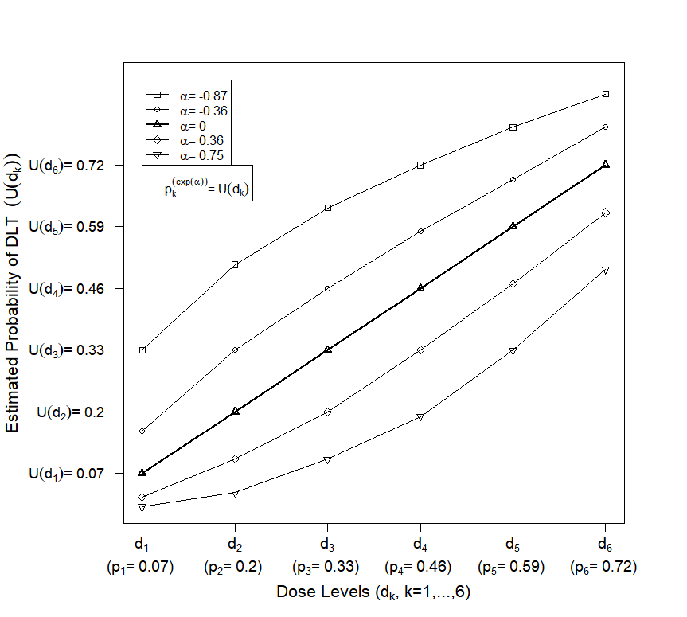

Slide 42
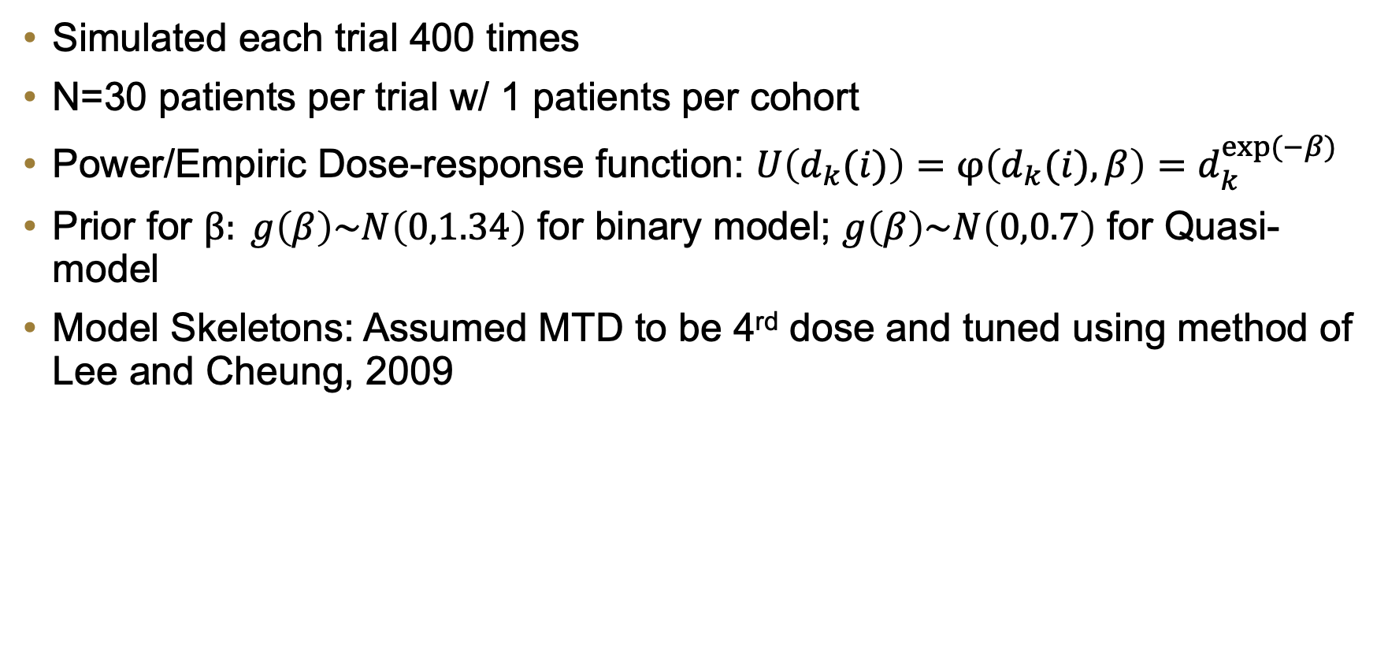
Simulated Trials
Simulated each trial 400 times
N=30 patients per trial w/ 1 patients per cohort
Power/Empiric Dose-response function: $U\left(d_{k}(i)\right)=φ\left(d_{k}(i),β\right)=d_{k}^{exp⁡(−β)}$
Prior for $β: g\left(β\right)\sim N\left(0,1.34\right)$ for binary model; $g\left(β\right)\sim N\left(0,0.7\right)$ for Quasi-model
Model Skeletons: Assumed MTD to be 4rd dose and tuned using method of Lee and Cheung, 2009

Slide 43
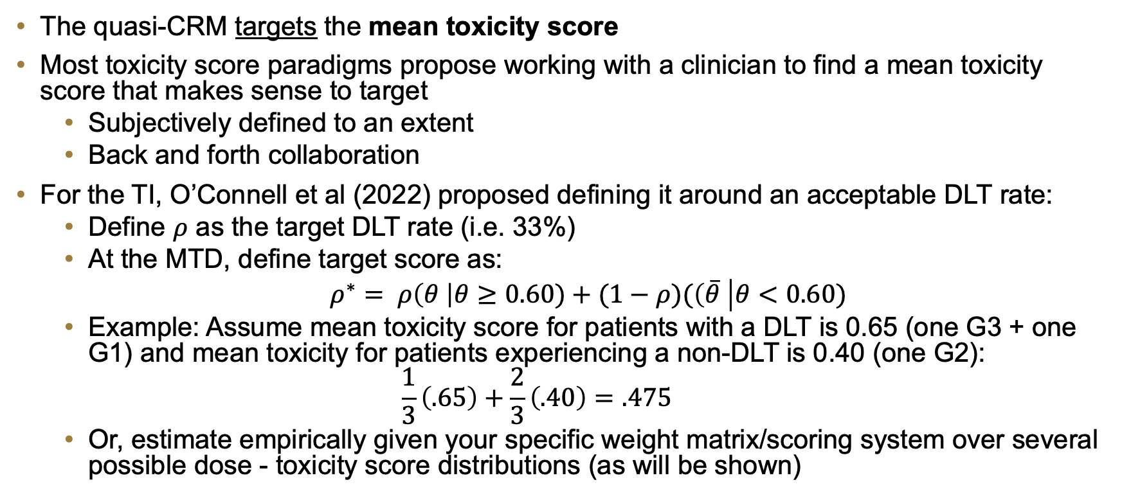
Defining a target score
The quasi-CRM targets the mean toxicity score
Most toxicity score paradigms propose working with a clinician to find a mean toxicity score that makes sense to target
  Subjectively defined to an extent
  Back and forth collaboration
For the TI, O’Connell et al (2022) proposed defining it around an acceptable DLT rate:
  Define $ρ$ as the target DLT rate (i.e. 33%)
  At the MTD, define target score as:
  $ρ^{∗}= ρ\left(θ \right|θ≥0.60)+(1−ρ)(\left(\overline{θ} \right|θ<0.60)$
  Example: Assume mean toxicity score for patients with a DLT is 0.65 (one G3 + one G1) and mean toxicity for patients experiencing a non-DLT is 0.40 (one G2):
  $$\frac{1}{3}\left(.65\right)+\frac{2}{3}\left(.40\right)=.475$$
  Or, estimate empirically given your specific weight matrix/scoring system over several possible dose - toxicity score distributions (as will be shown)

Slide 44
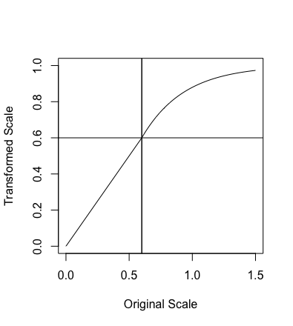
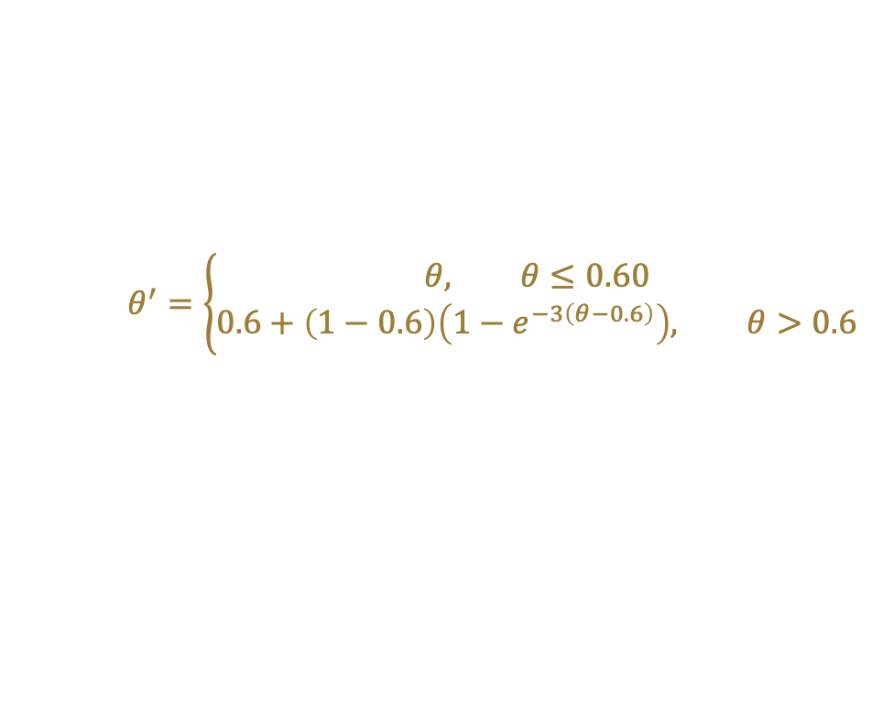
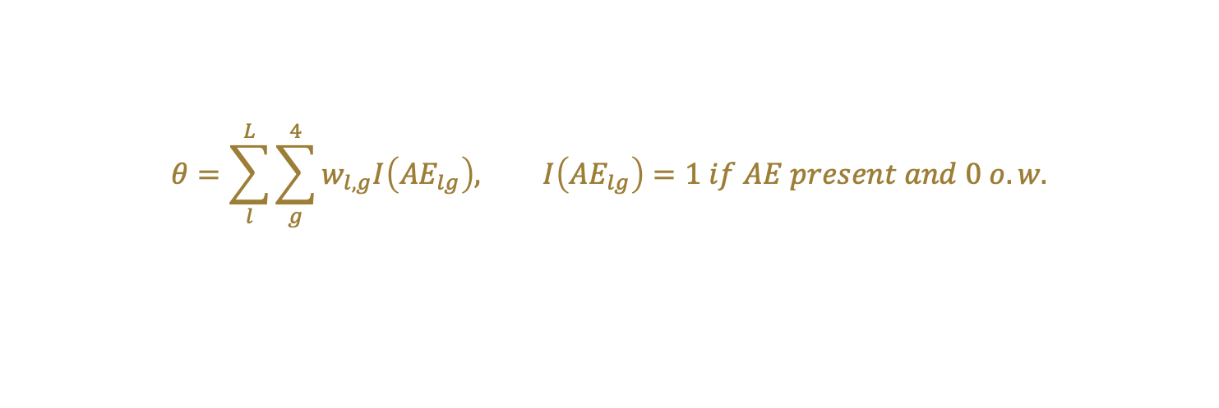
Toxicity Weight Matrix
Grade | 1 | 2 | 3 | 4
Tox A | 0.10 | 0.2 | 0.6 | 0.8
Tox B | 0.10 | 0.2 | 0.6 | 0.8
Tox C | 0.10 | 0.2 | 0.6 | 0.8
Tox D | 0.05 | 0.15 | 0.4 | 0.7
Tox E | 0.00 | 0.1 | 0.3 | 0.6
Defined Around a threshold of 0.6
Any AE or Sum of AEs with score > 0.6 is a DLT
Target MTD Rate = 33%
Target Toxicity score = 0.46 (chosen empirical through simulation; in coming slides)
Results: mean MTD selection, mean over-doses, and mean under-doses
$$θ=\sum_{l}^{L}{\sum_{g}^{4}{w_{l,g}I\left({AE}_{lg}\right), I\left({AE}_{lg}\right)}=1 if AE present and 0 o.w.}$$
$$θ^{′}=\left\{\begin{aligned}θ, θ≤0.60 \\ 0.6+\left(1−0.6\right)\left(1−e^{−3\left(θ−0.6\right)}\right), θ>0.6\end{aligned}\right.$$

Slide 45
6 trial scenarios under 6 different MTD/Toxicity Score distributions
The 6 dose-toxicity distributions by true DLT rate:
 | Dose 1 | Dose 2 | Dose 3 | Dose 4 | Dose 5 | Dose 6
Scenario 1 | 0.33 | 0.42 | 0.5 | 0.59 | 0.68 | 0.75
Scenario 2 | 0.21 | 0.33 | 0.44 | 0.54 | 0.65 | 0.75
Scenario 3 | 0.12 | 0.21 | 0.33 | 0.42 | 0.52 | 0.6
Scenario 4 | 0.05 | 0.12 | 0.21 | 0.33 | 0.42 | 0.51
Scenario 5 | 0.04 | 0.09 | 0.14 | 0.21 | 0.33 | 0.42
Scenario 6 | 0.01 | 0.07 | 0.13 | 0.18 | 0.24 | 0.33

Slide 46
Issues with targeting a Mean score
Mean Toxicity score of a dose-level inherently depends on the probability distribution of toxicity scores at a given dose-level
Mean toxicity score can vary relatively broadly while having a fixed DLT rate
Prior distributions of toxicity score at each and across dose levels likely unknown prior to the trial
Without safeties put in place, mis-specifying the target target score could lead to drastic over-dosing relative to an acceptable MTD based on DLT rate

Slide 47
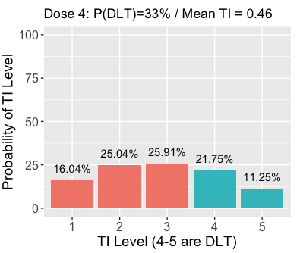
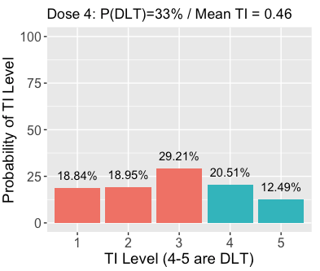
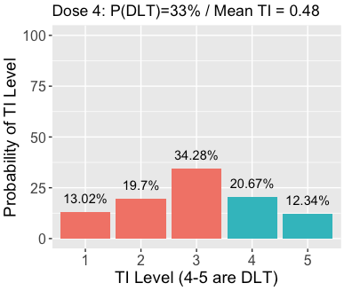
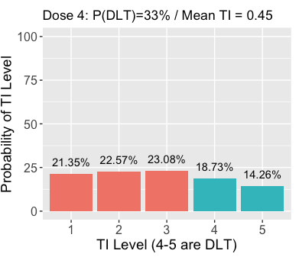
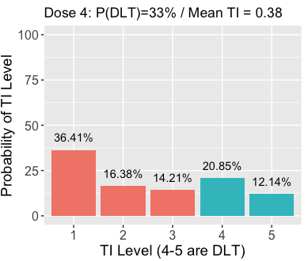
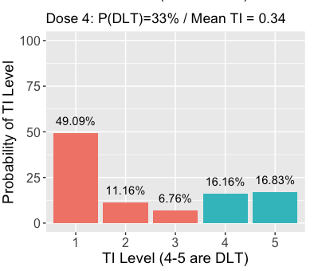
Comparison of Tox Score Distributions at the 6 MTD Scenarios
Light Bell
Medium Bell
Strong Bell
Flat
Light U
Strong U

Slide 48
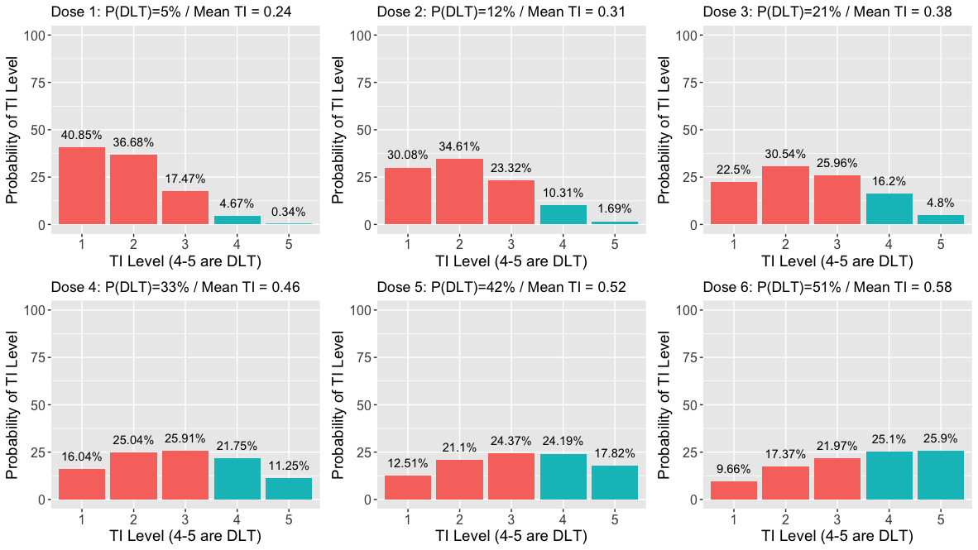
Scenario 1 (Light Bell)

Slide 49
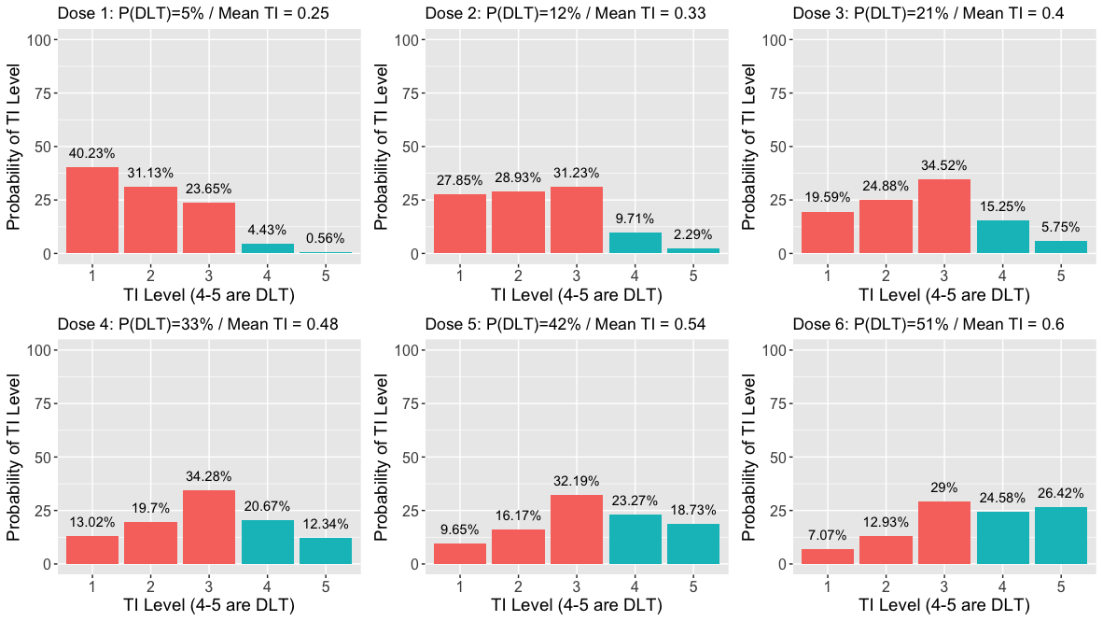
Scenario 3 (Strong Bell)

Slide 50
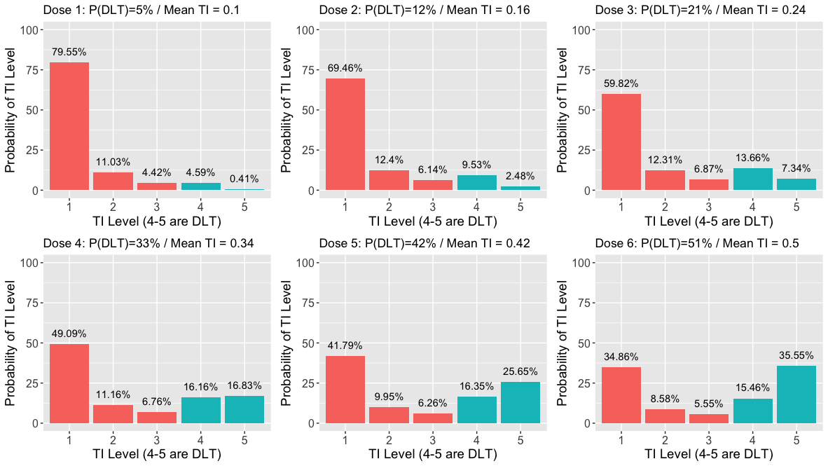
Scenario 6 (Strong U)

Slide 51
... add in an Overdose Constraint
Given the same patient data at a fixed point in the trial, fit both the Quasi-CRM and a conventional CRM (based on the binary DLTs).
Use the dose-recommended by the conventional CRM as the upper bound for dose-recommendation.
  This way, the dose recommended will never exceed the safety of the conventional methodology that has been thoroughly studied and tested
This allows to the dose-toxicity relationship to be driven by all patient AE data, while still controlling for an acceptable DLT rate – best of both models?

Slide 52
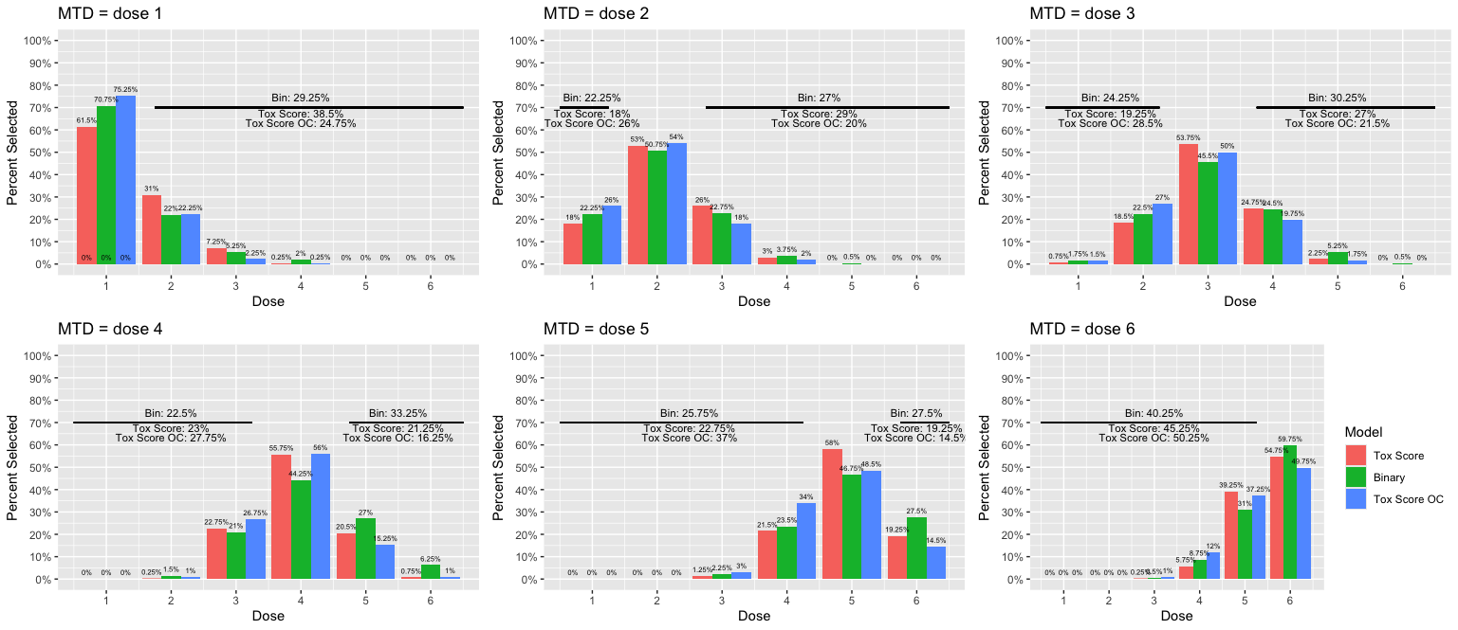
Results: Scenario 1 (Light Bell)

Slide 53
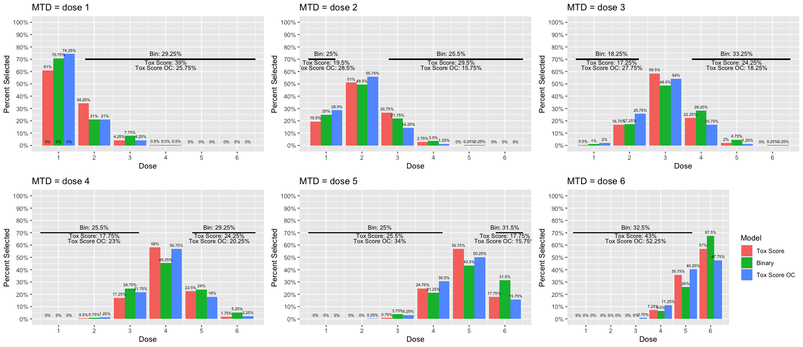
Results: Scenario 2 (Medium Bell)

Slide 54
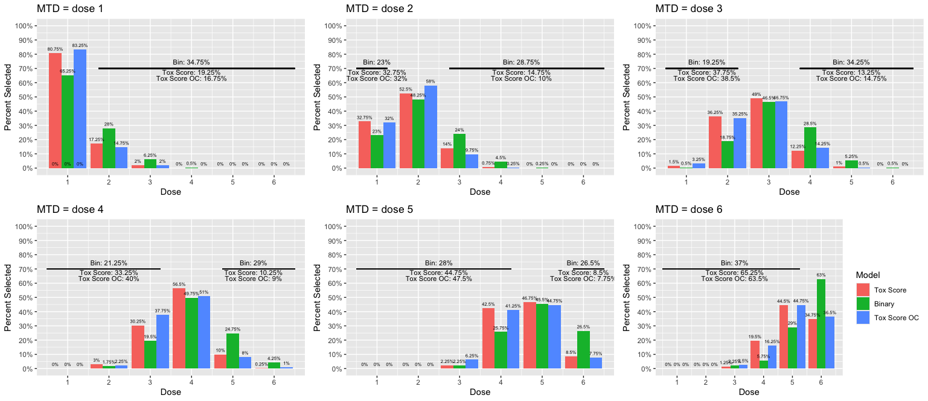
Results: Scenario 3 (Strong Bell)

Slide 55
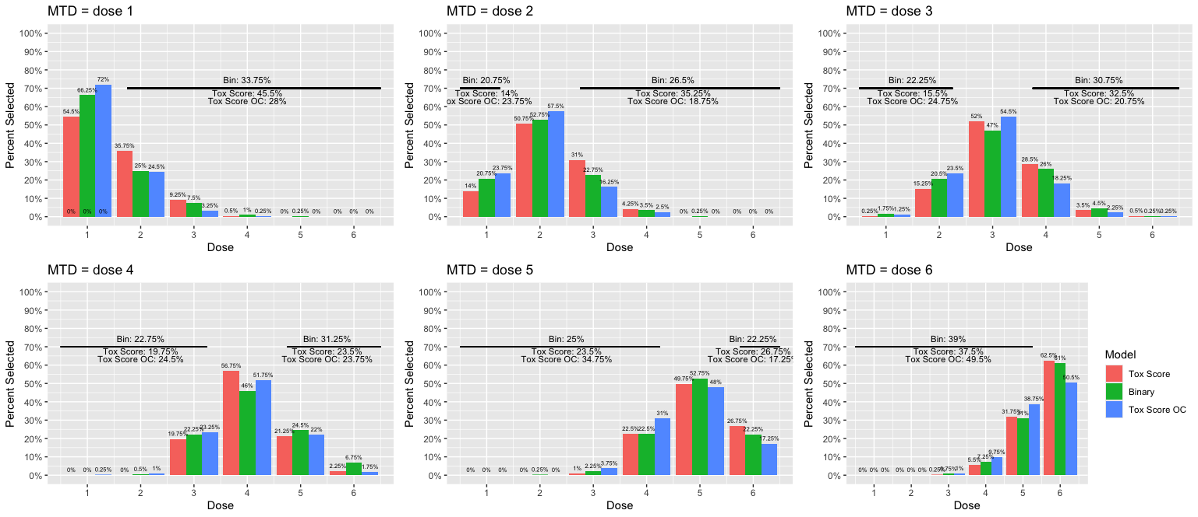
Results: Scenario 4 (Flat)

Slide 56
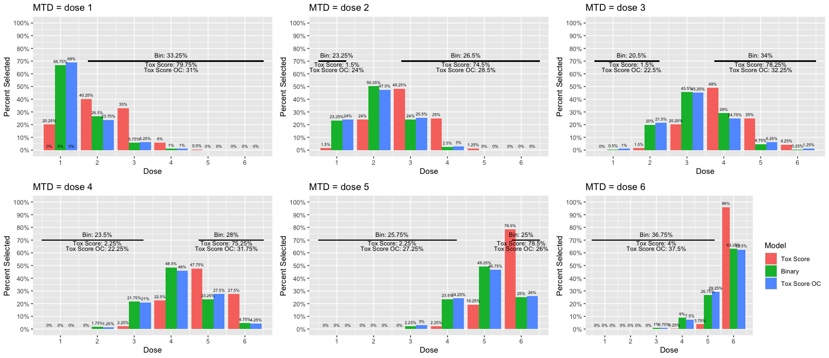
Results: Scenario 5 (light U)

Slide 57
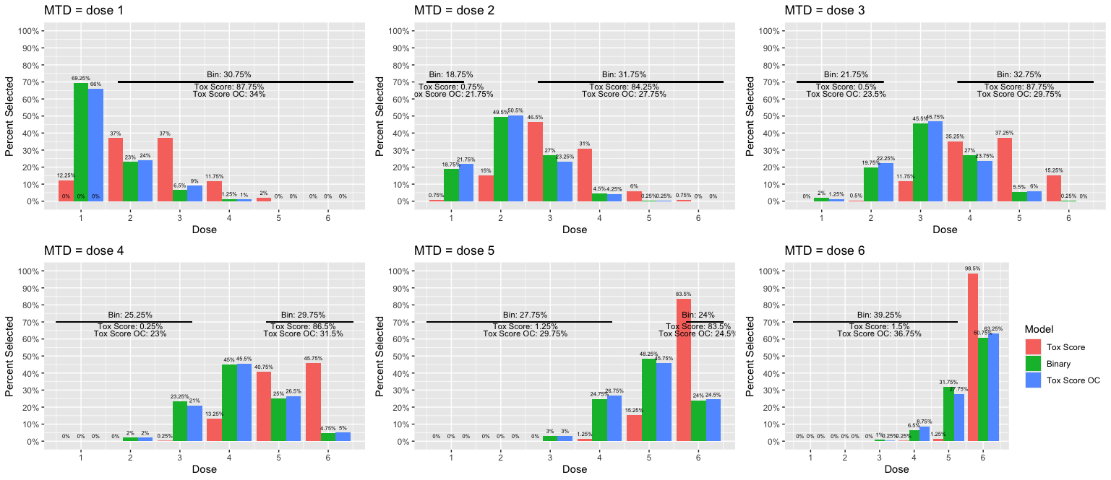
Results: Scenario 6 (High U)

Slide 58
Results in Summary
The unadjusted Toxicity Score model offers the best performance gains in some scenarios, but comes with a higher risk of overdosing patients if model is misspecified.
In most scenarios, the Toxicity Score approach (with OC) performs as well or better than the conventional binary endpoint, and is safer than the unconstrained Tox Score model
  Toxicity Score and overdose constraint
    Percent Correct Estimation of MTD relative to Binary model across 36 scenarios:
      In 23 scenarios (64%), it performed better better
      In 15 (42%), it performed net >3% better
      In 30 (83%), it performed no worse than 3% worse
      In 6 scenarios, it performed >3% worse than Binary (4 of those 6 were when the true MTD was the highest dose)
    In terms of Overestimation relative to the Binary outcome model:
      In 20 of 30 scenarios (when the highest dose wasn’t the MTD), the Toxicity Score OC approach selects a dose that’s too higher a net 5%+ less often than the binary approach.
      In the other 10 scenarios, Tox Score OC is never worse by more than 4% in over-estimation

Slide 59
3 Key Take-Aways
Using a patient’s entire toxicity profile can…
  Offer increased flexibility in defining a DLT beyond conventional, simple decision rules based on the binary endpoint
  Offer improved performance of MTD estimation accuracy
  When constrained properly, limit excessive over-estimation of the MTD

Slide 60
Conclusions for this talk as a whole…
We should not be ignoring all low- and moderate-grade AES
Low- and moderate-grade AEs are associated with self-reported side-effect burden and treatment discontinuation in later phase trials
  Clearly they impact a patients tolerability to stay on treatment
  We should be studying them and using them in the dose-finding process to better identify tolerable doses
Low- and moderate-grade AEs can improve MTD estimation and limit over-estimation

Slide 61
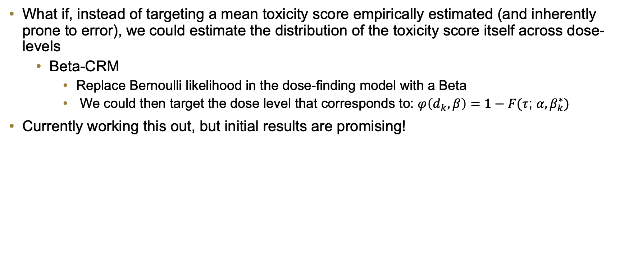
Next Steps
What if, instead of targeting a mean toxicity score empirically estimated (and inherently prone to error), we could estimate the distribution of the toxicity score itself across dose-levels
  Beta-CRM
    Replace Bernoulli likelihood in the dose-finding model with a Beta
    We could then target the dose level that corresponds to: $φ\left(d_{k},β\right)=1−F(τ$; $α,β_{k}^{∗})$
Currently working this out, but initial results are promising!

Slide 62
Acknowledgements
Low and Moderate-grade AEs on Side-Effect Burden and Discontinuation
  NCI 1U01CA233169-01: “Analysis of ECOG-ACRIN adverse event data to optimize strategies for the longitudinal assessment of tolerability in the context of evolving cancer treatment paradigms (EVOLV)”
    PIs: Robert Gray and Lynne Wagner
    Study Team/Co-Is: Eddie Ip, Ju-Whei Lee, Fengmin Zhao, Devin Peipert, Nnoah Graham, Mary Lou Smith, Llana F Gareen, Ruth Carlos, Samilia Obeng-Gyasi, Joseph Sparano, Tait Shanafelt, Mary L Thomas, David Cella
Toxicity Scores in Dose-Finding Trials
    Acknowledgements: Elizabeth Garrett-Mayer, Nolan Wages

Slide 63
Thank you!
Any questions?

Slide 64
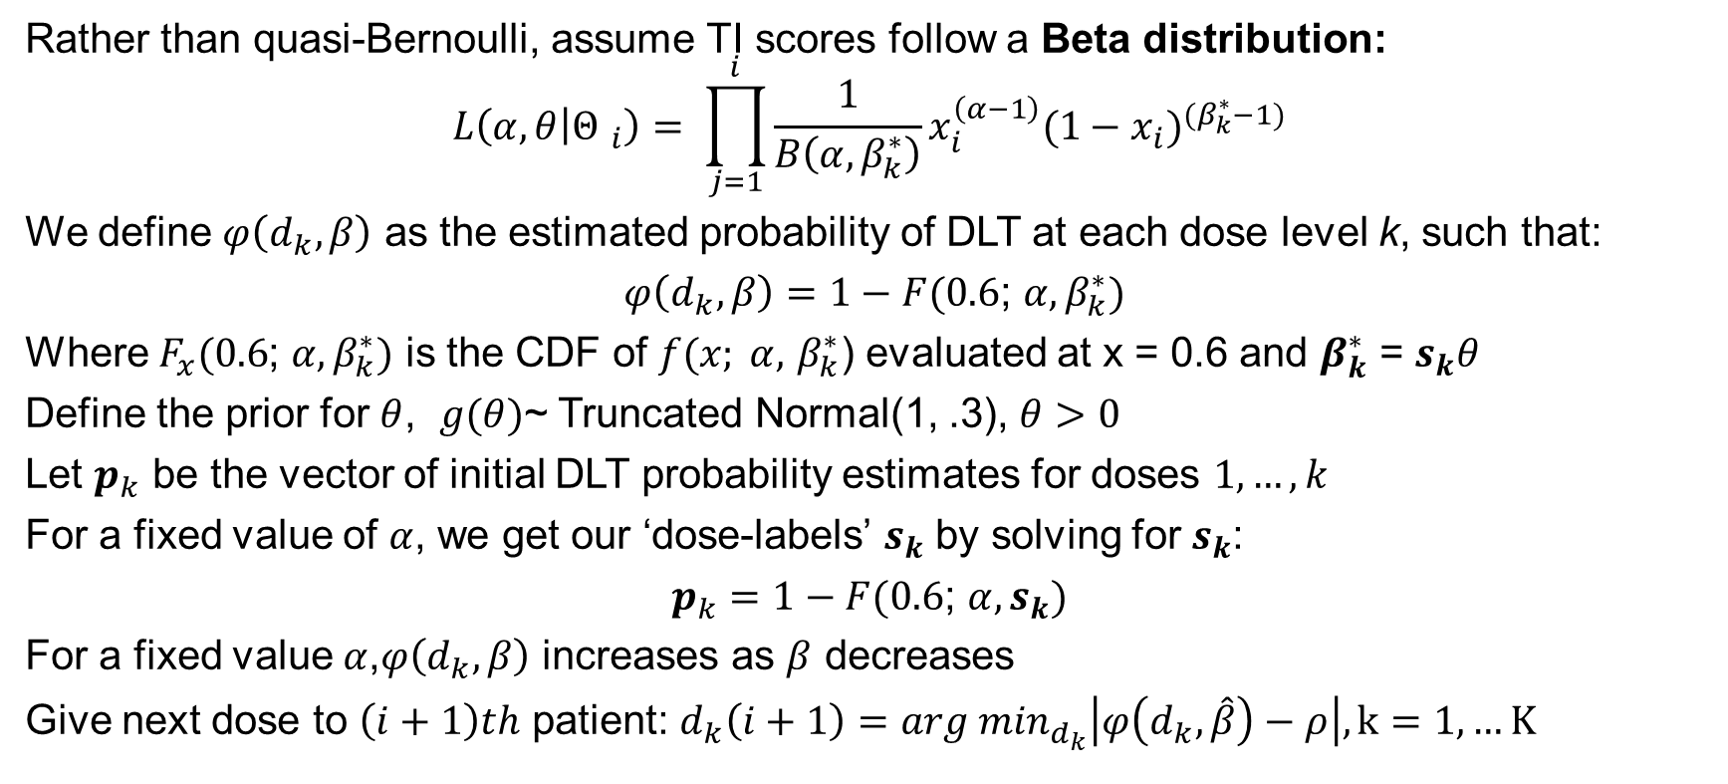
Beta-CRM
Rather than quasi-Bernoulli, assume TI scores follow a Beta distribution:
$$L\left(α,θ | {Θ }_{i}\right)= \prod_{j=1}^{i}{\frac{1}{B\left(α,β_{k}^{∗}\right)}}x_{i}^{\left(α−1\right)}{(1−x_{i})}^{(β_{k}^{∗}−1)}$$
We define $φ\left(d_{k},β\right)$ as the estimated probability of DLT at each dose level k, such that:
$φ\left(d_{k},β\right)=1−F(0.6$; $α,β_{k}^{∗})$
Where $F_{x}(0.6$; $α,β_{k}^{∗})$ is the CDF of $f(x; α,$ $β_{k}^{∗}$) evaluated at x = 0.6 and $β_{k}^{∗}$ = $s_{k}θ$
Define the prior for $θ$, $g(θ)$~ Truncated Normal(1, .3), $θ>0$
Let $p_{k}$ be the vector of initial DLT probability estimates for doses $1,…,k$
For a fixed value of $α$, we get our ‘dose-labels’ $s_{k}$ by solving for $s_{k}$:
$p_{k}=1−F(0.6$; $α,s_{k})$
For a fixed value $α$,$φ\left(d_{k},β\right)$ increases as $β$ decreases
Give next dose to $\left(i+1\right)th$ patient: $d_{k}\left(i+1\right)={arg min}_{d_{k}}\left|φ\left(d_{k}, \hat{β}\right)−ρ\right|, k=1,…K$

Slide 65
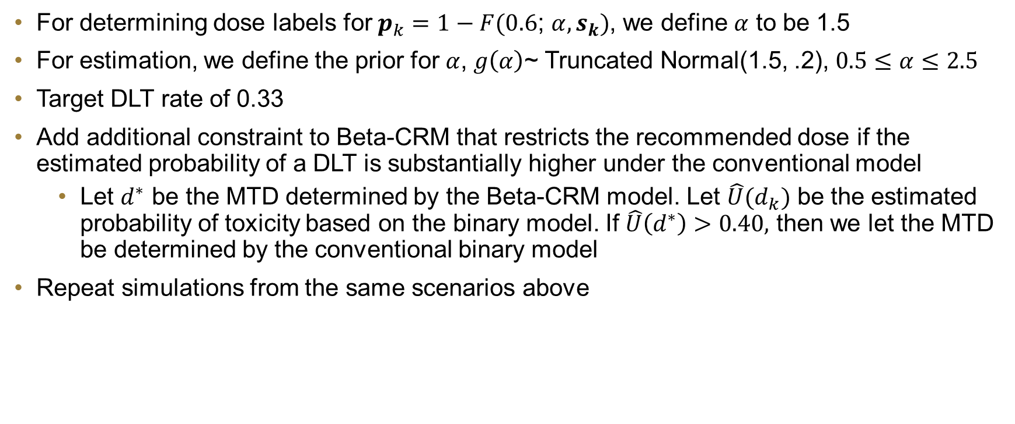
Simulation for Beta-CRM
For determining dose labels for $p_{k}=1−F(0.6$; $α,s_{k})$, we define $α$ to be 1.5
For estimation, we define the prior for $α$, $g\left(α\right)$~ Truncated Normal(1.5, .2), $0.5≤α≤2.5$
Target DLT rate of 0.33
Add additional constraint to Beta-CRM that restricts the recommended dose if the estimated probability of a DLT is substantially higher under the conventional model
  Let $d^{∗}$ be the MTD determined by the Beta-CRM model. Let $\hat{U}(d_{k})$ be the estimated probability of toxicity based on the binary model. If $\hat{U}\left(d^{∗}\right)>0.40,$ then we let the MTD be determined by the conventional binary model
Repeat simulations from the same scenarios above

Slide 66
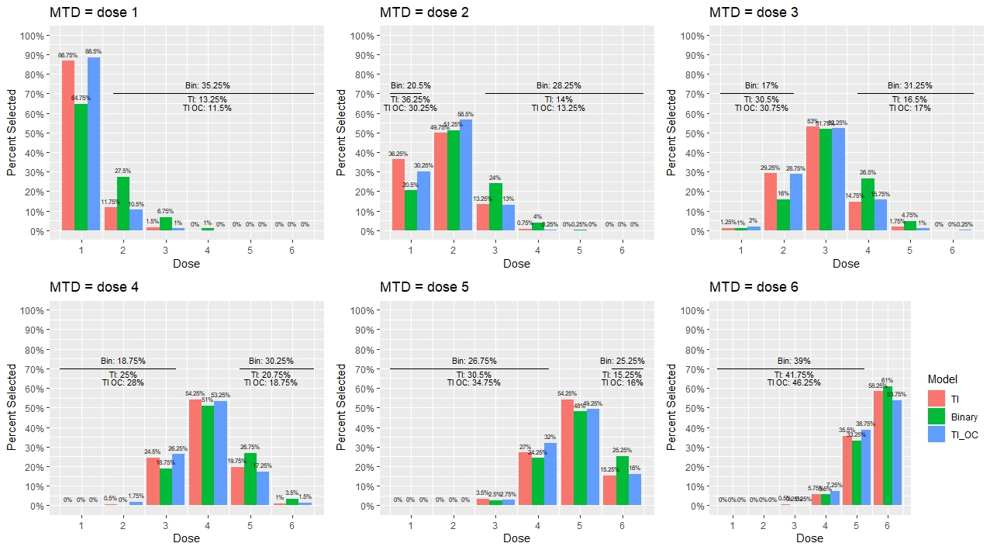
Simulation 1: Beta-CRM Results (Flat)

Slide 67
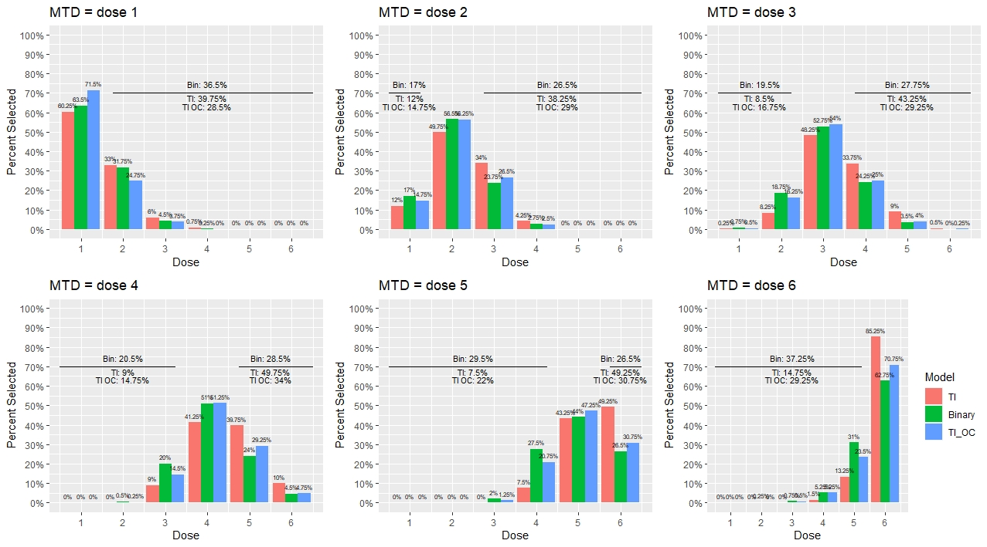
Simulation 2: Beta-CRM Results (Light U)

Slide 68
Results Summary
The Beta-CRM leads to comparable or better results to the conventional method for middle doses, and appears to perform better than the conventional model when doses are at the tails
In the second set of simulations, the restricted Beta model over-doses less than the standard Beta model, and performs similarly or slightly better than the conventional method
Beta-CRM may address shortcoming of the quasi-CRM models which target the mean toxicity score

