Slide 1
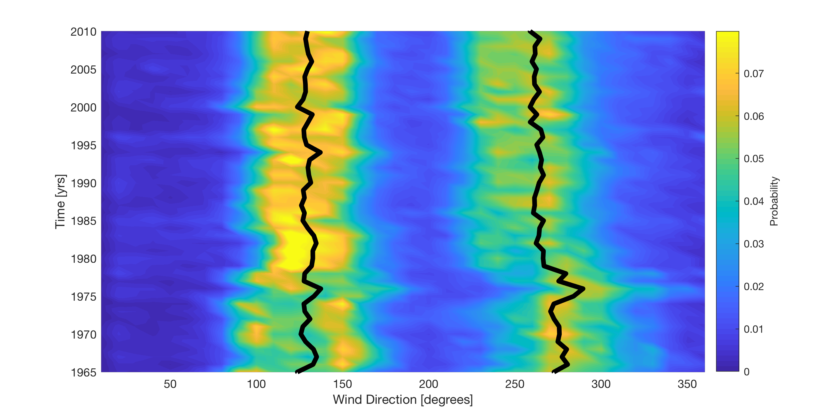

Southerly Winds
Northerly Winds
3$°$ - 5$°$ shift to north and south
North shift in wind direction

