Slide 1
TikTok Data Analysis with Python
Prepared by: Natella Mammadova
Date: August 2025

Slide 2
General information about Data
This TikTok dataset generally covers the features and user statuses of the videos on the platform.
The dataset includes columns such as claim_status,video_id,video_duration_sec,video_transcription_text,verified_status,author_ban_status,video_view_count,video_like_count,video_share_count,video_download_count,video_comment_count

Slide 3
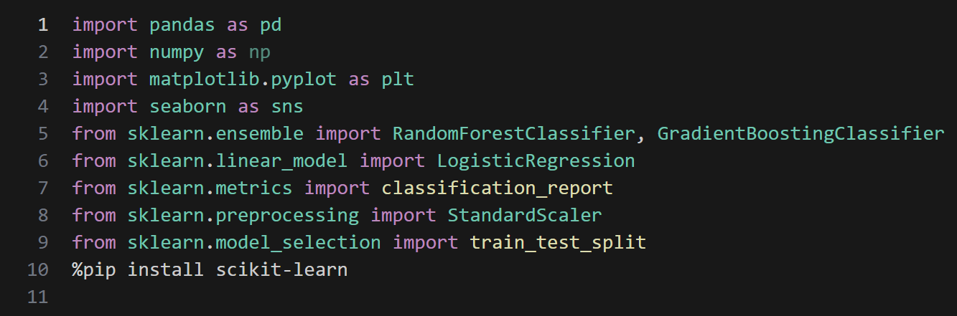
1. Importing Libraries

Slide 4
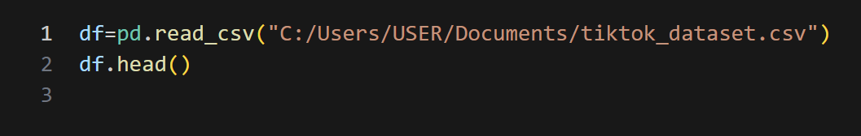
2. Loading the Dataset
Reads the TikTok dataset from a CSV file.
head() shows the first five rows to inspect structure and values.

Slide 5
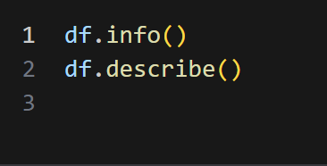
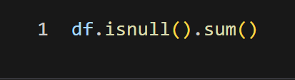
3. Dataset Overview
Python and Checking for Missing Values
1. General view of dataset We have seen what columns are, their data types and the number of empty values. We studied statistics such as average, median, min, max in numerical columns.
Counts NaN values in each column.
Important because ML models can’t work with missing values directly.

Slide 6
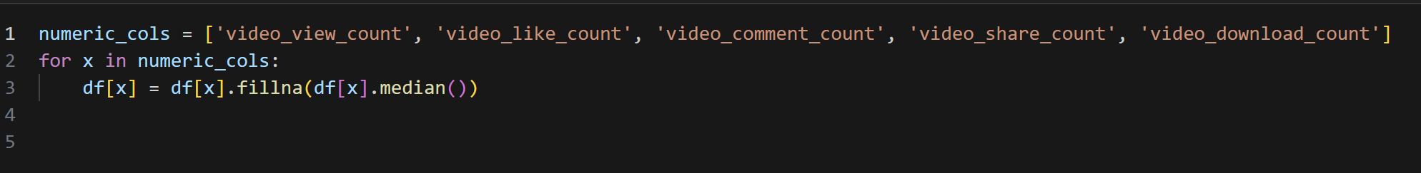
4. Filling Missing Values
Status of empty values and repeated rows We determined the number of empty values in the numeric columns and filled them with median. Median is less sensitive to outliers than the mean.

Slide 7
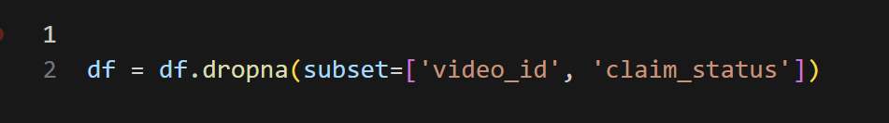
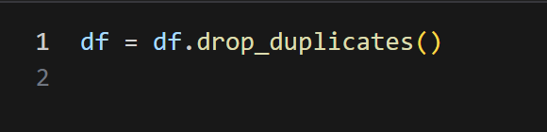
5. Dropping Rows with Missing Target/Key IDs and Removing Duplicates
Removes rows where video_id or claim_status is missing.
These fields are critical for analysis and prediction.
Ensures each record in the dataset is unique.
Prevents bias in training models.

Slide 8
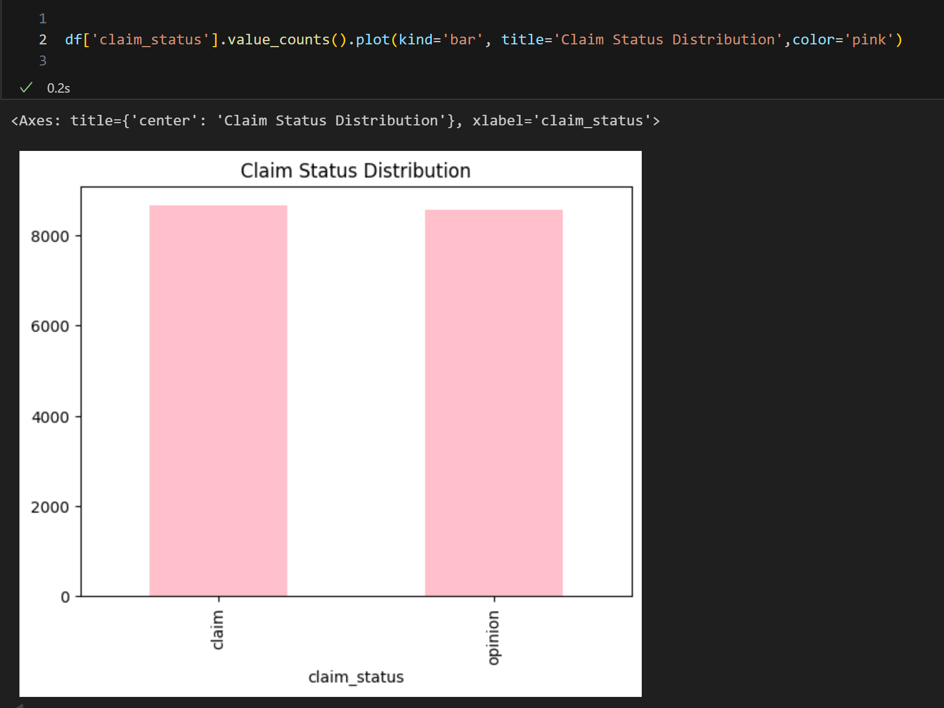
6.Claim status distribution
Claim status distribution We visually saw the number of videos claimed and not claimed. Basically, we figured out which type of video is more claimed.

Slide 9
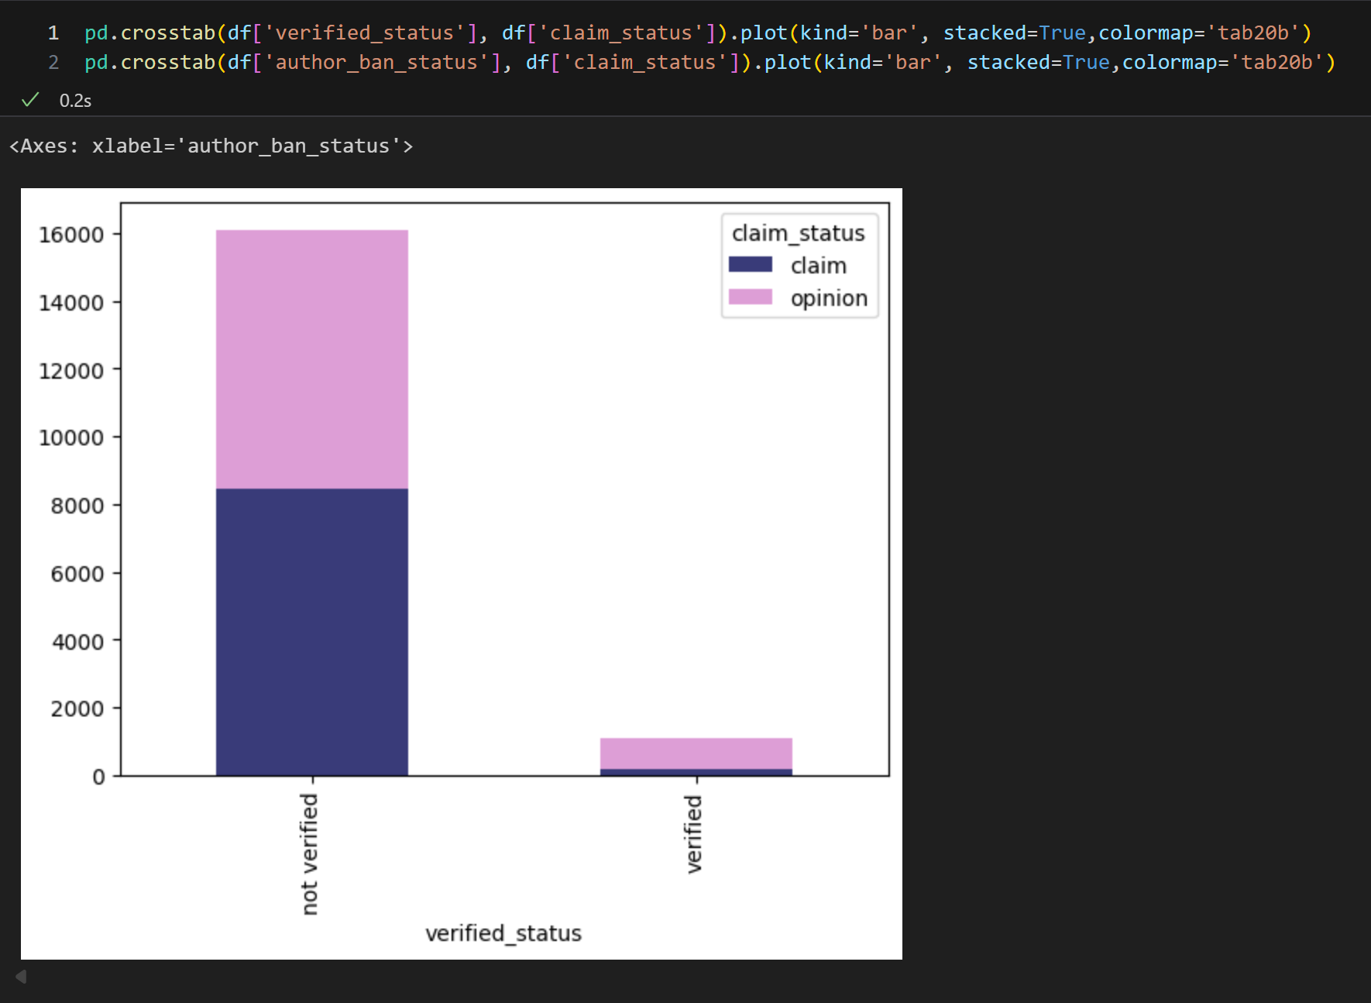
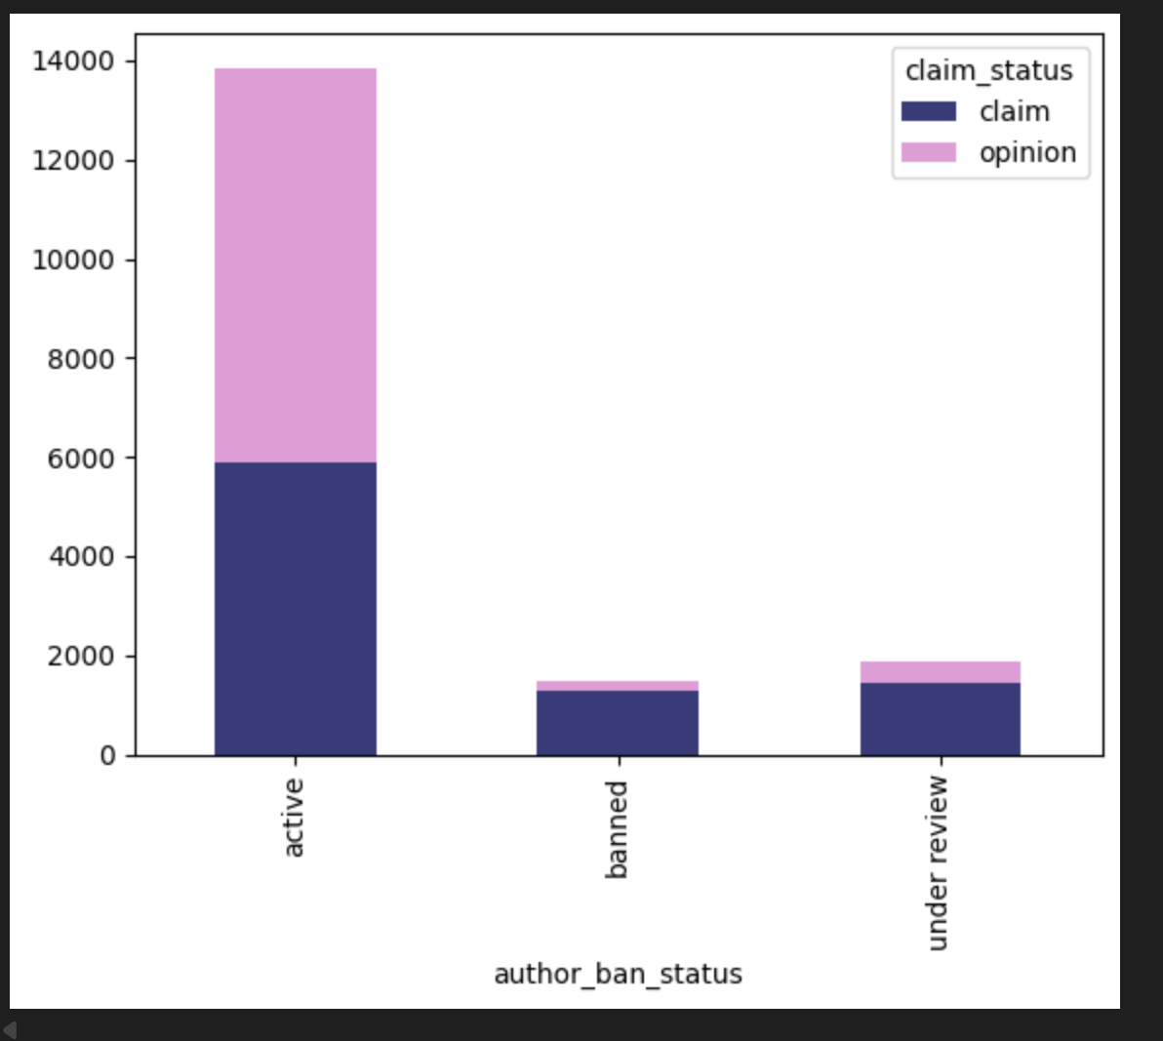
7.Verified and impact of ban status
Verified and impact of ban status We observed the relationship between Verified users and ban status and claim status in bar charts. For example, we compared how the probability of claiming verified accounts changed.

Slide 10
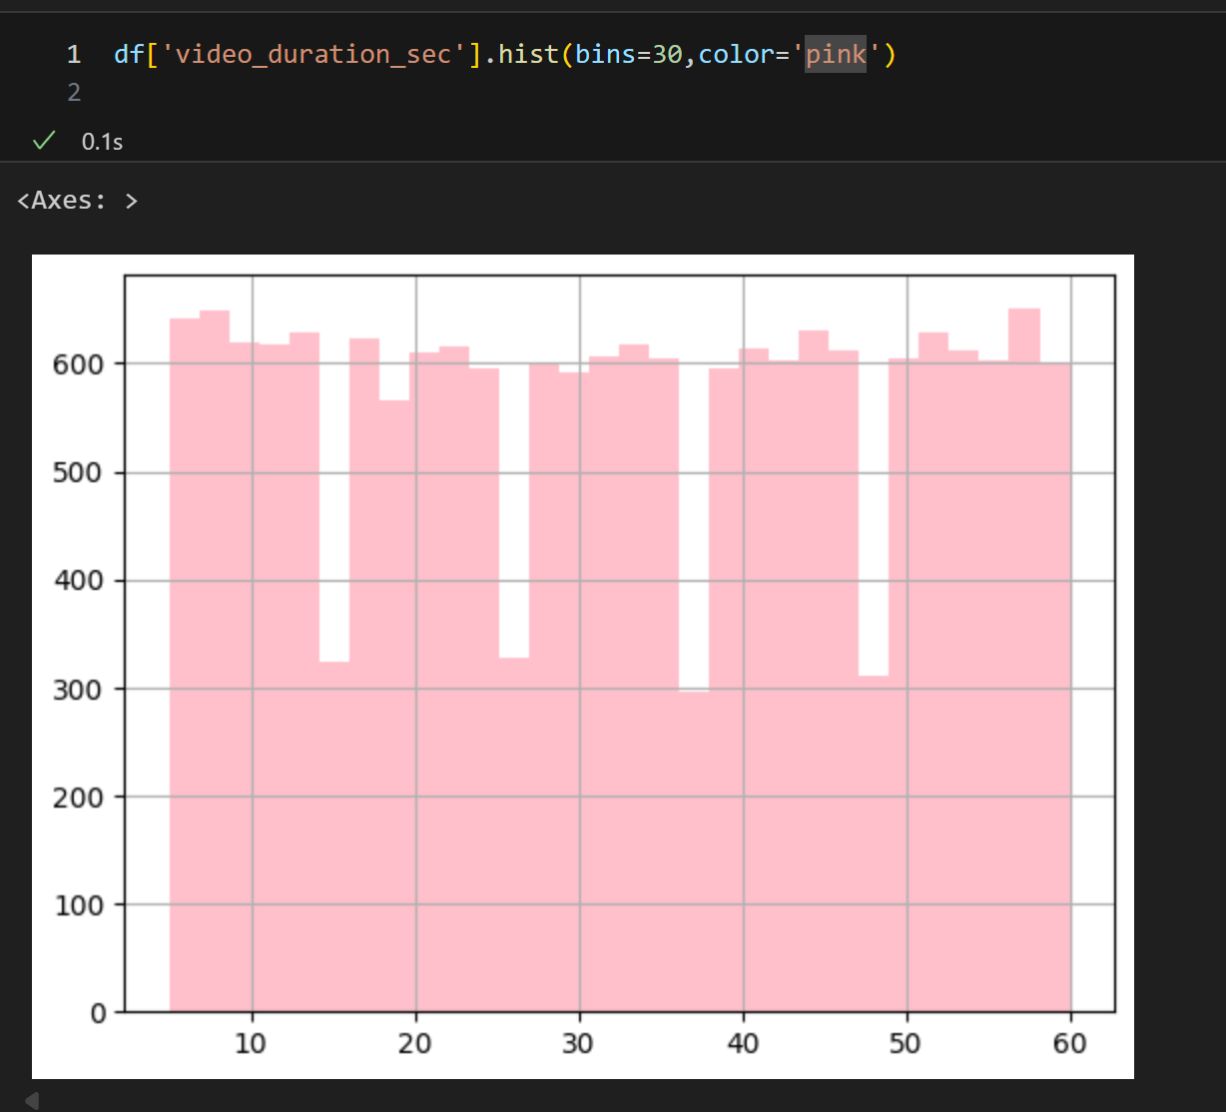
8.The distribution of video durations
Video lengths and engagement distribution By taking a histogram of the Video lengths, we saw what lengths of videos are the most.

Slide 11
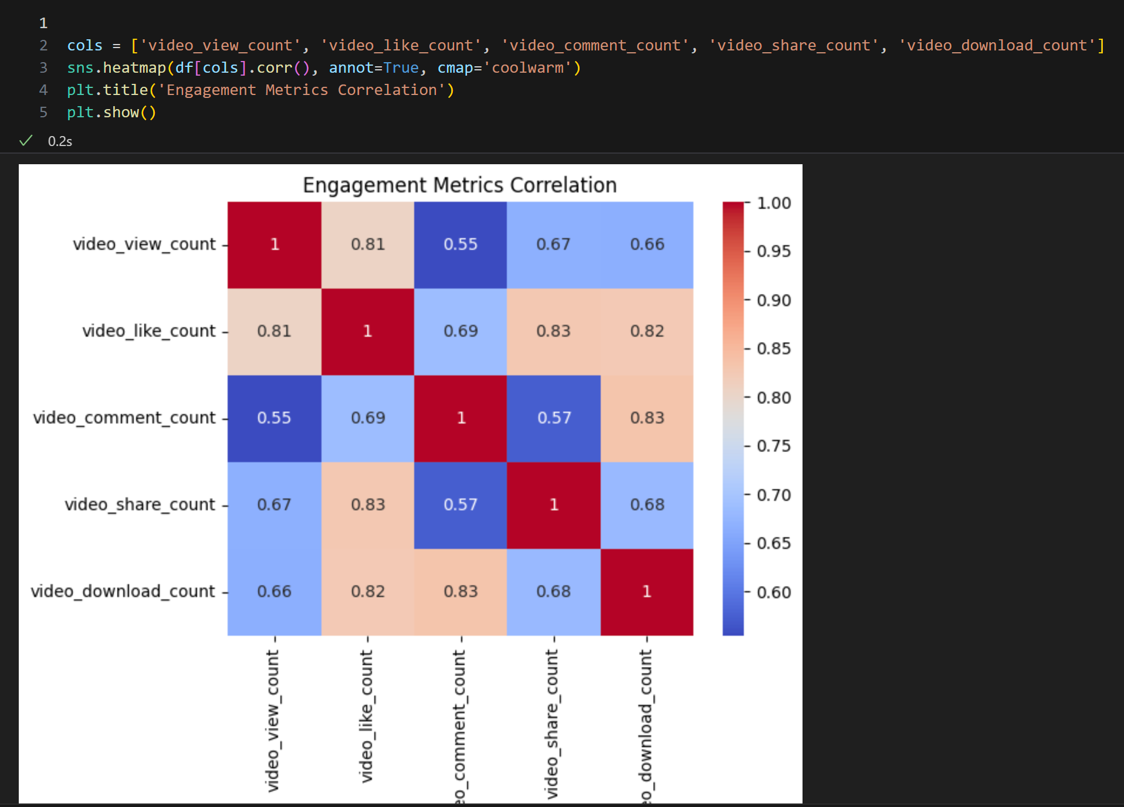
9.Correlation Between Engagement Metrics
The goal here: for example, there may be a very high relationship (≈1.0) between video_like_count and video_view_count. This helps to remove redundant (duplicate) variables during feature selection.

Slide 12
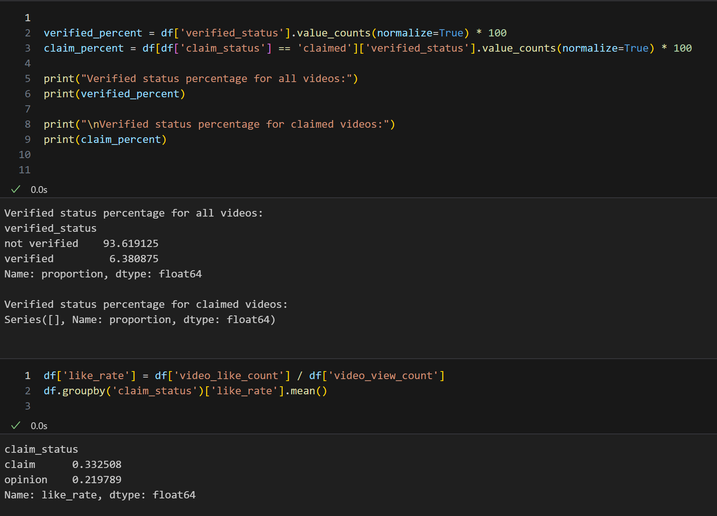
10. Verified User Percentages
Here we compare the percentage of total verified status and verified status in claimed videos.
Like rate shows how many percent of the views were liked.
groupby ('claim_status') – the average like rate for claimed and not_claimed groups is calculated.
Objective: to check if the claimed videos receive more engagement.

Slide 13
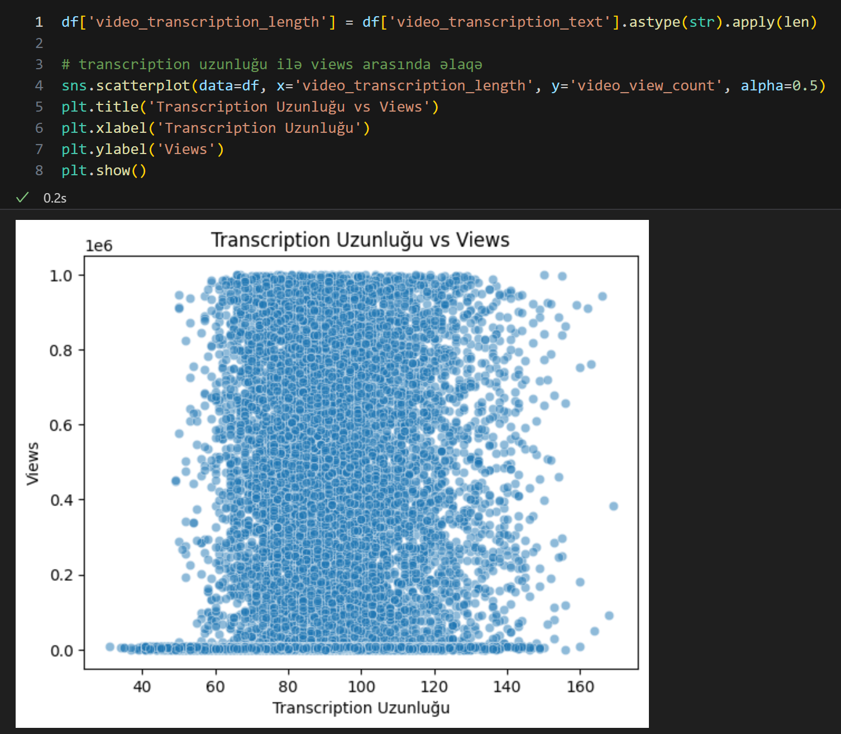
11. Transcription Length
We saw the visual relationship between the length of the video's transcription and the number of views in scatter plot.
We analyzed whether videos with long transcriptions were watched more often.

Slide 14
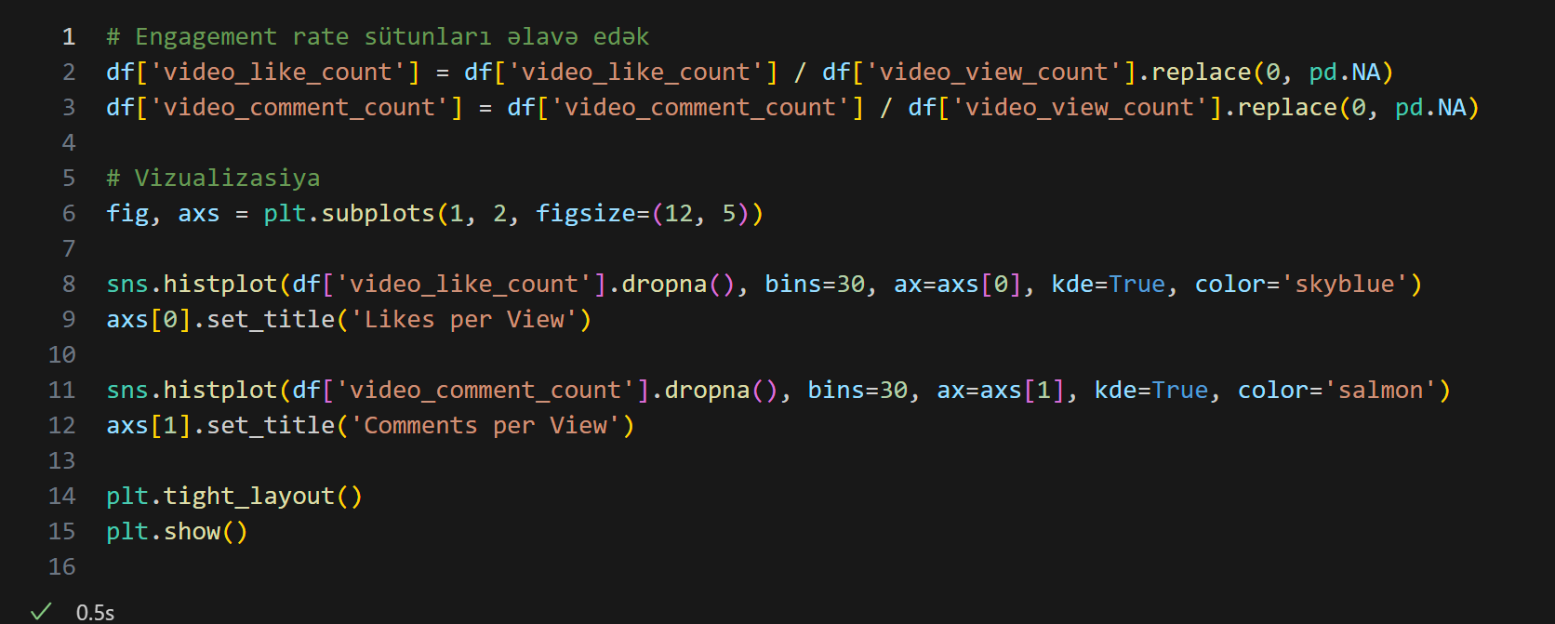
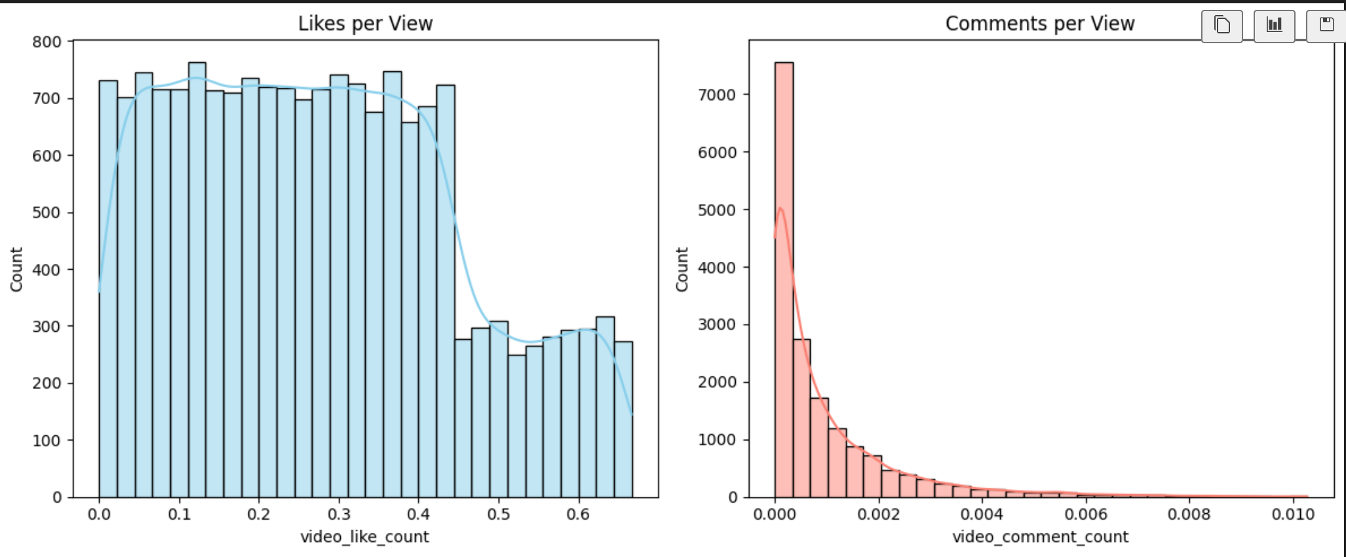
11.Calculate engagement rates (likes/views, comments/views)
The purpose is to go beyond raw counts and understand how much audience interaction a video generates relative to how many people watched it. By calculating metrics like likes per view and comments per view, we can compare engagement levels across videos of different sizes and popularity.

Slide 15
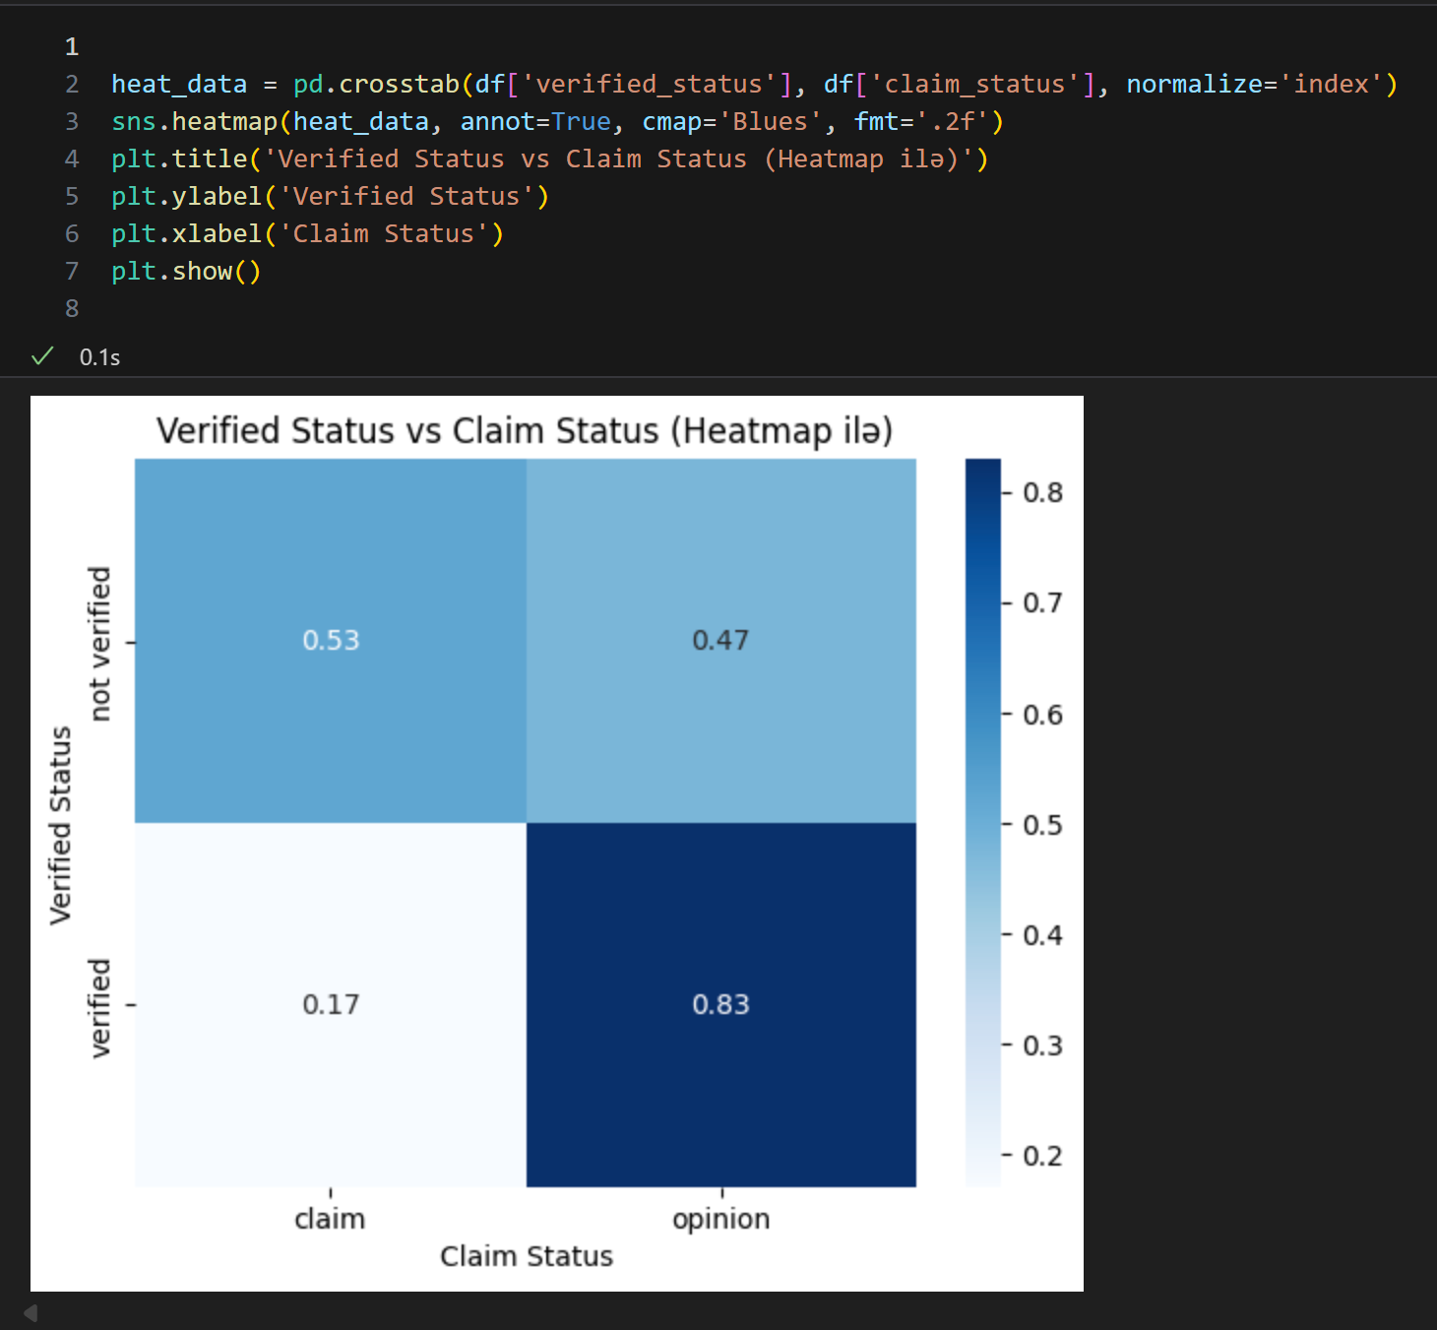
12.Analyze the relationship between verified_status and claim_status
The aim is to explore whether having a verified account influences the likelihood of a video being claimed. This helps identify if verified creators follow different content patterns or have different claim-related behaviors compared to non-verified users.

Slide 16
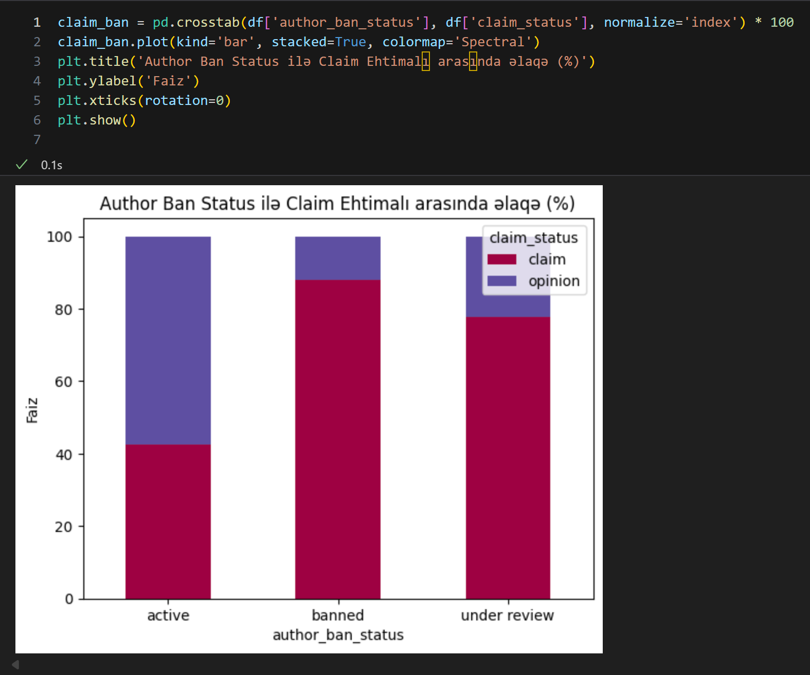
13.Investigate if author_ban_status correlates with likelihood of making claims
The goal is to determine whether banned accounts are more or less likely to be associated with claim activity. This can reveal if accounts facing restrictions tend to produce more content that leads to claims, potentially due to policy violations or controversial topics.

Slide 17
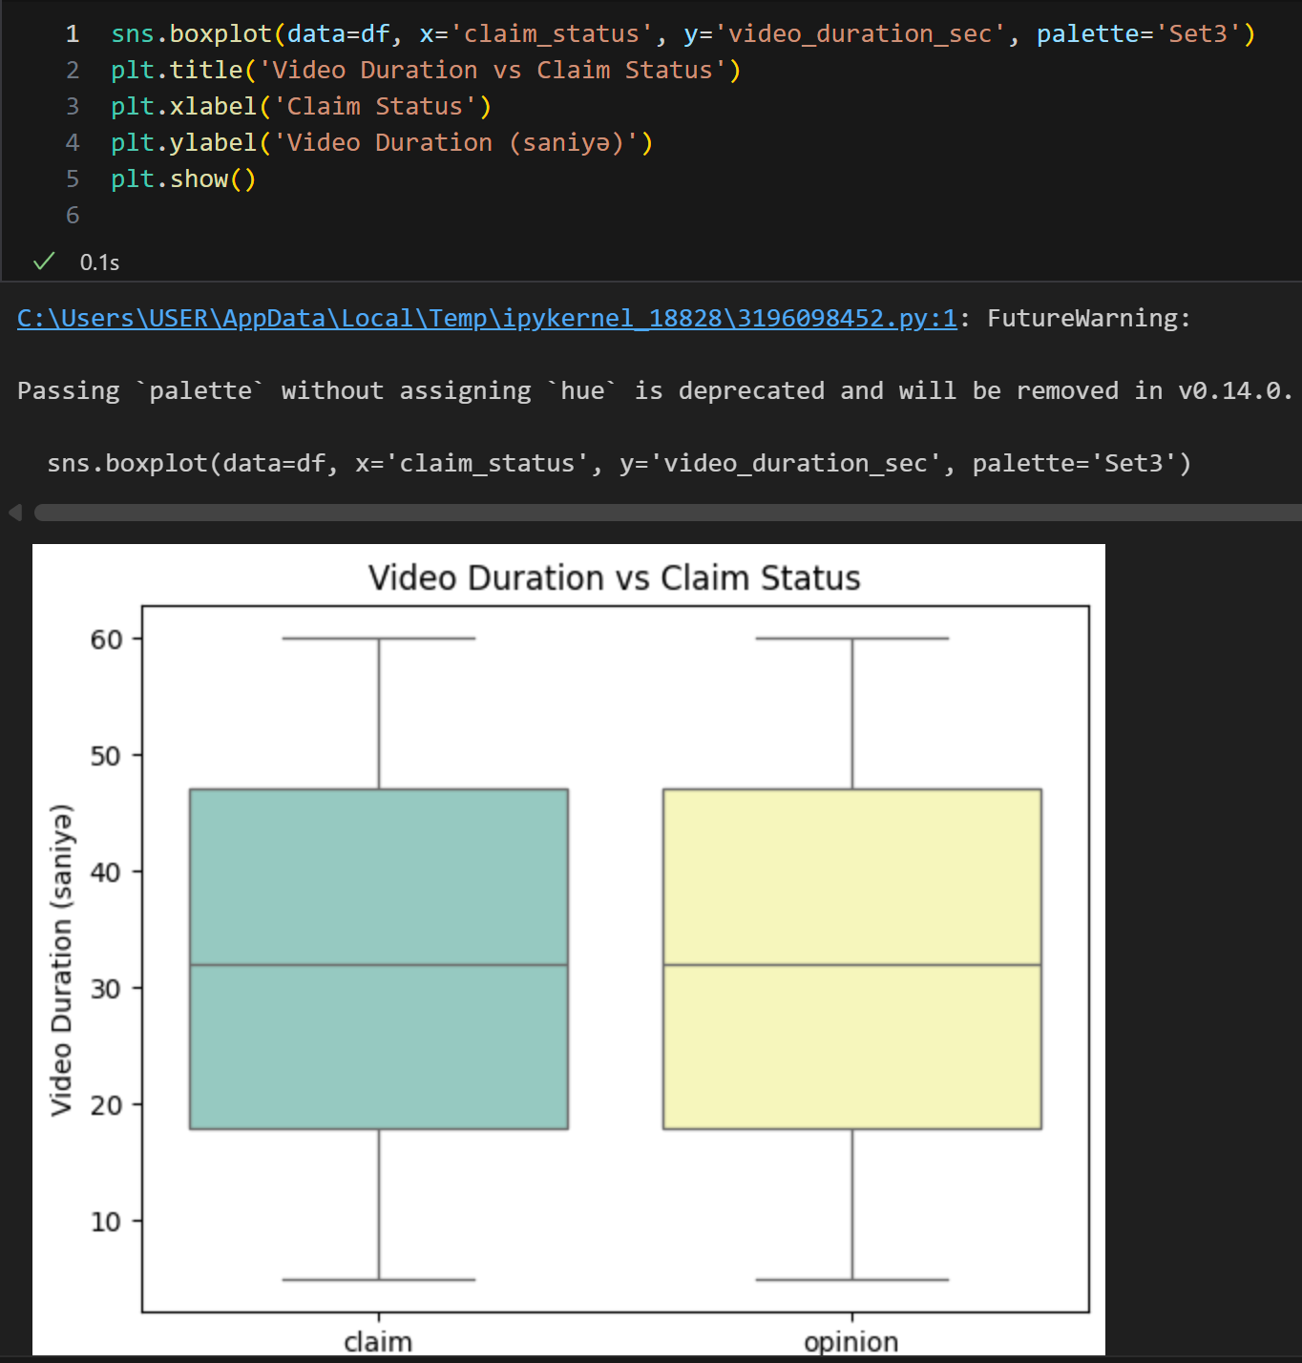
14.Examine if video duration correlates with likelihood of containing a claim
The purpose is to assess whether the length of a video influences its chances of being claimed. For example, longer videos might have a higher probability of containing copyrighted or disputed material, while shorter videos may have fewer opportunities for such issues.

Slide 18
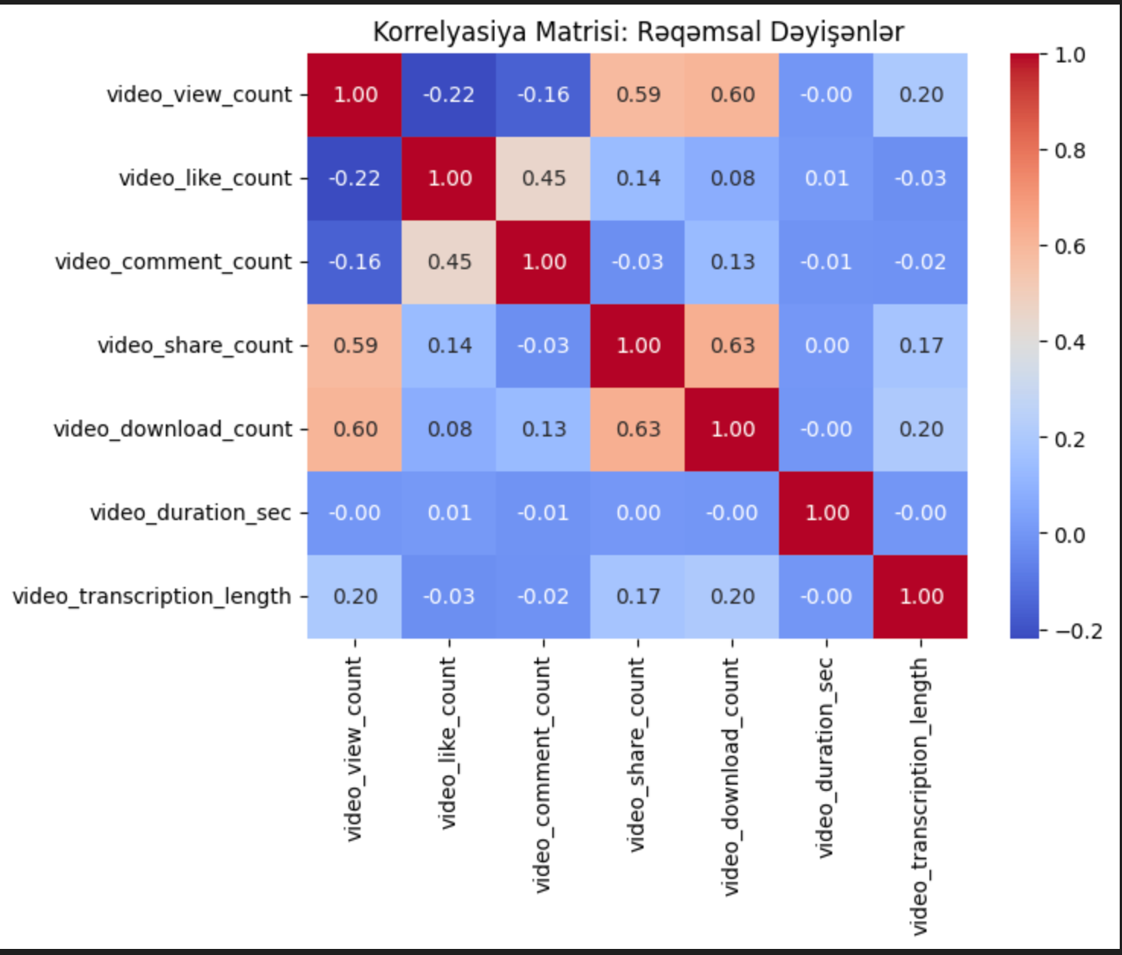
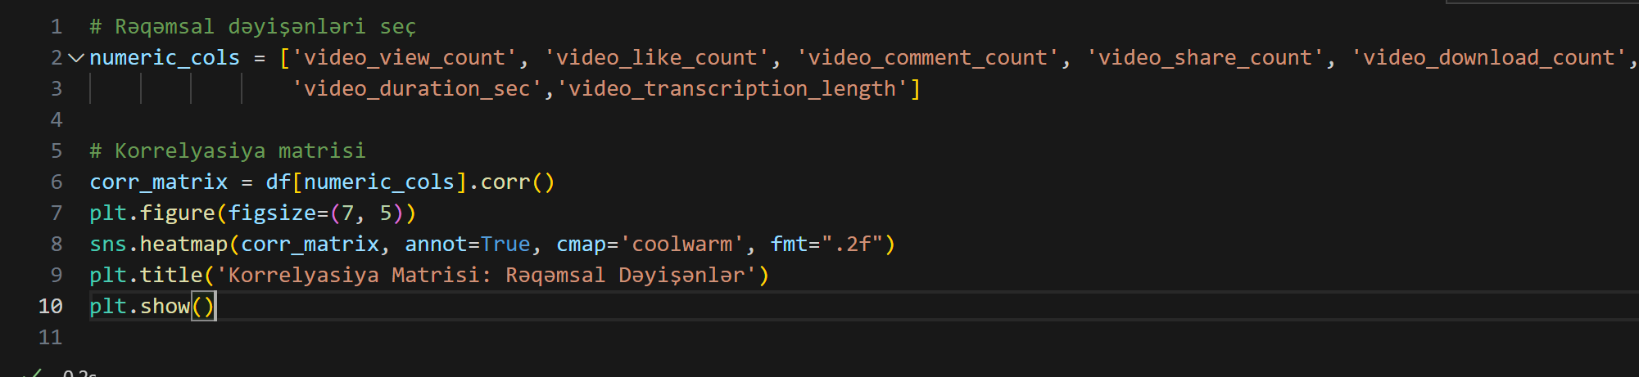
15.Create a correlation matrix to identify relationships between numeric variables
The aim is to measure and visualize the strength of relationships between different numerical features in the dataset. This helps detect patterns, avoid redundancy in model inputs, and understand how engagement metrics like views, likes, comments, and shares relate to each other.

Slide 19
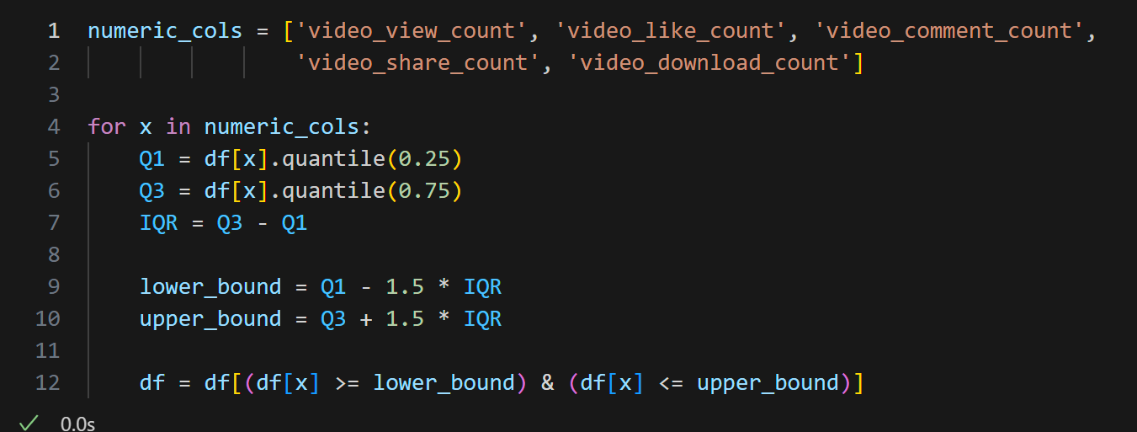
16.Outliers
To detect and manage extreme values in numerical columns such as views, likes, and comments that deviate significantly from the rest of the data. Outliers can distort statistical summaries, bias machine learning models, and reduce prediction accuracy. Methods like the IQR (Interquartile Range) or Z-score help identify these values so they can be removed, capped, or transformed to improve data quality.

Slide 20
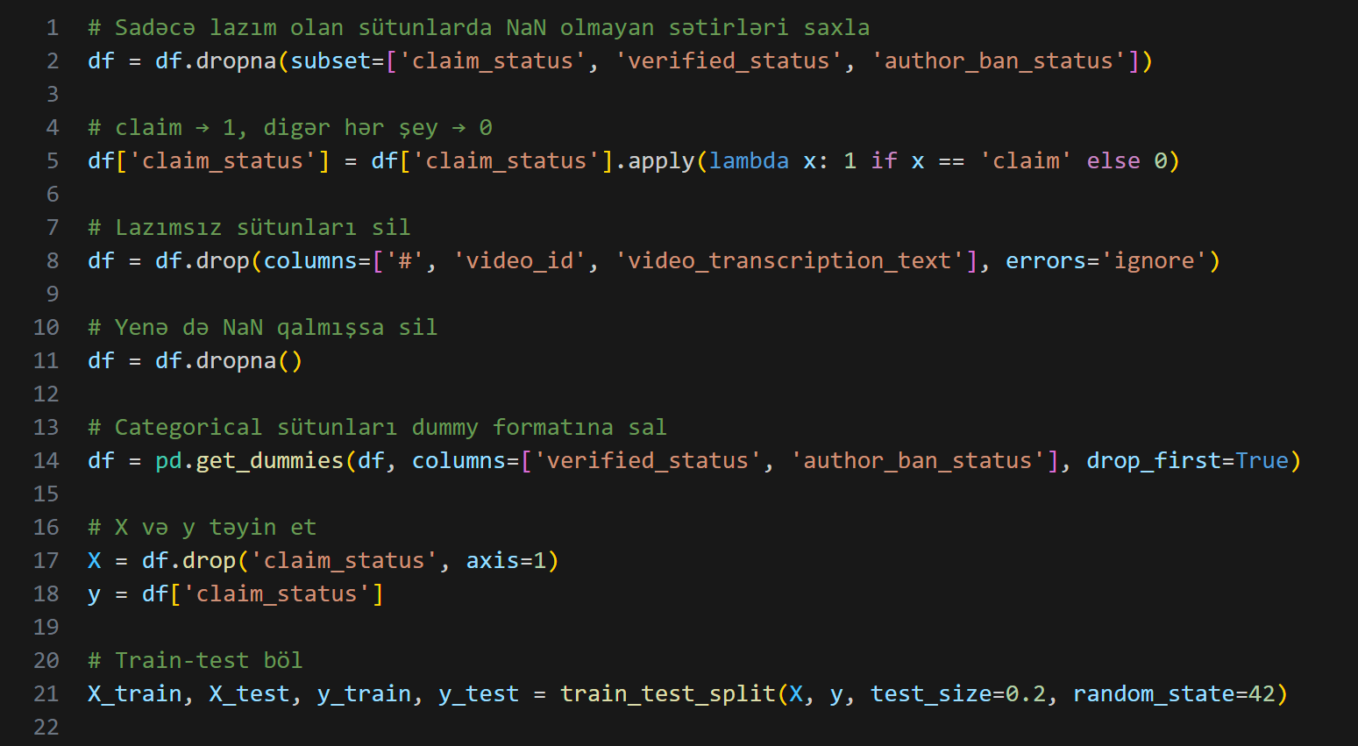
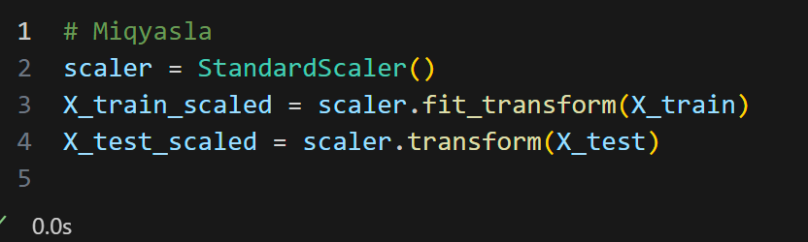
17.Binarize Categorical Variables, Split data into training and testing sets and Data Transformation
To convert text-based or multi-category variables (e.g., verified_status, author_ban_status) into binary or dummy variables so they can be used in machine learning models. Most algorithms require numeric input, so transforming categorical data into 0/1 (or one-hot encoded) format ensures the model can interpret these variables correctly.
Split data into training and testing sets To train the model on one portion of the data and test it on unseen data for unbiased performance evaluation.
Data Transformation
To prepare the dataset for effective machine learning

Slide 21
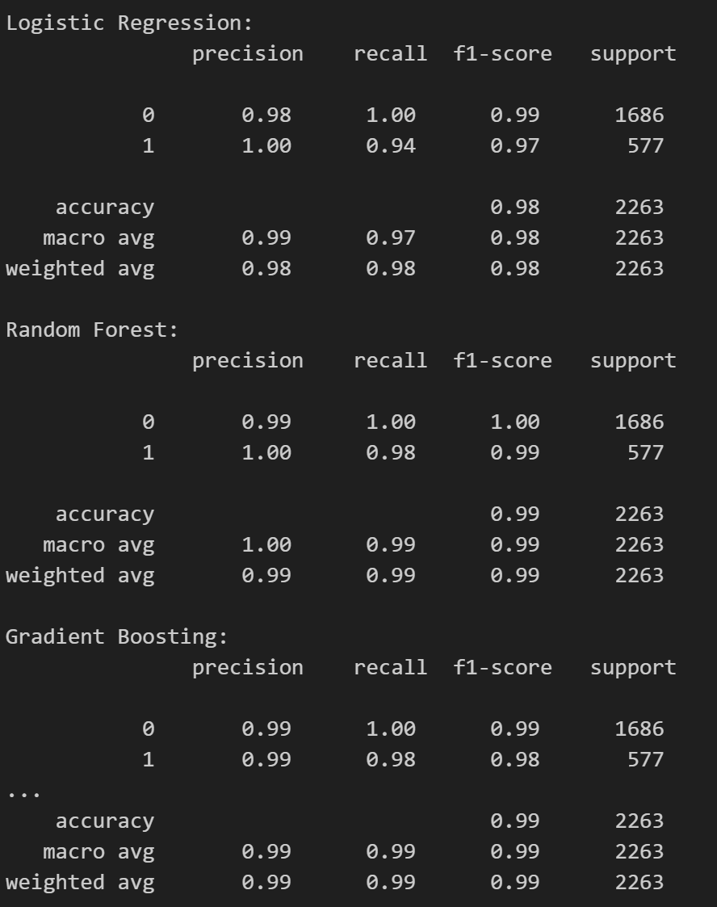
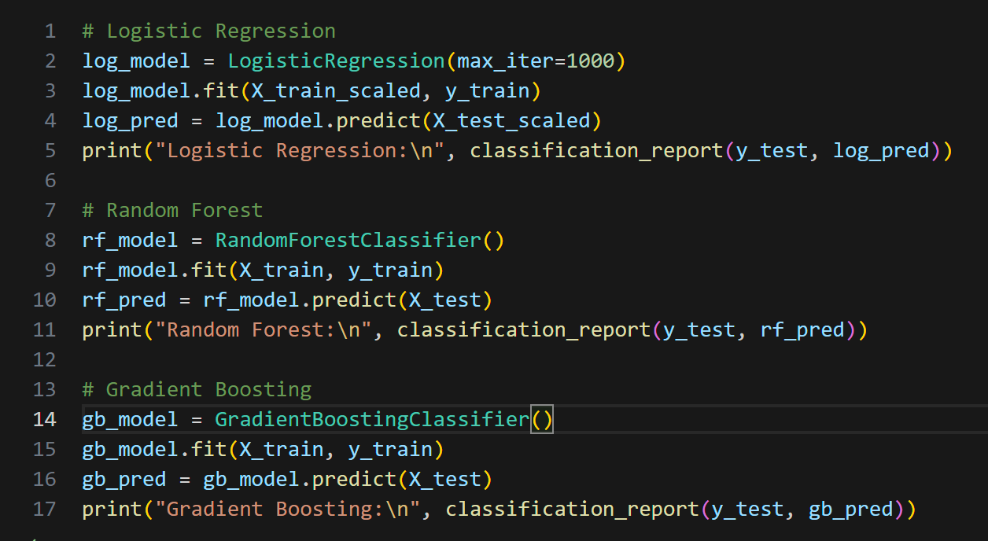
18.Modeling(Algorithms)
To compare models like Logistic Regression, Random Forest, and Gradient Boosting, each offering different strengths in capturing patterns and relationships.

Slide 22
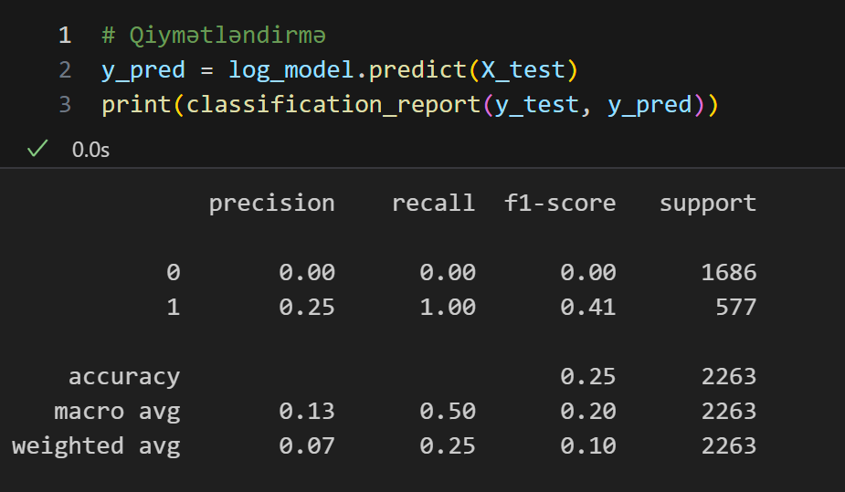
19.Evaluate models using metrics
To measure performance using accuracy (overall correctness), precision (quality of positive predictions), recall (ability to find actual positives), and F1-score (balance between precision and recall), ensuring the chosen model meets the project’s goals

