Slide 1







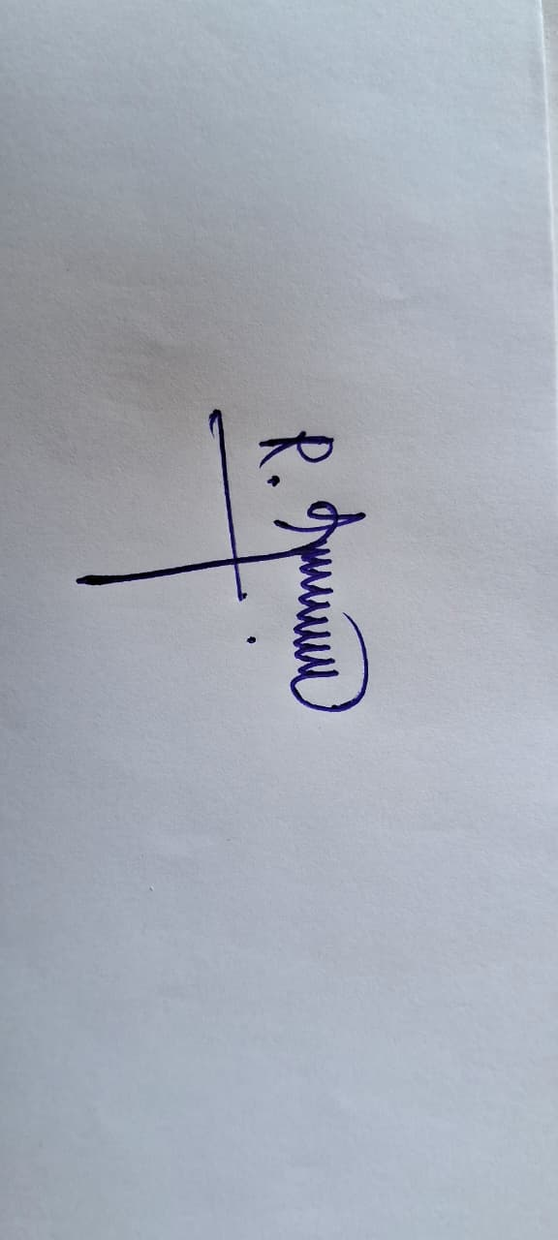
SIMATS ENGINEERING
A⁺⁺ 45
NBA Tier 1 | IET-UK | ABET Accreditation
CERTIFICATE
OF PARTICIPATION
This certificate is presented to
{{PARTICIPANT_NAME}}
.........................................................................................................................................................................................................
.........................................................................................................................................................................................................
for successfully participating in Hackathon 6 Hours Hackathon, Organised by Department of Medical Electronics, SIMATS Engineering, SIMATS, Thandalam, Chennai 602105, Tamil Nadu, India. Held on 24.08.2026
{{TEAM_NAME}}

Slide 2
SIMATS ENGINEERING
A⁺⁺ 45
NBA Tier 1 | IET-UK | ABET Accreditation
CERTIFICATE
OF PARTICIPATION
This certificate is presented to
PARTICIPANT NAME
.........................................................................................................................................................................................................
.........................................................................................................................................................................................................
for successfully participating in NeuralX 6 Hours Hackathon, Organised by Department of Medical Electronics, SIMATS Engineering, SIMATS, Thandalam, Chennai 602105, Tamil Nadu, India. Held on 24.08.2026
TEAM NAME

Slide 3
SIMATS ENGINEERING
A⁺⁺ 45
NBA Tier 1 | IET-UK | ABET Accreditation
CERTIFICATE
OF PARTICIPATION
This certificate is presented to
PARTICIPANT NAME
.........................................................................................................................................................................................................
.........................................................................................................................................................................................................
for successfully participating in NeuralX 6 Hours Hackathon, Organised by Department of Medical Electronics, SIMATS Engineering, SIMATS, Thandalam, Chennai 602105, Tamil Nadu, India. Held on 24.08.2026
TEAM NAME

Slide 4
SIMATS ENGINEERING
A⁺⁺ 45
NBA Tier 1 | IET-UK | ABET Accreditation
CERTIFICATE
OF PARTICIPATION
This certificate is presented to
PARTICIPANT NAME
.........................................................................................................................................................................................................
.........................................................................................................................................................................................................
for successfully participating in NeuralX 6 Hours Hackathon, Organised by Department of Medical Electronics, SIMATS Engineering, SIMATS, Thandalam, Chennai 602105, Tamil Nadu, India. Held on 24.08.2026
TEAM NAME

