Slide 1


NBA x Simple Machine Learning
uOEC 2018
Rouzbeh Majidi and Natesh Kukreja

Slide 2
What is Offensive Rating
FGA – OFFR + TO + (0.4*FTA) = TOTAL NUMBER OF POSSESSIONS (TNP)
OFFE = POINTS SCORED/TNP*100

Slide 3
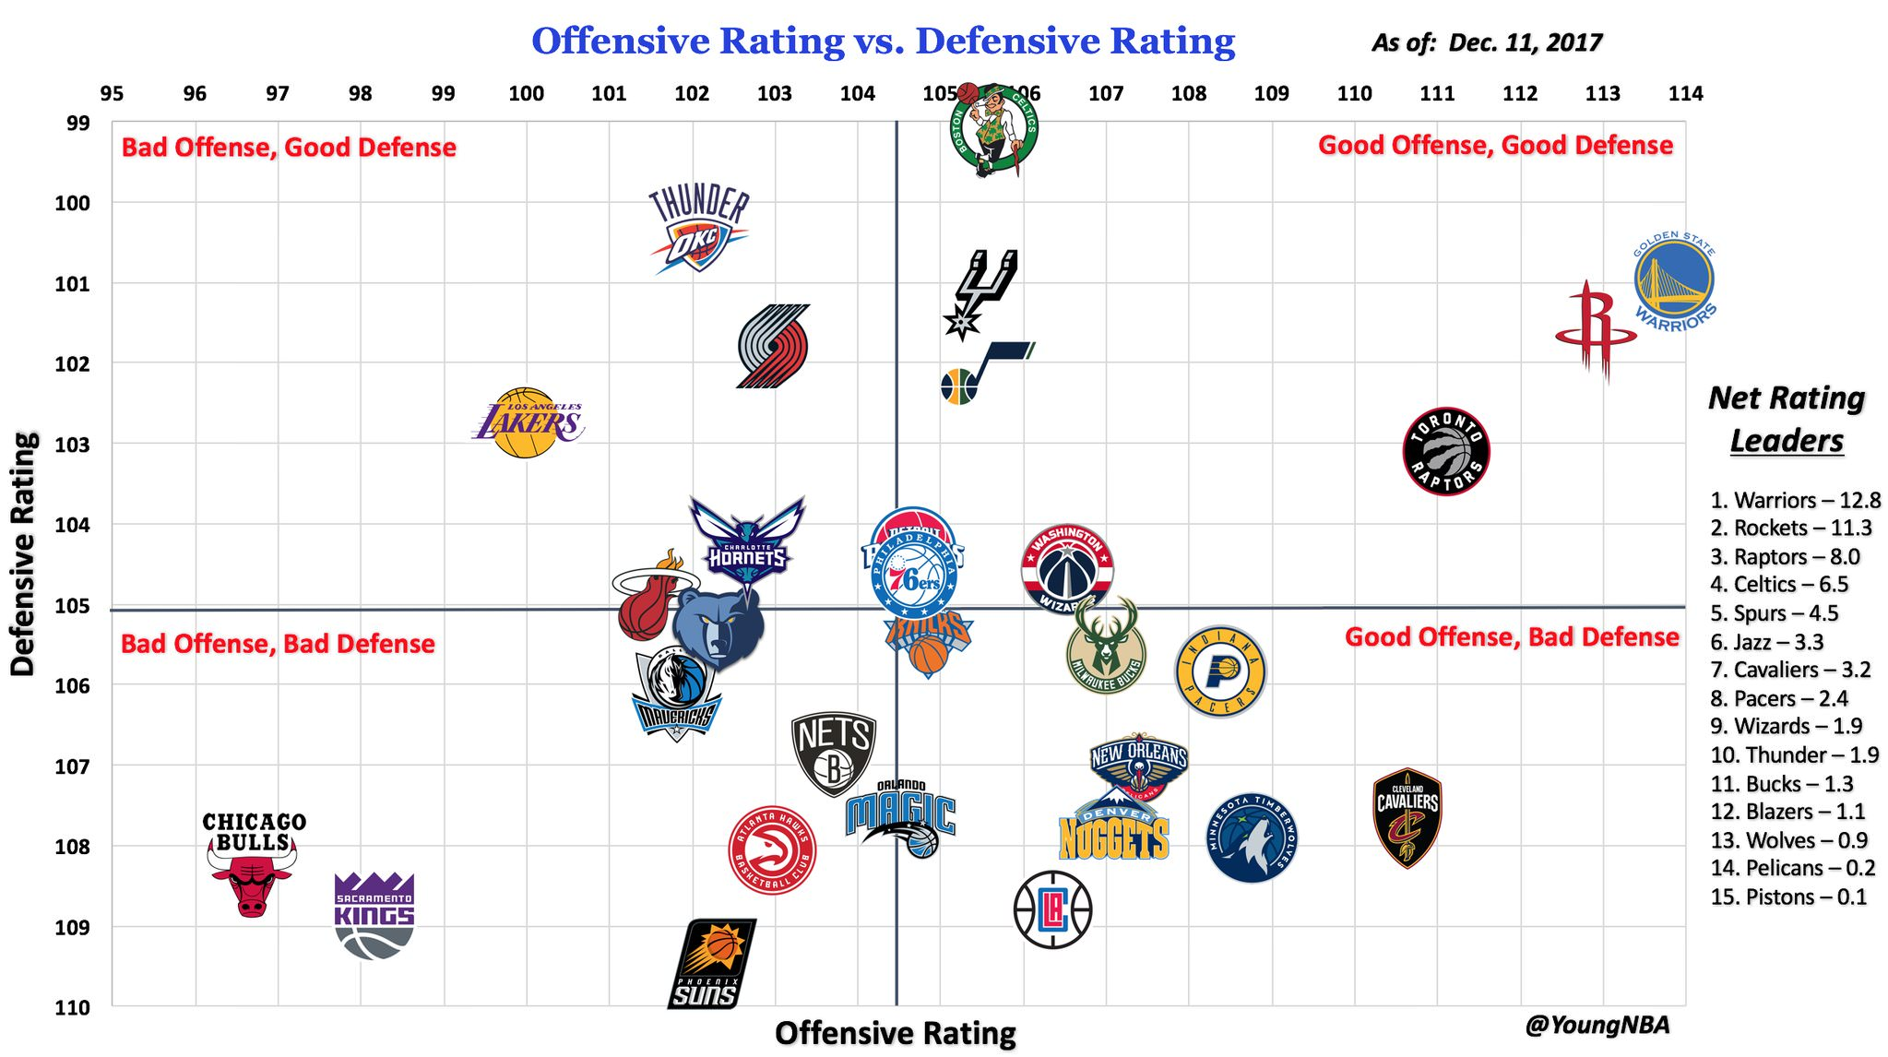
Offensive Rating is important!

Slide 4
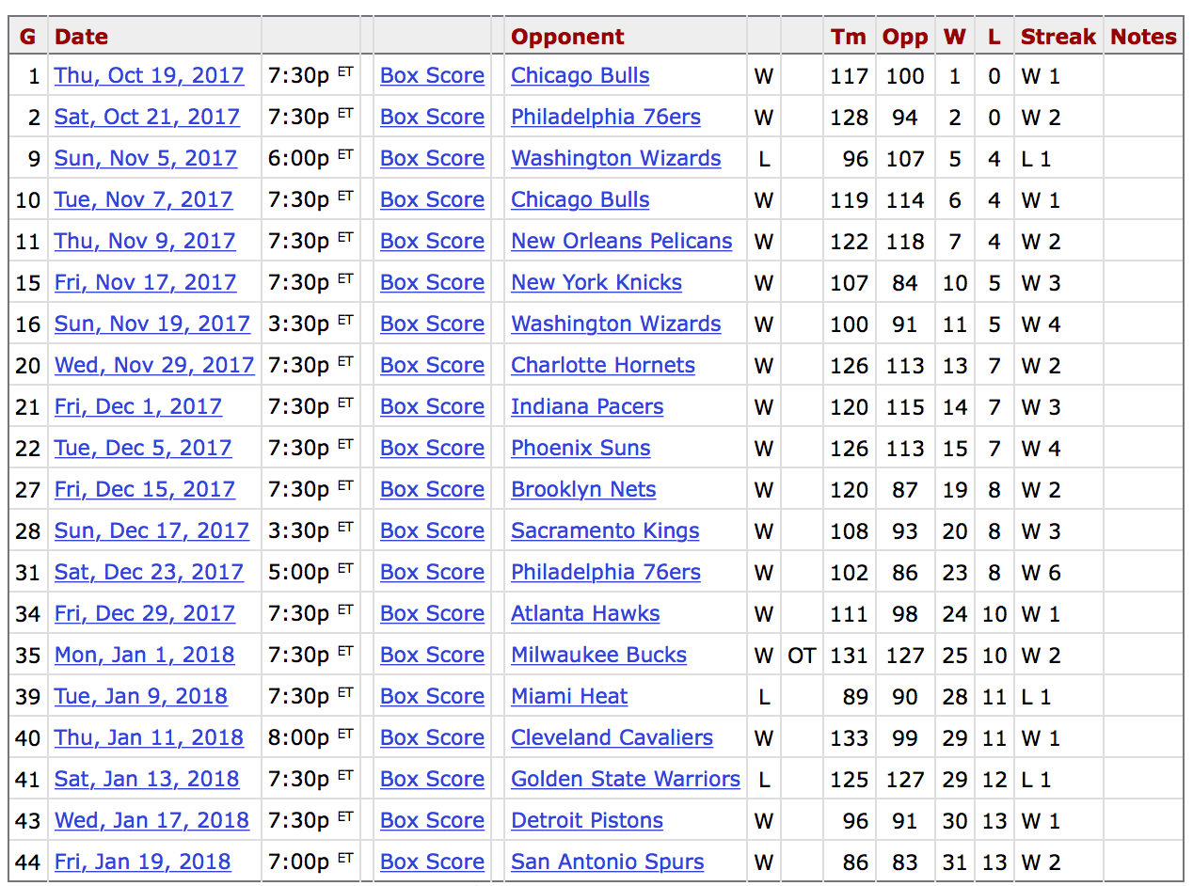
17 - 3

Slide 5
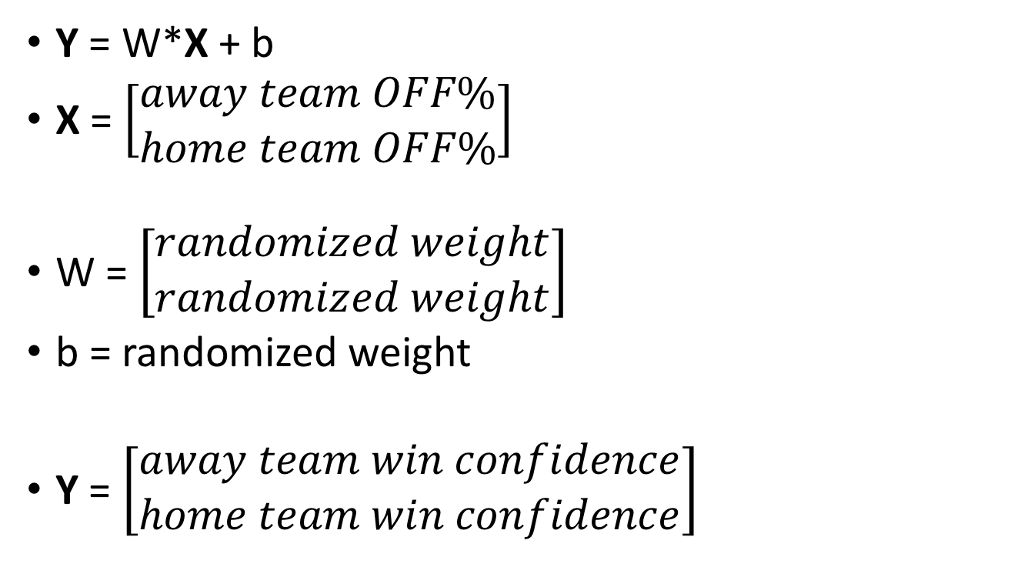
Simple Linear Regression Model
Y = W*X + b
X = $\left[\begin{matrix}away team OFF\% \\ home team OFF\%\end{matrix}\right]$
W = $\left[\begin{matrix}randomized weight \\ randomized weight\end{matrix}\right]$
b = randomized weight
Y = $\left[\begin{matrix}away team win confidence \\ home team win confidence\end{matrix}\right]$
} IN
} To be Trained
} OUT

Slide 6
Training Method
400 samples from previous NBA games
Following format
W_train = [away OFF rating, home OFF rating]
Y_train = [away win, home win]
This allowed TensorFlow to “train” the model and modify the weights (W, b) so that accurate results can be predicted for future games

Slide 7
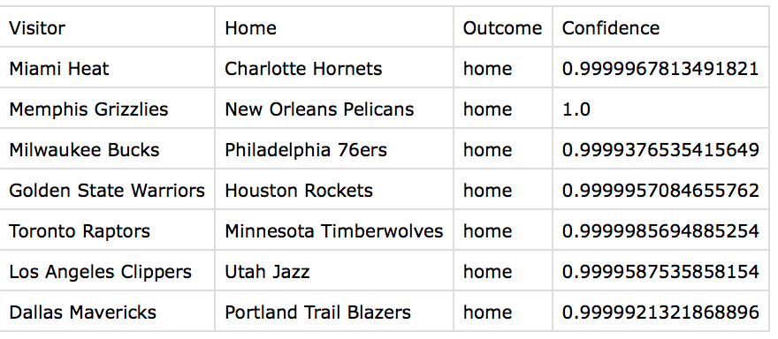
Predictions

Slide 8
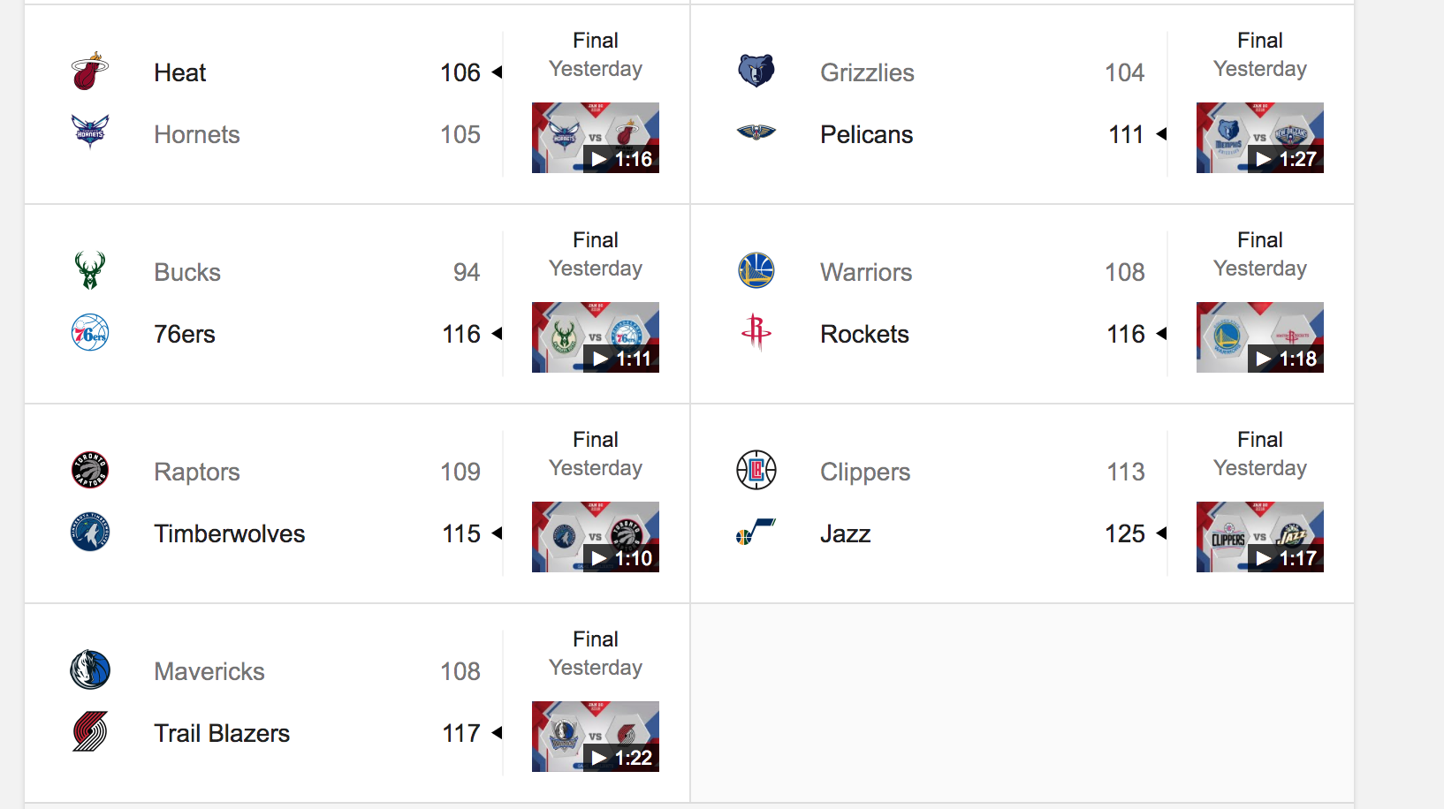
Final Results

