Slide 1


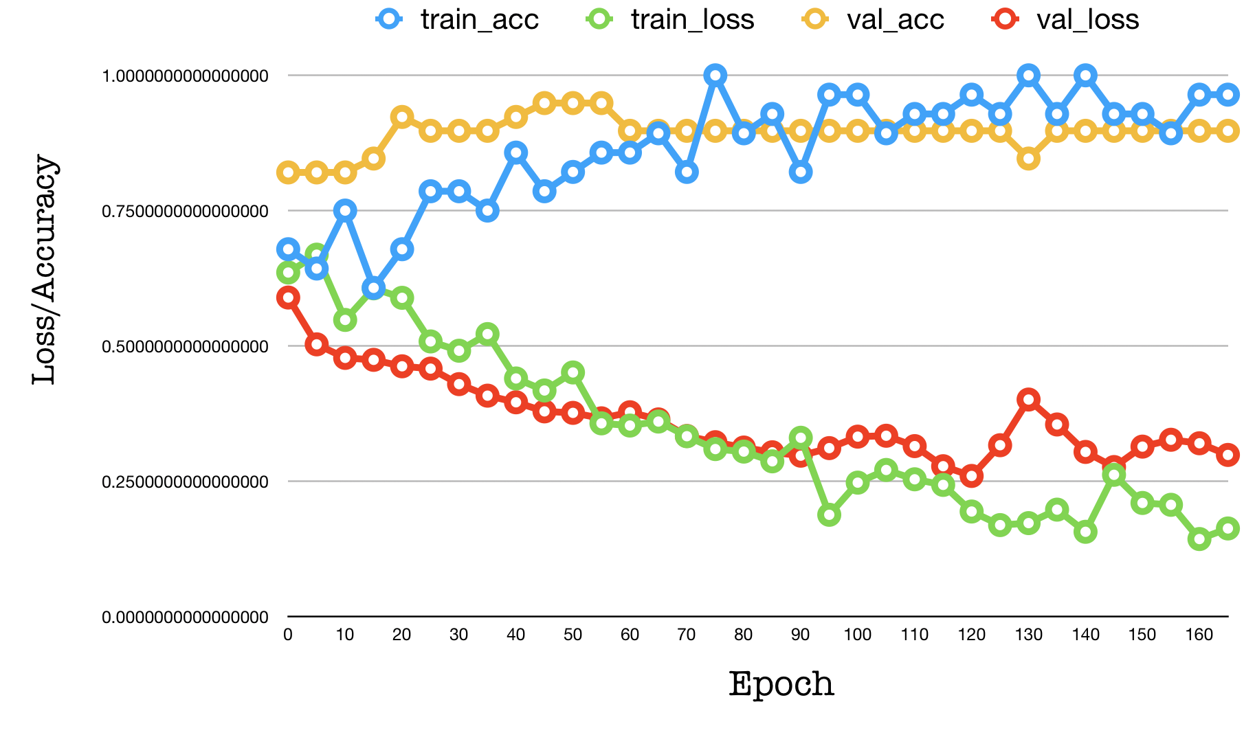
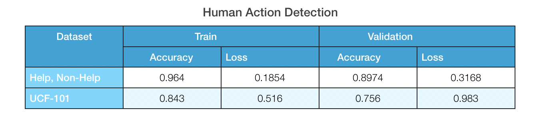
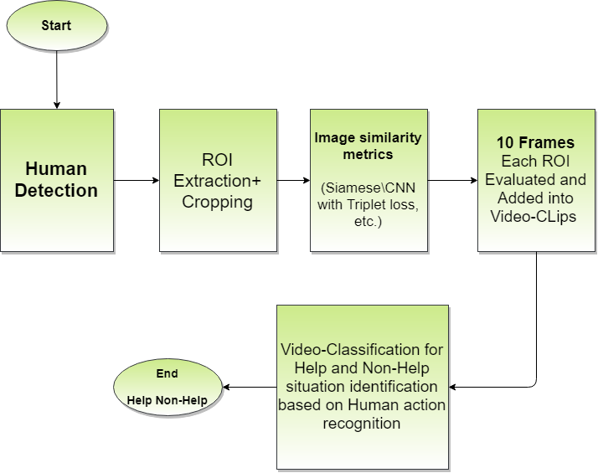

HUMAN ACTION RECOGNITION
Group Members: Manidhar Kondurupaka, K.Natesh Reddy,
Akash Wadhwa M, K.Chandra Harshitha
Mentors: Mr.Balmukund Mishra & Ms.Shambhavi Mishra
Abstract
Experimental Results and Discussion
Human Action Recognition is a very important topic in computer vision due to its many applications such as video surveillance, human and machine interaction and video retrieval autonomous driving vehicle, entertainment etc. As per vision –based action recognition on human is been varied on the different set of actions been performed, the machine needs to
lean all the possible actions can be performed. It also helps in prediction of future state of the human by inferring the current action being performed by that human.
Introduction
One of the most interesting HAR is high –level behavior recognition a moment of body is considered an action.
The main purpose of this project is to build an automatic system, which when given a video, will be able to classify the action being performed in the video.
The purpose of HAR is that it can be very useful in the society it can also be operated by installing the
software into a drone and that surveillance camera can recognize the activities by human.
Fig 2: On Help and Non-Help Video Dataset
Proposed Method
Table 1: Accuracy table
Conclusions
With the model and architecture we have designed, the project works fine with the dataset we have
created using drones.
This can be further taken into real-time deployment of this model as the accuracy and prediction was satisfied and could be useful during the disasters.
The CNN-RNN algorithm provides us with an accuracy of 96.4% on the video dataset for Help and Non-Help.
References
Zhongwen Xu, Yi Yang, Alex G. Hauptmann; The IEEE Conference on Computer Vision and Pattern Recognition (CVPR), 2015, pp. 1798-1807
Chen Zhao, JunGang Han, Xuebin Xu Xi’an, CNN and RNN Based Neural Networks for Action Recognition, Xi’an, Shanxi 710121, China, awp4211@gmail.com
Aman Pandey (2017csb1127) Amit Srivastava (2017csb1189)IIT Ropar,Punjab, Human Action Recognition
Kensho Hara, Hirokatsu Kataoka, Yutaka Satoh, Can Spatiotemporal 3D CNNs Retrace the History of 2D CNNs and ImageNet?, Submitted on 27 Nov 2017 (v1), last revised 2 Apr 2018 (this version, v2).
Fig 1: Complete Architecture of Search and Rescue based on Background Invariant Generalization of Deep learning models
Team No. - 22

