Slide 1
Fungal annotations paper

Slide 3
Some projects are largely noise.
Those with lots of aligned (green) are good - these are not gene associated.
Those which align to genes and align to genes in strand tell us about noise.
High stranded percentages point to mRNA degradation.
Higher ratios which are mixed-stranding or antisense point to sRNAs.

Slide 4
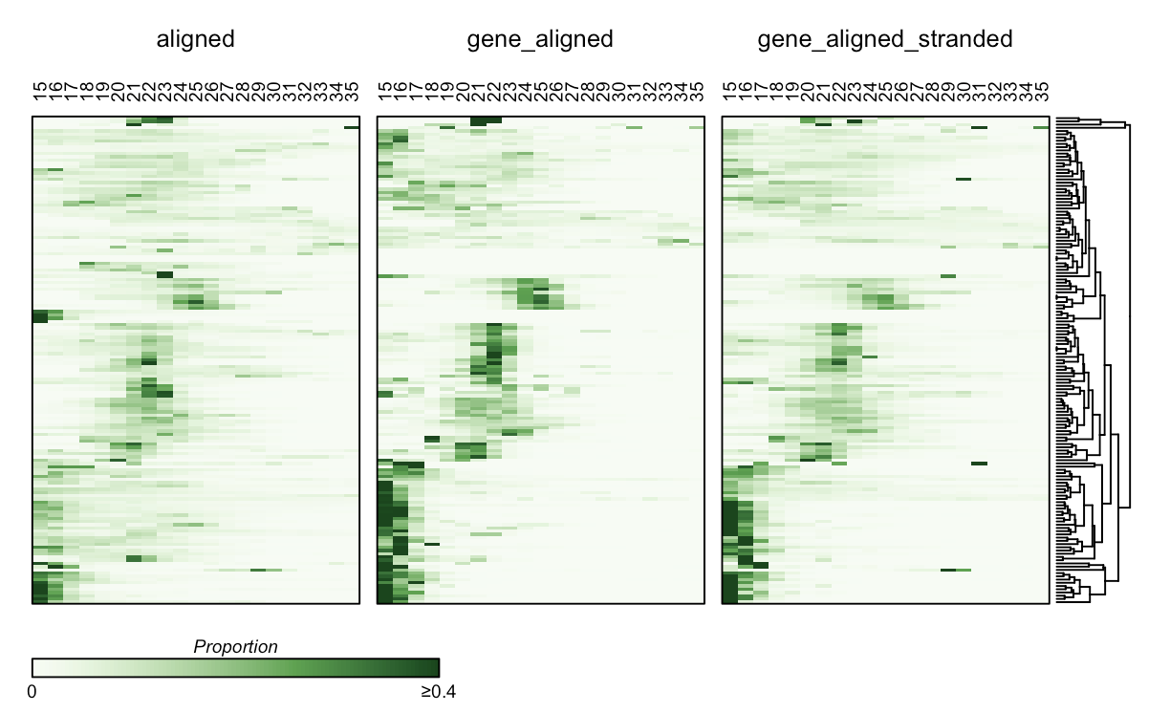
Gene-aligned reads usually have a similar profile
This was unexpected – shouldn’t these be only degradation?
This could be that sRNAs are coming from gene bodies too, perhaps in an unstranded way?
We need to do locus analysis to figure this out!

Slide 5
The majority of sRNAs are densely packed
Many are densly packed (greater than 95%of reads in a small genomic space).
Another group are medium… with some noise.
Some have much lower annotation rates… This looks to be largely nosema specific
Some are just bad – very low annotation rate.

Slide 6
Filtered Peaks are mostly 20-24
Unaggregated. Showing where peaks are identified for each species, project, and replicate group.

Slide 7
Summarized sizes say the same thing

