Slide 1
UTC BTEC Units 2 Case Study
Unit 2: Computer Systems: Computer Components, Suitable Software/Hardware Specs, Install, configure & Test System Components
Assignment 1: Prepare a Business Case and presentation to the finance review board, in order to gain strategic support & budget for a computer system upgrade.
Notes:
1

Slide 2
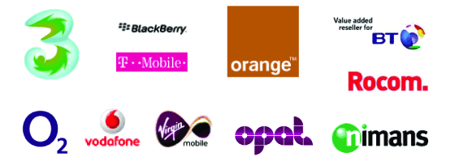
Unit 2: Scenario
You are a IT Technical PM in TelXGroup – a large Telco >
You experience a company merger – e.g. Search: BT/EE merger and/or 02/Three
The user base increases from 1200 > to 2000 users
You are asked to pull together a business case for a project that upgrades the current computer systems to ensure the business can support the increase in users
You will use a cost effective/user friendly Operating System with the required utilities of a telcomms business, which will need to be explained and justified.

Slide 3
Unit 2: Assignment 1
Assignment 1: Business case providing a recommended computer system that meets the needs of the company’s functions within this industry, including the upgrade from 1200 to 2000 people. Ensuring there is justification on the hardware and software you will need to purchase (including cost) for this environment.
Business case must include;
Types of OS to be used & why
Software utilities used by each function and why (including licensing)
Any hardware costs
Resourcing costs – how many people do you need to complete the upgrade?
The business case should outline the project scope, time and cost;
Include a project plan outlining
The project methodology used & why
A high level timeline
Budget required
Resources required
Format: Cover page, Table of Contents, Introduction, Conclusion, Bibliography & References

Slide 4
Unit 2: Assignment 1
Supporting information provided in outline document.
Use the resources available to you
If you where a user what would OS would you want to use?
If you where on the review board, what would you want to see if you were responsible for signing off?
If you were the Chief Financial Officer (CFO) why would you spend your money on this?
Think of a standard organisation structure with typical users and business functions relevant to Telco businesses

Slide 5
Unit 2: Assignment 1 - Considerations
OS analysis you must ensure the business case includes;
What an operating system is, including technical information such as what services and functions are provided by the OS in a Telecomm environment, what features they have and what device drivers are and why they are important.
Due to large variety of operating system in the market, ensure you compare the features and functions of two different operating systems that would be suitable for individual needs
Choosing Utilities
You need to explain the purpose of different software utilities by giving at least on example from each category of software utilities. Refer to security tools, clean up tools, and drive formatting
Consider the benefits of computer performance created by using software utilities. You should give reasons for possible improvements from using a specific utility
Be creative, research, research, research…..the information unique to this scenario is all out there!

Slide 6
Thank You
Any Questions?
Contact details;
m.conner@replyltd.co.uk
UTCproject.support@replyltd.co.uk

