Slide 1
Riverside Community Garden
Members' meeting, October 2026

Slide 2
What we grew
Vegetables
  Tomatoes, beans and peas
  Squash and pumpkins
Herbs and flowers
Fruit from the young orchard

Slide 3
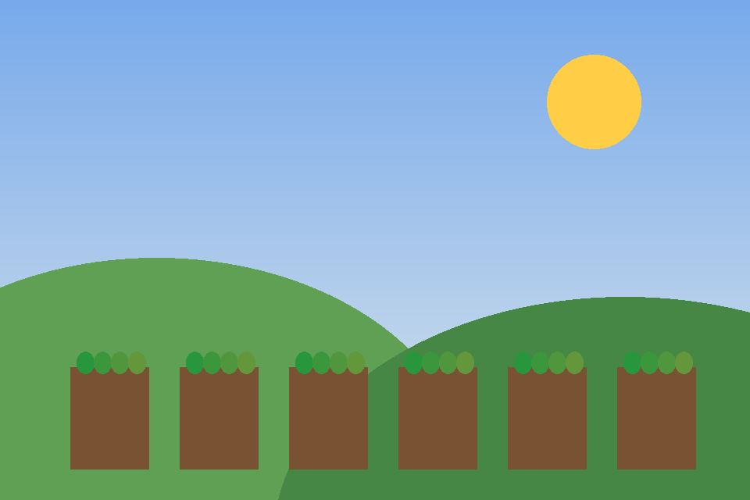
The beds in June
Drawn by a member of the garden

Slide 4
Harvest
Crop | Beds | Harvest (kg)
Tomatoes | 4 | 212
Potatoes | 3 | 240
Pumpkins | 2 | 190
Apples | 0 | 85

Slide 5
Draft notes, not for the meeting

Slide 6
How the garden works
Sow
Grow
Harvest
Share
Every member takes a turn at each step, so everyone learns the whole year.

Slide 7
Harvest by month

