Slide 1
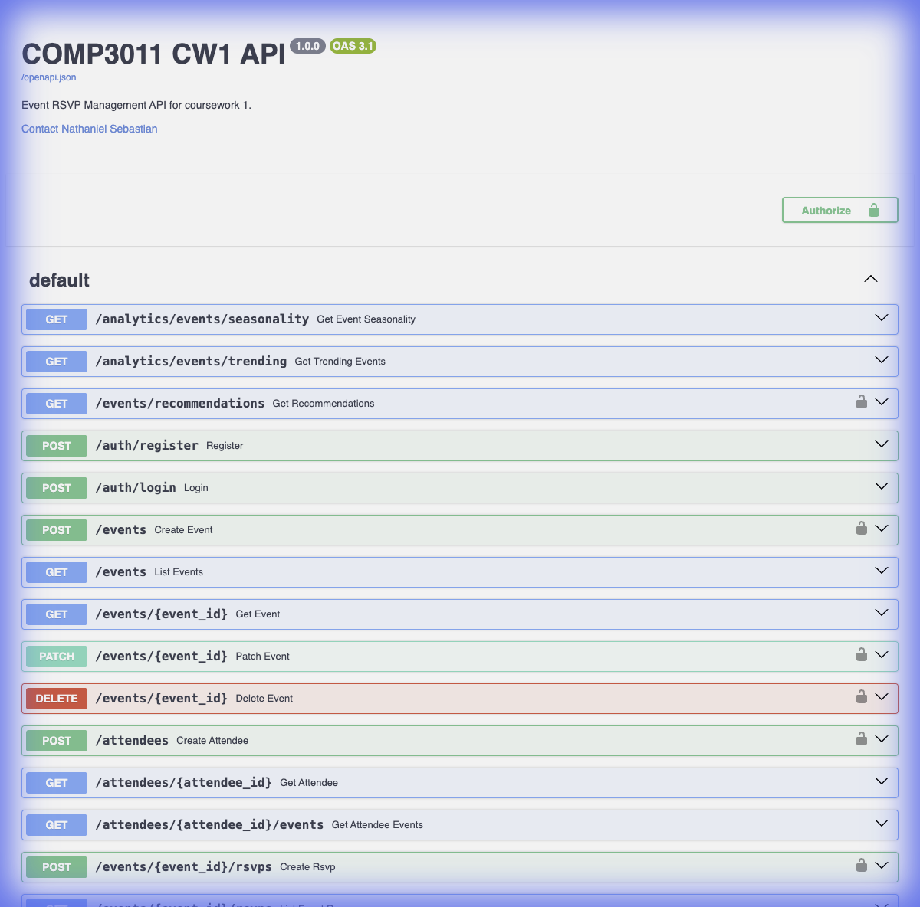
EventHub
Event & RSVP Management API
Nathaniel Sebastian (sc232ns)
COMP3011 – Web Services and Web Data
University of Leeds • February 2026
🔗 comp3011-cw1-api.onrender.com
📂 github.com/NathS04/comp3011-cw1-api

Slide 2
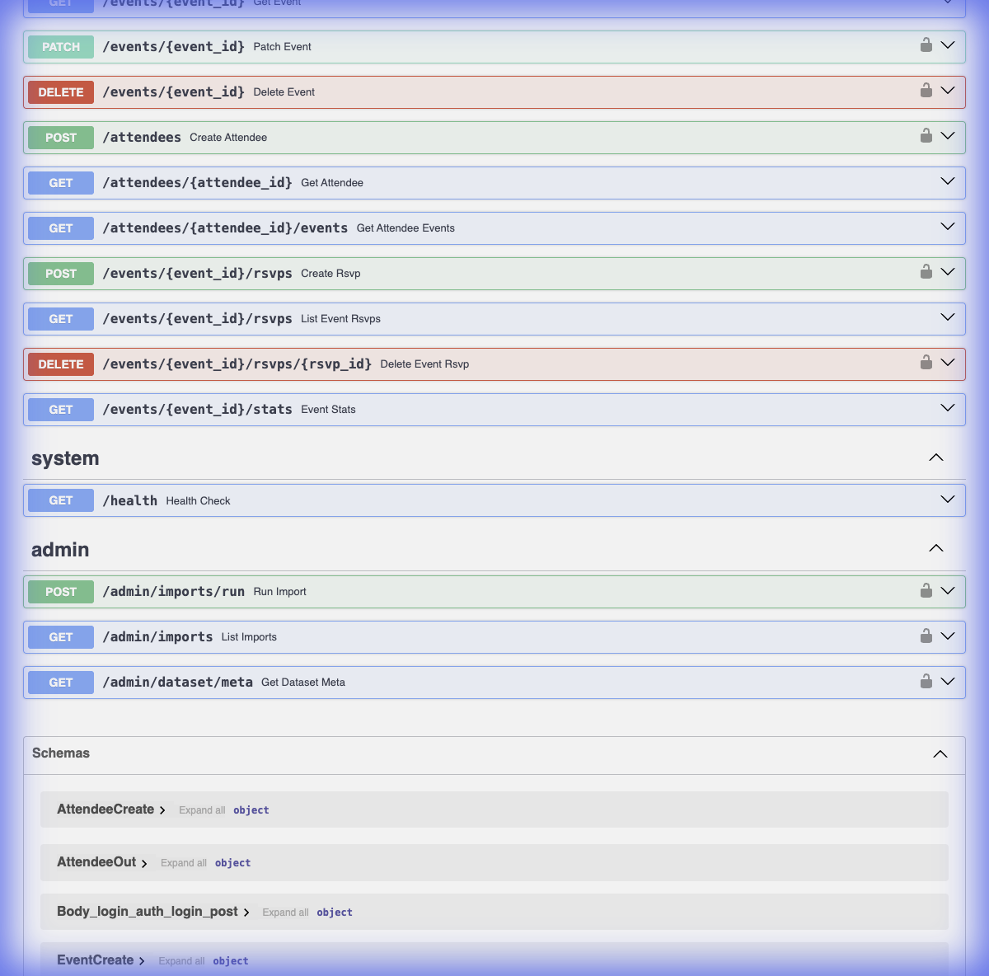
Problem & Solution
❌ Problem
Student societies lack event management tools
No centralised RSVP tracking
Manual attendance, no analytics
✅ Solution
RESTful API with JWT Authentication
Full CRUD for Events, Attendees, RSVPs
Real-world data integration (Leeds TEN Dataset)
Analytics: seasonality, trending, recommendations
Production-grade security (RBAC, headers, ETag)

Slide 3
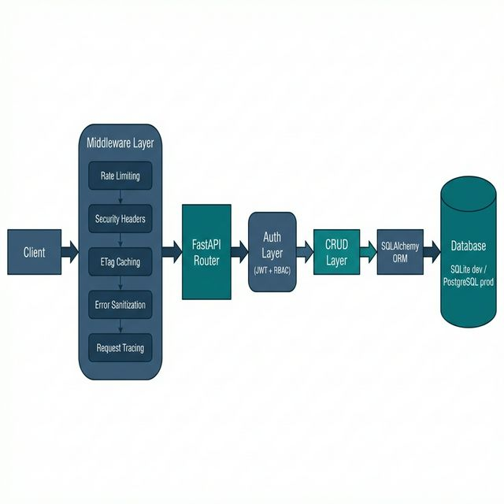
System Architecture

Slide 4
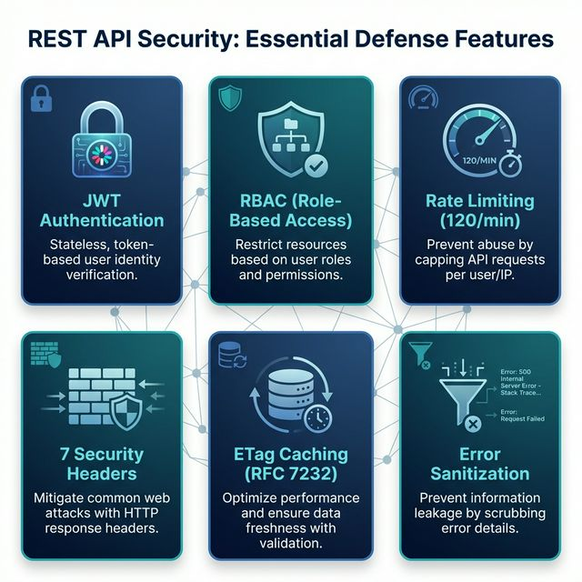
Security & Advanced Features
🔒 JWT (PBKDF2-SHA256, 30-min expiry)
🛡️ RBAC: /admin/* → 403 for non-admin
⚡ Rate Limiting: 120/min global, 10/min login
📋 7 Security Headers on ALL responses
🔄 ETag/304 (RFC 7232) on /events
🚫 500s sanitized — no stack traces
📍 X-Request-ID tracing on every response
All verified by 41 automated tests

Slide 5
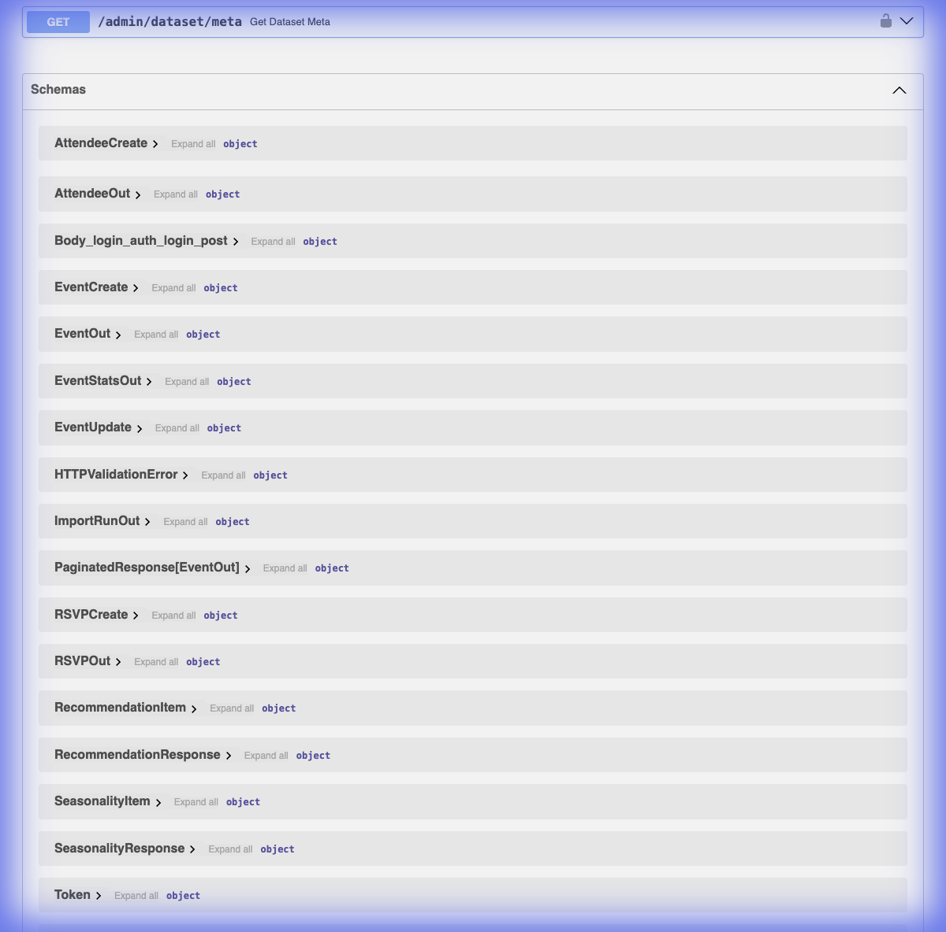
21 API Endpoints
Authentication
Events CRUD
Attendees & RSVPs
Analytics
Admin (RBAC)
POST /auth/register
POST /auth/login
POST /events (auth)
GET /events (paginated)
GET /events/{id}
PATCH /events/{id} (auth)
DELETE /events/{id} (auth)
POST /attendees (auth)
GET /attendees/{id}
GET /attendees/{id}/events
POST /events/{id}/rsvps (auth)
GET /events/{id}/rsvps
DELETE /events/{id}/rsvps/{id} (auth)
GET /analytics/events/seasonality
GET /analytics/events/trending
GET /events/recommendations (auth)
POST /admin/imports/run
GET /admin/imports
GET /admin/dataset/meta

Slide 6
Novel Data Integration
Leeds City Council
Import Pipeline
Temporary Event Notices (TEN)
1. Admin triggers POST /admin/imports/run
2. System fetches XML from Data Mill North
3. SHA256 hash computed for provenance
4. XML parsed → Event objects created
5. ImportRun record saved with metadata:
• source_url, sha256_hash
• rows_imported, rows_skipped
• duration_seconds
6. Events available via GET /events
GET /admin/imports → full audit history
GET /admin/dataset/meta → source metadata
📦 Source: Data Mill North (XML format)
📜 License: Open Government Licence v3.0
🔗 Auto-import via /admin/imports/run
Provenance Tracking:
• SHA256 hash of source file
• ImportRun audit table
• Timestamp, duration, row counts
• Source URL + version metadata
Why this dataset?
• Real UK public events data
• XML parsing demonstrates data pipeline skills
• Provenance = enterprise-grade audit trail

Slide 7
Testing & Error Handling
✅ test_auth.py — JWT register/login/token
✅ test_events.py — Full CRUD lifecycle
✅ test_attendees.py — Attendee management
✅ test_rsvps.py — RSVP + duplicate rejection
✅ test_analytics.py — Seasonality/trending
✅ test_admin.py — Import + dataset meta
✅ test_admin_security.py — RBAC 401/403
✅ test_etags.py — ETag + 304
✅ test_headers_security.py — 7 headers
✅ test_middleware.py — Rate limit 429
✅ test_dataset_provenance.py — SHA256
✅ test_health.py — /health fields
✅ test_admin_errors.py — Error cases
✅ test_import.py — Import pipeline
Error Handling
41
404 — not found
401 — unauthorised
403 — forbidden (RBAC)
409 — duplicate
429 — rate limited
500 — sanitized
All include:
X-Request-ID
Security headers
tests passing

Slide 8
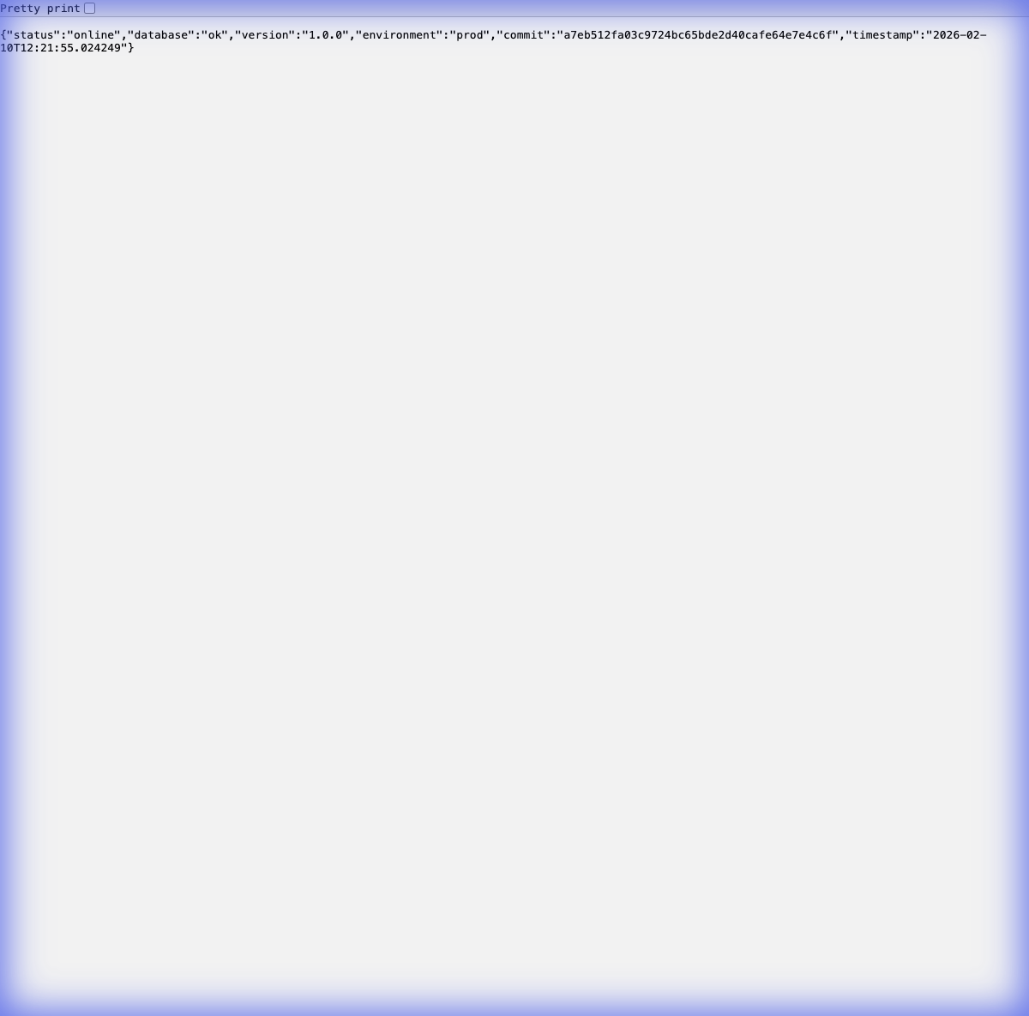
Live Deployment
Render.com
🌐 comp3011-cw1-api.onrender.com
Infrastructure:
• Python 3.x runtime
• Managed PostgreSQL database
• Auto-deploy from GitHub main branch
• render.yaml (Infrastructure as Code)
Configuration:
• ENVIRONMENT = prod
• RATE_LIMIT_ENABLED = true
• ALLOWED_ORIGINS = restricted
• SECRET_KEY = auto-generated
Environment Detection:
RENDER env var → always prod
load_dotenv() skipped on Render

Slide 9
Version Control & Commit Discipline
126+
Methodology
Conventional Commits:
feat: / fix: / docs: / test: / chore:
Each commit is:
• Logically atomic
• Verified by test suite
• Reviewable in isolation
Branch strategy:
• Direct to main (solo project)
• CI equivalent: pytest on every change
No monolithic dumps
Clear separation of concerns
Feature → Bug Fix → Docs → Test
commits
Recent Commits (git log --oneline)
f30a13b fix(docs): correct header count 6→7
a7eb512 fix(config): bulletproof env detection
51c27c1 fix(test): use fixture in header tests
dca5aa6 docs(claude): regenerate PDFs
23b7054 fix(test): use fixture for etag tests
f72a36b fix(config): rate limit true/1 + clean zip
fa1f4e5 docs(verify): bulletproof verification steps
6d2a33d docs(slides): align narrative + viva prep
acfb22c docs(genai): final audit-ready logs
5d31b97 docs(report): finalize evidence + tradeoffs
38168e5 docs(api): finalize errors/headers/etag
f9d7fe6 docs(readme): sync final features
cfaca6c test(final): ensure >=39 tests and green
342473d fix(errors): sanitize all 500s, no leakage
37d5574 feat(etag): ETag + 304 for list + detail

Slide 10
Creative GenAI Usage
Google Gemini
Failures & Lessons
Architecture, code generation, deployment automation
❌ Missing `requests` → ModuleNotFoundError
→ Added to requirements.txt
❌ Placeholder test with `pass`
→ False coverage; replaced with real assertions
❌ Deprecated Query(regex=...)
→ Updated to modern Pydantic validation
❌ Headers missing from 429 responses
→ Fixed middleware to apply headers to ALL paths
Full logs: docs/GENAI_EXPORT_LOGS.pdf
Claude
Documentation QA, PDF generation, consistency audits
ChatGPT
Research, alternative exploration, debugging
Design Decisions Explored
1. RSVP: embedded vs relational → chose relational
2. Rate limiting: in-memory vs Redis → in-memory
3. ETag: manual vs library → manual (RFC 7232)
4. Middleware order: security-first pipeline

Slide 11
Summary
21
41
126+
7
3
3
API Endpoints
Tests Passing
Commits
Security Headers
Data Models
GenAI Tools
✅ Production-grade API with comprehensive security
✅ Novel data integration with provenance tracking
✅ Publication-quality documentation (6 deliverables)
✅ Creative GenAI usage with honest failure analysis
✅ 126+ incremental commits with clean history
🔗 Live: comp3011-cw1-api.onrender.com
📂 Code: github.com/NathS04/comp3011-cw1-api
Thank You — Questions?

