Slide 1
CODE REVIEW - HOTEL
NATI

Slide 2
Step 1 – requirement anaylsis
ENTITIES
BOOKINGS
ROOMS
GUESTS
ROOM TYPES
FACILITIES
HOTEL_ MANAGER
SEASON
BOOKER
ROOM SERVICE
RESTAURANT
ROOMS_FACILITIES
POSTAL CODE
RESTAURANT_VISITS
ROOM_SERVICE_CALLS
CONTACT INFORMATION

Slide 3
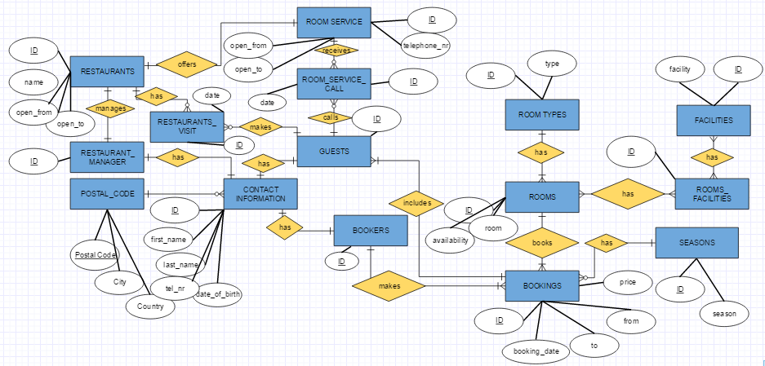
STEP II - The Entity-Relationship Model

Slide 4
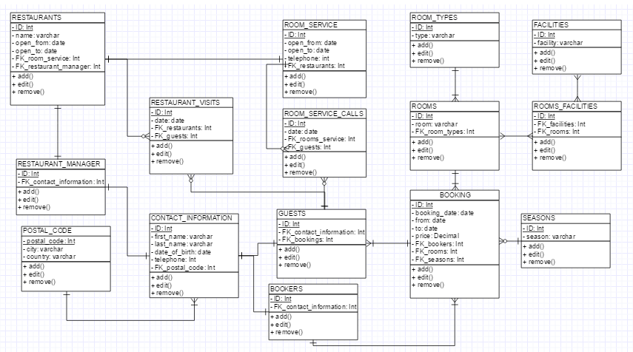
SteP III - The Unified Modeling Language (UML)

Slide 5
Step IV - Refine & Normalize the Design
In the data base

