Slide 1
Diploma Web Application Development: Introduction
ICT50220 Diploma of Information Technology(Front-End Web Development)
Code | Title
ICTWEB517 | Create web-based programs
ICTWEB546 | Validate application design against specifications

Slide 2
Web Application Development
React Core Concepts

Slide 3
Core Concepts
Component Lifecycle
State and setState()
Higher-Order Components
Context API
Data Flow
React Hooks
Props

Slide 4
React Component Lifecycle
Life
Mounting - the component has been created and inserted into the DOM
Re-rendered - the component is reinserted into the DOM due to a change in the props or the state
Unmounting - the component is removed from the DOM
Death

Slide 5
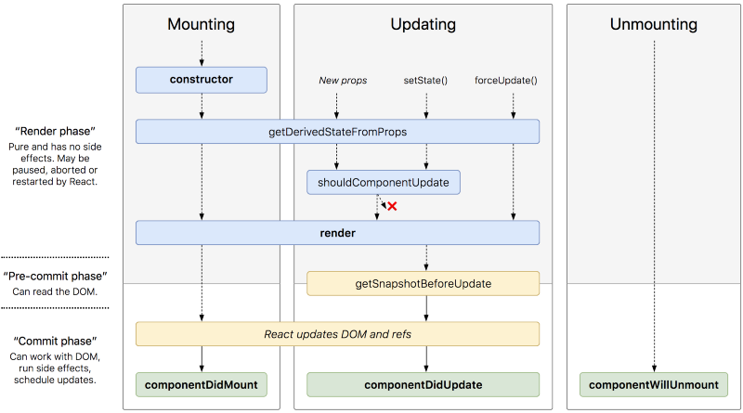
React Component Lifecycle
Life
Death
https://www.freecodecamp.org/news/these-are-the-concepts-you-should-know-in-react-js-after-you-learn-the-basics-ee1d2f4b8030/

Slide 6
State & React
constructor(props) {
// Remember props is only data
super(props);
// Initialising state
this.state = {
count: 0
};
}
// Method to update state
incrementCount = () => {
this.setState((prevState) => ({
count: prevState.count + 1
}));
};
State is a built-in React object
this object contains data/information about our component
we know that this data can change over time
however, we can use & set this state
our component and its children will be re-rendered with the updated state
Remember: we discussed form state: empty, typing, submitting, success & error

Slide 7
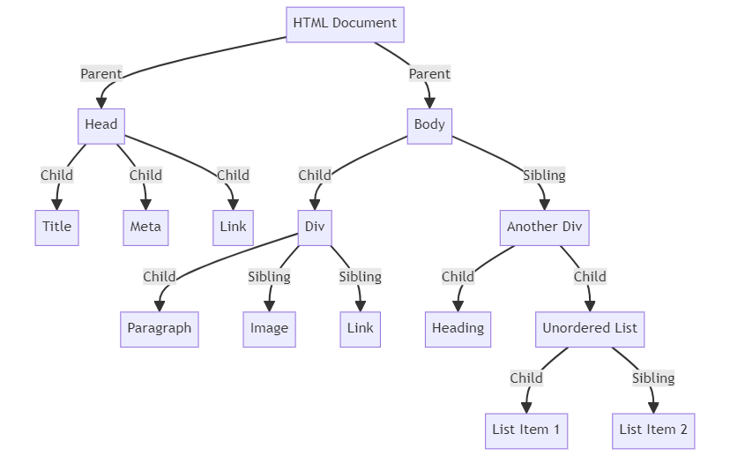
DOM – the family tree

Slide 8
React Hooks
hooks are in-built React functions
we can use them in the lifecycle of function components.
useState - adds state to function components.
useEffect - lets you use side effects in function components.
function NasaApod() {
const [apodData, setApodData] = useState(null);
useEffect(() => {
// NASA API key and URL
const apiKey = 'DEMO_KEY';
const apiUrl = `https://api.nasa.gov/planetary/apod?api_key=${apiKey}`;
…
}
}

Slide 9
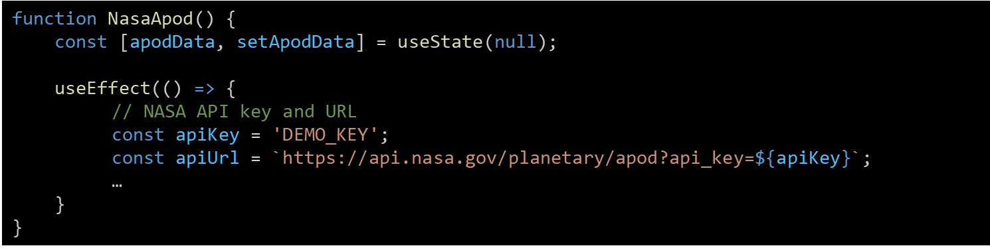
React – Side Effects
Our code will run actions which run outside of the sequence of the current code.
Updating an external document (e.g. .csv file)
Adding event listeners
Animation of UI elements
Fetching data from an API
Synchronisation with a Cloud Storage service

Slide 10
Javascript Objects
.
contain key, value pairs
we can de-structure them
we can use dot notation to get values
can contain other objects & functions
const user = {
firstName: "John",
lastName: "Doe",
age: 30,
isStudent: false,
address: {
street: "123 Main St",
city: "Perth",
zipCode: "6000",
},
}
Notes:
Go through the user object using destructuring and navigation
Then go through props object to reenforce the true nature of props.

Slide 11
The Props Object
.
// An example props object
const props = {
apodData: {
title: "Astronomy Picture of the Day",
date: "2024-08-21",
url: "https://example.com/image.jpg",
explanation: "This is a description of
the image.",
},
// We can pass function in props
showAlert: () => alert("Title: Astronomy Picture of the Day"),
};
the object is passed between Parents & Children
the object properties are used but not changed by the children
it is really a plain JavaScript object
the key: value pairs can contain all types of values
including functions, used to pass data back to the parent to use

Slide 12
Higher Order Functions
.
// Component to display our NASA Image only
function ApodImageDisplay({ apodData }) {
return (
<div>
<h1>{apodData.title}</h1>
<img src={apodData.url} alt={apodData.title}/>
</div>
);
}
// The Higher order function uses our ApodImageDisplay Component
const updatedDisplay = withNasaApodData(ApodImageDisplay);
a function that takes a component and returns a new component
use case: re-using components for different UI
the original component is passed in the props object ( in this case ApodImageDisplay )

Slide 13
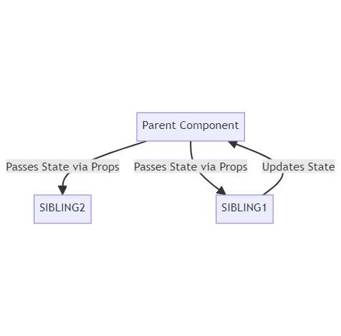
React High Order Functions

Slide 14
React Context
.
// Create a Theme Context with
// "light" as the default value
const ThemeContext = createContext('light’);
// Custom hook to use the Theme Context
function useTheme() {
return useContext(ThemeContext);
}
// Use the custom hook const theme = useTheme(); // Apply theme-based css styles
const themeStyles = {
backgroundColor: theme === 'light' ? '#fff’ : '#333',
};
// Add a button to a component to switch the themes
<button onClick={() => setTheme(theme === 'light’ ? 'dark' : 'light')}>
Toggle Theme
</button>
if we want a particular state to be available throughout the application.
creating a context means you can use it anywhere without having to pass it between components
use case: creating a dark and light theme for the application

Slide 15




Big 3 JS Frameworks & Components
.
all use components to manager structure, behaviour and look (HTML/CSS & JS)
they all promote modularity (DRY)
all use the concept of parents & children in a tree structure
data and functions are passed between these relations

Slide 16
Big 3 JS Frameworks & Component Life
.
All three follow the sequence:
birth: initialisation or mounting
change: updated or onchange
cleanup: beforeDestroy, willUnmount
death: destroy
The final stage ensures state, events and requests from components don’t conflict.

Slide 17
Big 3 JS Frameworks & Props
.
the concept of a props object exists in all 3 frameworks (props/inputs/attributes)
these props flow down from parents to child
children can use but not change props
in all 3 frameworks props are really ust JS objects.

Slide 18
Big 3 JS Frameworks & State
.
all manage state at a component level
changes in state re-render the DOM automatically

Slide 19
Challenge 1
.
revise your JS Fundamentals
fix the broken code in the 7 files for challenge 1

Slide 20
Challenge 2
.
using the JS fundamentals
follow the instructions for challenge 2
create your react project
fix the bugs

Slide 21
🦆

