Slide 1
Diploma Web Application Development: Introduction
ICT50220 Diploma of Information Technology(Front-End Web Development)
Code | Title
ICTWEB517 | Create web-based programs
ICTWEB546 | Validate application design against specifications

Slide 2
Routing in React & Intro to Next JS

Slide 3
Recap
Last week we:
refactored our code to build our apodUrl
moved out components from HTML templates to react
Let's complete the exercise with the rest of our components and look at dynamic routing

Slide 4
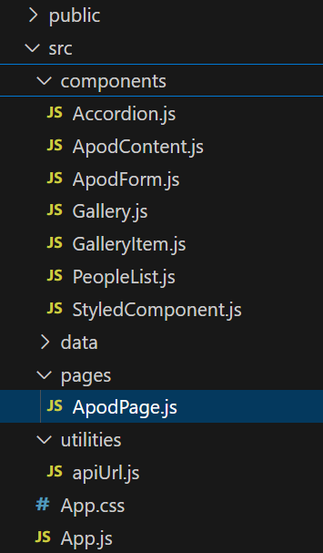
Move our Apod API -1
As we converted this to a react app we can start move our work across
Move our Form and Content components across
Bring our refactored URL builder utility across
Then put the CSS for Video Container into App.css

Slide 5
Move our Apod API – 2
However, we want to use our routes so let's:
move the Apod App component into its own page
Remembering to change the imports & check the CSS is loading
<Link to="/" className="navbar-item">
Home
</Link>
</nav>
{/* Routing Setup */}
<Routes>
<Route path="/" element={<ApodPage />} />

Slide 6
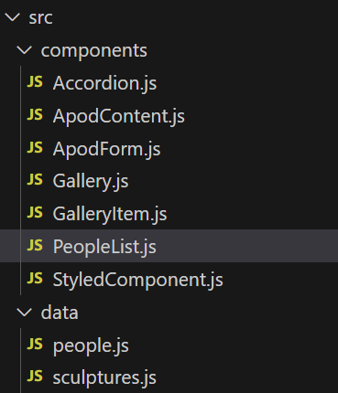
PeopleList using the Map function
Let’s separate the data from the template to match our sculpture list.
move our people array into the data folder
move the template for the component into the components folder

Slide 7
Testing a Dynamic Route
Often we want to create pages with paths that are determined dynamically
Useful when we have pages like product details, user profiles, or sculptures…
These follow a common pattern but vary based on parameters such as the ID
<Link to="/gallery/1" className="navbar-item">
Galaxy
</Link>
<Route path="/gallery/:id" element={<GalleryItem />} />

Slide 8
Building a Dynamic Route
importantly, since the data structure is identical
they can use the same template
{
name: "Floralis Genérica",
artist: "Eduardo Catalano",
description:
"This enormous (75 ft. or 23m) silver flower is located in Buenos Aires. It is designed to move, closing its petals in the evening or when strong winds blow and opening them in the morning.",
url: "https://i.imgur.com/ZF6s192m.jpg",
alt: "A gigantic metallic flower sculpture with reflective mirror-like petals and strong stamens.",
},

Slide 9
Using React hooks
We will use useEffect and useParams to capture the id from the url and send our request
we need to add a unique identifier to each sculpture
then we need to pass our property as a matching parameter in the url so we can search our array
{
id: 9,
name: "Terracotta Army",
artist: "Unknown Artist",
…
},
<Link to="/gallery/1" className="navbar-item">
Galaxy
</Link>
<Route path="/gallery/:id" element={<GalleryItem />} />

Slide 10
GalleryItem Component
Last, we need a component which takes the id parameter and renders the template for each sculpture.
It needs to:
de-structure the id parameter for reuse
Have state for the sculpture item
search the array of sculptures for the item
set the state of the sculpture each time the id changes
render the sculpture to the template

Slide 11
Next JS – Nested Routes
We can group all the routes for a part of our UI together
this can include all the JS logic & CSS
the layout.js allows us to reuse components for the group e.g. navigation
/app
/dashboard
layout.js <-- Layout for the dashboard
page.js <-- Main dashboard page
dashboard.module.css <-- Styles for the dashboard
/profile
page.js <-- Profile page nested inside the dashboard
profileLogic.js <-- Logic for the profile feature

Slide 12
Next JS – Choosing How we Render
We can use to render our components from the server or the client
consider the security of fetching data(dynamic) from the server for our component
we can reduce the amount of JS (& dependencies) that run by getting our server to serve our components
fast moving UI states such as forms/modals can be rendered by the client
anything that needs event handling can be render by the client
things such as CSS animations can be render using the client
'use client'

Slide 13
Next JS & React
Although everything NEXTJS does can be achieved with JS or REACT.
Next JS does come with several things ready to go:
No need to set up external routing libraries (like React Router).
Handles static and dynamic rendering from the start.
Client & Server-side logic use a single codebase, providing authentication & API usage (e.g. user login)

Slide 14
Next JS features
single fetch() method for getting server-side values and props
pre-optimised Image component
fall back UI state while the user is waiting for a server/request response
pages that load as each component is ready not when all the components are ready to be rendered.
API routes which can hold our backend logic (GET, POST, PUT & DELETE)

Slide 15
Server vs Client
Server: Render Server Components into a Payload
Client: Display Fast Non-Interactive HTML Preview
JavaScript Instructions Hydrate Page: Attach Event Listeners
Client: Hydration Handled by React
User Performs Subsequent Navigation
Client: Render Components on Client Side
Server: Download and Parse JavaScript Bundle
Reconcile Client & Server Component Trees
Client: Update DOM with New Content
Next.js Server Sends Static HTML Preview and RSC Payload to Client

Slide 16
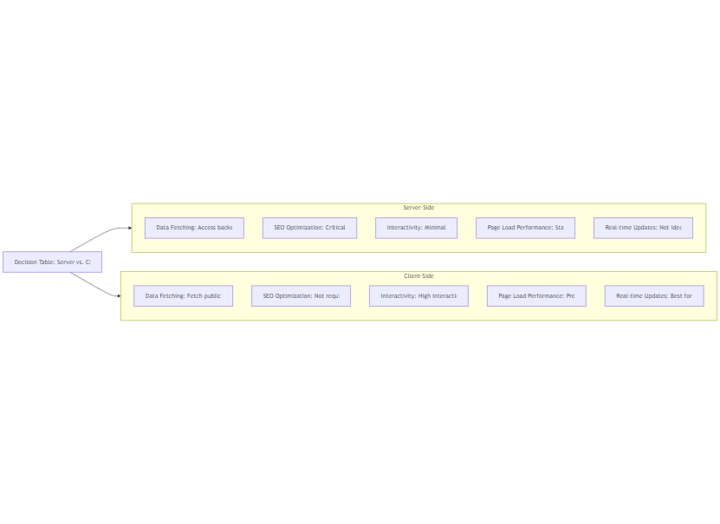
Planning your Server vs Client Decision

Slide 17
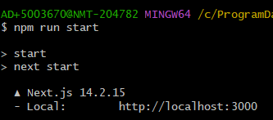

Next JS folder structure
Lets review the folder and files contents to try to identify the purpose.
Notice what is missing from our React app
Lets run the 2 commends below to see how we build, complie and test our produticion site.

Slide 18
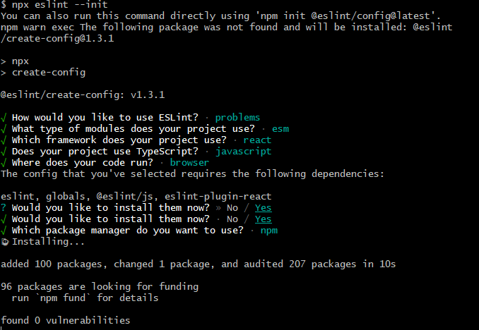
Activity 1: Adding a Package
Using NPM, complete activity 1.md to add, configure and run ES Lint
Consider how this might be automated in Github for a team of Developers?

Slide 19
Activity 3: CLI Activity
Hopefully, you are beginning to understand that Web Application Development is a web of dependencies, libraries and toolsets that can quickly get out of control.
Many projects break because builders fail to maintain these dependencies as the project grows or gets older.
Use of the Command Line is one way for Developers to become much more effective in a team environment. It is also a good way to fix other people breakages!

Slide 20
Where else might we build a utility or helpers in our application?

Slide 21
🦆

