Slide 1
Diploma Web Appication Development: Introduction
ICT50220 Diploma of Information Technology(Front-End Web Development)
Code | Title
ICTWEB517 | Create web-based programs
ICTWEB546 | Validate application design against specifications

Slide 2
Web Application Development – Introduction to React

Slide 3
What is React?
JavaScript library for building the user interface (UI)
Involves the creation & reuse of components.
created by Meta (for Facebook)
originally single-page applications (SPA’s) - NextJS is changing this
native mobile apps
Use case: managing dynamic data.

Slide 4
Why use React?
import React from 'react';
function Sidebar() {
return (
<div>
<ul>
<li>Dashboard</li>
<li>Users</li>
<li>Settings</li>
</ul>
</div>
);
}
we describe what the UI should look like (declarative)
not how to change the UI.
we build encapsulated components (OOP)
components manage their state (how they change)
Use case: admin dashboards

Slide 5
The React Learning Curve
// Core React
import React, { useState, useEffect } from 'react';
// Routing
import { BrowserRouter as Router, Route, Switch, Link } from 'react-router-dom';
// State Management
import { Provider, useSelector, useDispatch } from 'react-redux';
import store from './store';
import { connect } from 'react-redux';
// UI Components (Material-UI as an example)
import Button from '@material-ui/core/Button';
import AppBar from '@material-ui/core/AppBar';
the React ecosystem including tools for state management, routing for navigation, UI components & more
there is a massive community that contributes
however, the use packages and plugins can be complex & hard to manage

Slide 6
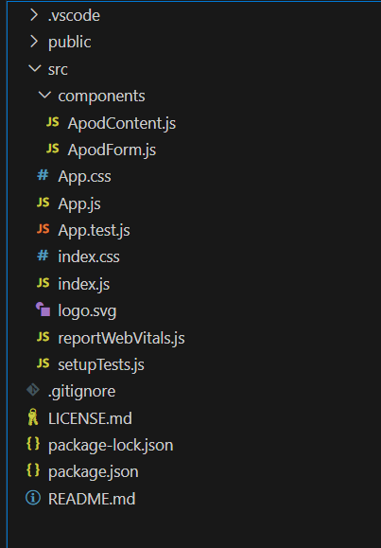
The React Development Environment
use the CLI to start a new React application.
this sets up your development environment
lays out the initial structure & tooling for the project
includes Webpack, Babel & ESLint.

Slide 7
Package Management – package.json
Source of truth for your project storing metadata for the project.
manages the project's dependencies (production & development).
script commands for repetitive tasks like building, testing & starting
version control to manage conflicts as libraries/plugins change
{
"name": "apod-app",
"version": "1.0.0",
"private": true,
"dependencies": {
"react": "^17.0.2",
"react-dom": "^17.0.2",
"react-scripts": "4.0.3"
},
"scripts": {
"start": "react-scripts start",
"build": "react-scripts build",
"test": "react-scripts test",
"my-custom-script": "run something clever"
}
}

Slide 8
Package Managers – NPM & Yarn
used to install, share & manage library dependencies
manages React itself, React-DOM, and other libraries
controls dependencies using the package-lock.json
Hint: npx is included with npm – it allows you to run & test versions of packages without installing them on your global system
npm install <package-name>
npx install <package-name>
yarn install <package-name>
Documentation | Yarn
Documentation | NPM

Slide 9
Package Versions
Minor & Patch versions are backward compatible
Major versions may break previous code
Caret(^): ^17.0.2 allows updates to any 17.x.x release, but not to 18.0.0 +
“react-scripts”: “4.0.3” means the package version is set to this version only
"dependencies": {
// Major.Minor.Patch
"react": "^17.0.2",
"react-dom": "^17.0.2",
"react-scripts": "4.0.3"
},
Hint: read the release notes before installing major versions

Slide 10
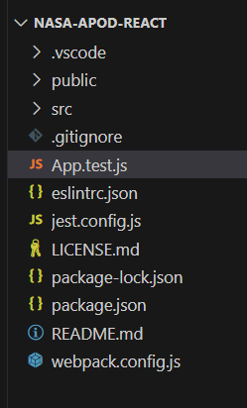
React Tooling – CI/CD
Jest
testing platform for functions, components, objects & can be automated in deployment
React Testing
use actual DOM nodes, simulating users interacting with your application.
ESLint
enforces the style guide & can be automated in deployment
Webpack
bundles your code & assets
provides Hot Module Replacement

Slide 11
JSX
JSX is an extension for JavaScript
looks like HTML but is closer to JavaScript.
we can include JavaScript expressions in JSX by wrapping JS in curly braces.
JSX tags can be HTML tags or React components.
<div className="container">
<h1 className="title">NASA Astronomy Picture of the Day</h1>
<ApodForm fetchApodData={fetchApodData} />
{error && <p className="has-text-danger">{error}</p>}
<ApodContent apodData={apodData} />
</div>

Slide 12
JSX - Rules
only return one element can be returned
we can however return a ‘fragment’ with multiple elements inside
we must use PascalCase for out components by convention
all elements/fragments must have a closing tags
// A fragment created by empty tags
<>
<div className="container">
<h1 className="title">NASA Astronomy Picture of the Day</h1>
// PascalCase component name - ApodForm
<ApodForm fetchApodData={fetchApodData} />
{error && <p className="has-text-danger">{error}</p>}
<ApodContent apodData={apodData} />
</div>
// The closing tag for the fragment
</>
Notes:
You will be assessed on these

Slide 13
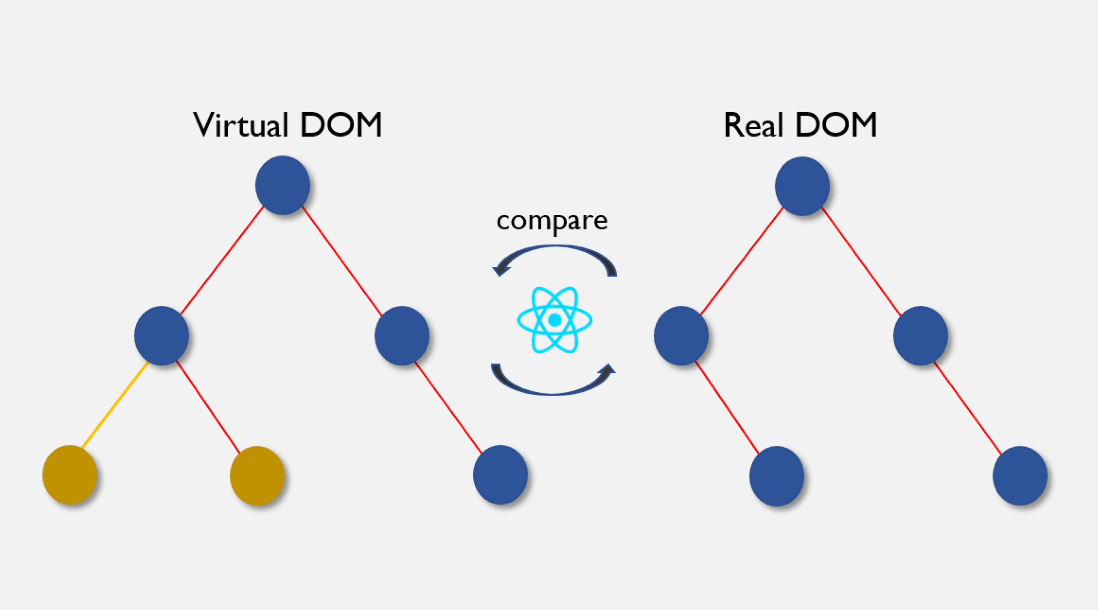
React & the DOM
React creates its own copy of the DOM (virtual)
it compares the virtual & real DOM’s
it then re-renders only the changes (diffing) to the real DOM
making it extremely fast
https://hackernoon.com/the-react-virtual-dom-explained

Slide 14
JSX uses React.createElement
// JSX
const element = <h1 className="greeting">Hello, world!</h1>;
// Translated to JS
const element = React.createElement(
'h1',
{ className: 'greeting' },
'Hello, world!'
);
createElement converts elements written in JSX into vanilla JavaScript
prepares the element representation without touching the actual DOM

Slide 15
ReactDOM
manages the interaction between React components and the actual DOM.
allows React to update only parts of the DOM that have changed (diffs)
import React from 'react';
import ReactDOM from 'react-dom';
import App from './App';
ReactDOM.render(<App />, document.getElementById('root'));

Slide 16
Converting JSX with Babel
Babel is a compiler that lets you use modern JavaScript (ES6+)
Babel compiles JSX into React.createElement() code for our browser to use
Specifically, it uses @babel/preset-react
{
"presets": [
"@babel/preset-env",
"@babel/preset-react"
],
"plugins": [
// Example of a plugin
"@babel/plugin-proposal-class-properties"
]
}
Notes:
ES6 features Anonymous arrows functions, template literals & de-structuring, modules, spread operator, let & const
lukehoban/es6features: Overview of ECMAScript 6 features (github.com)

Slide 17
Converting JSX with Babel
// Converts to the following in the DOM
"use strict";
const ApodDisplay = ({ title, imageUrl }) => React.createElement(
"div",
null,
React.createElement(
"h1",
null,
title
),
React.createElement("img", { src: imageUrl, alt: title })
);
// JSX
const ApodDisplay = ({ title, imageUrl }) => (
<div>
<h1>{title}</h1>
<img src={imageUrl} alt={title} />
</div>
);

Slide 18
Challenge 1: Babel Setup
initialise a new React project
configure Babel
create a simple React Greeting component
ensure it compiles correctly using babel

Slide 19
Challenge 2
create a JSX component that takes the array of items
this is returned to the App component
the component renders them in an ordered list.

Slide 20
Challenge 3
update the JavaScript challenge 3 starter code to use React.createElement to render the DOM

Slide 21
Challenge 4
update the React.createElement code you created in challenge 3 code to use JSX & Babel together.
create a UserProfile component returns the user object detail to the App component to render the DOM.
Notes:
React Developer tools
VS Code launch.json

Slide 22
Complete Session 07 - 01 - Tutorial - JSX
Notes:
React Developer tools
VS Code launch.json

Slide 23
🦆

