Slide 1
Diploma Web Appication Development: Introduction
ICT50220 Diploma of Information Technology(Front-End Web Development)
Code | Title
ICTWEB517 | Create web-based programs
ICTWEB546 | Validate application design against specifications

Slide 2
Sessions
A session is a component of study
Sessions may include:
Notes
Demonstrations
Challenges
Out of class activities

Slide 3
Introduction to State
Notes:
App.js from session 6

Slide 4
Last session
We discussed the following 3 actions in our JS
Data: retrieving or accessing the data we need
Template: the reusable HTML/CSS we place our data structure in
Render: taking these template and applying them to the DOM (Document Object Model)

Slide 5
What is State?
State is just data.
However, there is a time-bound aspect to this data.
State is data at a particular moment in time.
Our DOM can have multiple states when the User acts

Slide 6
Why do we use State?
initially, we build web apps without using JS-based state or data.
however, we can’t edit, delete or check items off.
<ul id="list">
<li>Harry Potter I</li>
<li>Harry Potter II</li>
<li>Harry Potter III</li>
</ul>

Slide 7
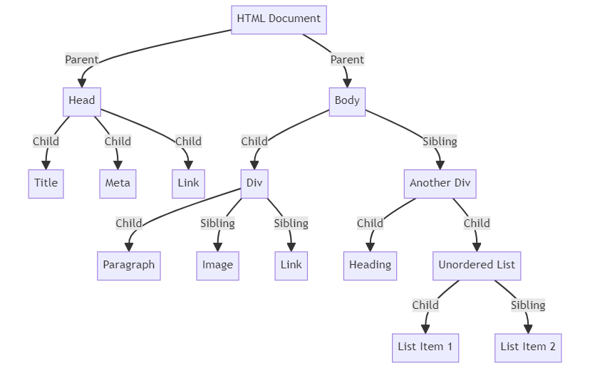
The DOM Tree

Slide 8
Manipulating the DOM manually?
the addBook() adds items to our list
it gets the #list element form the DOM.
we use createElement() method to create a new list item.
we add the book name to the list item with the textContent property.
we then use the appendChild() method to inject the list item into the UI.
var addBook = function (book) {
if (!book || book.length < 1) return;
var list = document.querySelector('#list');
var listItem =document.createElement('li');
listItem.textContent = book;
list.appendChild(listItem);
};

Slide 9
Limits of Manual Manipulation?
for simple apps like this, manual DOM manipulation is a valid way to do things
but things get complicated once you start adding more features and functionality.
var addBook = function (book) {
if (!book || book.length < 1) return;
var list = document.querySelector('#list');
var listItem =document.createElement('li');
listItem.textContent = book;
list.appendChild(listItem);
};

Slide 10
Manipulating the DOM manually?
Let users create multiple lists
Allow list items to be deleted.
Support list item editing.
Provide a way to clear the entire list.
Save the data to (and loaded it from) local storage.
Consider how you would solve this list of added functionality manually?

Slide 11

Challenge – Stage 1…

Slide 12
Stage 1
// Challenge - Stage 1
let addBook = function (book) {
// If there's no book to do, do nothing
if (!book || book.length < 1) return;
// Get the list
let list = document.querySelector('#list');
// Create a new list item
let listItem = document.createElement('li');
listItem.textContent = book;
// Append the item to the list
list.appendChild(listItem);
};
let book = "Harry Potter IV"
addBook(book)

Slide 13
Using state
State-based UI provides a simpler way to manage more complex web applications.
you store all the data in a JavaScript object.
you then use JavaScript to build the DOM based on the current state of the data.

Slide 14
Using state
<ul id="list">
<li>Harry Potter I</li>
<li>Harry Potter II</li>
<li>Harry Potter III</li>
</ul>
Lets take our list app from the previous slide and convert it to a state-based UI approach.

Slide 15
Making it work
We need three things:
the data object
the template for how the UI should look based on different data states
a way to render the template into the DOM
<ul id="list">
<li>Harry Potter I</li>
<li>Harry Potter II</li>
<li>Harry Potter III</li>
</ul>

Slide 16
How to create UI based…
// The data
let data = {
books: [
'Harry Potter I’, 'Harry Potter II’, 'Harry potter III’
]
};
This is, at a high level, how bigger JS frameworks like React and Vue work.
We would then create an #app element in HTML so we have a place to render our list of items into the DOM

Slide 17
How to create UI based…
// The template
let template = function (props) {
let html =
'<ul>' +
props.books.map(function (book) {
return '<li>' + book + '</li>';
}).join('') +
'</ul>';
return html;
};
We can create a template function that accepts the data as an argument and uses it to create an HTML string for our UI.

Slide 18
Rendering the UI
// Render the template into the UI
let app = document.querySelector('#app');
app.innerHTML = template(data);
we render the HTML string into the UI using the innerHTML property.

Slide 19
Updating the UI
to update the UI, update the data object.
then we render a new version of the template into the UI.
how might this work with new data from an API call?
// Update the UI
data.books.push('Harry Potter IV');
data.books.push('Harry Potter V');
app.innerHTML = template(data);

Slide 20
Update the UI
// Manipulating the data
data.books = data.books.slice(1);
data.books = data.books.pop();
data.books = data.books.filter();
app.innerHTML = template(data);
If want to remove/filter books from the list, we update the array and reset the innerHTML again.

Slide 21
Challenge – Stage 2…

Slide 22
Stage 2
// Challenge - Stage 2
// The data
let data = {
books: ['Harry Potter I', 'Harry Potter II', 'Harry Potter III']
};
// The template
let template = function (props) {
let html =
'<ul>' +
// Loop through the props array wrapping each item in a <li>
props.books.map(function (book) {
return '<li>' + book + '</li>';
}).join('') +
'</ul>';
return html;
};
// Render the template into the UI
let app = document.querySelector('#app');
app.innerHTML = template(data);
// Update the UI
data.books.push('Harry Potter IV');
data.books.push('Harry Potter V');
app.innerHTML = template(data);

Slide 23
Benefits of using components.
we don’t have to worry about the current state of the UI.
we don’t have to target elements when we remove, add, or update anything.
simply update the data & our template handles the rest.
as our apps grow, the UI is easier to manage.

Slide 24
The Constructor Pattern
// Constructor function
function Person(name, age) {
this.name = name;
this.age = age;
}
// Creating instances using the constructor
let person1 = new Person("Alice", 25);
let person2 = new Person("Bob", 30);
used to create objects with properties and methods
in JavaScript functions act as constructors for creating instances

Slide 25
Using OOP principles with the Constructor
// Constructor function
function Circle(radius) {
this.radius = radius;
this.calculateArea = function() {
return Math.PI * Math.pow(this.radius, 2);
};
}
// Creating an instance
let myCircle = new Circle(5);
console.log(myCircle.calculateArea());
Encapsulation - properties and methods encapsulated within the constructor
Abstraction - details of implementation abstracted away from the user
// Encapsulation
// Abstraction

Slide 26
Challenge 3

Slide 27
Challenge 3
.
Create a constructor function for a "Book" with properties (title, author) and a method to display book information.
Hints
Use the Book constructor to create instances.
Call a displayInfo method on each instance to display the book information

Slide 28
Using state based components
For our book lists we need a component to use with different elements, data, and templates.
Let’s start by creating a new component using a constructor pattern…
let MyListComponent =
function (selector, options) {
…
};

Slide 29
Remember this principle…
We need three things:
the data object
the template for how the UI should look based on different data states
a way to render the template into the DOM

Slide 30
Using state-based components
In our constructor, we accept two arguments:
the selector for the element to render our template into
An object with our data and template.
We save each option as a property using the this keyword.
let MyListComponent =
function (selector, options) {
this.element = document.querySelector(selector);
this.data = options.data;
this.template = options.template;
};

Slide 31
Getting the data & the template
// The list of books
let app = new MyListComponent('#app', {
data: {
books: ['Harry Potter I', 'Harry Potter II’, 'Harry Potter III']
},
template: function (props) {
let html =
'<ul>' +
props.books.map(function (book) {
return '<li>' + book + '</li>';
}).join('') +
'</ul>';
return html;
}
});
Now, we instantiate a new version of our component by using the new operator and passing in our options.

Slide 32
Using this to render the data
.
Because we used a constructor pattern:
we can add a render() method to the MyListComponent.prototype
we access to all of the properties set to this for use in the render() function
/**
* Render a new UI
*/
MyListComponent.prototype.render = function () {
};

Slide 33
Injecting the data into the DOM
.
We will use our access to the properties of this to:
pass the data to the template function
inject the resulting HTML into the selected element
/**
* Render a new UI
*/
MyListComponent.prototype.render = function () {
this.elem.innerHTML = this.template(this.data);
};

Slide 34
Updating the DOM
.
When we want to render our UI, run the render() method on your specific instance.
Here we add two new books to our list.
// Update the UI
app.data.books.push('Harry Potter IV');
app.data.books.push('Harry Potter V');
app.render();
// app.data.books = [];
// app.render();

Slide 35
Done
.
Now we have a simple, reusable state-based UI component that deletes, updates and creates items in the DOM.
Consider how this approach would integrate with our NASA API project (when the API route returns a new data array)?

Slide 36
🦆

