Slide 1

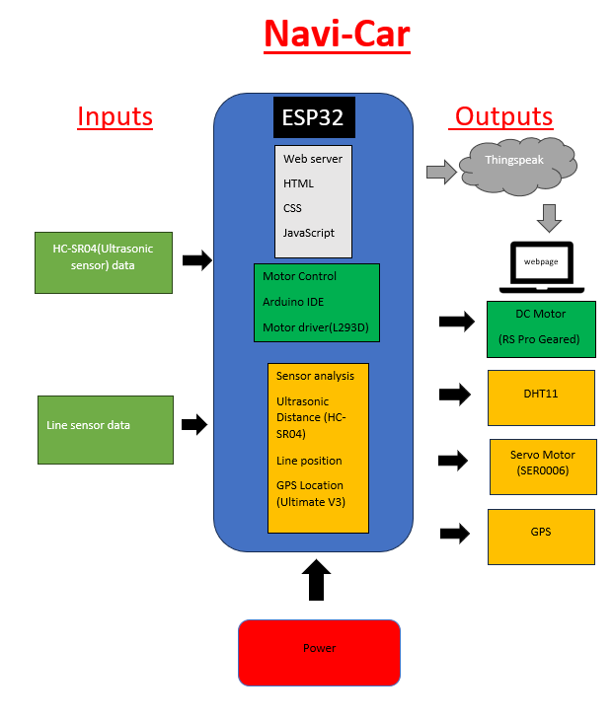
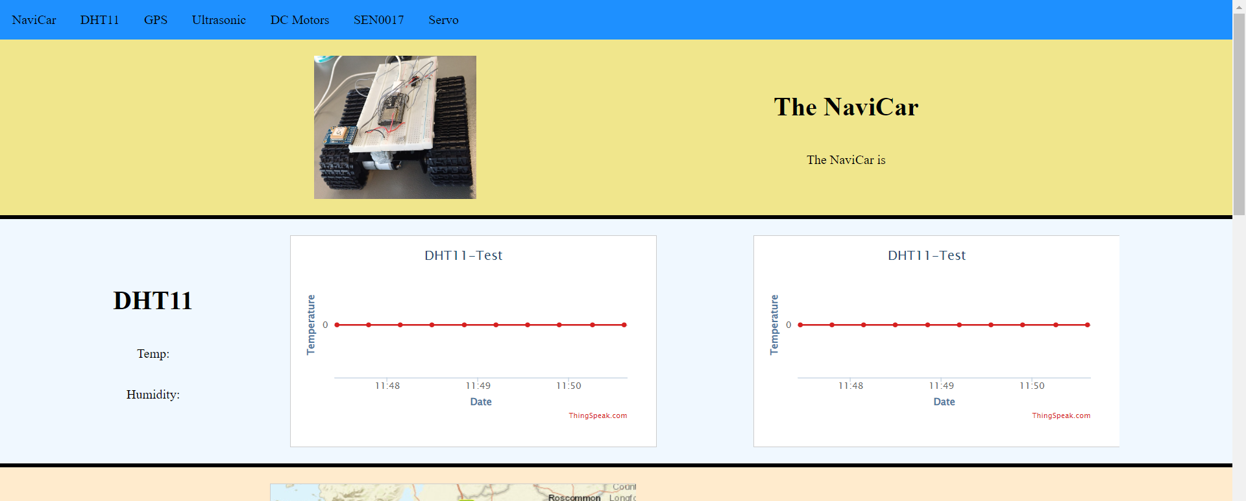
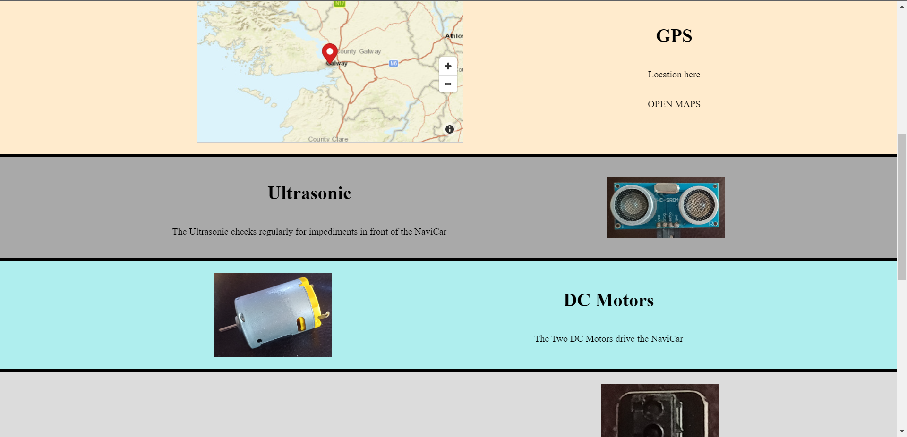
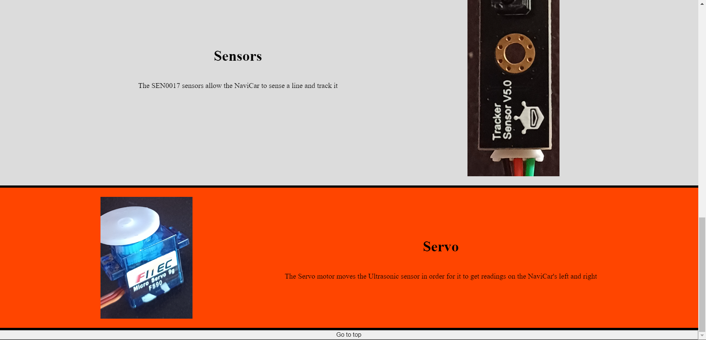
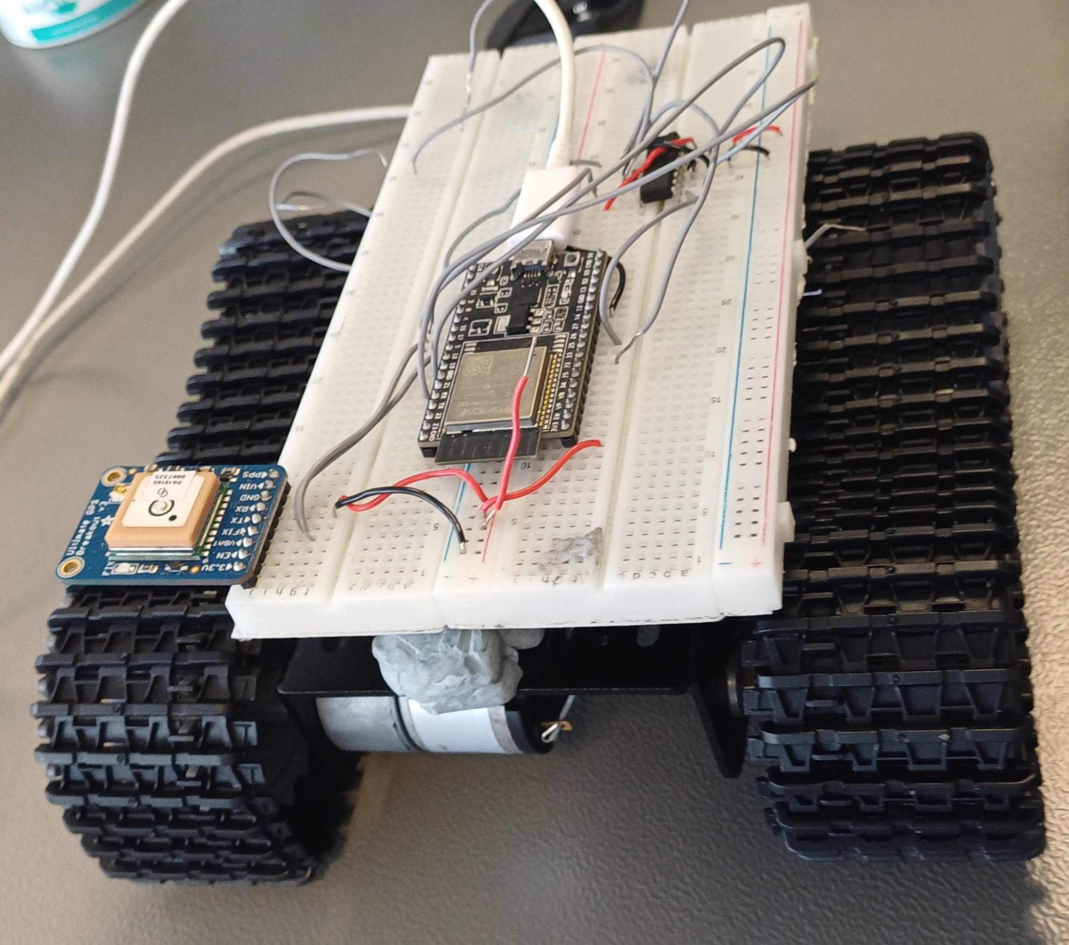
QR Code
here
Navi Car
2nd Year Internet of Things Project
Nathan Ferry
BEng)(Hons) Software and Electronic Engineering
Project Summary
Architecture Diagram
The automotive industry has been attempting to implement the highest safety standard for decades now, the NaviCar show’s that with self driving technology road deaths and accidents can be reduced even further if we take human error out of contention.
The NaviCar is a self autonomous vehicle that utilises 2 SEN0017 line sensors to detect and follow a line.
Two DC motors drive the chassis using an L293D motor driver with an ESP32 microcontroller.
A DHT11 measures temperature and humidity and passes it to a website live. The temperature is also passed to the HC-SR04 ultrasonic sensor to calculate the NaviCar’s distance between itself and obstacles more accurately.
A GPS also passes the live location of the NaviCar to the website. A Servo motor rotates the ultrasonic sensor in order for it to read the value on the NaviCar’s left and right.
Website Data
With Thingspeak the NaviCar can put data onto the cloud and up on a website live.
It can display the temperature and humidity live
A user can click the link to view the NaviCar’s current co-ordinates
The NaviCar
Sustainable Development Goals
Skills and Technologies
Goal 3: The NaviCar targets the U.N. goal target 3.6 which is to half the number of road deaths and accidents by 2020
The NaviCar uses sensing technology to avoid collisions when moving forward while never deviaiting from a set path. The NaviCar uses 2 SEN0017s for path following.
Goal 11: Target 11.2 is to providing access to safe, affordable, accessible and sustainable transport systems as well as improve road safety for all.
The NaviCar’s ability to follow a predetermined path and sense upcoming collisons leads to improved road safety. The NaviCar can avoid possible collisions by braking and senses with the ultrasonic sensor.
Hardware & Software Debugging
Logical problem solving
Visual studio code
3D Modelling/Printing
Arduino programming
Html/CSS
IoT analytics with Thingspeak
C/C++
Hardware Used
DC Motors
GPS Ultimate V3
DHT11 Temperature & Humidity sensor
SEN0017 Line Sensors
L293D Motor Driver
ESP32 Microcontroller
HC-SR04 Ultrasonic sensor
Servo Motor

