Slide 1
Implementation of Simple Cloud-based Distributed File System
Group ID: 4
Baolin Wu, Liushan Yang, Pengyu Ji

Slide 2
Motivation & Goals
Distributed File System provides more reliable service.
Cloud Storage Service is very popular. Google Cloud Storage, Dropbox, Amazon SC3 have many users.
Many users have more than one cloud storage service accounts.
But there is no unified way of managing all the accounts. Currently some products provide the solution that treats different accounts as different folder but a single file can only be stored in one of the platform.
Our project is to combine different cloud platforms together and give users the file system’s perspective about the files stored in cloud. Such distributed platform has following advantages:
1. Easier to manage the files.
2. Distributed File System will give user more robust file system. Single node cloud service failure will not bring the whole system down because files are sliced, replicated and stored in different cloud products.
3. More space is available by combining different products together.
4. Can enhance security of the stored file. Different file segments can be encrypted using different keys. It is harder to know the file contents even under compromised server. (add-on feature if we have enough time)
Goals:
Fault-tolerant file system transparent to user. Better space utilization of different cloud storage service and easy user interface.

Slide 3
Related Work and Reference
Cloud Storage Product: The cloud service includes Google Storage, DropBox, Box, Amazon SC3 etc.
The APIs used to manipulate the files in the Storage Products:
Google Storage: https://developers.google.com/
DropBox: https://www.dropbox.com/developers/
Some products give user File System’s view of single cloud storage service:
FUSE file system for Google Drive: http://gdfuse.forge.ocamlcore.org/
Dropbox file system for Linux: http://www.dropbox.com/install?os=lnx
Some products view different cloud service as separate folder, most of them are commercial:
Otixo: https://www.otixo.com/
Jolicloud: https://www.jolicloud.com/
Mover: http://www.mover.io/
Some important papers:
Ghemawat, Sanjay, Howard Gobioff, and Shun-Tak Leung. "The Google file system." ACM SIGOPS operating systems review. Vol. 37. No. 5. ACM, 2003.
Shvachko, Konstantin, et al. "The Hadoop distributed file system." Mass Storage Systems and Technologies (MSST), 2010 IEEE 26th Symposium on. IEEE, 2010.

Slide 4
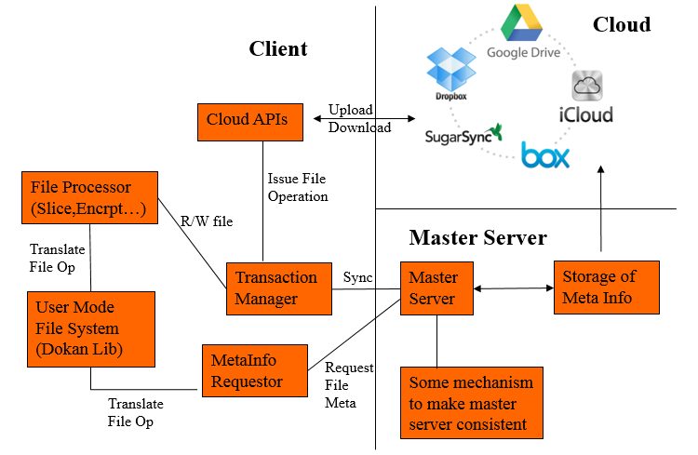
System Architecture
To simplify the communication between client and server, we use HTTP protocol.
Master server only care about transaction and meta information. No upload/download happens to server. Single Master node with mechanism to recover like what Google File System does.
Client sends request to master server for reading/writing. Master approves/declines the request. Receiving the approve token, the client calls the cloud service directly.

Slide 5
Implementation & Evaluation Plan
Week | Milestone
3 | Draft of User Mode File System, Cloud APIs, MetaInfo Requestor
4 | User File Processor, MetaInfo Requestor and MetaInfo Storage.
5 | File replication algorithm, Single User file synchronization
6 | Fault Tolerance Evaluation with single user.
7 | Support Concurrent Modification of file and Transaction Manager.
8 | Fault-tolerance with single Master server.
9-10 | Potential Improvement (Encryption etc.), Project Report.
We first implement the client by calling the server function directly. Then separate server and client and bring the HTTP communication into the system.
Before implementing the File system, we will use many test cases simulating file create/read/write, then mount the file system and manipulate files in the system.
Try to evaluate some failure case where client, server or cloud platform crashes. But there is no way to evaluate every possible failure cases due to the time and complexity.

