Slide 1

ADDIS ABABA INSTITUE OF TECHNOLGY
School of Electrical and Computer Engineering
Communication System
Course: ECEGE - 4301
Survey
WCDMA (Wideband Code Division Multiple Access)
Name Id Stream
1. Bereket Shimels ETR/4165/11 communication
2. Attelel Tizazu ATR/1340/11 Communication
3. Bedasa Hika ETR/5344/11 Communication
4. Beamlak Dejene ATR/2278/11 Communication
5. Biruke Wesenseged ATR/2859/11 Communication Submission date: 20/1/2022 G.C

Slide 2
Content
Introduction
Analog to Digital conversion
Source coding and Decoding
Channel coding and Decoding
Ciphering and De-Ciphering
Modulation and Demodulation Techniques

Slide 3
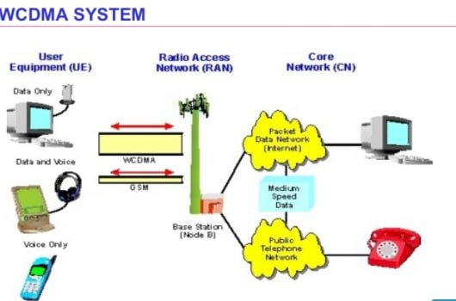
WCDMA
A high speed 3G mobile wireless technology with capacity to offer higher data rate than CDMA.
stands for wide band code division multiple access.

Slide 4
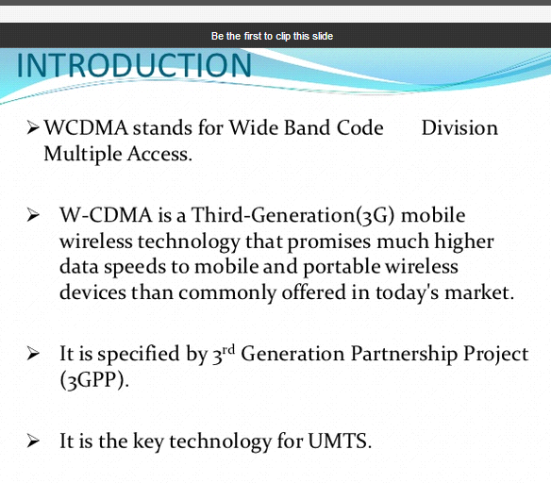

Slide 5
WCDMA features two modes:
Frequency Division Duplex (FDD): Separates users by employing both codes as well as frequencies. One frequency is used for the uplink, while another is used for the downlink.
Time Division Duplex (TDD): Separates users by employing codes, frequencies and time, wherein the same frequency is used for both uplink and downlink.
WCDMA is able to artificially increase a signal's bandwidth. It does so by modulating each baseband symbol with a binary or quaternary signature with a much higher rate than that of the original data symbol.

Slide 6
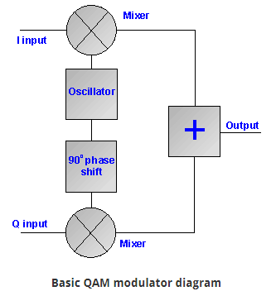
how it work
WCDMA works on WCDMA cellphones as well as laptops and portable devices with WCDMA modems. ... Supporting both voice and data, WCDMA provides a modest speed increase, and many GSM operators jumped to HSPA for data, which is also based on WCDMA, while keeping GSM for voice.

Slide 7
Analog to digital conversion of WCDMA
WCDMA technology used delta sigma modulation method
A method is used to convert analog to digital signal
The first step in sigma delta modulation is delta modulation
In delta modulation the change in the signal is encoded
Accuracy is improved by passing the delta output to 1 bit DAC
Analog signal encodes using high frequency delta sigma modulation
This method apply digital filter to form high resolution
Why we use this technique?
Because of cost efficiency and reduced complexity this technique has found on many technologies including WCDMA

Slide 8
Continue…
The modulator runs off of the modulator clock
Which determines the sampling interval of the input
The modulation loop begin by integrating the difference between the input sample and 1 bit DAC
Comparator determines the next modulator value based on the integrator value
1 bit DAC produces voltage equal to the positive and negative reference voltage of ADC based on the output state of the comparator
As the modulator clock runs each modulator clock pulse will generate an other modulator output pulse

Slide 9
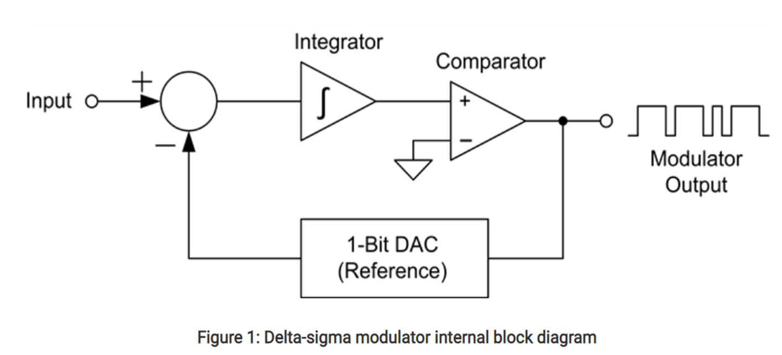
Analog to digital conversion Block diagram

Slide 10
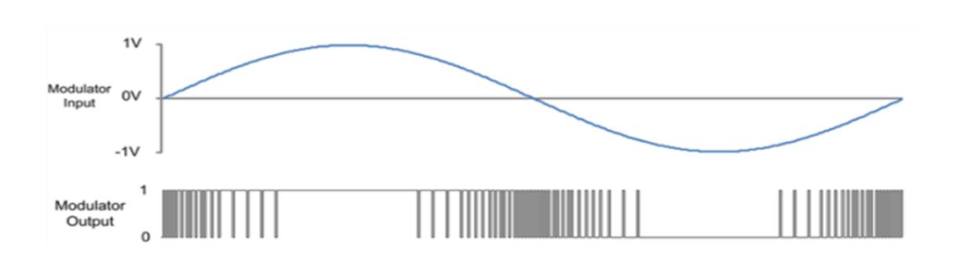
Continue…
The resulting output bit stream becomes a representation of the input voltage proportional to the reference voltage
By using delta sigma the quantization error spectral density is shaped by pushing it to higher frequency
The fig below shows the sign input and digital bit output

Slide 11
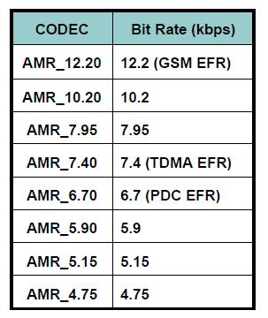
WCDMA Source Coding
AMR (Adaptive Multi-Rate) Speech
A integrated speech codec with 8 source rates
The AMR bit rates can be controlled by the RAN depending on the system load and quality of the speech connections
Video Phone Service
H.324 is used for VP Service in CS domain
Includes: video codec, speech codec, data protocols, multiplexing and etc.

Slide 12
AMR is compatible with current mobile communication system (GSM, IS-95, PDC and so on), thus, it will make multi-mode terminal design easier.
The AMR codec offers the possibility to adapt the coding scheme to the radio channel conditions. The most robust codec mode is selected in bad propagation conditions.
The codec mode providing the highest source rate is selected in good propagation conditions.
During an AMR communication, the receiver measures the radio link quality and must return to the transmitter either the quality measurements or the actual codec mode the transmitter should use during the next frame. That exchange has to be done as fast as possible in order to better follow the evolution of the channel’s quality.

Slide 13
Modulation and Spreading Specifications
Modulation:
QPSK.
Same gain for I and Q components.
Spreading or Channelization Operation:
Transforms every bit into a given number of chips, hence increasing the bandwidth.
Chip Rate = 3.84 Mcps.
By using an orthogonal code for each physical channel, receiver can separate them.
Orthogonal codes are real-valued OVSF codes (Orthogonal Variable Spreading Factor) of different length.
Scrambling:
Separates different Base Stations.
Complex-valued Gold Code Sequences.

Slide 14
Continue…
Power weighting:
Different power is applied to each physical channel before being added together.
Pulse shaping:
Root-raised cosine filter with ß=0.22.
Bandwidth is 5MHz.

Slide 15
Continue…
Physical channels required during a connection:
Dedicated Channel:
DPCH → Dedicated Physical Channel
Common Channels:
P-CPICH → Primary Common Pilot Channel
Could be used at the receiver end for channel estimation, tracking
P-CCPCH → Primary Common Control Physical Channel
SCH → Synchronization Channel
Not multiplied by orthogonal code.
Used mainly for cell search: slot and frame timing acquisition.
PICH → Paging Indicator Channel
OCNS → Orthogonal Channel Noise Simulator
Simulates interference caused by other users or signals.

Slide 16
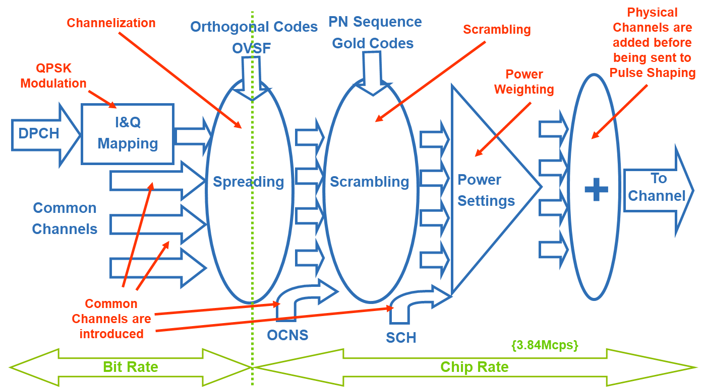
Modulation and Spreading Overview

Slide 17
Channel coding in WCDMA
Effects of channel coding Enhance the correlation among symbols so as to recover the signal when interference occurs Provides better error correction at receiver, but brings increment of the delay Channel Types No Coding Convolutional Coding (1/2, 1/3) Turbo Coding (1/3)

Slide 18
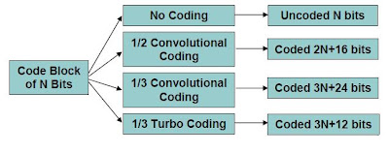
*Convolutional codes are typically used when the timing constraints are tight. The coded data must contain enough redundant information to make it possible to correct some of the detected errors without asking for repeats. *Turbo codes are found to be very efficient because they can perform close to the theoretical limit set by the Shannon’s Law. Their efficiency is best with high data rate services, but poor on low rate services. At higher bit rates, turbo coding is more efficient than convolutional coding

Slide 19
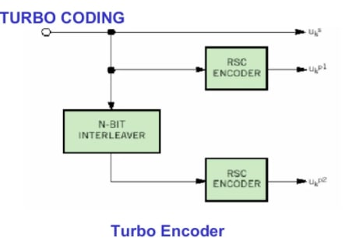
In WCDMA network, both Convolution code and Turbo code are used. Convolution code applies to voice service while Turbo code applies to high rate data service

Slide 20
Turbo codes
Turbo codes are the first practical codes to closely approach the maximum channel capacity or Shannon limit, a theoretical maximum for the code rate at which reliable communication is still possible given a specific noise level. Turbo codes are used in 3G/4G mobile communications (e.g., in UMTS and LTE) and in (deep space) satellite communications .

Slide 21
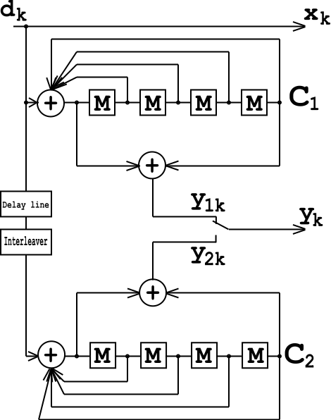
this turbo code encoder consists of two identical RSC coders, C1 and C2, as depicted in the figure, which are connected to each other using a concatenation scheme, called parallel concatenation:

Slide 22
Channel decoding in WCDMA
A channel decoder is used on the receiver side to return the binary information back to its original form by removing the parity bits. The channel-coded bits should be mapped into a certain electromagnetic waveform employing amplitude, frequency, and phase by a modulator.
In WCDMA there are two types of coding/decoding schemes.We are now going to describe TURBO decoding.

Slide 23
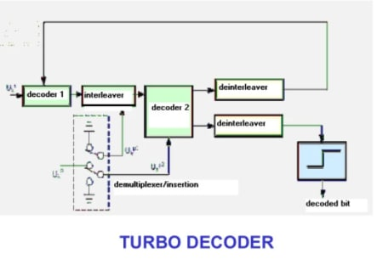
WCDMA Turbo Decoder
TC7100 is a convolutional turbo code (CTC) decoder supporting 3GPP specifications. The Core is self-contained and does not require external memory banks. The decoded throughput is typically 40 Mbits/s. The Core is available for FPGA or ASIC implementation, and is silicon-proven.

Slide 24
Ciphering and De-ciphering for WCDMA
A method for forwarding a ciphering key for a WCDMA network to a decipher application, comprising
capturing a first message carrying the ciphering key from a first network interface;
identifying a network node associated with the first network interface;
identifying a monitor responsible for processing messages captured from interfaces coupled to the network node; and
forwarding the ciphering key to the monitor.

Slide 25
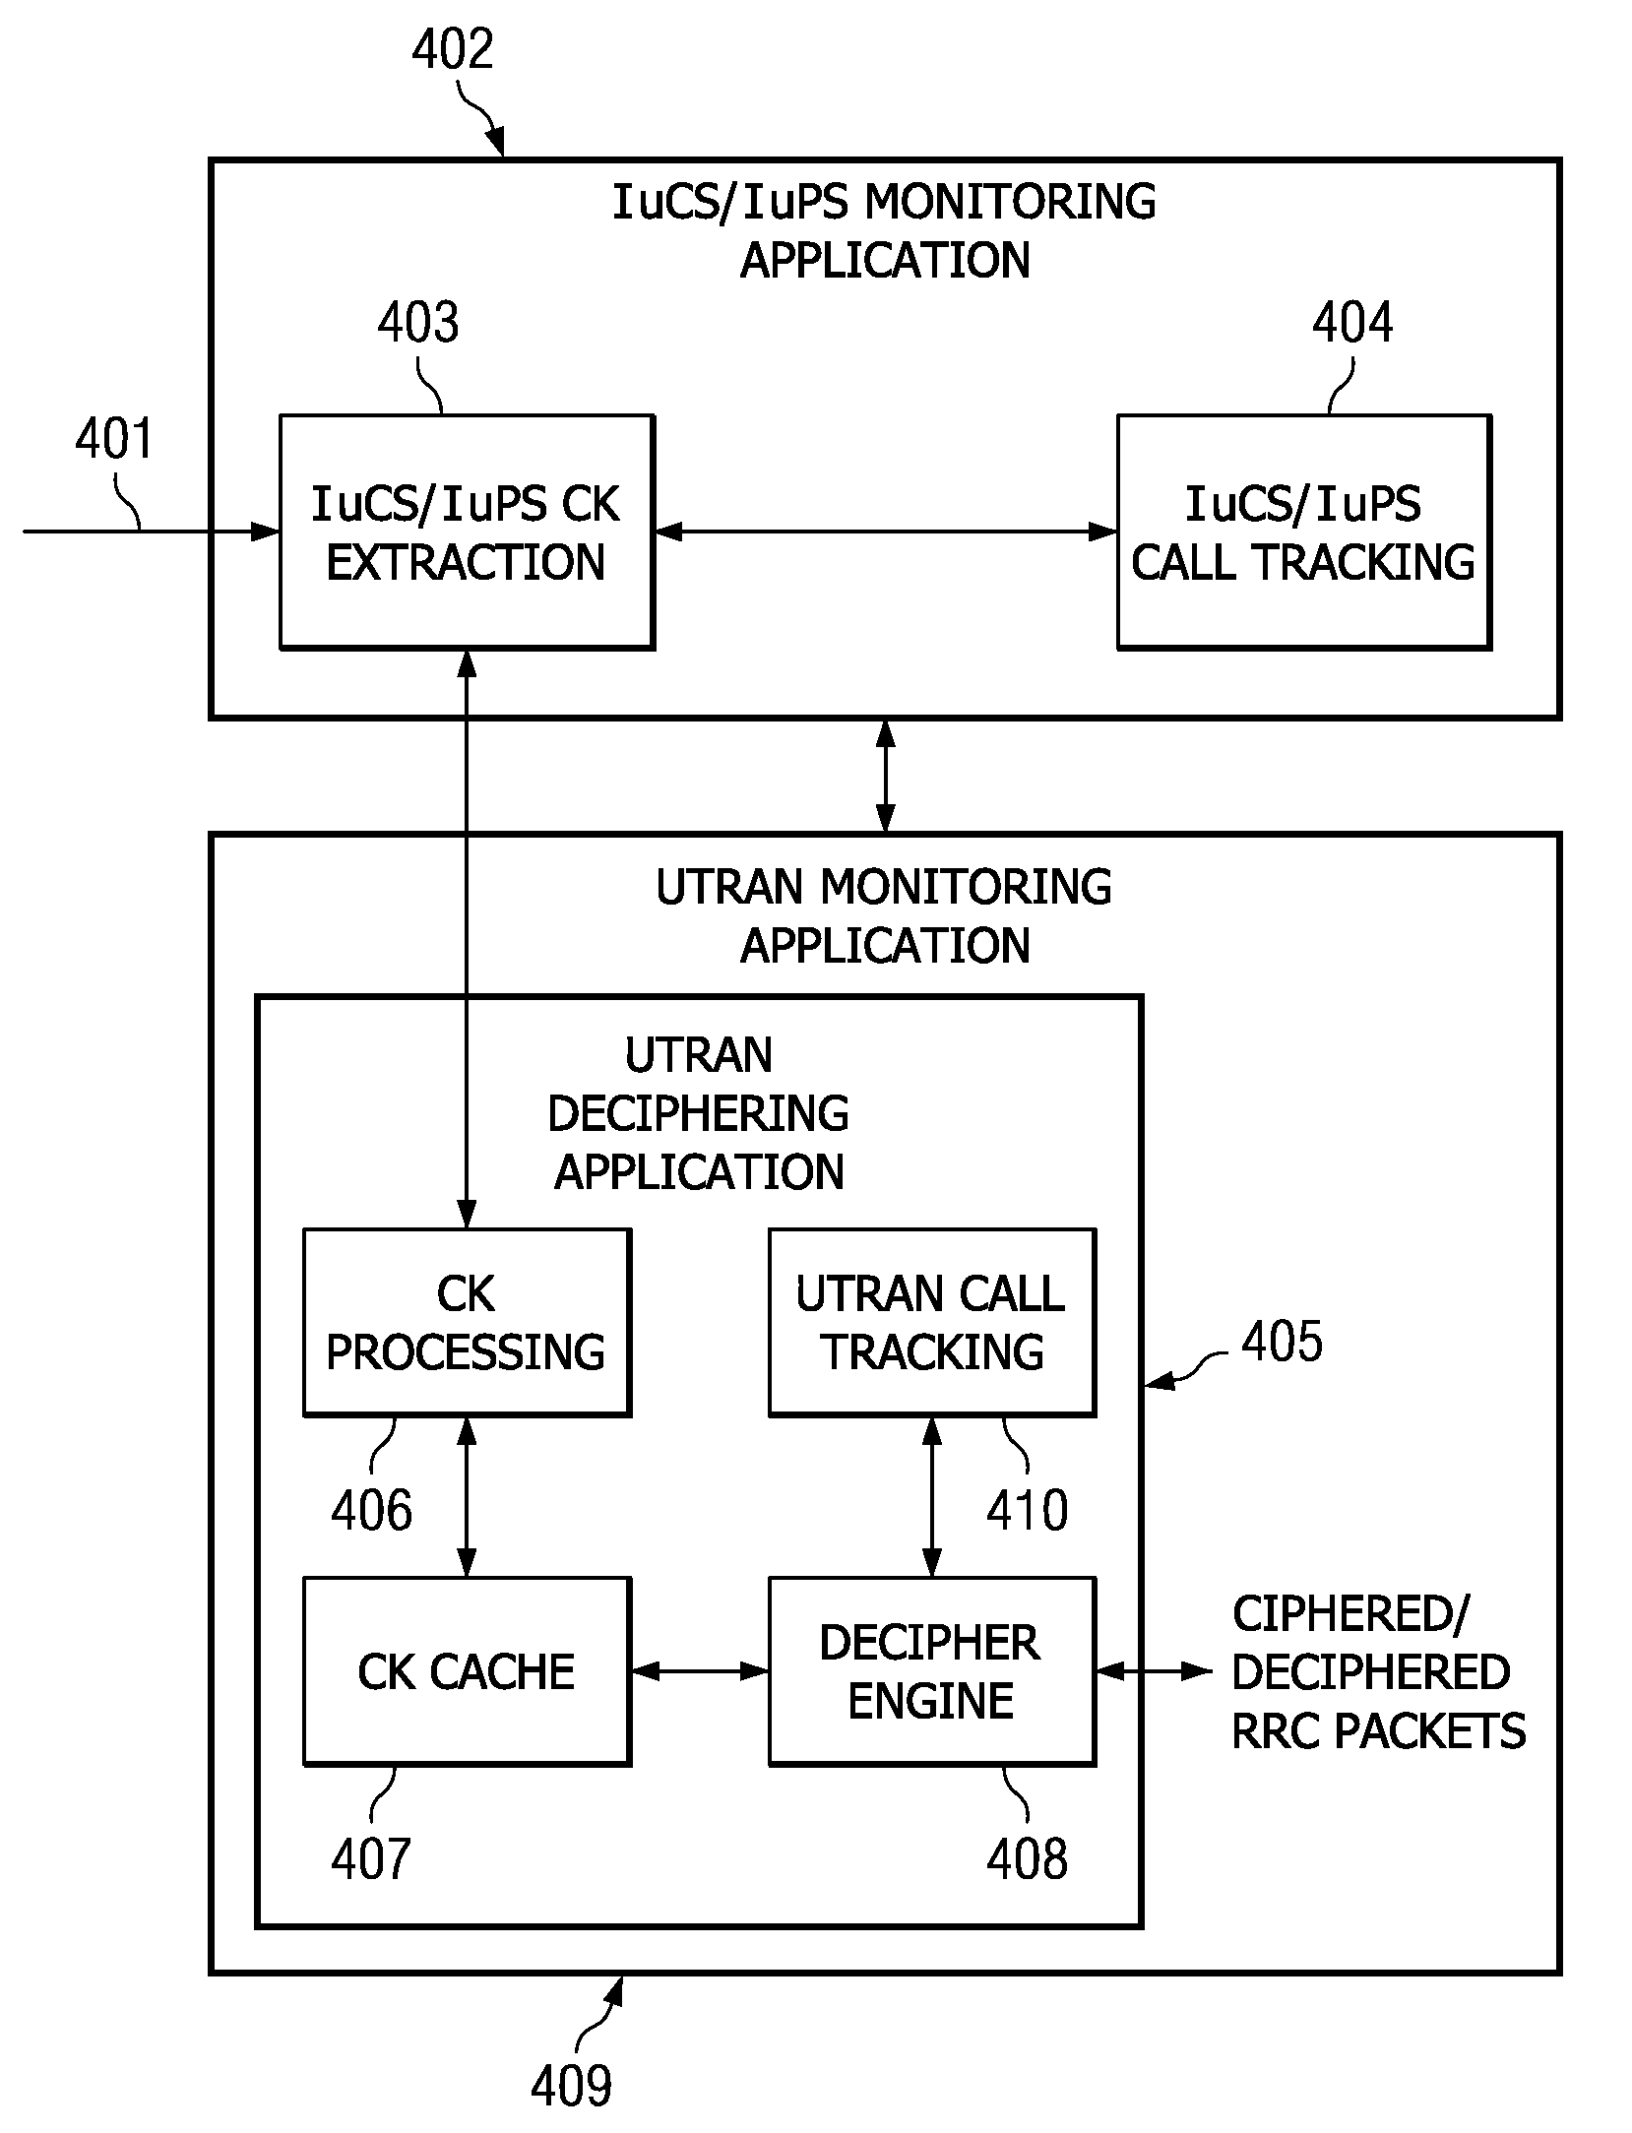

Slide 26
Deciphering for WCDMA
A method for deciphering data packets in a WCDMA network, comprising:
extracting a ciphering key from a message carried on a first network interface;
determining a first user equipment identifier associated with the ciphering key
forwarding the ciphering key to a deciphering application
receiving encrypted data packets at the deciphering application;
determining a second user equipment identifier associated with the encrypted data packets, wherein the second user equipment identifier corresponds to the first user identifier; and
deciphering the encrypted data packets using the ciphering key.

Slide 27
Conclusion
WCDMA standard has enabled vastly increased data rates for cellular phone subscribers by leveraging the advantages of CDMA architecture.
Use of chip codes at increased chip rates helps simultaneous use of available spectrum with higher data throughput.
It is worth noting that successful implementation of WCDMA should regulate the output power levels in the networks.

Slide 28
References
[1] B. Gestner and B. Persson. (2002) RNC3810-Ericsson's rst WCDMA radio network controller. Ericsson.
[2] 3GPP specication detail. online. 3gpp.
[3] Congestion control in WCDMA with respect to dierent service class. online.
[4]http://www.springer.com/jp/book/9789400713864

