Slide 1
Design Jury Presentation
COMP8380 – University of Kent
Presented by Nathan Moignard

Slide 2
Overview
Project Presentation
IoT System & Technology Choices
IoT Device
Backend
Mobile Application
Conclusion
Demo

Slide 3






Project Presentation
IoT Device (Wi-Fi embedded)
Humidity Sensor
API
Router
User retrieves information about the Sensors using the API
Sensor Data Collection + Data Transmission to the API
User

Slide 4
IoT System & Technologies

Slide 5
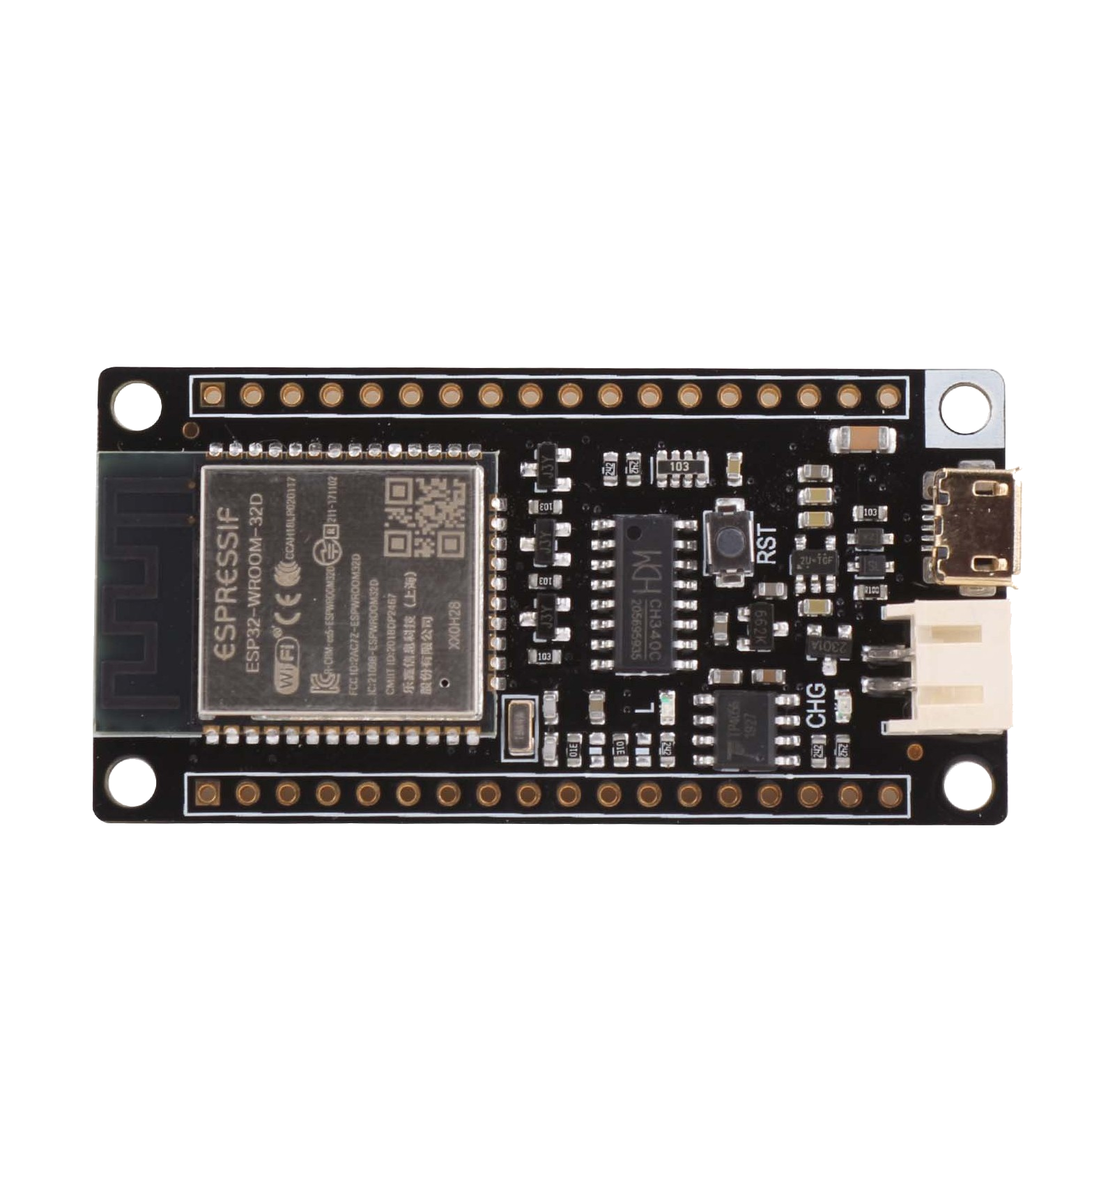
IoT Device
ESP32 FireBeetle
Humidity Sensor DHT11
WiFi embedded

Slide 6


Backend
Ubuntu Server
Strapi CMS
Systemd service

Slide 7


Mobile Application
React-Native
TypeScript

Slide 8
Conclusion
First time with IoT
Arduino environment learned
Very good experience
Thanks to the SHED for help

Slide 9
Any Questions ?

