Slide 1
Charleston Southern University Cyber Practice Range
Nathan Satterfield

Slide 2

Project Purpose
The Charleston Southern cyber competition team lacked an environment to practice
To fix this I planed to setup an environment where they can practice what they have in a hands-on environment
To help students with knowledge of system hardening techniques and practice for cybersecurity competitions

Slide 3
Research Done
Existing infrastructure and practice environment
ESXI servers
Scoring method for Linux machines

Slide 4
Project Hardware and Software
Nehemiah server
USB drive
Windows operating system
Ubuntu operating system
CyberPatriot Scoring Engine
PySEL scoring system
power shell, bat files, bash, and sed

Slide 5
Project Requirements
Enumerate network
Configure network
Setup the ESXI server
Create virtual machines
Host the virtual machines on the server
Accessibility
User capacity
Expandability

Slide 6
Project Description
ESXI server
Virtual machines
Windows scoring engine
Linux scoring engine
Automation tools
Walkthroughs

Slide 7
Test Plan
test connectivity to the ESXI server from AH 203 Ethernet ports.
test user account for ESXI to make sure they can be logged into.
test ESXI user permissions to see if they can interact with the virtual machines properly.
test Windows scoring engine to ensure it works.
test Ubuntu scoring engine to ensure it works.
test one vulnerability from each category for each virtual machine.
test virtual machine backups to ensure that they can be reverted to a completely unsolved state without data lose.

Slide 8
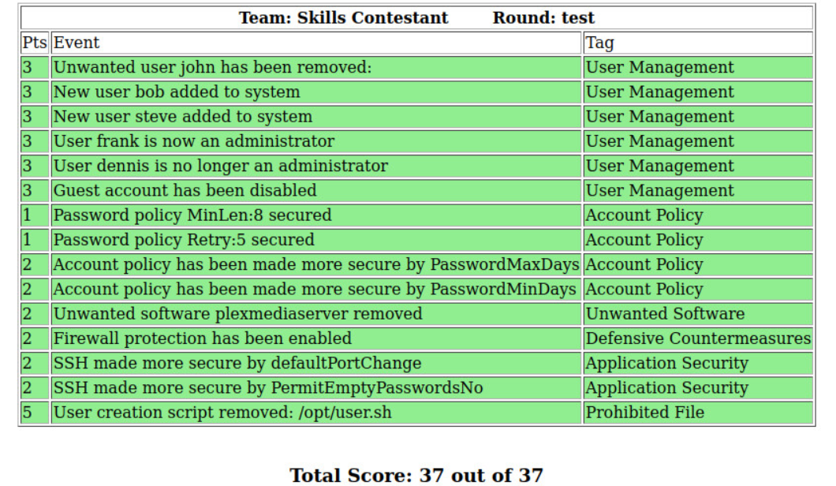
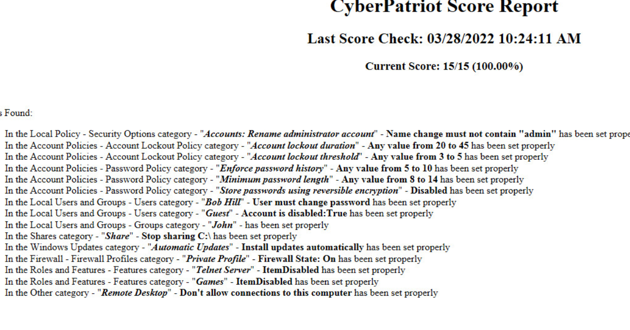
Test Results
Connectivity was allowed as expected
All user accounts functioned properly
Scoring engines functioned properly
Vulnerabilities are scored properly
Backups worked as expected

Slide 9
Challenges Overcome
Obtaining ESXI license
Hardware compatibility with the Nehemiah server and ESXI
Finding Linux scoring system
Installing the Linux scoring system
Issue with one event check for Linux scoring system

Slide 10
Future Enhancements
More virtual machines
Creating more event checks for the Linux scoring system
Setup the virtual machines to simulate an active attack environment

Slide 11




Documentation links
https://docs.vmware.com/en/VMware-vSphere/index.html
https://www.uscyberpatriot.org/competition/training-materials/practice-images/
https://github.com/FWSquatch/pysel
https://github.com/Nathan-Satt/Senior_Project

