Slide 1
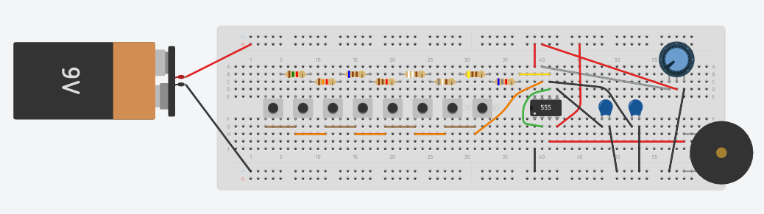
SIMPLE PIANO USING A 555 IC TIMER
NATHAN COPROS
BHAGAT S MATHIVANAN
YANPENG YUE

Slide 2
Introduction
The objective of this project is to replicate the sounds produced by a piano or an electronic keyboard using basic circuit components.
The key part of this circuit is the ic 555 timer. The 555 timer is a very unique 8 pin DIL (dual in line) IC (integrated circuit).
Audible frequency range of humans is from 20hz to 20khz, so we generate frequencies in this range using 555 timer and feed it to the loudspeaker.

Slide 3
Material
9V battery
List of 8 resistors: 6.825kΩ, 406Ω, 886Ω, 994Ω, 1.115kΩ, 608Ω, 1.328kΩ, 1.487kΩ
10kΩ potentiometer
Piezo Buzzer
8 push buttons
capacitor 100nF,10nF
555 IC timer
jumper wires

Slide 4
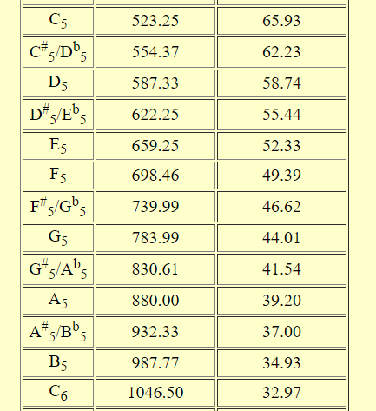
Note Frequencies
note
Frequency(Hz)
Wavelength(cm)
C is Do, D is Re...
small number represents location on piano->0 is lowest pitch
Project:
scale from C₅ to C₆
1 scale -> 8 notes
1 note per button
No flat/sharp

Slide 5
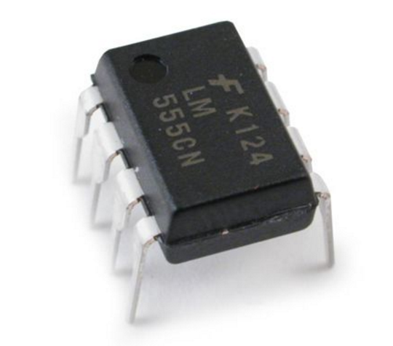
555 IC timer modes
Monostable: pulse with adjustable duration
Astable: oscillating pulse with tunable frequency-> switches between low and high states
Bistable: toggle output high/low voltage according to input
555 IC Timer

Slide 6
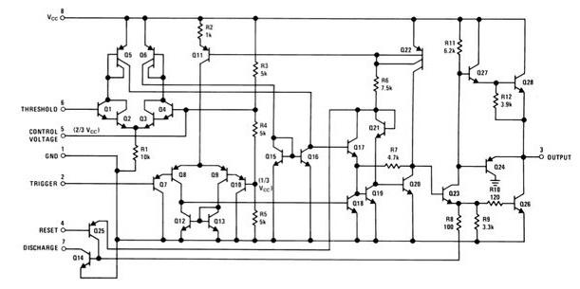
How does astable mode work?
Inside of 555 IC timer

Slide 7
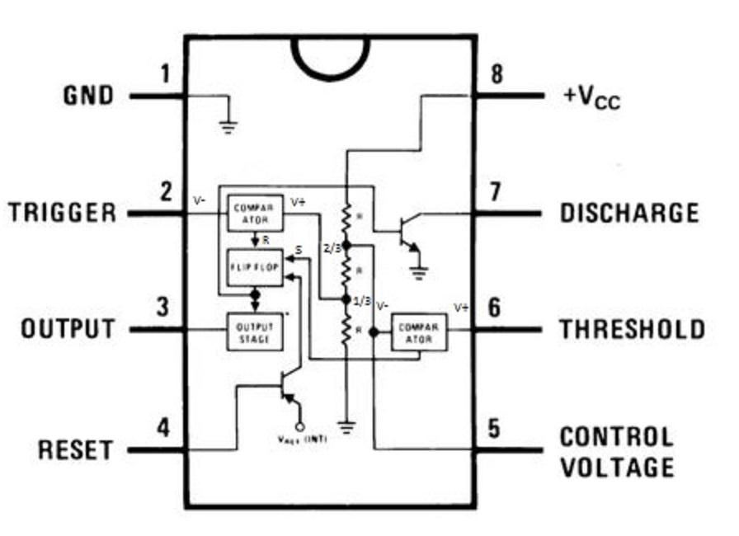
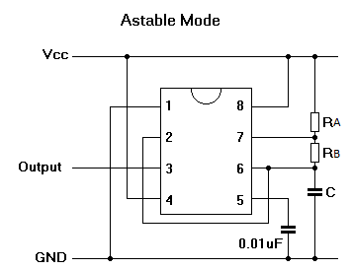
How does astable mode work?
Astable 555 timer
Simplified 555 inside

Slide 8
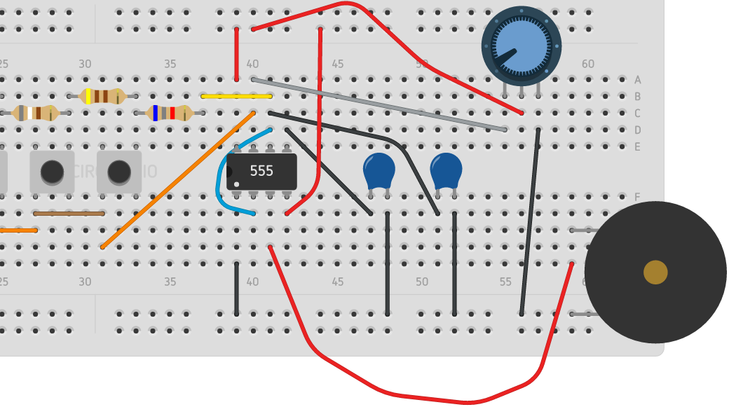

Our design

Slide 9
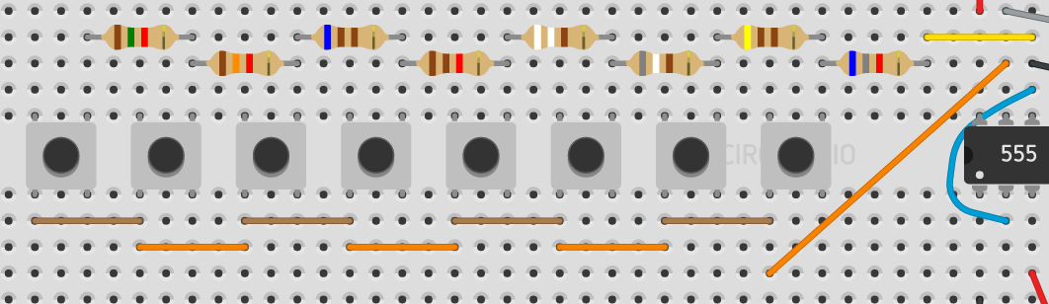
What is RB?
8 Resistors in series,
biggest resistance when left button pressed

Slide 10


Determination of resistances
With values
R_{A}＝ 0 Ω
C ＝100nF

Slide 11
Determination of resistances
NOTE | RESISTANCEΩ | R_{B} Ω | FREQUENCY Hz
C6 | 6825 | 6825 | 1046.5
B5 | 406 | 7231 | 987.8
A5 | 886 | 8117 | 880.0
G5 | 994 | 9111 | 784.0
F5 | 1115 | 10226 | 698.5
E5 | 608 | 10834 | 659.3
D5 | 1328 | 12162 | 587.3
C5 | 1487 | 13649 | 523.3

Slide 12
SIMULATION
For the Simulation, we used the circuit design website 123D Circuits.

Slide 13
Conclusion
Only one button can be pressed at a time in this piano
Small range
Annoying timbre
Further development
Increased number of musical notes
Parallelism to enable several combination of buttons pressed
Maximize sound quality and change timbre

Slide 14
QUESTIONS?

