Slide 1
Adaptive Active Snore Noise Control Using Microphone and Loudspeaker Arrays
Nathan Walker
M.S. in Electrical Engineering · Utah State University
Major Professor: Todd Moon, Ph.D.
Committee: Jacob Gunther, Ph.D. · Jonathan Phillips, Ph.D.
Department of Electrical and Computer Engineering · 2026

Slide 2
THE PROBLEM
Snoring Disrupts Sleep for Both Partners
A common source of sleep disturbance that negatively affects partner sleep quality and relationship well-being
Existing mitigation includes CPAP devices, nasal strips, earplugs, and surgery requires the user (or partner) to wear physical hardware or undergo a procedure
These approaches provide only limited attenuation of the low-frequency acoustic energy characteristic of snoring
Snoring mitigation increases the amount of time the partner is asleep through the night
CPAP
Requires a worn mask + machine every night
Nasal Strips
Physical device, limited effect on airway noise
Earplugs
Burden falls on the partner, not the source
2
Notes:
We all know at least one or two people that deal with snoring at night. Some studies have shown that 25% of men snore while 15% of women snore. That’s about 43,850,000 men and 26,040,000 women in america that snore.
Snoring often has a variety of sounds with all the bells and whistles in all the wrong ways. Thus earplugs can sometimes struggle to actually block out the snore.
However, studies have shown that with CPAP machines partners were able to get 62 more minutes of sleep per night.
Now if some existing solutions exist why am I working on another. Well mainly because people can struggle to sleep with the physical hardware or can’t get surgery to fix their snoring.

Slide 3
PROPOSED APPROACH
A Non-Wearable, Array-Based Alternative
Near-field microphone and loudspeaker array processing
beamforming combined with active noise control (ANC)
Generates a spatially localized anti-noise field directed at the sleeping partner's ear
Minimizes disturbance to the surrounding environment
Near-field array modeling improves low-frequency cancellation vs. passive methods
Quiet
Zone
Snorer
Partner
Cancelling noise
Arrays
array-generated anti-noise localized at the partner's ear
3
Notes:
Explain the slide first and explain what an array is,
What does all this mean? Well essentially its similar to noise cancelling earbuds. Where earbuds have a microphone listening to the ambient noise so then the earbud can play the opposite of the ambient noise along with the music to cancel the noise. I will go into more of the nuances of how earbuds and my system do that but when you have an array you are able to listen in a specific spot rather than what the individual microphones pick up. Speakers also work similarly in an array where they can focus the noise and project the noise on a specific spot. This is useful for this situation so that the microphone can focus on what the partner is hearing to know what to cancel and for the speakers to focus on cancelling just on the partners ear to minimize how loud the surrounding environment is.

Slide 4
OVERVIEW
Research Objectives
01
Configurable hardware platform
16-element microphone and loudspeaker arrays with adjustable geometry
02
Real-time array processing
Fractional delay beamforming via sinc interpolation
03
Supporting electronics
Custom interfaces and a programmable analog filter bank
04
Adaptive algorithms
LMS and FARLS for real-time acoustic cancellation
4
Notes:
Previous efforts on this research led to the building of a platform that microphones were used on. However, it was hard to adjust the parameters of the microphone array. Thus it was important to add some functionality to change the array as well as incorporate a speaker array.
Along with some of the hardware previous work has been done to implement near-field array processing. However the previous work did not do it in real-time. meaning they would record sounds from the microphone array and then do the algorithm without any time constraints.
In addition to adding speakers to the platform to test additional electronics were needed to be built for the speaker array
This is one that I would need to start testing as previous research efforts had not yet worked on this at this university.

Slide 5
METHODS – REAL-TIME ARRAY PROCESSING
Time-Aligning the Array
Delays each speaker's signal so sound reaches the target location at the right time
Each speaker gets a different delay based on its position
Automatically calculates the delays for any desired focal point
Real-time implementation allows the array to be steered to new locations
Focal Point
Speaker Array
Visualization of array processing
Methods
7

Slide 6
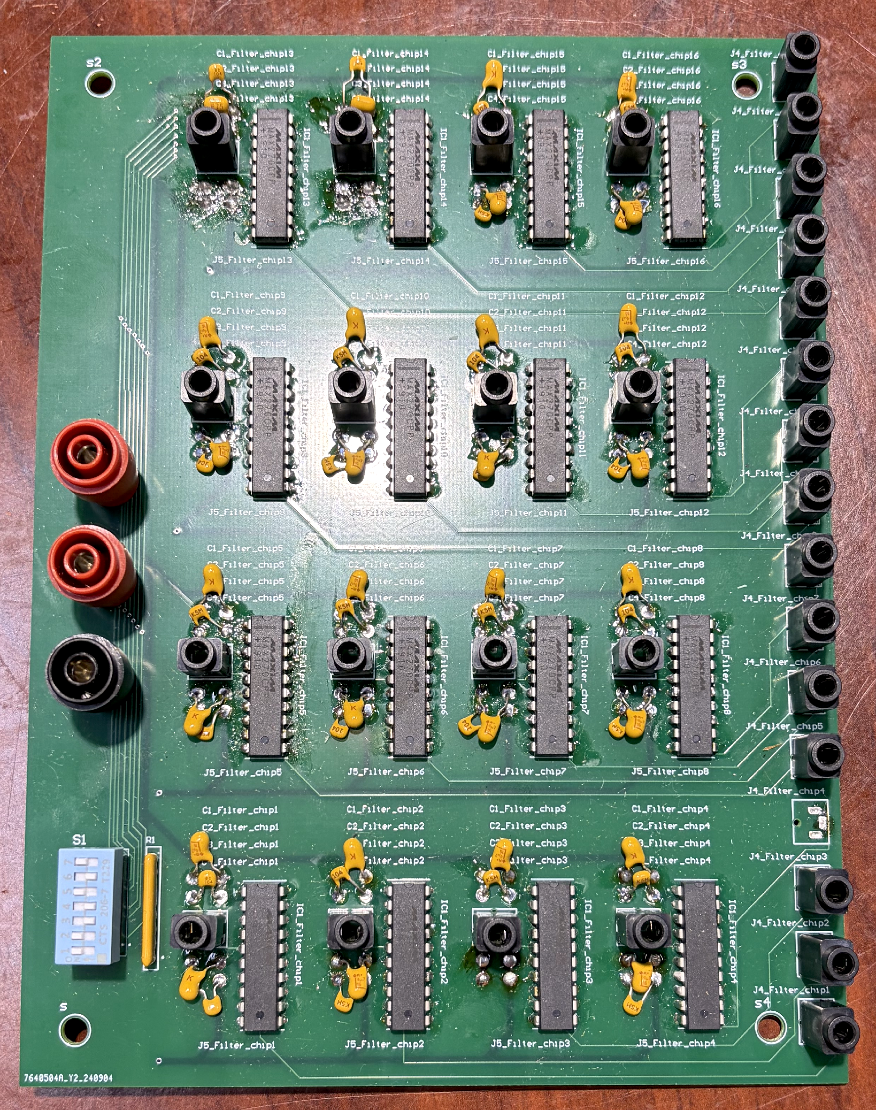
METHODS - SUPPORTING ELECTRONICS
Digital to Analog Filter Bank
Digital-to-analog conversion doesn't produce a perfectly smooth signal. it creates a "stair-stepped" waveform that carries unwanted high-frequency noise
A low-pass filter acts like a sieve for frequencies; it lets the desired lower frequencies through and blocks the higher ones
The "cutoff frequency" is the dividing line between what passes and what's blocked
Verified this by feeding in signals across a range of frequencies and confirming the filter reliably passed the low ones and blocked the high ones right at the expected cutoff
Custom PCB: MAX270CPP+ programmable filter array
Methods
9

Slide 7
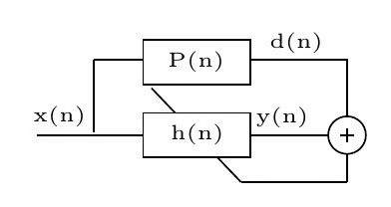
BACKGROUND – ADAPTIVE ALGORITHM
How Active Noise Control(ANC) Works
A reference microphone detects the incoming noise before it reaches the listener
Reflections and other effects change the sound as it travels, so the exact path can't be known in advance
An adaptive filter learns that path and continuously updates as conditions change
It generates an inverted "anti-noise" wave, a mirror image of the original, that cancels the noise when the two combine
This is the same principle behind noise-canceling headphones, just applied at a distance instead of inside the headphones
adaptive filtering block diagram
5

Slide 8
METHODS — ADAPTIVE ALGORITHM
From LMS to FARLS
LMS: Low computational cost, but slower to adapt when the acoustic path changes
RLS: Adapts quickly to those changes, but requires more processing power
FARLS: Reduces the processing required by RLS
Goal: Fast adaptation without exceeding real-time processing limits
LMS
RLS
FARLS
Simple, efficient
Fast convergence
Fast + efficient
Slow on correlated signals
Heavy computation
Used throughout this work
Methods
8

Slide 9
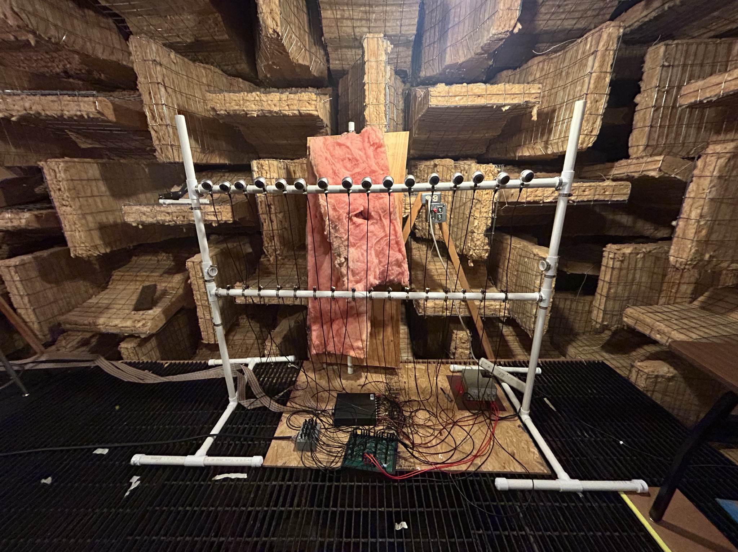
RESULTS – CONFIGURABLE HARDWARE PLATFORM
Experimental Platform
16-element microphone array + 16-element loudspeaker array
PVC support frame: height, orientation, and spacing independently adjustable
Removable acoustic baffle reduces direct coupling between arrays
All testing performed in an anechoic chamber to eliminate reflections
Adjustable microphone/loudspeaker array in the anechoic chamber
6

Slide 10
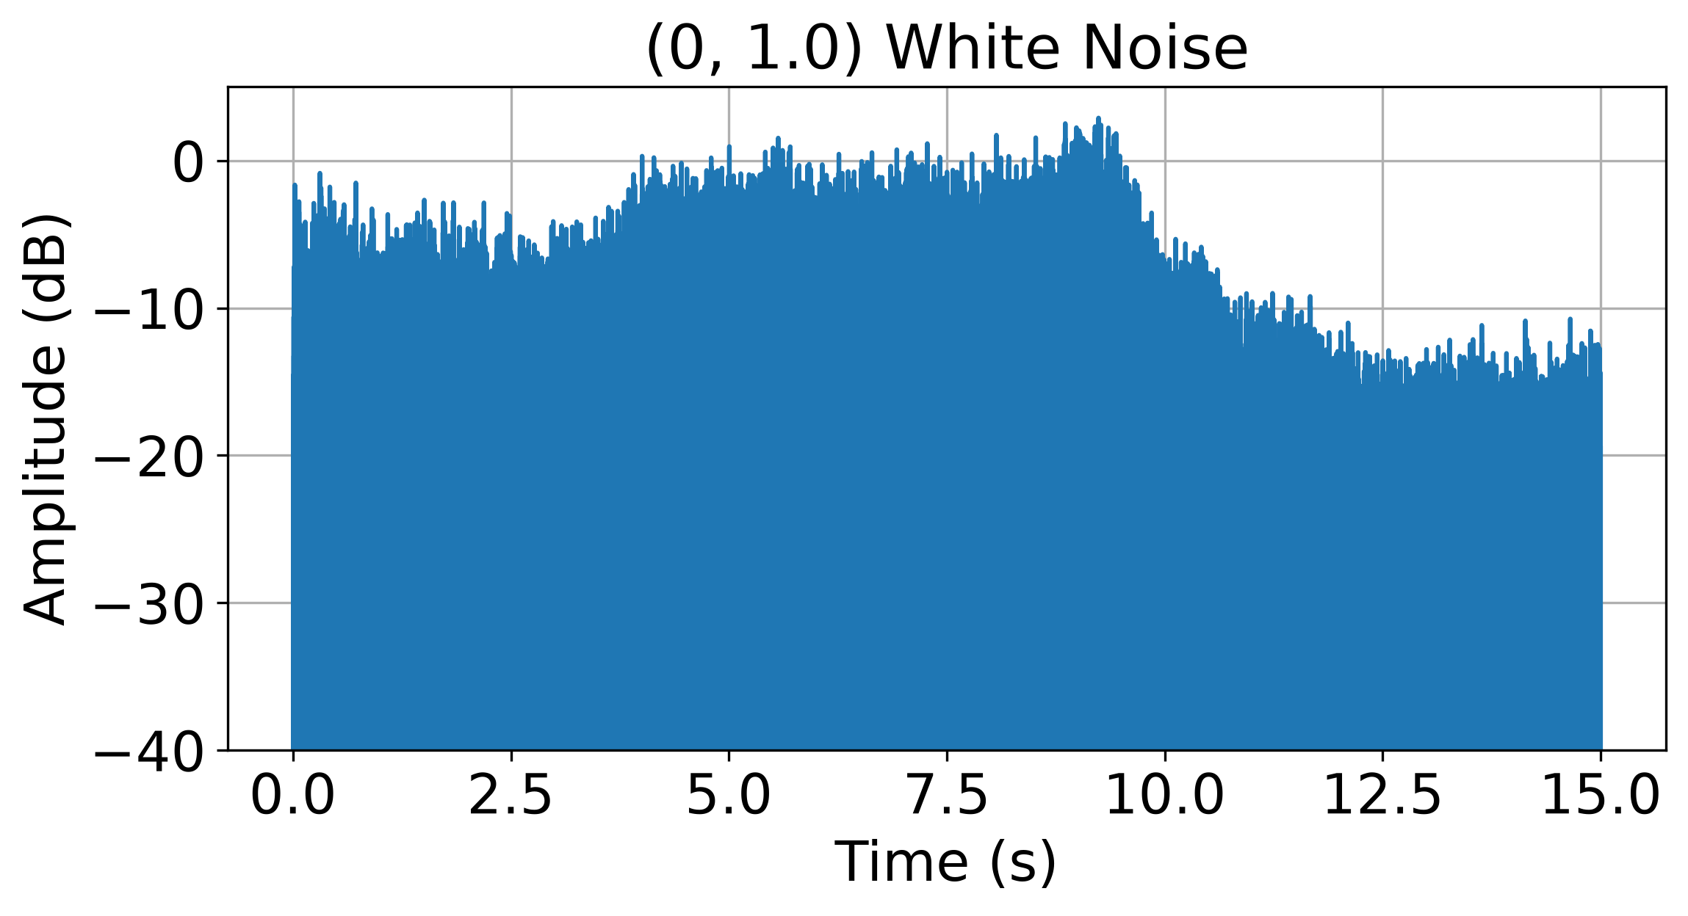
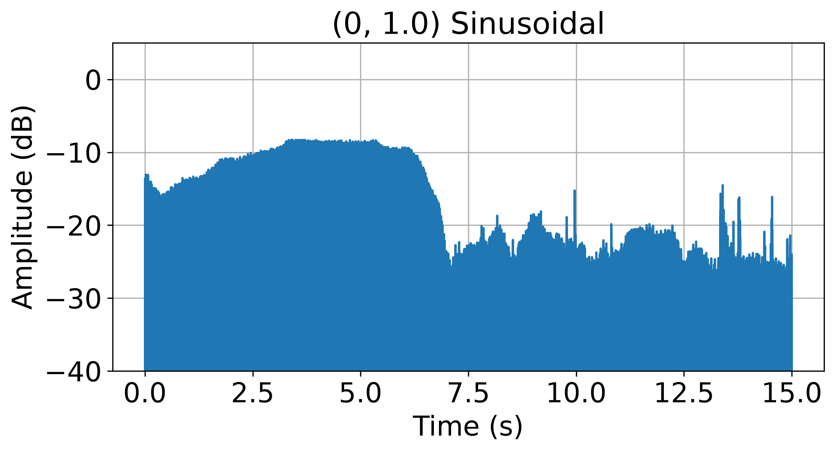
RESULTS – REAL-TIME ARRAY PROCESSING
Array Processing Localizes the Source
Processed RMS amplitude increases as the acoustic source approaches the selected focal region
Amplitude decreases as the source moves away
Behavior matches the expected response of the array-processing algorithm
Confirms the near-field steering / delay-and-sum implementation works as designed
Focal Point
Microphone Array
Processed RMS signal level as a sinusoidal and white noise source moves through a tested focal point
Results
10

Slide 11

RESULTS – REAL-TIME ARRAY PROCESSING
Array Processing Localizes the Source
Processed RMS amplitude increases as the acoustic source approaches the selected focal region
Amplitude decreases as the source moves away
Behavior matches the expected response of the array-processing algorithm
Confirms the near-field steering / delay-and-sum implementation works as designed
Focal Point
Microphone Array
Processed RMS signal level as a sinusoidal and white noise source moves through a tested focal point
Results
10

Slide 12
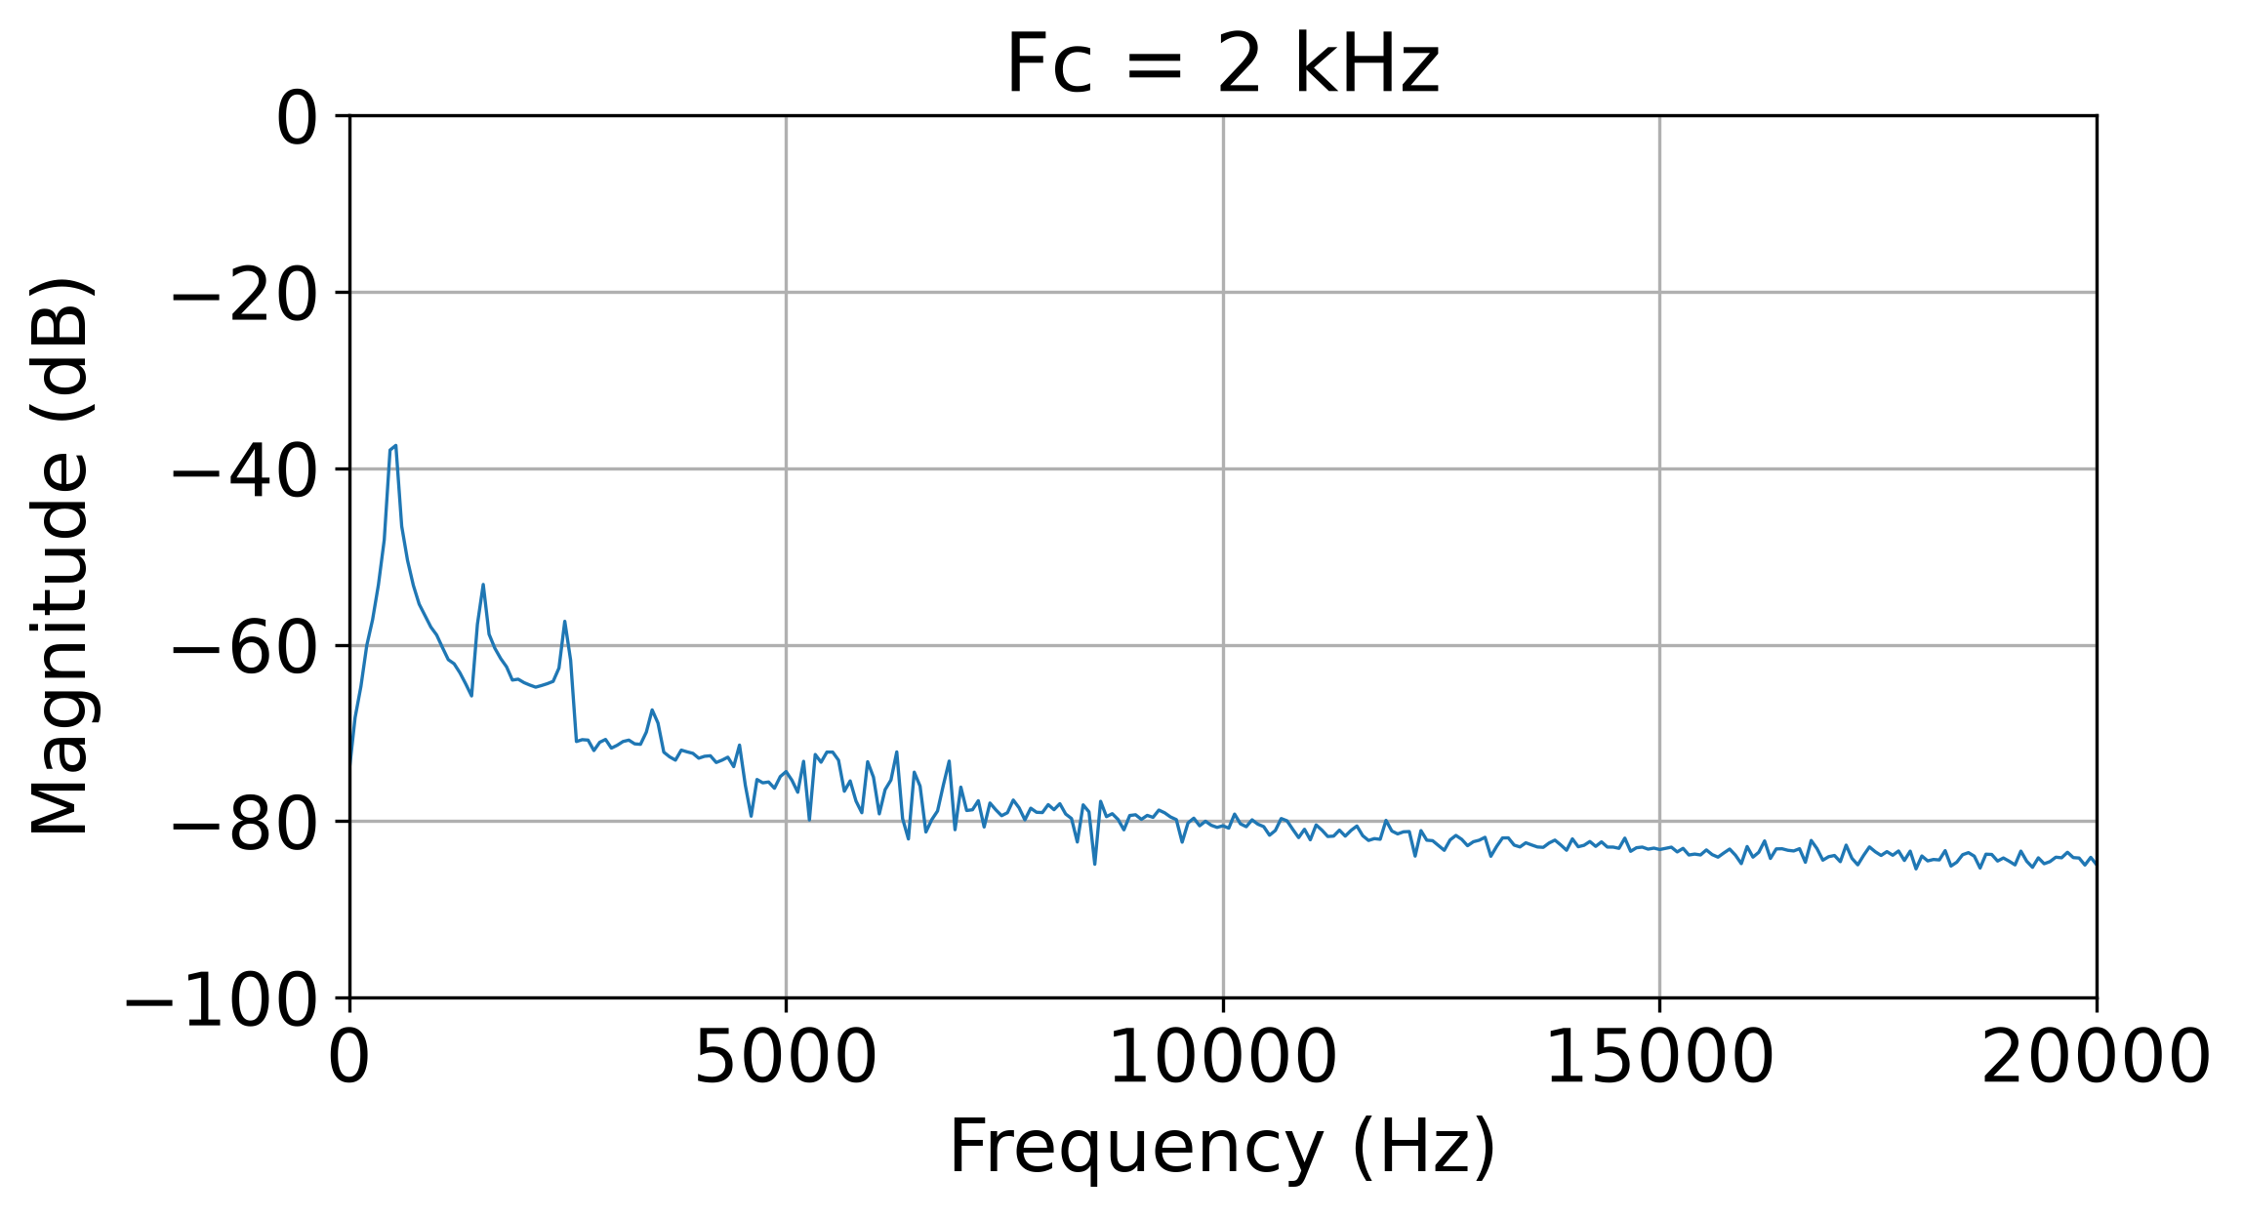
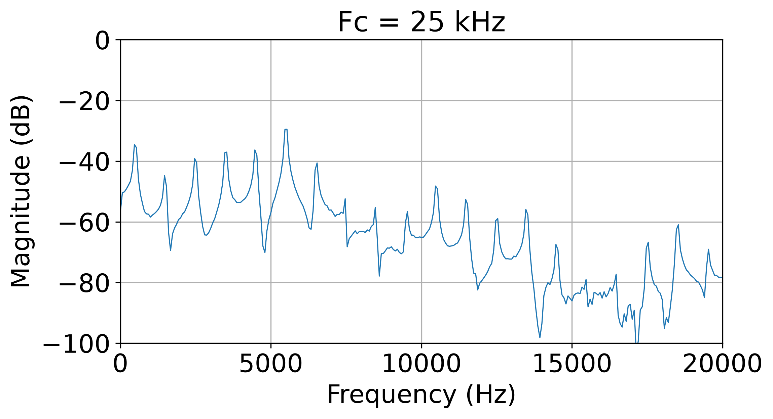
RESULTS – SUPPORTING ELECTRONICS
Programmable Filter
Testing the filter across several cutoff frequencies (25 kHz down to 2 kHz) showed the roll-off point shifting exactly as expected
Before filtering, the DAC output carried extra high-frequency noise
After filtering, that noise was greatly reduced while the desired signal stayed intact
Confirms the filter bank works as designed
Frequency Components of DAC output
Results
10

Slide 13
RESULTS – SUPPORTING ELECTRONICS
Programmable Filter
Testing the filter across several cutoff frequencies (25 kHz down to 2 kHz) showed the roll-off point shifting exactly as expected
Before filtering, the DAC output carried extra high-frequency noise
After filtering, that noise was greatly reduced while the desired signal stayed intact
Confirms the filter bank works as designed
Frequency Components of DAC output
Results
10

Slide 14
RESULTS – SUPPORTING ELECTRONICS
Programmable Filter
Testing the filter across several cutoff frequencies (25 kHz down to 2 kHz) showed the roll-off point shifting exactly as expected
Before filtering, the DAC output carried extra high-frequency noise
After filtering, that noise was greatly reduced while the desired signal stayed intact
Confirms the filter bank works as designed
Frequency Components of DAC output
Results
10

Slide 15
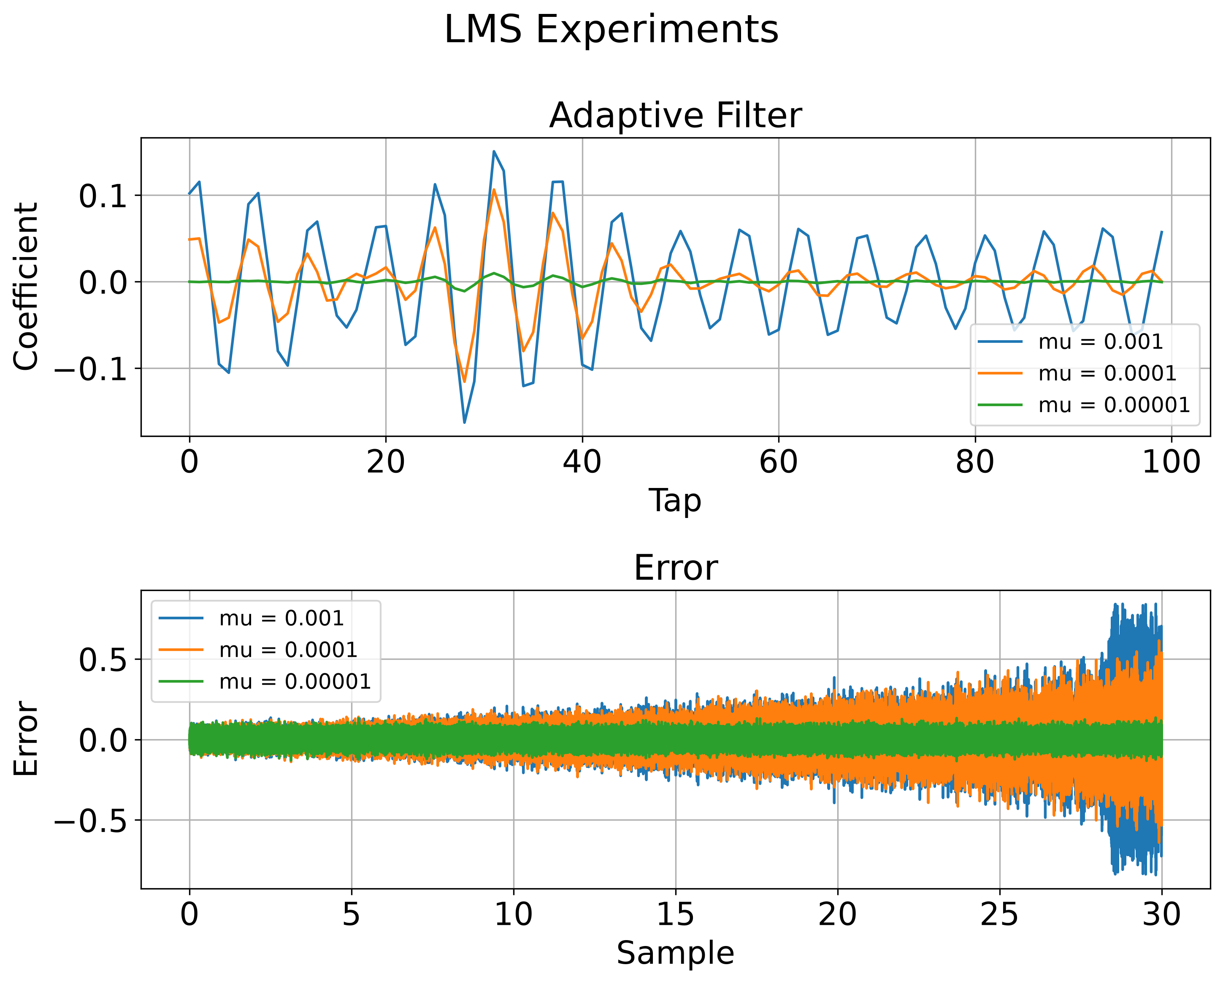
RESULTS – ADAPTIVE ALGORITHM
Adaptive ANC Did Not Converge
Both LMS and FARLS adapted their coefficients in response to the error signal
Neither achieved stable convergence to the expected acoustic response
Same result for narrowband (sinusoidal) and broadband inputs
Not specific to one algorithm or one signal type, this pointed to a systemic cause
LMS experiment: filter coefficients and error signal over time
Results
11

Slide 16
RESULTS – ADAPTIVE ALGORITHM
Finding the Root Cause
Cross-correlation analysis measured the timing offset in the computer-based signal path
Identified additional latency beyond expected acoustic propagation delay
This latency misaligns the cancellation signal with the acoustic signal at the error microphone
Explains the non-convergence seen with both LMS and FARLS
Real Path: 1.37 m
Delayed Path: 3.3 m
Speaker
Distance implied by the measured delay vs. the microphones' actual position
~45 samples of unexplained delay
5.625 ms at 8 kHz — beyond the expected acoustic propagation delay
Results
12

Slide 17
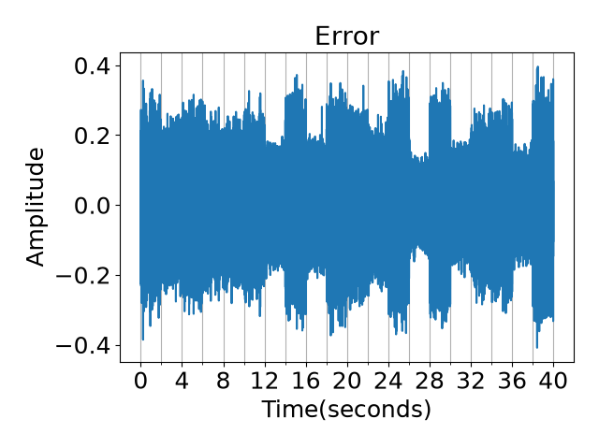
RESULTS
Proof of Concept
Manually delaying and inverting the cancellation signal to compensate for the measured latency
Spatial acoustic cancellation was achieved once timing was corrected
Suggests system timing, not the adaptive algorithm was the limiting factor
Supports the overall ANC approach, pending a lower-latency hardware path to test it under normal (non-manual) conditions
Error signal with a manually corrected delay — periodic dips show active cancellation
Results
13

Slide 18
RESULTS
Proof of Concept
Manually delaying and inverting the cancellation signal to compensate for the measured latency
Spatial acoustic cancellation was achieved once timing was corrected
Suggests system timing, not the adaptive algorithm was the limiting factor
Supports the overall ANC approach, pending a lower-latency hardware path to test it under normal (non-manual) conditions
Error signal with a manually corrected delay — periodic dips show active cancellation
Results
13

Slide 19
SUMMARY
Contributions
1
Configurable hardware platform
2
Real-time array processing
16-element microphone + loudspeaker arrays with independently adjustable geometry
Integer + fractional (sinc) delay compensation for accurate time alignment
3
Supporting electronics
4
Adaptive algorithms
Interface enclosures and a programmable analog low-pass filter bank
LMS baseline and a FARLS implementation adapted for real-time operation
Conclusions
14

Slide 20
WHAT'S NEXT
Future Work
Reduce hardware latency
1
Investigate DSPs, FPGAs, or a custom DAC PCB to cut the ~5.6 ms system delay
Compare adaptive algorithms
2
Evaluate NLMS, FxLMS, conventional RLS, and further FARLS refinements once latency is reduced
Full-array, realistic-environment testing
3
Move from isolated subsystem tests to the complete array in a simulated bedroom
Conclusions
15

Slide 21
Thank You
Questions?
Nathan Walker · Department of Electrical and Computer Engineering · Utah State University

