Slide 1

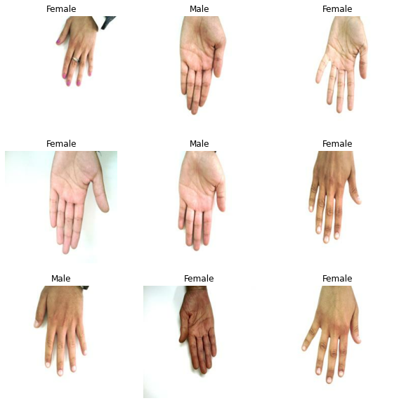
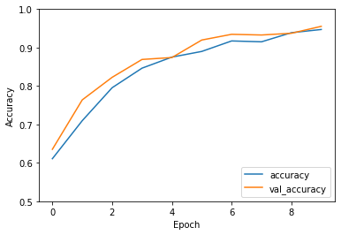
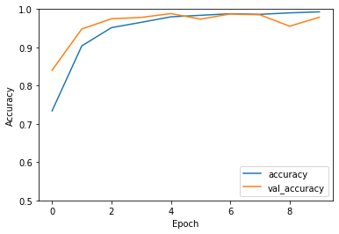
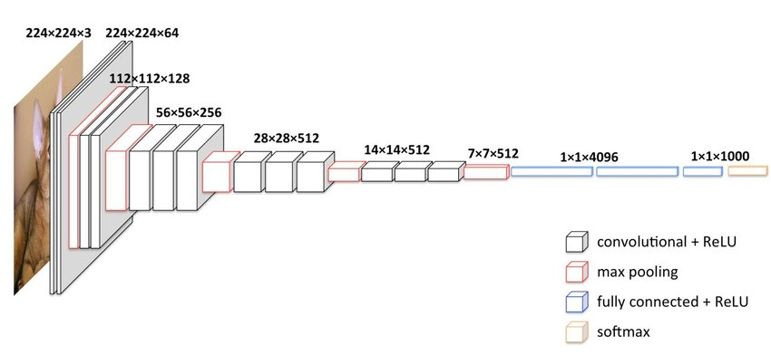
Gender Classification Based on Hand Images
Nathan Wang, David Dickson, Damian Huerta-Ortega, Laurence Leon
Introduction
Key notes:
Shortage of GPU RAM:
Had to resize images, which resulted in worse quality data
Google Colab would only allow access to their GPUs for a restricted amount of time every day
Baseline model accuracy = 95.53%
Optimizer: Adam [4]
Activation Layer: RELU [4]
Hidden Layer: 16 [4]
Dropout: 0.0 [4]
Different Number of Hidden Layers:
3 Hidden Layers
Validation accuracy of 96.93%
16 Hidden Layers (Default Case)
Validation accuracy of 95.53%
Slight reduction in accuracy but tuning of other model parameters will improve results
Dropout Implementation:
Values Tested
Dropout of 0
Validation accuracy of 95.53%
Dropout of 0.2
Validation accuracy of 98.01%
Dropout of 0.8
Validation accuracy all of 96.5%
Dropout was best at 0.2. But overall accuracy was still high throughout the tested range.
Hand dimensions have been shown to aid in identifying gender [1]. This kind of information falls into the category of soft biometrics. Soft biometric classification can be combined with primary biometric classification to increase the confidence of biometric identification methods.
This work focuses on the design of a CNN for gender classification from hand images, as a supporting technology for the identification of individuals.
The team was interested in CNNs for use of image classification. Using hands was a basic dataset that was easy to find and in the future the team is interested in using CNNs for image classification of people for autonomous vehicles.
Conclusions
Best Results:
Best overall model accuracy = 98.01%
Optimizer: Adam
Activation Layer: RELU
Hidden Layers: 16
Dropout: 0.2
Approach
Experiments
Setup: Jupyter Notebook on Google Colab running a CNN with Tensorflow
Dataset: 11,000 hands [2]
Goal: Test variations on CNN model for hand classification accuracy improvements
Different Optimizers:
Adam (Default Case)
Validation accuracy of 95.53%
SGD
Validation accuracy of 94.04%
Slight gain in validation accuracy using Adam vs SGD
Different Activation Layers:
RELU (Default Case)
Validation Accuracy of 95.53%
Sigmoid
Validation Accuracy of 63.52%
Significant gain using RELU for the activation layer over sigmoid, likely due to vanishing gradients
References
[1] Kanchan T, Krishan K (2011) Anthropometry of hand in sex determination of dismembered remains-a review of literature. J Forensic Leg Med 18(1):14–17
[2] Afifi, Mahmoud https://sites.gOptimization oogle.com/view/11khands?pli=1
[3] Karim, Raimi. Illustrated: 10 CNN Architectures. Retrieved from https://towardsdatascience.com/illustrated-10-cnn-architectures-95d78ace614d
[4] Thite, Avinash. Introduction to VGG16 | What is VGG16. Retrieved from https://www.mygreatlearning.com/blog/introduction-to-vgg16/

