Slide 1
Introduction to Data Science
Nathan Wang
3/7/2016
美国研发中心

Slide 2
Syllabus
Introduction
Data processing
linux awk, pandas sql, text, matrix, filter, join, unique, notebook
Data visualization
principles, tools, ggplot, D3, processing, examples, ect
Machine Learning basics (NW)
supervised learning, cross validation, target leak, loss function, convex optimization, stat vs ml, kaggle learned
Algorithms
Tree, LR, SVM, Ensemble, ANN
Dive into Recom engine (NW)
classic algorithms, evaluation, application domains
Other industry applications
Ads, fraud, credit, search, CRM
Project management (NW)
GA, set expectations, debts

Slide 3
Format
Seminar: everyone needs to lead a topic
# create slides
# lead reading discussion
# you will be reviewed by others
Homework: readings and project
Subscribe to:
http://ml.memect.com/
Pycoders Weekly

Slide 4
Language
English
Python
Google

Slide 5
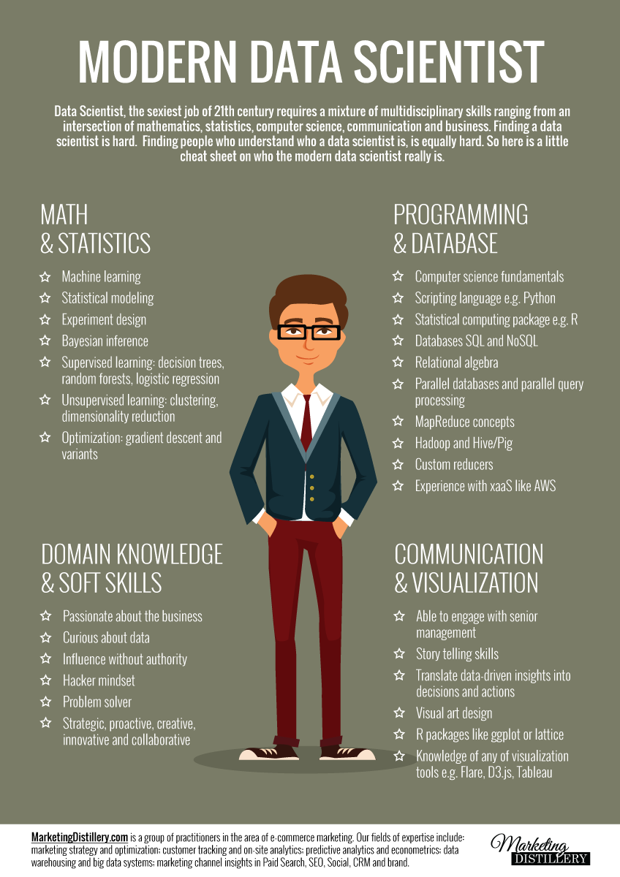
What is data science?
Reading assignments:
66 interview questions
Analyzing the Analyers

Slide 6
Recommender Engine As a Thread
http://www.slideshare.net/xamat
http://www.slideshare.net/xamat/recommender-systems-machine-learning-summer-school-2014-cmu
http://www.slideshare.net/xamat/mlconf-seattle-2015
http://www.slideshare.net/xamat/10-more-lessons-learned-from-building-machine-learning-systems-mlconf

