Slide 1
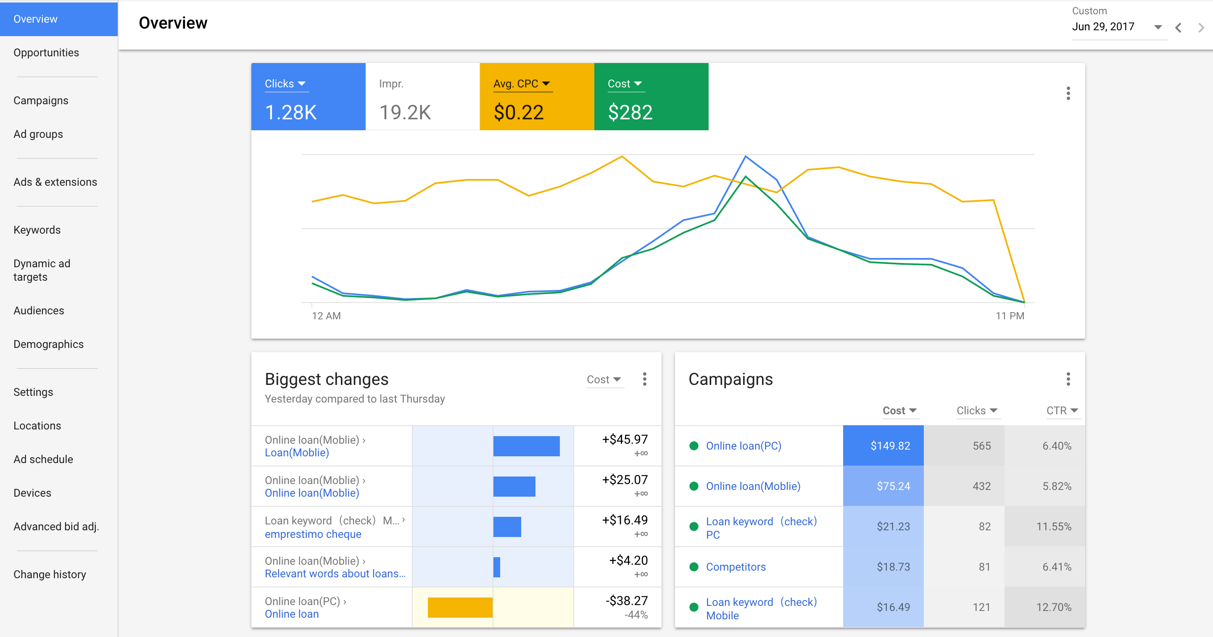
Real practice of Google Adwords optimization
Understand the algorithms behind Google Adwords and our business goal to efficiently spend our daily advertising budget
It is an explore-exploit problem under a realistic business setting. Keep in mind that you need to optimize the whole period, not just give me the best solution by the last day
Three challenges:
Accuracy
Allocation
Scale-up

Slide 2
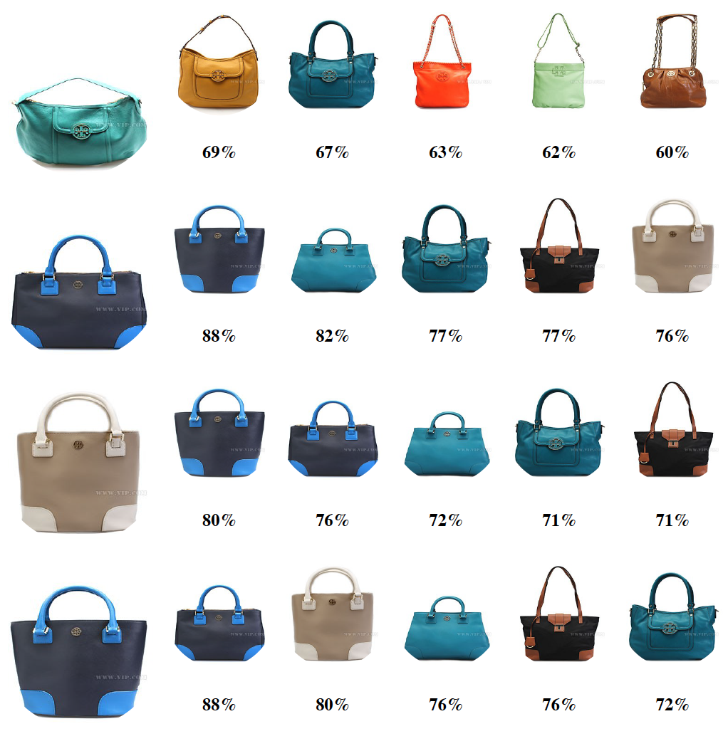
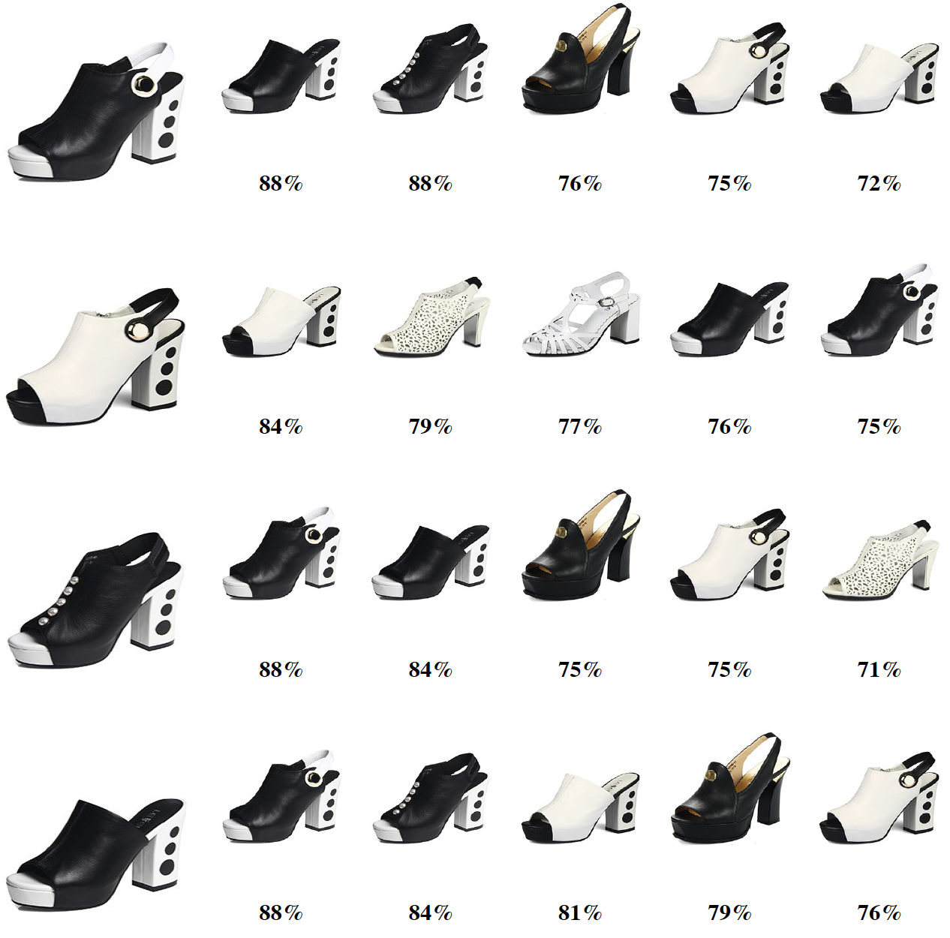
Build recommender engine from almost no data
Traditional e-commerce recommender uses CF algorithm and requires millions users’ behavior on millions items, which has the cold-start problem.
Deep neural net algorithm to find the semantic similarity between items
Web crawlers to assemble a web-scale merchandise knowledge graph
Use Bayesian and RL to guide interactions with new users

