Slide 1

HERA
A conversational copilot that helps health-app developers identify ethical and regulatory risks — and address them early.
Risk & Safety Copilot
Health Ethical & Regulatory Assessment
Digital health · mHealth
Nathan Massicot
MSE Data Science — Berner Fachhochschule (BFH)
Supervisor: Prof. Dr. Kerstin Denecke
Specialisation Project 2 · June 2026

Slide 2
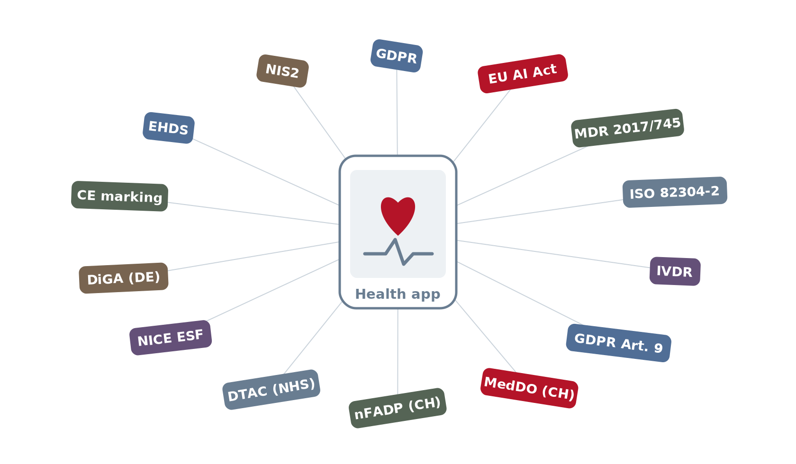
A health app must navigate dozens of regulations
The moment an app touches health, it enters a maze of frameworks: data protection, medical devices, artificial intelligence, accessibility…
These frameworks overlap, change fast, and differ from one country to the next (EU, Switzerland, UK…).
10+
regulatory frameworks may apply to a single health app
HERA · Risk & Safety Copilot
2

Slide 3
And these risks are often spotted too late
No expertise
Too late
No tool
Developers are neither lawyers nor ethicists: it's hard to know what actually applies.
Risks surface after launch — costly to fix, and sometimes dangerous for patients.
No tool guides the thinking upfront, in a structured and complete way.
→ Hence a copilot that asks the right questions, right from the design stage.
HERA · Risk & Safety Copilot
3

Slide 4
Agenda
1
The problem
2
HERA — why & how
3
Approaches, tests & results
4
What we kept
5
Demo
HERA · Risk & Safety Copilot
4

Slide 5
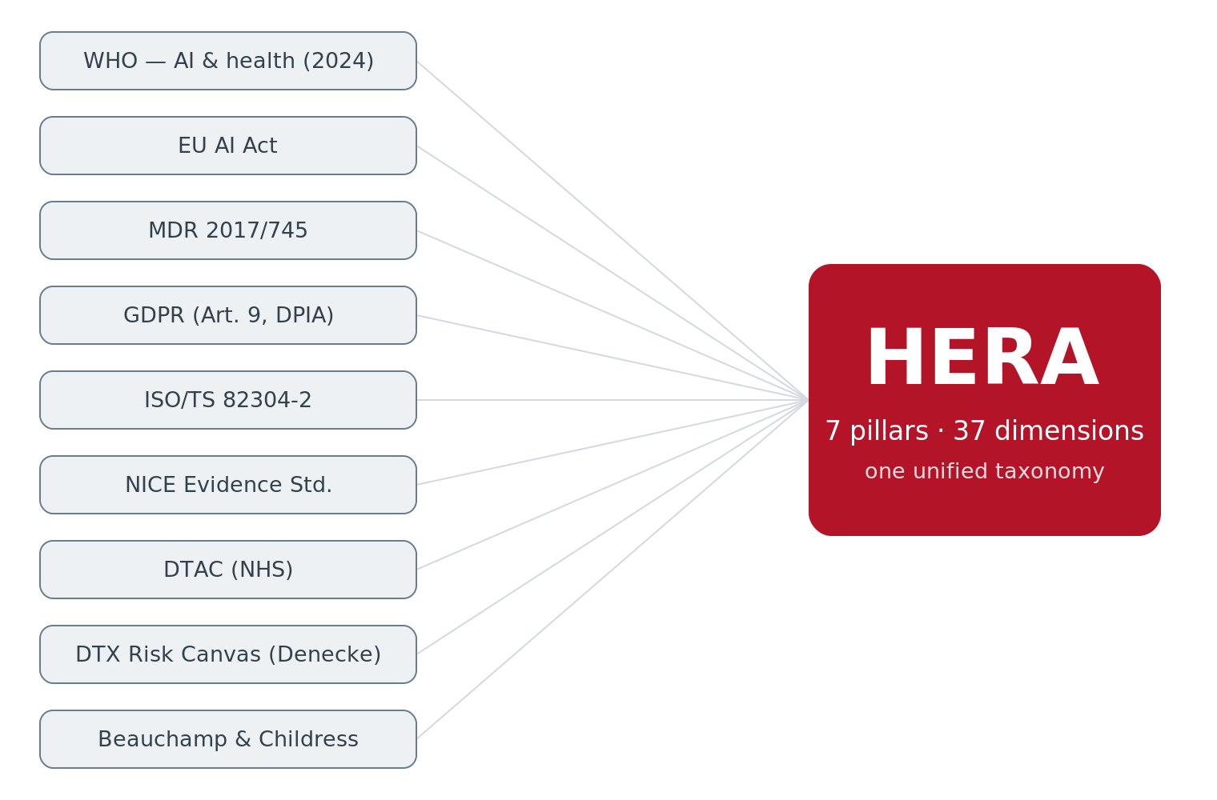
HERA — why a new taxonomy?
HERA = Health Ethical & Regulatory Assessment
The right frameworks already exist
…but they're scattered and written for experts. None is designed to guide a health-app developer, step by step.
Our answer: HERA
A taxonomy that merges 8+ frameworks into a single, clear and actionable structure — with or without AI.
Inspired by Deng, Viganò & Hauser (2025): we adapt their structured-taxonomy idea (HIEDE, finance) to organise health risks → HERA.
HERA · Risk & Safety Copilot
5

Slide 6
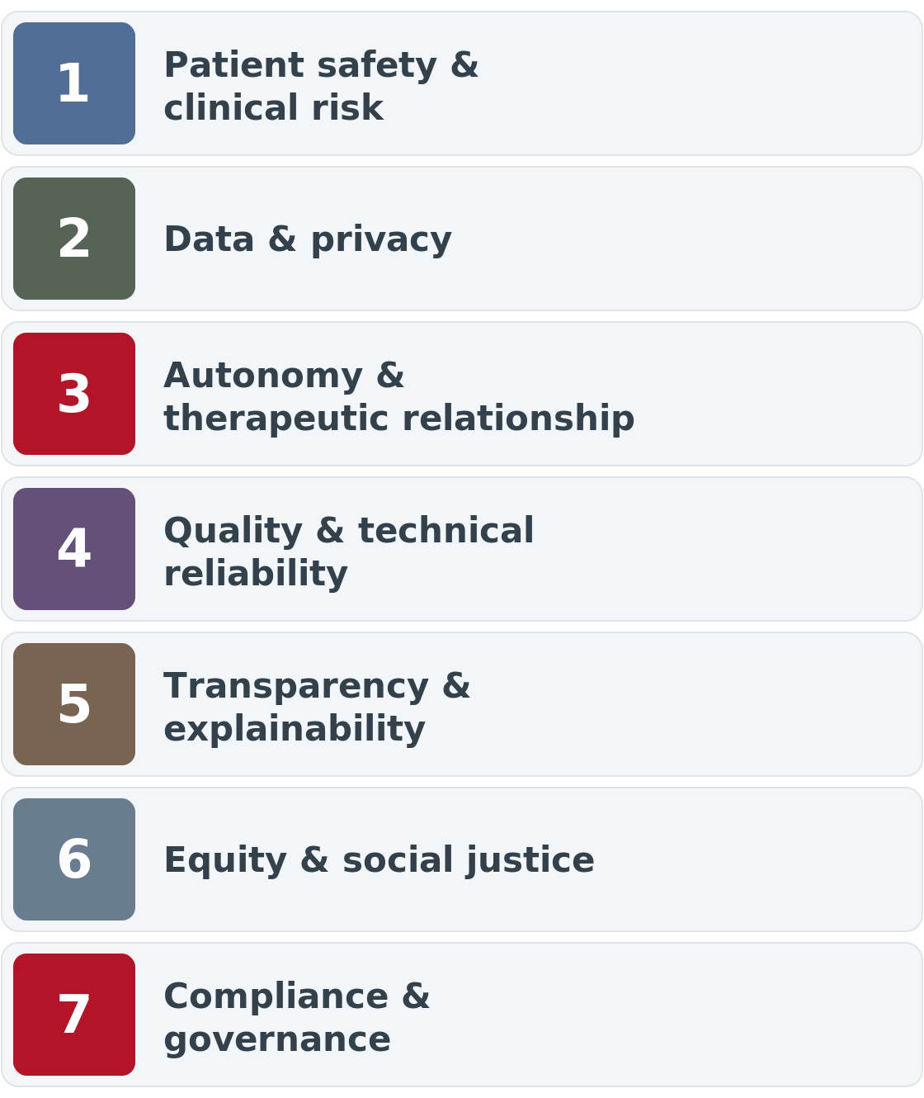
HERA — how it works
7 pillars, 37 dimensions
patient safety, data & privacy, autonomy, quality, transparency, equity, and regulatory compliance.
For each dimension
reflection questions, the typical risks, and concrete mitigation ideas.
A guided conversation
the copilot asks one question at a time, listens, digs deeper, then generates a structured risk report.
HERA · Risk & Safety Copilot
6

Slide 7
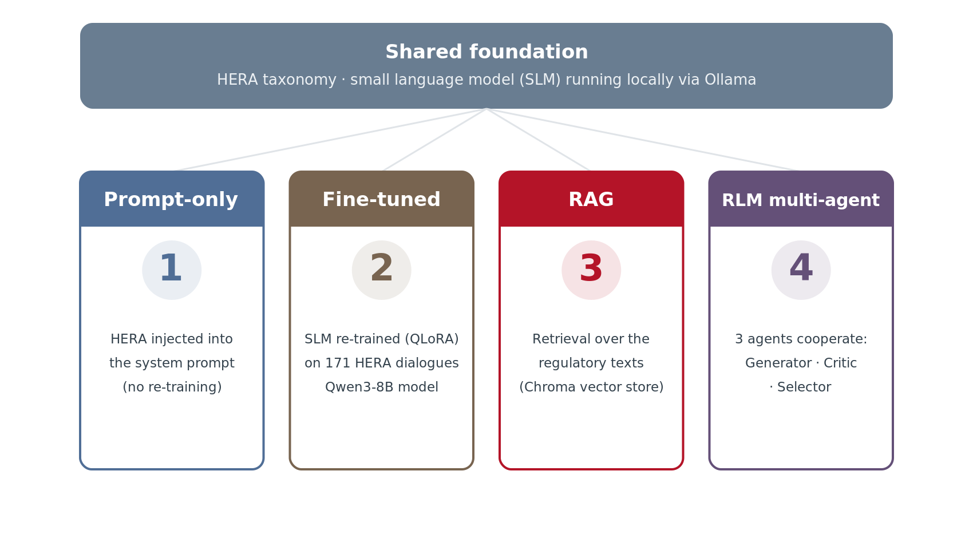
Four ways to build the copilot
Same HERA taxonomy, same small local model — four architectures compared.
HERA · Risk & Safety Copilot
7

Slide 8
How we compared the approaches
→
→
→
1
2
3
4
25 scenarios
Simulated developer
Auto metrics
AI judge
realistic health apps, each with a hand-written « gold answer ».
answers identically for every approach → fair comparison.
dimension coverage, risk accuracy, latency.
rates the depth and actionability of answers (1–5).
Principle: every approach gets exactly the same inputs — we only compare how they reason.
HERA · Risk & Safety Copilot
8

Slide 9
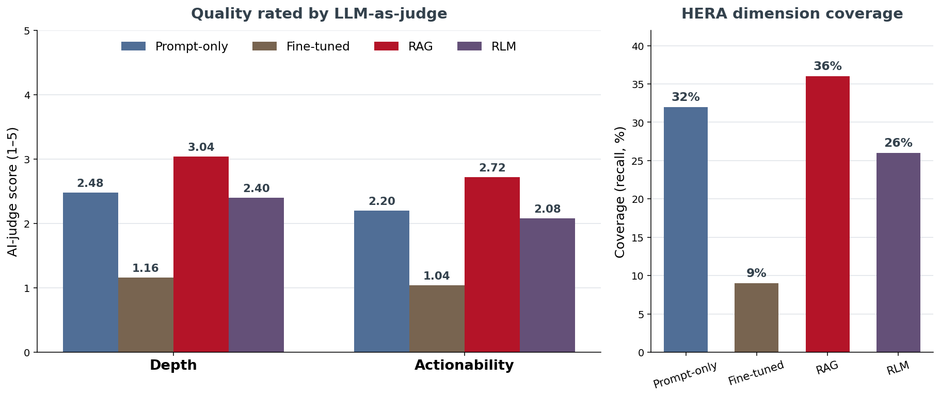
Results: RAG wins, fine-tuning collapses
RAG
best depth (3.0/5) and best coverage (36%).
Fine-tuned
collapses: repeats the same questions, invents references.
Prompt-only / RLM
prompt-only fast and solid; multi-agent 2× slower, no clear gain.
HERA · Risk & Safety Copilot
9

Slide 10
What we kept
The RAG copilot
A 3-page web app
100% local & private
the best quality; it grounds answers in the regulatory texts. Prompt-only as a fast fallback.
app profile (onboarding), interactive regulation diagram, and HERA chatbot.
the model runs locally via Ollama; no data sent to any external service.
Dropped: fine-tuning alone (too little data) and the multi-agent setup (too slow for the gain).
HERA · Risk & Safety Copilot
10

Slide 11
The HERA copilot in action
1
Onboarding — describe the health app
Demo
2
Guided conversation — the copilot asks its questions
3
Risk report — summary mapped to HERA
Local web app · Mistral 7B model via Ollama

Slide 12
Key takeaways
1
HERA unifies 8+ frameworks into an actionable taxonomy for digital health.
2
A rigorous comparison of 4 approaches over 25 scenarios → RAG is the most useful.
3
A local, private prototype, demonstrable end to end.
Thank you! Questions?
Nathan Massicot
MSE Data Science, BFH · Supervisor: Prof. Dr. Kerstin Denecke

Slide 13
References
Approaches & models
HERA foundations
RAG — Lewis, P. et al. (2020). Retrieval-Augmented Generation for Knowledge-Intensive NLP Tasks. NeurIPS 33.
Reflection framework — Deng, Viganò & Hauser (2025). Smart Automated Questions, Less Risks: Using LLMs to Foster Ethical & Social Awareness in Data-Related Projects. (HIEDE → HERA; multi-agent → RLM.)
Reflexion — Shinn, N. et al. (2023). Reflexion: Language Agents with Verbal Reinforcement Learning. NeurIPS 36.
Self-Refine — Madaan, A. et al. (2023). Self-Refine: Iterative Refinement with Self-Feedback. NeurIPS 36.
LoRA — Hu, E. et al. (2022). LoRA: Low-Rank Adaptation of Large Language Models. ICLR.
QLoRA — Dettmers, T. et al. (2023). QLoRA: Efficient Finetuning of Quantized LLMs. NeurIPS 36.
Qwen3 — Qwen Team (2025). Qwen3 Technical Report. arXiv:2505.09388.
DTX Risk Canvas — Denecke, K. et al. (2023). Digital Therapeutics Risk Assessment Canvas.
WHO (2024). Ethics & Governance of AI for Health: Large Multi-Modal Models.
EU AI Act — Regulation (EU) 2024/1689.
EU MDR — Regulation (EU) 2017/745 (Medical Devices).
GDPR — Regulation (EU) 2016/679.
ISO/TS 82304-2 (2021). Health & wellness apps — Quality & reliability.
Beauchamp & Childress (2019). Principles of Biomedical Ethics (8th ed.).
HERA · Risk & Safety Copilot
13

