Slide 1

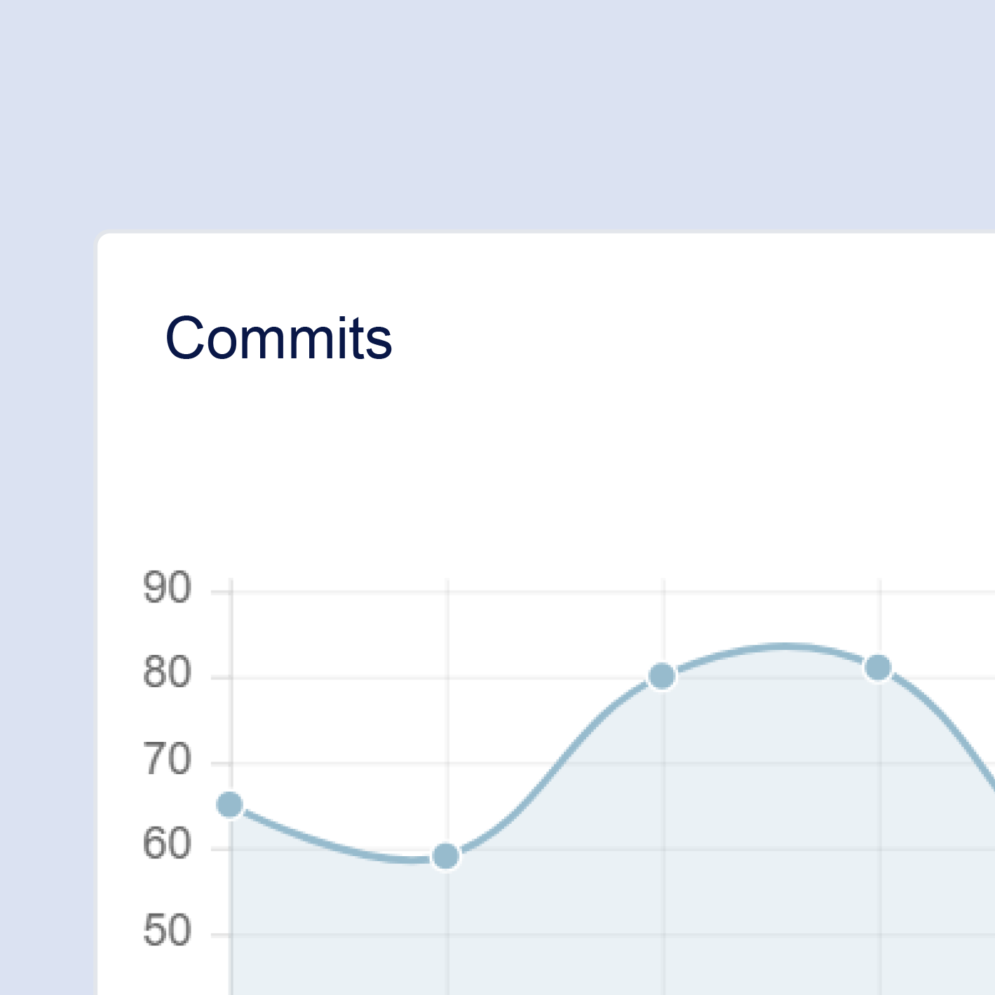
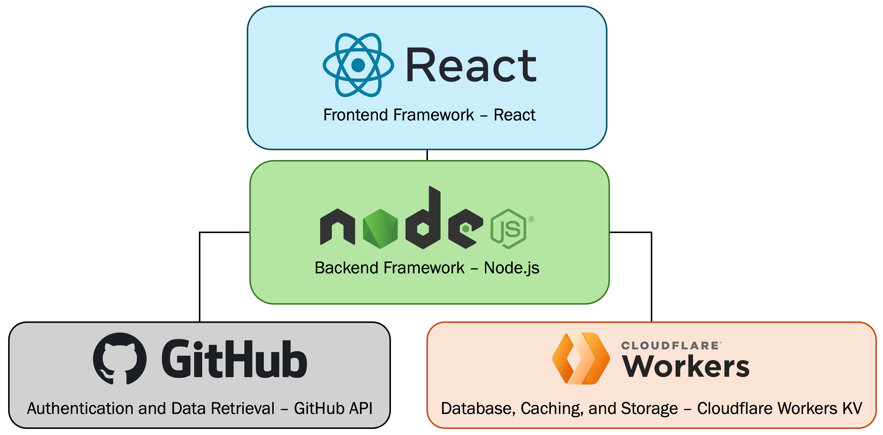
RepoInsight
Ali Akbar
Kidus Hailu
Nathan Larsen
Ogbu George Oruada
Zhenghao Zhang
Introduction
Repolnsight provides software developers, team leads, and project managers with insights into their collaborative work within GitHub repositories
Empower users to visualize and assess their contributions over time, fostering a deeper understanding of both individual and team performance
Provides an understanding of individual and collective efforts, supporting a culture of accountability and continuous improvement
Features
Technologies
Interactive charts that display an individual's contributions over time
Detailed statistics summarizing overall activity within a repository
Line modification tracker that shows the last person to modify each line in a specified file, helping users understand code ownership and history

