Slide 1
Introduction to Teleop Robot Code
2017-5-9

Slide 2
What is this about?
Learning the parts of the Robot
Learning how they are connected in Code
Learning how to implement Your strategy for Teleop

Slide 3
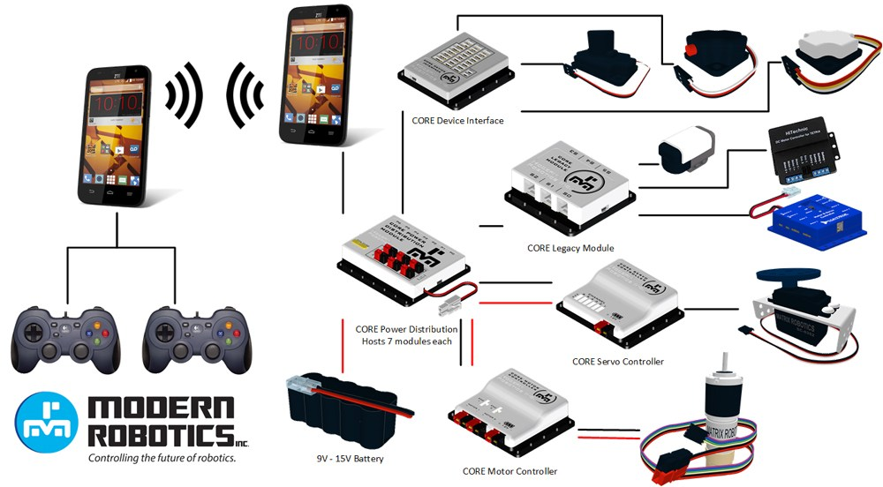
Parts of the Robot thanks to RoboAztecs

Slide 4
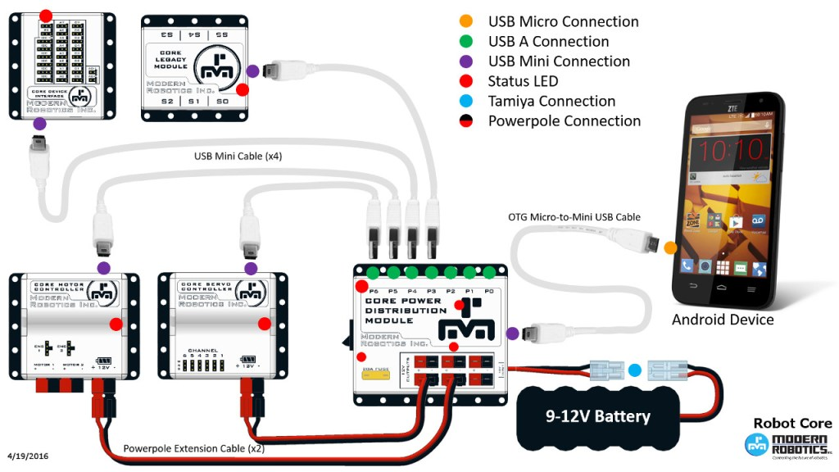
Phone to Module specific Wiring

Slide 5
Transferring Physical to Virtual – Robot Side
You can see what controller modules are attached to which motor or sensor
How can the phone see?
Name each connection on the phone app
Use that name to manage the java classes and actions in the code
You have to match names in two places
The FTC code will handle communicating between them
Robot Phone – In Setup
Controller Code
motorFrontRight = hardwareMap.dcMotor.get("fr"); motorFrontLeft = hardwareMap.dcMotor.get("fl"); motorBackRight = hardwareMap.dcMotor.get("br"); motorBackLeft = hardwareMap.dcMotor.get("bl"); // Set up ball lifter, doesn't matter which way it spins ballLifter = hardwareMap.dcMotor.get("motorBallLifter"); // Set up ball arm ballArm = hardwareMap.servo.get("servoBallArm");

Slide 6
Transferring Physical to Virtual – Controller Side
The game controller talks to the phone is a similar way
But FTC already did all the naming for us
Thanks FTC!
// note that if y equal -1 then joystick is pushed all of the way forward. float left_y = -gamepad1.left_stick_y; float left_x = gamepad1.left_stick_x; float right_x = gamepad1.right_stick_x; float rotate_x = gamepad1.right_trigger - gamepad1.left_trigger;

Slide 7
Connecting it all together
Declare any needed classes
You can go back and get this later too
Connect any needed Hardware in the code
Use try -> catch in order to allow for off bot troubleshooting
Read the desired controller values
Translate controller values the way you want
Send the translated values to the hardware
Important ideas
Using classes
Value types
Loop mechanism
Output to debug for trouble shooting

Slide 8
Simple Example

Slide 9
Two hardware labels
11625
7776
fr
fl
br
bl

Slide 10
Ideas to program
Tank Drive (Simplest)
Position Tester
Mechanum wheels

