Slide 1

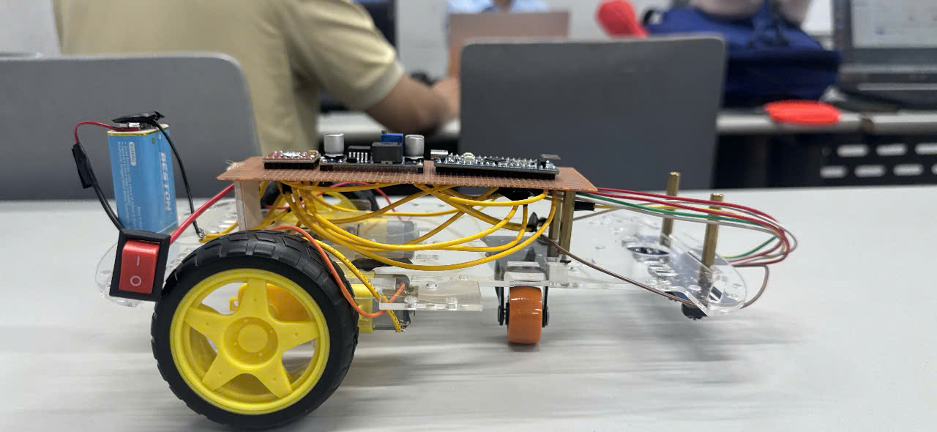
STM32 Line-Following Robot
Design and firmware implementation
STM32F103C8T6
Five digital line sensors
Two motors with ON/OFF PWM control
Team J4F
Class IC2011 Course MCP201
Instructor: VinhPT30
Nguyễn Hiếu, Nguyễn Thành Nhân,
Nguyễn Thiên Tâm, Bùi An Quốc
J4F / MCP201
01
Notes:
Project source: https://github.com/Nathan6426/MCP201-STM32-Line-Follower/tree/b7d286baf13f199ba33ffff2714baa552d69740e
Firmware: https://github.com/Nathan6426/MCP201-STM32-Line-Follower/blob/b7d286baf13f199ba33ffff2714baa552d69740e/apps/main.c
Configuration: https://github.com/Nathan6426/MCP201-STM32-Line-Follower/blob/b7d286baf13f199ba33ffff2714baa552d69740e/doline1.ioc
Identity and project context retained from the supplied presentation. Concept: detect and follow a black line. Application context: introductory embedded robotics and guided transport. Photo: https://github.com/Nathan6426/MCP201-STM32-Line-Follower/blob/b7d286baf13f199ba33ffff2714baa552d69740e/images/Side.jpg
FPT University logo: https://fpt.edu.vn/brand . Original logo asset: https://fpt.edu.vn/Resources/brand/uploads/749540_132829686029858301_o.jpg

Slide 2
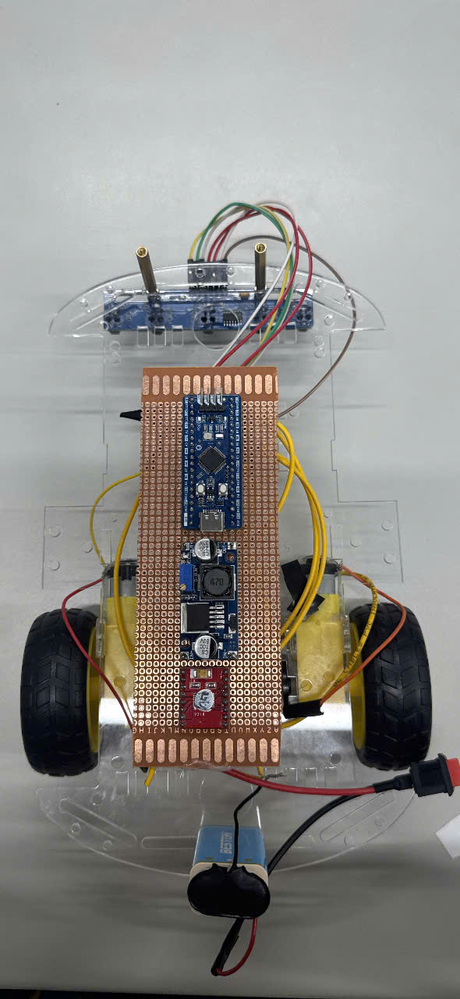
Hardware architecture
Digital sensing, embedded processing and differential drive
PA0–PA4
TIM3 / TIM4 PWM
TCRT5000 sensor array
5 digital outputs
STM32F103C8T6
GPIO + control logic
DRV8833
Dual H-bridge
Power system
Left and right
TT geared motors
9 V battery with separate regulated 5 V branches for logic and motors.
Power distribution: slide 05.
Prototype top view
J4F / MCP201
02
Notes:
Project source: https://github.com/Nathan6426/MCP201-STM32-Line-Follower/tree/b7d286baf13f199ba33ffff2714baa552d69740e
Firmware: https://github.com/Nathan6426/MCP201-STM32-Line-Follower/blob/b7d286baf13f199ba33ffff2714baa552d69740e/apps/main.c
Configuration: https://github.com/Nathan6426/MCP201-STM32-Line-Follower/blob/b7d286baf13f199ba33ffff2714baa552d69740e/doline1.ioc
Hardware and original power distribution: README sections 2–3. Photo: https://github.com/Nathan6426/MCP201-STM32-Line-Follower/blob/b7d286baf13f199ba33ffff2714baa552d69740e/images/Top-Down.jpg
Current power configuration confirmed by the project owner: separate regulated 5 V logic and motor branches from the 9 V battery. This supersedes the older README power description.
FPT University logo: https://fpt.edu.vn/brand . Original logo asset: https://fpt.edu.vn/Resources/brand/uploads/749540_132829686029858301_o.jpg

Slide 3
Sensor connections
S1 is the outer-left sensor and S5 is outer-right, viewed in the direction of travel
Sensor output | STM32 input | Position weight
S1 / OUT1 | PA0 | −2
S2 / OUT2 | PA1 | −1
S3 / OUT3 | PA2 | 0
S4 / OUT4 | PA3 | +1
S5 / OUT5 | PA4 | +2
Digital convention
BLACK = 0
WHITE = 1
Sensor VCC: +5 V logic rail
All grounds connected
Measure OUT1–OUT5 HIGH levels. Use suitable level shifting if they exceed 3.3 V.
These are signal names, not a physical header layout.
J4F / MCP201
03
Notes:
Project source: https://github.com/Nathan6426/MCP201-STM32-Line-Follower/tree/b7d286baf13f199ba33ffff2714baa552d69740e
Firmware: https://github.com/Nathan6426/MCP201-STM32-Line-Follower/blob/b7d286baf13f199ba33ffff2714baa552d69740e/apps/main.c
Configuration: https://github.com/Nathan6426/MCP201-STM32-Line-Follower/blob/b7d286baf13f199ba33ffff2714baa552d69740e/doline1.ioc
Sensor order and electrical cautions follow the supplied wiring reference. STM32 PA0–PA4 are not designated FT in the pin table. Datasheet: https://www.st.com/resource/en/datasheet/stm32f103c8.pdf . Module supply and output circuit must be verified against the actual PCB.
FPT University logo: https://fpt.edu.vn/brand . Original logo asset: https://fpt.edu.vn/Resources/brand/uploads/749540_132829686029858301_o.jpg

Slide 4
Motor driver connections
Pin mapping follows apps/main.c and doline1.ioc
STM32 pin | Timer channel | DRV8833 input | Motor
PB6 | TIM4_CH1 | AIN1 | Left
PB7 | TIM4_CH2 | AIN2 | Left
PB4 | TIM3_CH1 | BIN1 | Right
PB5 | TIM3_CH2 | BIN2 | Right
Driver outputs
Required configuration
AO1 / AO2: left motor
BO1 / BO2: right motor
Motor terminals connect across each H-bridge.
TIM3 partial remap for PB4 / PB5
JTAG disabled, SWD retained
nSLEEP HIGH at 3.3 V; confirm module label
J4F / MCP201
04
Notes:
Project source: https://github.com/Nathan6426/MCP201-STM32-Line-Follower/tree/b7d286baf13f199ba33ffff2714baa552d69740e
Firmware: https://github.com/Nathan6426/MCP201-STM32-Line-Follower/blob/b7d286baf13f199ba33ffff2714baa552d69740e/apps/main.c
Configuration: https://github.com/Nathan6426/MCP201-STM32-Line-Follower/blob/b7d286baf13f199ba33ffff2714baa552d69740e/doline1.ioc
Archived project doline1.zip, Core/Src/stm32f1xx_hal_msp.c confirms __HAL_AFIO_REMAP_TIM3_PARTIAL and __HAL_AFIO_REMAP_SWJ_NOJTAG. Supplied reference labels STBY as corresponding to nSLEEP on its module. Verify actual PCB pinout. AO/BO are module labels for AOUT/BOUT. DRV8833 device documentation: https://www.ti.com/lit/ds/symlink/drv8833.pdf
FPT University logo: https://fpt.edu.vn/brand . Original logo asset: https://fpt.edu.vn/Resources/brand/uploads/749540_132829686029858301_o.jpg

Slide 5
Power supply configuration
Separate regulated branches for logic and motors
LM2596
5 V logic branch
Blue Pill 5 V input
Sensor VCC
9 V battery
Power switch
Dedicated buck
5 V motor branch
DRV8833 VM
Two TT motors
Common GND across battery, converters, MCU, sensors and driver
The +5 V logic and +5 V motor outputs are separate rails.
J4F / MCP201
05
Notes:
Project source: https://github.com/Nathan6426/MCP201-STM32-Line-Follower/tree/b7d286baf13f199ba33ffff2714baa552d69740e
Firmware: https://github.com/Nathan6426/MCP201-STM32-Line-Follower/blob/b7d286baf13f199ba33ffff2714baa552d69740e/apps/main.c
Configuration: https://github.com/Nathan6426/MCP201-STM32-Line-Follower/blob/b7d286baf13f199ba33ffff2714baa552d69740e/doline1.ioc
Official project power configuration, confirmed by the project owner in this conversation on 2026-11-11: a 9 V battery feeds two separate regulated 5 V branches, with LM2596 for logic and a dedicated buck for motors. Logic supplies Blue Pill board 5 V input and sensor VCC. Motor branch supplies DRV8833 VM. Common GND, separate positive outputs. This confirmation supersedes earlier proposal labels and the older README direct-battery motor branch. It confirms the circuit configuration, not measured performance. DRV8833 reference: https://www.ti.com/lit/ds/symlink/drv8833.pdf
FPT University logo: https://fpt.edu.vn/brand . Original logo asset: https://fpt.edu.vn/Resources/brand/uploads/749540_132829686029858301_o.jpg

Slide 6
Main program flow
RUN_MODE = 2 selects automatic line following
Power on / Reset
HAL_Init() and SystemClock_Config()
Initialize GPIO, TIM4 and TIM3
Any PWM start fails
Error_Handler()
Clear timer outputs, disable IRQs
and loop forever
Start PWM on TIM3 and TIM4
Channels 1 and 2
All starts succeed
Motors_Stop()
Set targets and outputs to zero
Line_Follow_Update()
Repeat
HAL_Delay(10 ms)
J4F / MCP201
06
Notes:
Project source: https://github.com/Nathan6426/MCP201-STM32-Line-Follower/tree/b7d286baf13f199ba33ffff2714baa552d69740e
Firmware: https://github.com/Nathan6426/MCP201-STM32-Line-Follower/blob/b7d286baf13f199ba33ffff2714baa552d69740e/apps/main.c
Configuration: https://github.com/Nathan6426/MCP201-STM32-Line-Follower/blob/b7d286baf13f199ba33ffff2714baa552d69740e/doline1.ioc
Main program and initialization order from apps/main.c. Initialization failures also call Error_Handler(). Four PWM start statuses are checked. RUN_MODE 0 reads sensors and stops motors (state 8). RUN_MODE 1 reads sensors and runs both motors (state 7). Other compile-time values stop motors. Each loop ends with HAL_Delay(LOOP_MS), so processing time is additional to the 10 ms delay.
FPT University logo: https://fpt.edu.vn/brand . Original logo asset: https://fpt.edu.vn/Resources/brand/uploads/749540_132829686029858301_o.jpg

Slide 7
Sensor processing and line position
A valid line contains 1–4 adjacent black sensors
Sensor | S1 | S2 | S3 | S4 | S5
Weight | −2 | −1 | 0 | +1 | +2
line_error = sum of active weights / black_count
Example
Pattern handling
S2 and S3 detect black
black_count = 2
line_error = (−1 + 0) / 2 = −0.5
Command: turn left
All white: search for the line
All black: stop this cycle
Separated black groups: stop this cycle
Direction memory: S1 black / S5 white = left. S5 black / S1 white = right.
J4F / MCP201
07
Notes:
Project source: https://github.com/Nathan6426/MCP201-STM32-Line-Follower/tree/b7d286baf13f199ba33ffff2714baa552d69740e
Firmware: https://github.com/Nathan6426/MCP201-STM32-Line-Follower/blob/b7d286baf13f199ba33ffff2714baa552d69740e/apps/main.c
Configuration: https://github.com/Nathan6426/MCP201-STM32-Line-Follower/blob/b7d286baf13f199ba33ffff2714baa552d69740e/doline1.ioc
Sensors_Read() snapshots GPIOA->IDR once and extracts PA0–PA4. sensor_mask sets bits for active-black sensors and black_count counts them. Sensors_Valid() rejects all-black and non-contiguous active patterns. All-white is handled before this validation. Weighted mean is calculated only for valid nonempty patterns. Example is derived from the supplied weights.
FPT University logo: https://fpt.edu.vn/brand . Original logo asset: https://fpt.edu.vn/Resources/brand/uploads/749540_132829686029858301_o.jpg

Slide 8
Line-following control flow
Each call reads sensors once and selects a motor command
Read PA0–PA4
Update direction memory from S1 and S5
All sensors white?
State 3: search using
last_direction
Update motors and return
YES
NO
State 4: invalid pattern
Motors_Stop()
Return
NO
Valid black pattern?
YES
Compute weighted line_error
Select left, straight or right
State 1: Motors_Update() and return
J4F / MCP201
08
Notes:
Project source: https://github.com/Nathan6426/MCP201-STM32-Line-Follower/tree/b7d286baf13f199ba33ffff2714baa552d69740e
Firmware: https://github.com/Nathan6426/MCP201-STM32-Line-Follower/blob/b7d286baf13f199ba33ffff2714baa552d69740e/apps/main.c
Configuration: https://github.com/Nathan6426/MCP201-STM32-Line-Follower/blob/b7d286baf13f199ba33ffff2714baa552d69740e/doline1.ioc
S1 black and S5 white sets last_direction=-1. S5 black and S1 white sets +1. Otherwise retain the prior value. Direction memory updates before all-white and validity branches. Search and invalid branches return immediately. Invalid patterns stop only for the current cycle, with no fault latch in this path. No debounce or timeout is applied to line searching by this function. LOST_CONFIRM_MS, LOST_TIMEOUT_MS and Emergency_Stop() are defined but unused by this control path.
FPT University logo: https://fpt.edu.vn/brand . Original logo asset: https://fpt.edu.vn/Resources/brand/uploads/749540_132829686029858301_o.jpg

Slide 9
Motor commands and PWM output
Commands on the automatic control path are forward-only
Condition | Left duty | Right duty | Action
line_error < −0.01 | 0% | 65% | Turn left
−0.01 ≤ line_error ≤ +0.01 | 65% | 65% | Go straight
line_error > +0.01 | 65% | 0% | Turn right
All white, direction < 0 | 0% | 65% | Search left
All white, direction > 0 | 65% | 0% | Search right
All white, direction = 0 | 0% | 0% | Stop
All black / invalid groups | 0% | 0% | Stop this cycle
PWM frequency = 8 MHz / (0 + 1) / (399 + 1) = 20 kHz
ON duty = CCR / (ARR + 1) = 260 / 400 = 65%
J4F / MCP201
09
Notes:
Project source: https://github.com/Nathan6426/MCP201-STM32-Line-Follower/tree/b7d286baf13f199ba33ffff2714baa552d69740e
Firmware: https://github.com/Nathan6426/MCP201-STM32-Line-Follower/blob/b7d286baf13f199ba33ffff2714baa552d69740e/apps/main.c
Configuration: https://github.com/Nathan6426/MCP201-STM32-Line-Follower/blob/b7d286baf13f199ba33ffff2714baa552d69740e/doline1.ioc
TIM3/TIM4 use HSI-derived 8 MHz clock, prescaler 0 and ARR 399. Motor_Write() maps every nonzero signed speed to CCR 260 on one directional channel after clearing both channels. Motors_Update() maps targets >0 to 65, otherwise 0, so the automatic path uses forward/stop only. Zero output is not a claim of active braking. These are configured duty ratios, not measured wheel speeds.
FPT University logo: https://fpt.edu.vn/brand . Original logo asset: https://fpt.edu.vn/Resources/brand/uploads/749540_132829686029858301_o.jpg

Slide 10
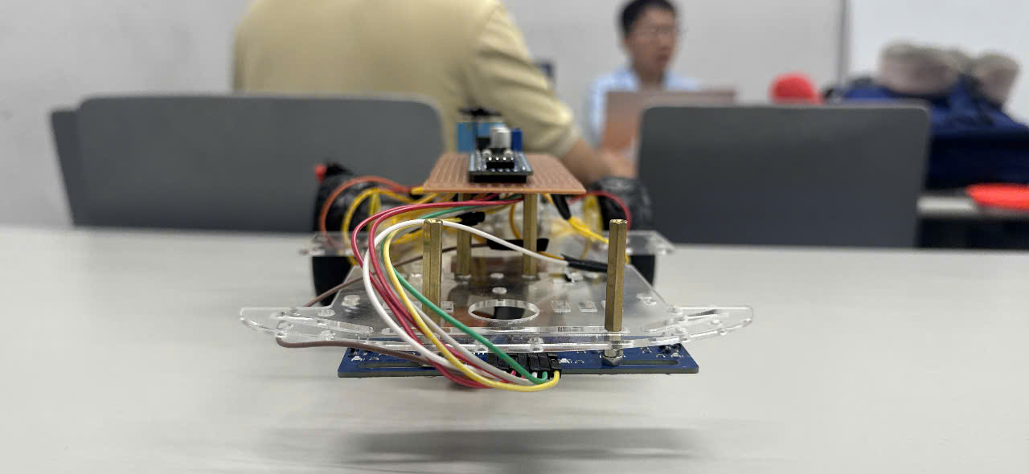
Prototype and preliminary results
Qualitative observations reported by the project team
Reported achievement
Black-line detection and basic steering
on some simple track sections.
Remaining limitation
Reliable operation on sharp turns
and intersections is not established.
No documented benchmark for success rate, maximum reliable speed or endurance.
J4F / MCP201
10
Notes:
Project source: https://github.com/Nathan6426/MCP201-STM32-Line-Follower/tree/b7d286baf13f199ba33ffff2714baa552d69740e
Firmware: https://github.com/Nathan6426/MCP201-STM32-Line-Follower/blob/b7d286baf13f199ba33ffff2714baa552d69740e/apps/main.c
Configuration: https://github.com/Nathan6426/MCP201-STM32-Line-Follower/blob/b7d286baf13f199ba33ffff2714baa552d69740e/doline1.ioc
Results are qualitative reports from original deck slides 5–6 and README section 7, not newly measured results. Photo: https://github.com/Nathan6426/MCP201-STM32-Line-Follower/blob/b7d286baf13f199ba33ffff2714baa552d69740e/images/front.jpg . Success rate, speed and long-duration reliability have no documented repeatable benchmark.
FPT University logo: https://fpt.edu.vn/brand . Original logo asset: https://fpt.edu.vn/Resources/brand/uploads/749540_132829686029858301_o.jpg

Slide 11
Current limitations
Reported prototype issues and confirmed firmware behavior
Area | Evidence / behavior | Effect
Power supply | Voltage drops reported under motor load | Unstable operation
Sensor signals | Unstable readings reported on some surfaces | Incorrect steering decisions
Steering control | Only 0% or 65% duty on each motor | Abrupt command changes
Lost-line search | No active timeout in Line_Follow_Update() | Search continues until line returns
Intersections | All-black and separated groups are invalid | Motors stop for the current cycle
Hardware detail still to confirm
Older documents list different motor ratings (3–6 V vs 3–9 V). Record the exact motor specification in the final documentation.
J4F / MCP201
11
Notes:
Project source: https://github.com/Nathan6426/MCP201-STM32-Line-Follower/tree/b7d286baf13f199ba33ffff2714baa552d69740e
Firmware: https://github.com/Nathan6426/MCP201-STM32-Line-Follower/blob/b7d286baf13f199ba33ffff2714baa552d69740e/apps/main.c
Configuration: https://github.com/Nathan6426/MCP201-STM32-Line-Follower/blob/b7d286baf13f199ba33ffff2714baa552d69740e/doline1.ioc
Reported issues: original deck slide 6 and README sections 7–8. Software behavior: apps/main.c. Motor rating conflict: original deck 3–6 V, README 3–9 V. The project owner confirms the dual regulated 5 V branches as the official configuration. Earlier reported voltage drops do not establish performance after that configuration. No new bench tests or firmware build were performed.
FPT University logo: https://fpt.edu.vn/brand . Original logo asset: https://fpt.edu.vn/Resources/brand/uploads/749540_132829686029858301_o.jpg

Slide 12
Development priorities
Proposed work for the next iteration
01
Stabilize and verify power
Measure startup current and supply droop to evaluate the existing battery and both regulated branches.
02
Calibrate the sensor array
Check logic levels, sensor height and black/white thresholds on the actual lab track.
03
Improve recovery and steering
Add bounded lost-line search and explicit intersection behavior. Evaluate P or PD control with variable PWM.
04
Run repeatable track tests
Record completion rate, turn recovery, lap time and supply voltage under the same test conditions.
J4F / MCP201
12
Notes:
Project source: https://github.com/Nathan6426/MCP201-STM32-Line-Follower/tree/b7d286baf13f199ba33ffff2714baa552d69740e
Firmware: https://github.com/Nathan6426/MCP201-STM32-Line-Follower/blob/b7d286baf13f199ba33ffff2714baa552d69740e/apps/main.c
Configuration: https://github.com/Nathan6426/MCP201-STM32-Line-Follower/blob/b7d286baf13f199ba33ffff2714baa552d69740e/doline1.ioc
Future work, not implemented or validated. Original deck and README support power, sensor and P/PD/PID work. Bounded search and intersection handling follow from current code limitations. Proposed tests have no supplied targets or outcomes.
Power priority refers to measurements of the existing official dual-branch supply, not a proposal to build that circuit.
FPT University logo: https://fpt.edu.vn/brand . Original logo asset: https://fpt.edu.vn/Resources/brand/uploads/749540_132829686029858301_o.jpg

Slide 13
Conclusion and discussion
A working foundation for embedded robotics
The prototype integrates digital line sensing, STM32 control and dual-motor PWM drive.
Basic line following is reported. Reliable operation on complex tracks still needs validation.
Thank you
Questions and discussion
Project source: github.com/Nathan6426/MCP201-STM32-Line-Follower
J4F / MCP201
13
Notes:
Project source: https://github.com/Nathan6426/MCP201-STM32-Line-Follower/tree/b7d286baf13f199ba33ffff2714baa552d69740e
Firmware: https://github.com/Nathan6426/MCP201-STM32-Line-Follower/blob/b7d286baf13f199ba33ffff2714baa552d69740e/apps/main.c
Configuration: https://github.com/Nathan6426/MCP201-STM32-Line-Follower/blob/b7d286baf13f199ba33ffff2714baa552d69740e/doline1.ioc
Conclusion preserves basic operation vs unresolved complex-track reliability. Electrical references: https://www.st.com/resource/en/datasheet/stm32f103c8.pdf and https://www.ti.com/lit/ds/symlink/drv8833.pdf . Original deck and three attached wiring/control-flow diagrams supplied by the user are supporting references.
FPT University logo: https://fpt.edu.vn/brand . Original logo asset: https://fpt.edu.vn/Resources/brand/uploads/749540_132829686029858301_o.jpg

