Slide 1
GROUP 1
Circuit Presentation
BSCS 2-2
Final Project in Logic Design and Digital Computer Circuits

Slide 2


GROUP 1 MEMBERS
Nathanael A. Almazan
Christian Roed P. Boyles
Kenneth M. Soria
Trisha Mae M. Erandio
Claire Zeni M. Guanlao

Slide 3

GIVEN DIAGRAM

Slide 4

FORMULA

Slide 5
TRUTH TABLE
A | B | (AB)’ | (A(AB)’)’ | ((AB)’B)’ | F1 = ((AB)’(AB)’)’ | F2 = ((A(AB)’)’((AB)’B)’)’
0 | 0 | 1 | 1 | 1 | 0 | 0
0 | 1 | 1 | 1 | 0 | 0 | 1
1 | 0 | 1 | 0 | 1 | 0 | 1
1 | 1 | 0 | 1 | 1 | 1 | 0

Slide 6
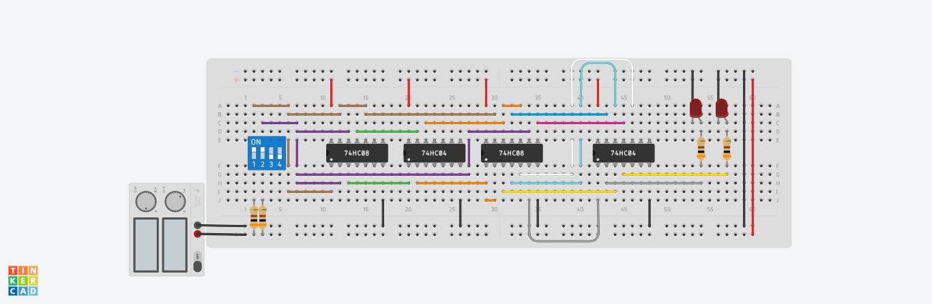
TINKERCAD CIRCUIT

Slide 7
Displaying 0-8 in 7-segment Decoder

Slide 8
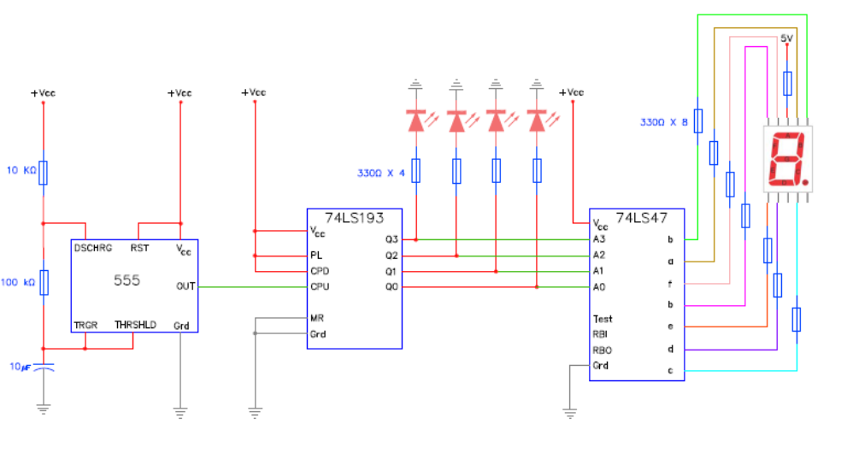
SCHEMATIC DIAGRAM

Slide 9
1-SECOND DELAY FORMULA
1 second Time Period (T) = 0.693 x (R1 MΩ + (2 x R2 MΩ) x C1 µF
where;
R1 = Resistor 1
R2 = Resistor 2
C1 = Capacitor

Slide 10
Given that;
R1 = .010 MΩ
R2 = .100 MΩ
Solve the value of the Capacitor
1 s = 0.693 x (.010 MΩ + (2 x .100 MΩ) x C1 µF
1 s = 0.693 x (.010 + .200) x C1 µF
1 s = 0.693 x (.21) x C1 µF
1 s = .14553 x C1 µF
C1 µF = 6.871435443 µF

Slide 11
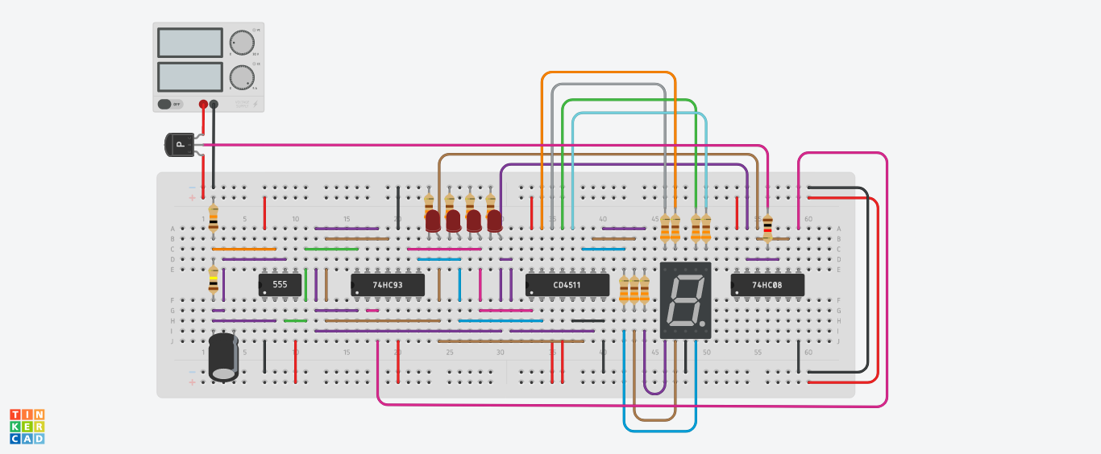
TINKERCAD CIRCUIT

Slide 12

THANK YOU FOR LISTENING!

Slide 13
THANKS!
Do you have any questions?
youremail@freepik.com
+91 620 421 838 I yourcompany.com
Please keep this slide for attribution

