Slide 1


Slide 2
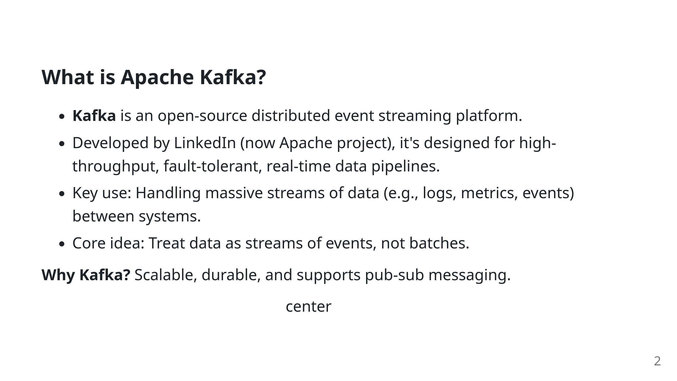
Notes:
Kafka logo image

Slide 3
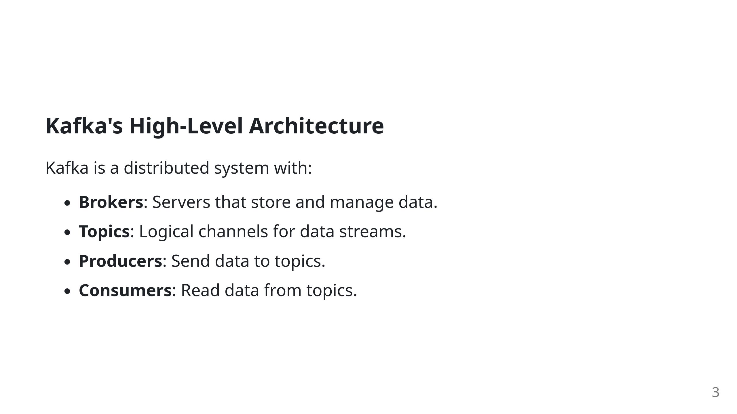

Slide 4

Notes:
Kafka docs diagram of brokers ![width:400px center](assets/kafka-architecture-diagram.png) <!-- Kafka Architecture Diagram [Reference: Novell Zenworks — Kafka documentation](https://www.novell.com/documentation/zenworks-24.4/zen_kafka/data/zen_kafka.html)

Slide 5
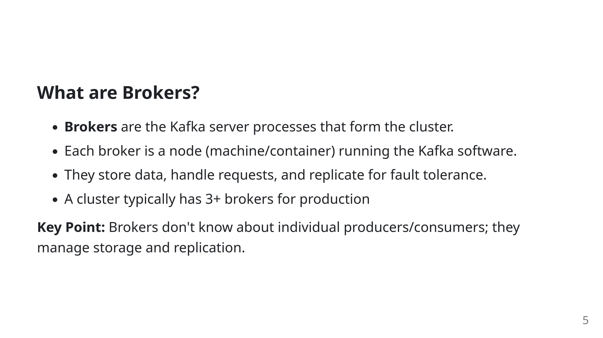

Slide 6
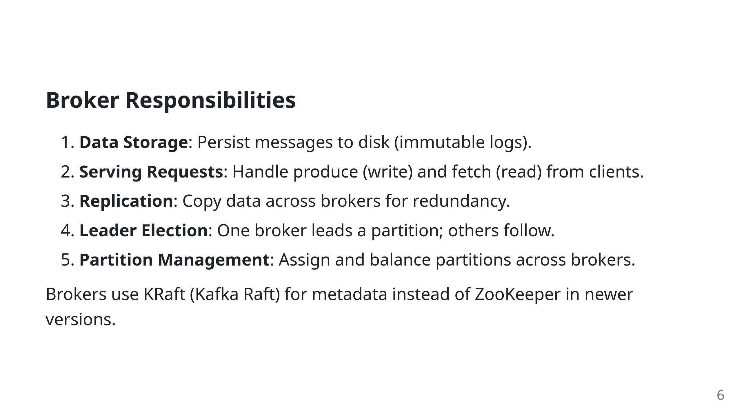

Slide 7
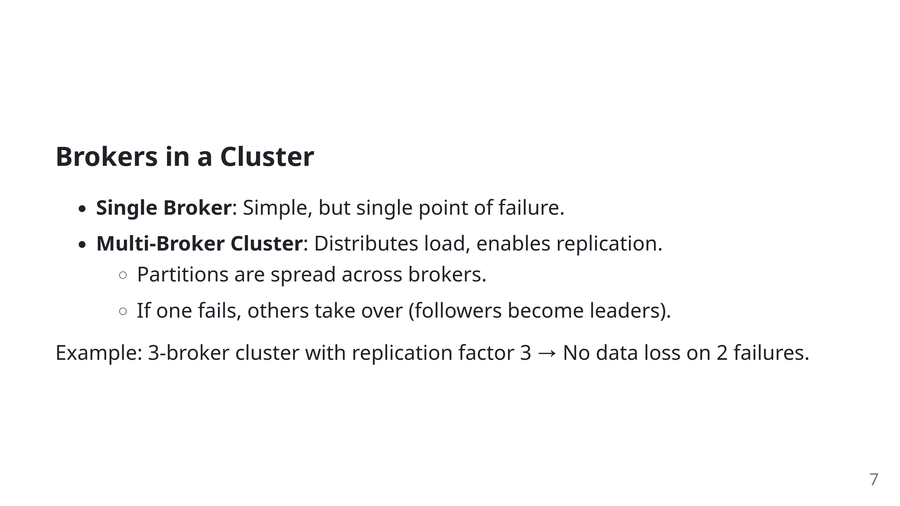

Slide 8
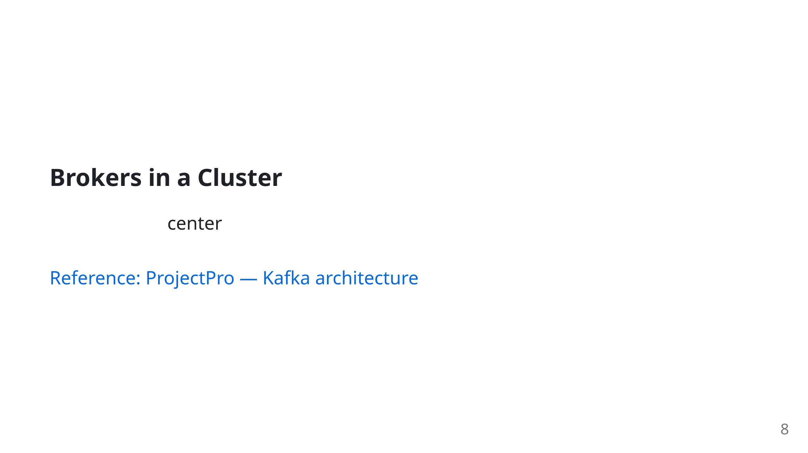
Notes:
Kafka docs diagram of brokers

Slide 9
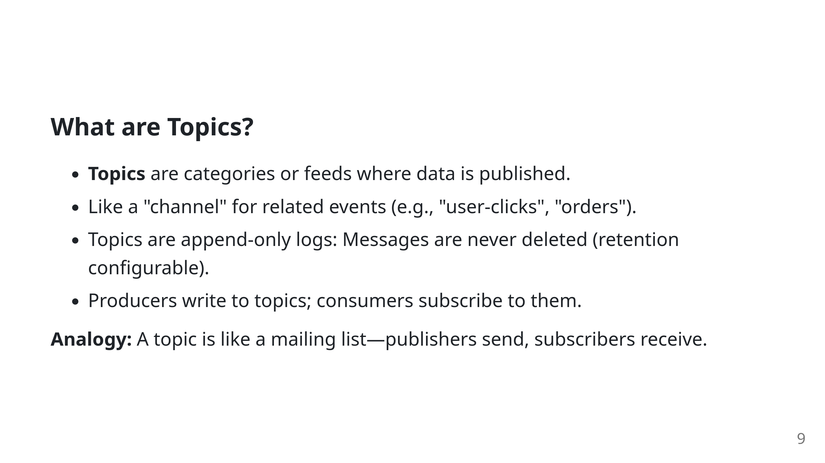

Slide 10
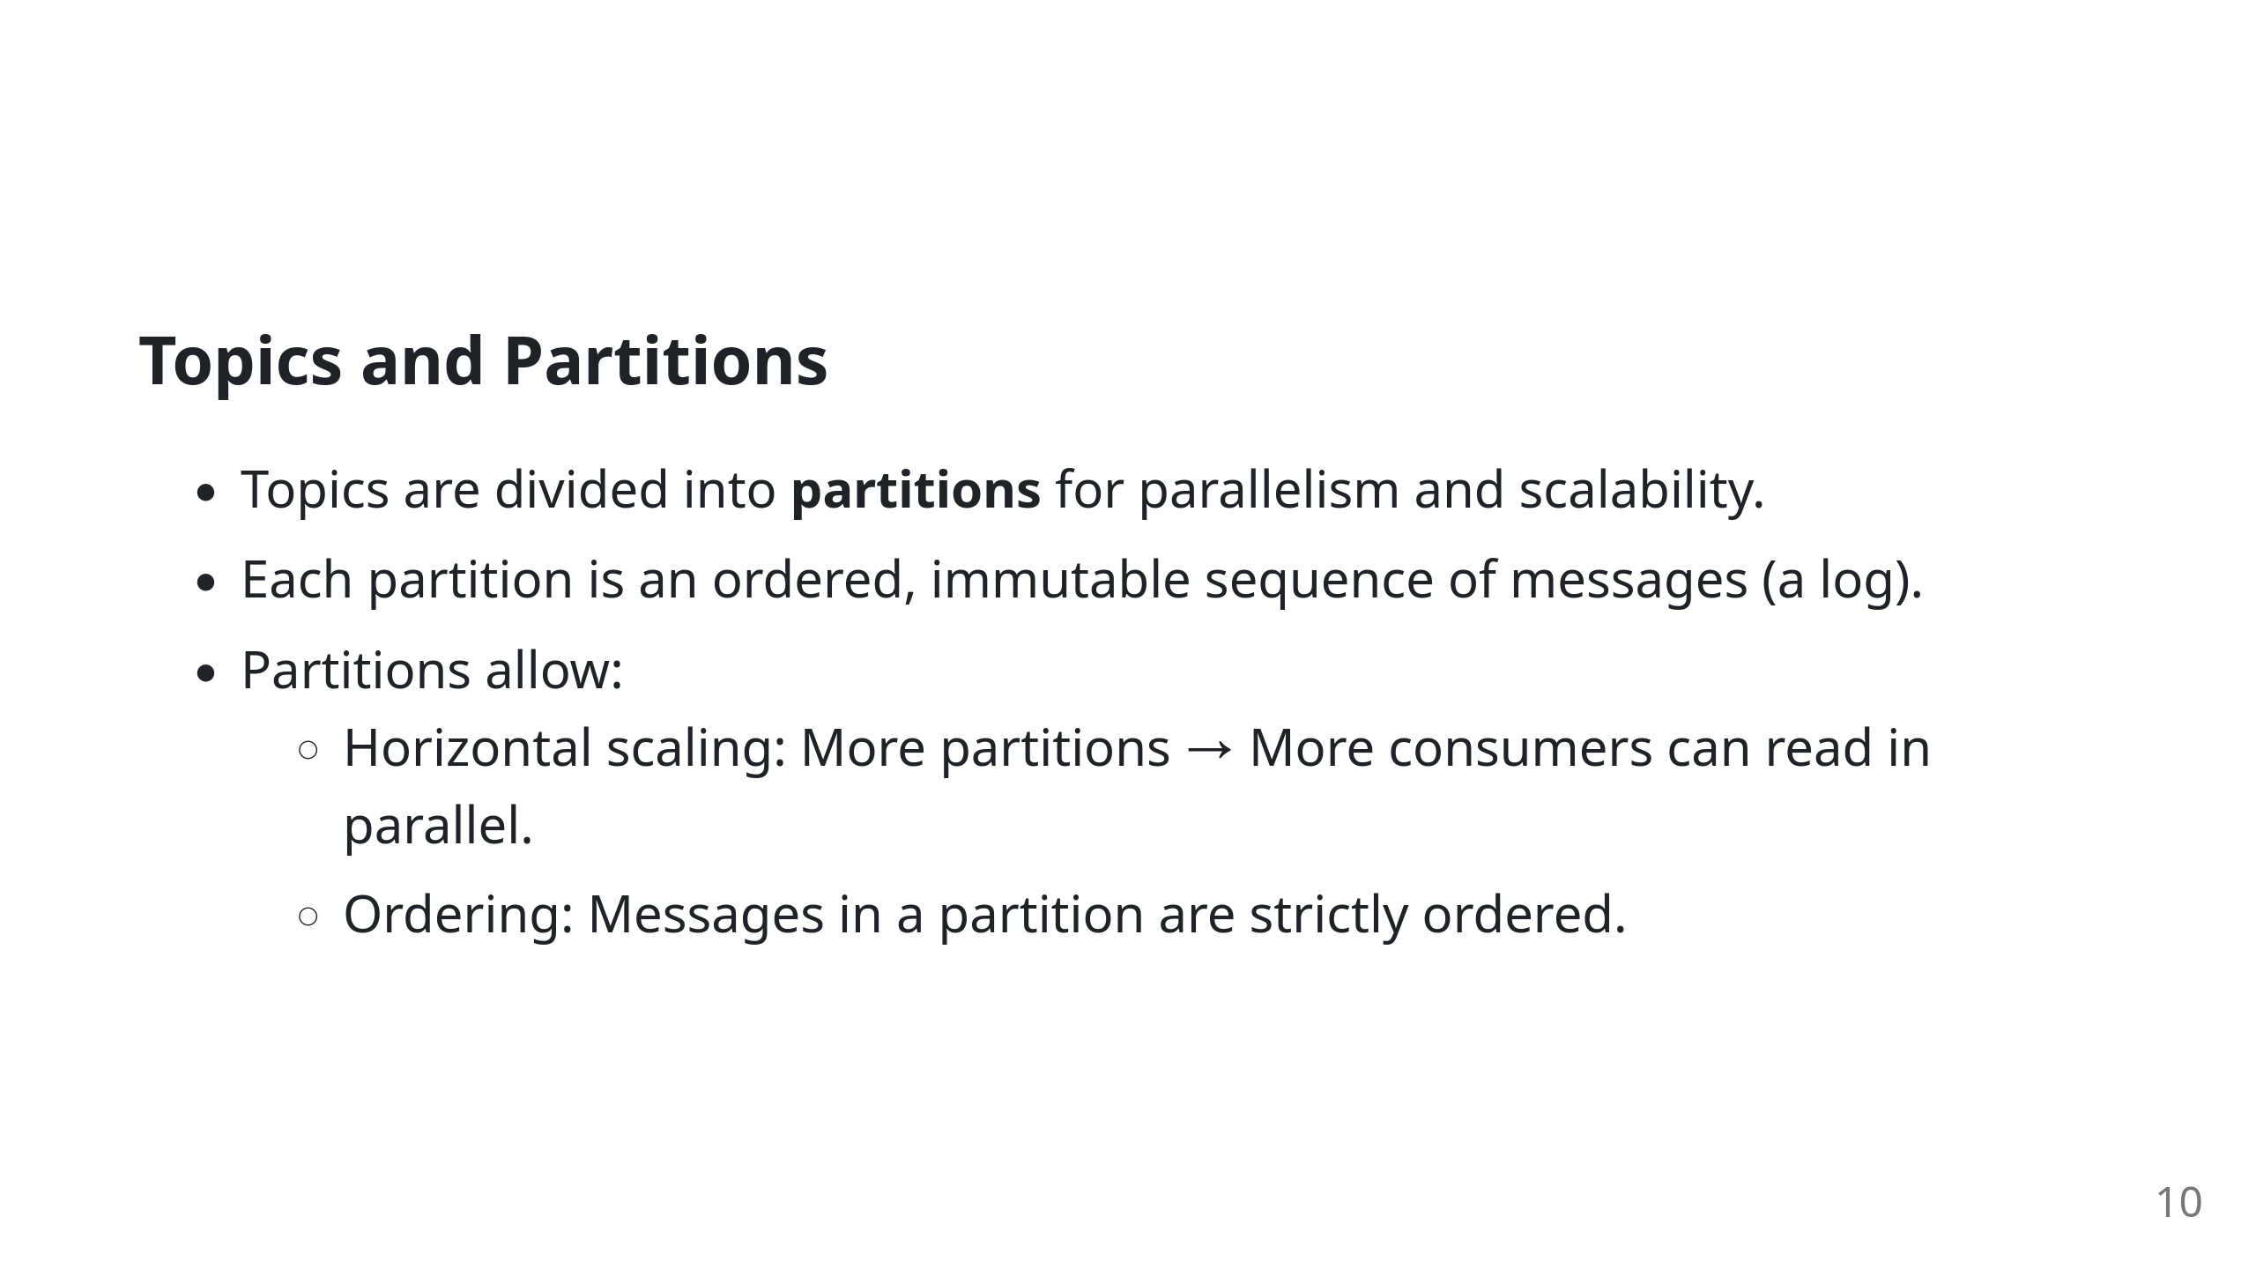

Slide 11
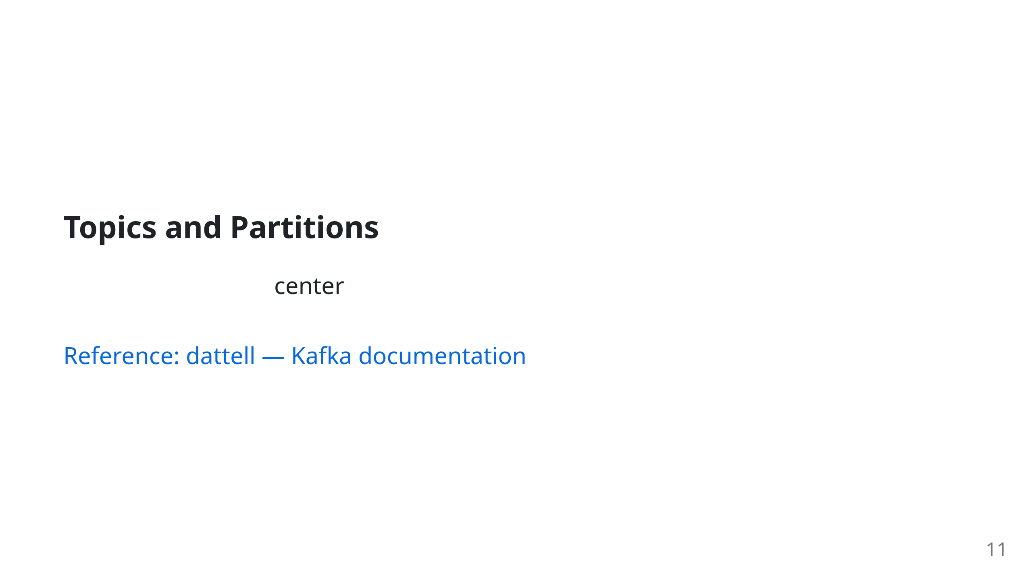
Notes:
Topic Partitions

Slide 12
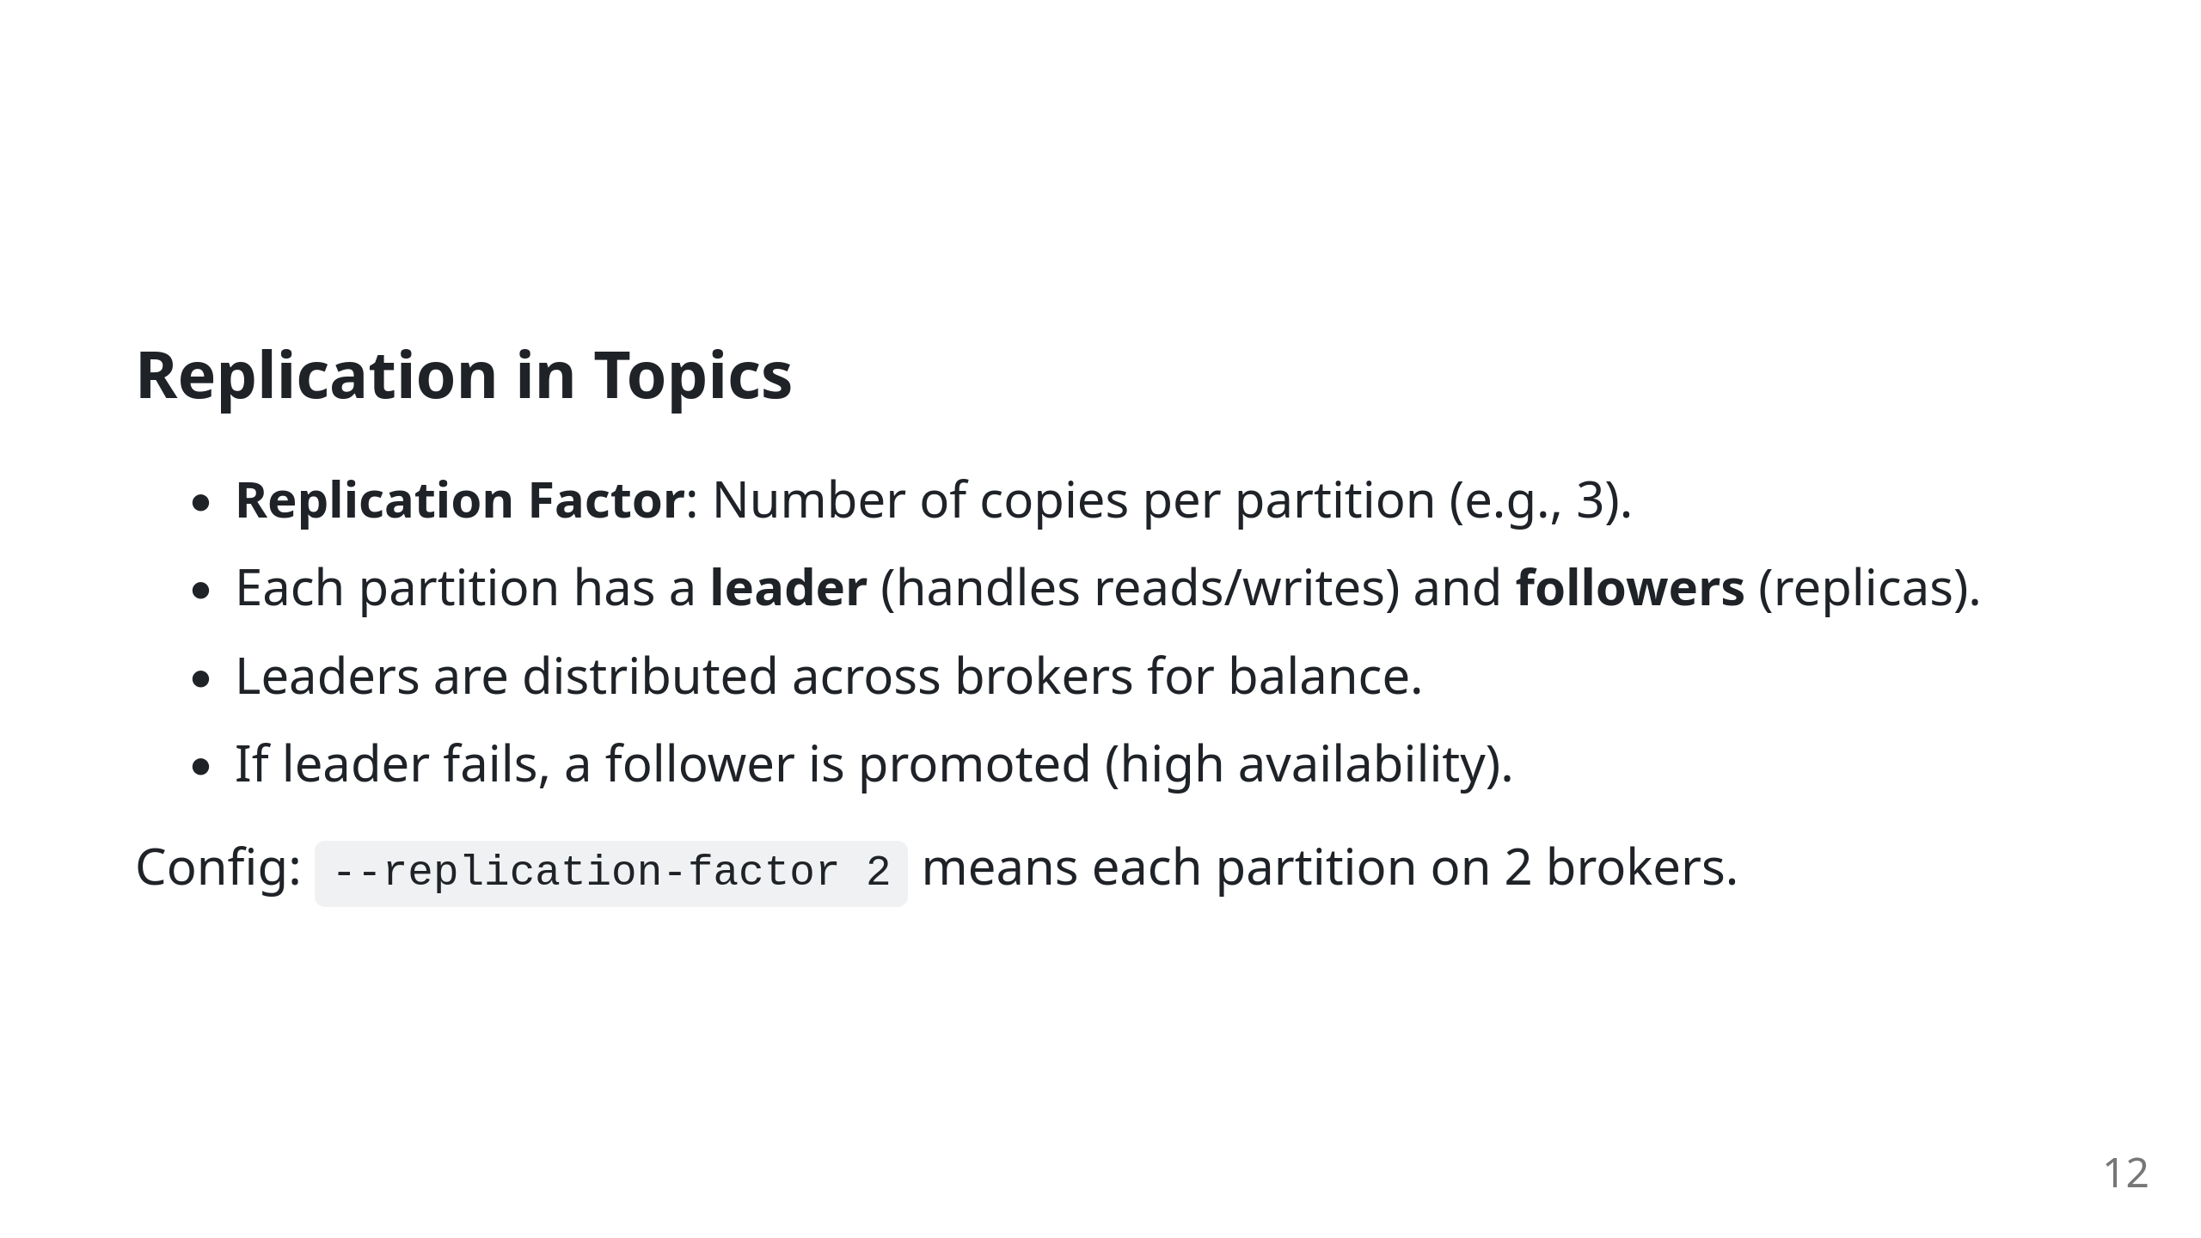

Slide 13
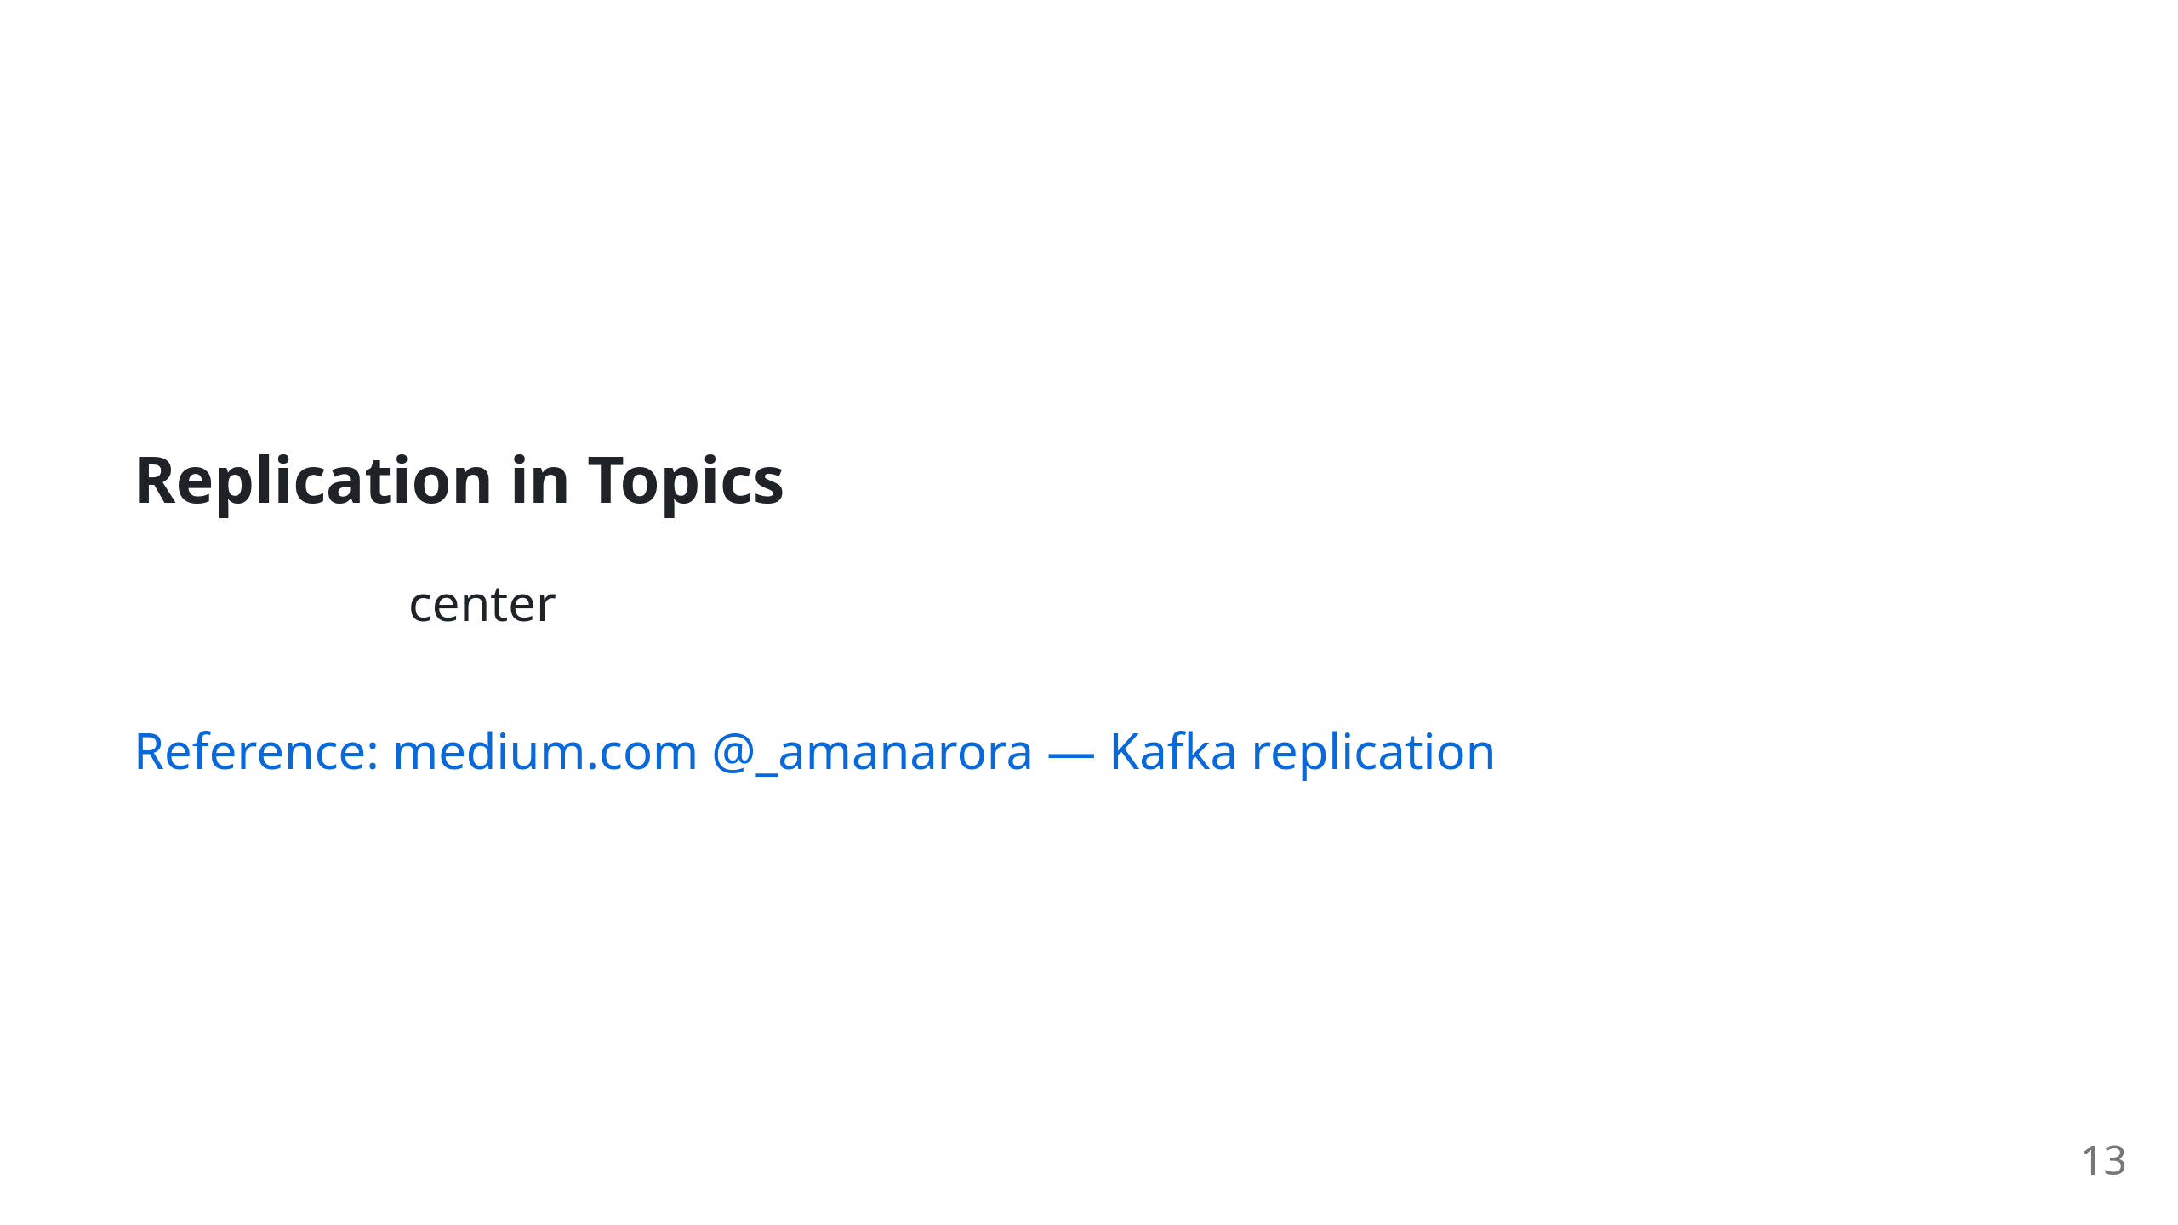
Notes:
Replication Diagram

Slide 14
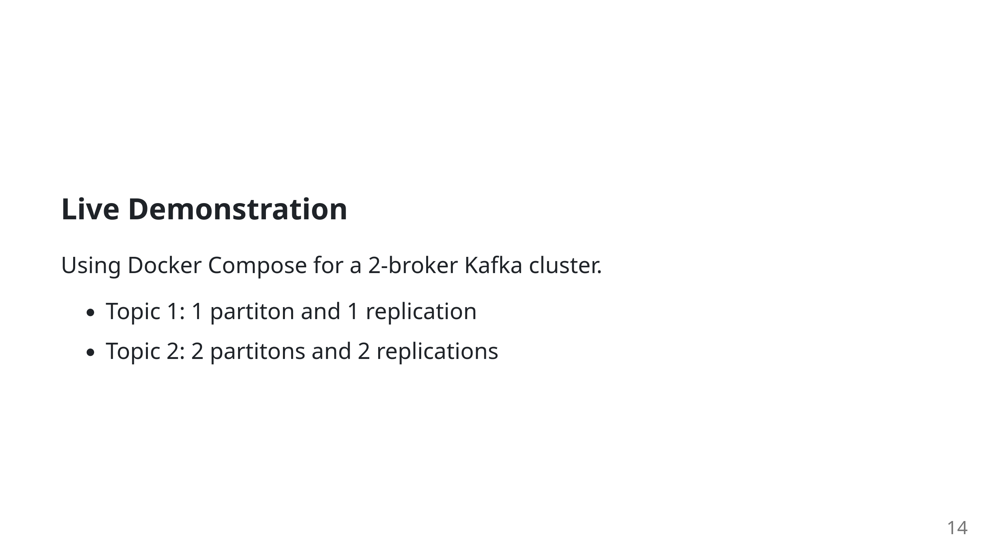

Slide 15
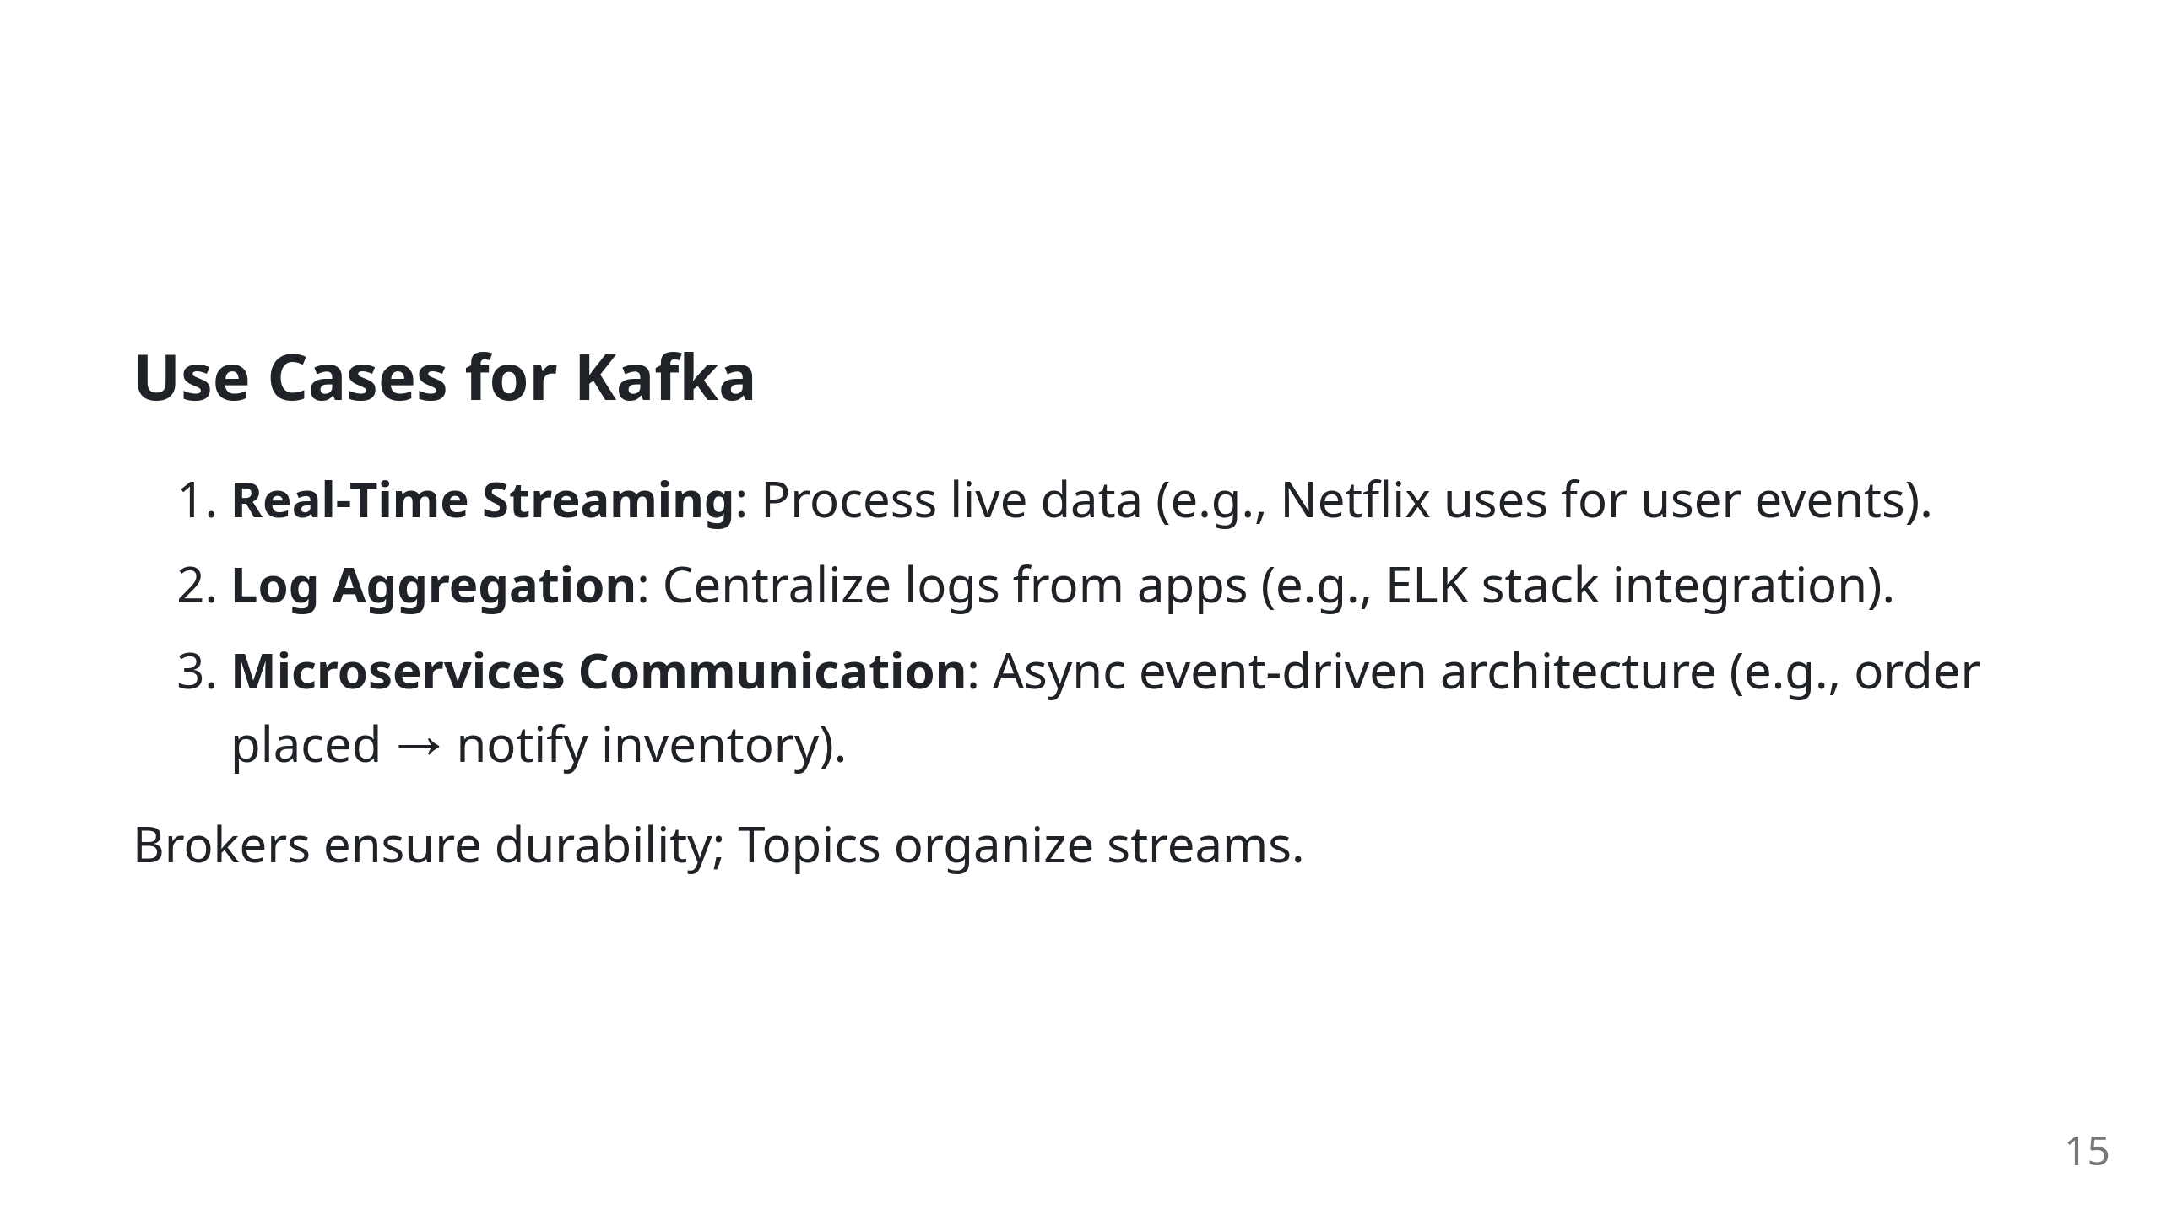

Slide 16
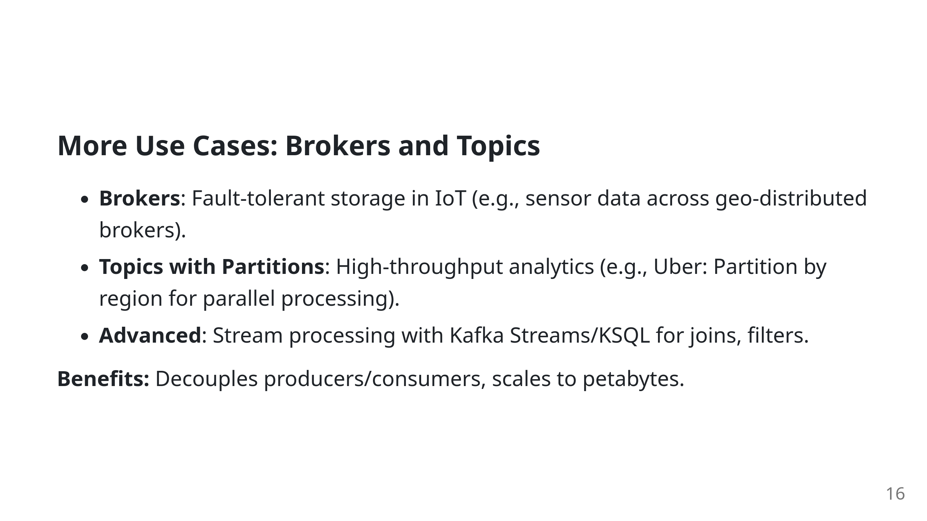

Slide 17
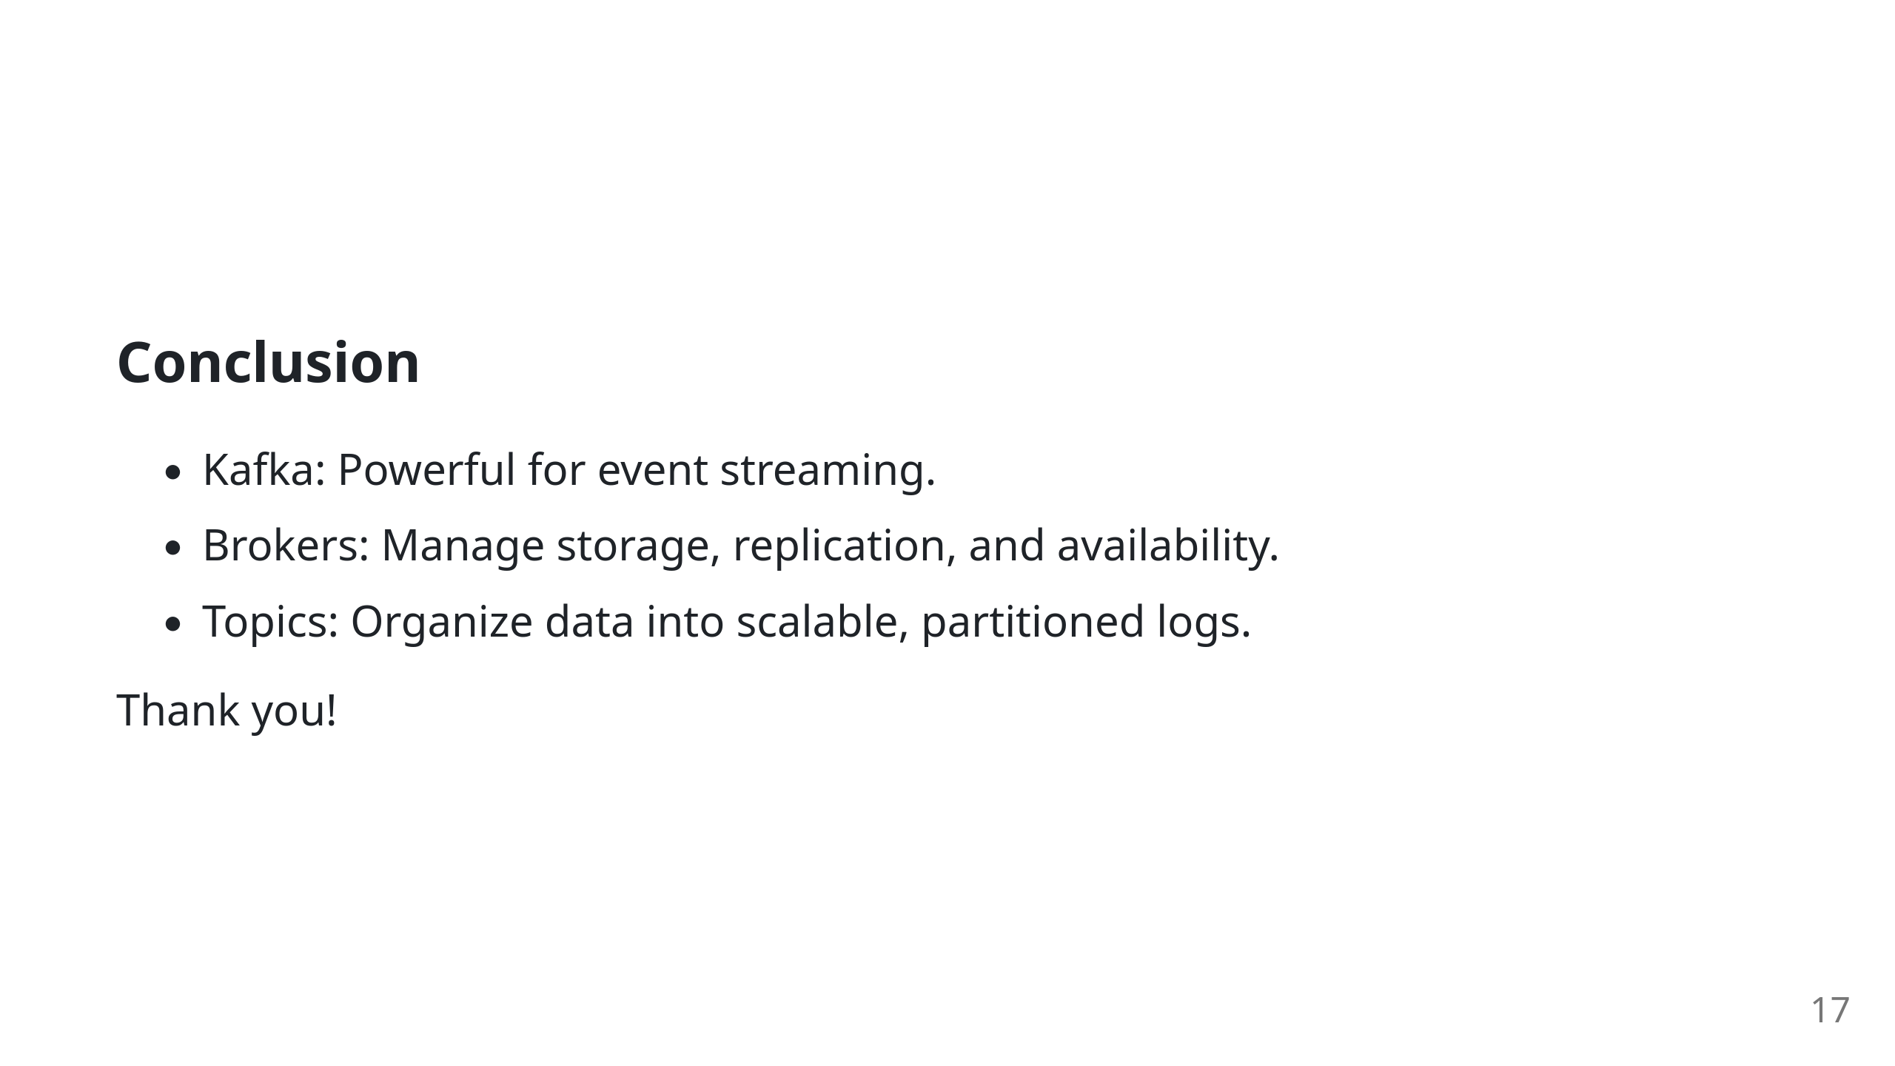

Slide 18


