Slide 1

Building PW, VW, and EW Portfolios
16 September 2025
Overview of our three portfolios including how they performed against and correlated to three major indices

Slide 2
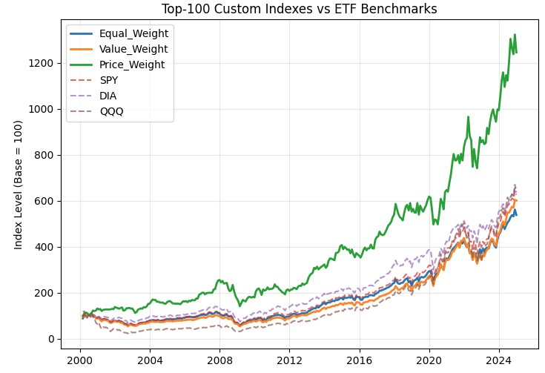
11.2%
7.5% v 8.3%
Lehman Brothers 2.0
Year-over-year returns for the price-weighted index from 2000-2024 using the top 100 stocks
Year-over-year comparison of the value-weighted portfolio (with 100 stocks) and the S&P 500 from 2000-2024
Major Takeaways:
Large vs small cap returns:
Small cap has value from 2000-2016
Magnificent 7 and other market leaders (BRK) have dominated since 2016 without frequent stock splits

Slide 3
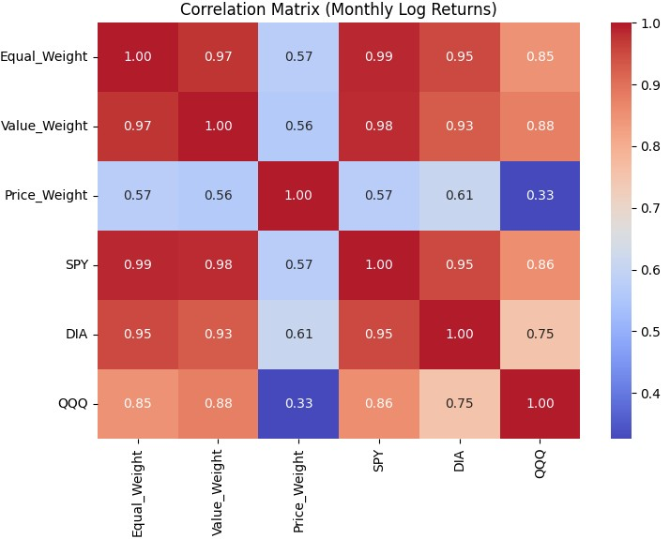
Lehman Brothers 2.0
Weighting Styles
The value-weighted portfolio has a high correlation with the S&P 500 (SPY) and NASDAQ (QQQ) because these indices are also value-weighted. The price-weighted portfolio has the highest correlation with the DOW (DIA) because of their shared weighting style.
Investable Universe
The three portfolios created were all using the top 100 stocks. This constraint led to a bias towards large cap stocks. Even the equal-weighted portfolio favored large cap, because it was only the top 100. This led to high correlations between EW, VW, SPY, QQQ, and DIA.
Sectors of Focus
Although QQQ is value-weighted, there is a lower correlation with the other portfolios, most likely due to not investing in the financial sector. Financial services is the second largest sector today (at 15.22%) so QQQ excluding these stocks can lead to a lower correlation.

Slide 4
Thank you
Nathan Arimilli, Joseph Bailey, Shahmir Javed

