Slide 1
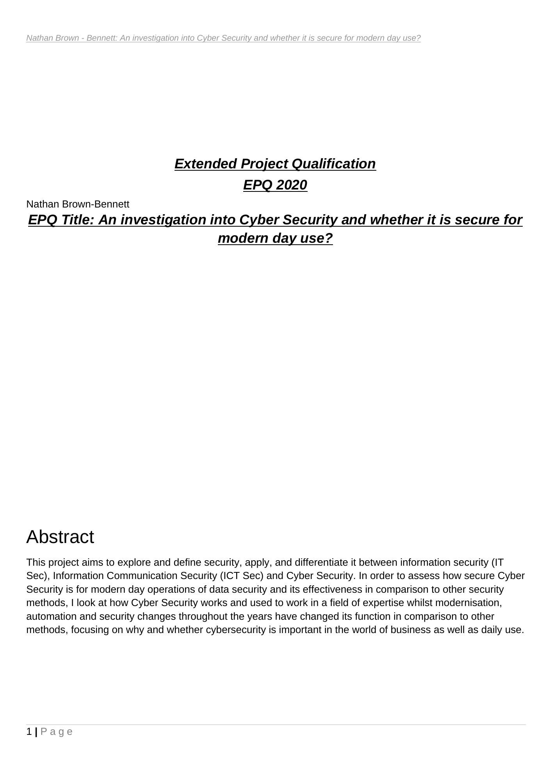
RESEARCH NOTES / EPISODE 01
Can cybersecurity keep pace with modern digital risk?
A new 2026 investigation built from my first A-level dissertation—and the question that led towards safer product decisions.
Nathan Brown-Bennett · Revised July 2026
1
Notes:
Open with the original question and explain that this is a new standalone investigation; the assessed 2020 submission remains preserved as the historical record.
The imperfect wording contains the long-term product question: how can protection be practical enough to use and strong enough to matter?

Slide 2
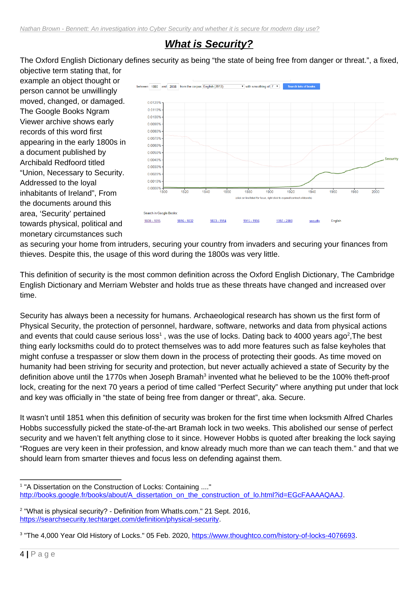

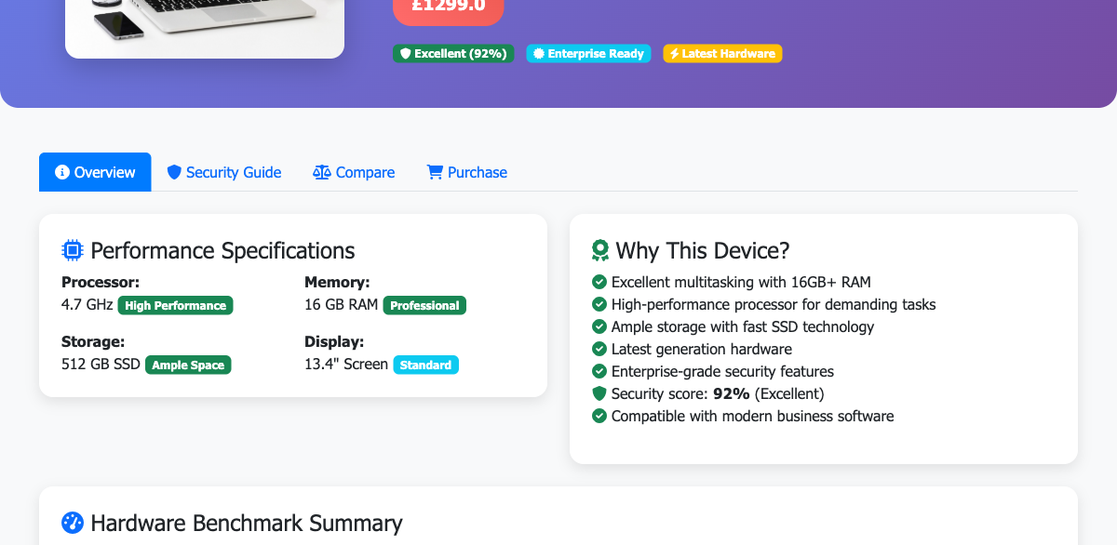
One question became a research-to-product thread
2020 / A-LEVEL EPQ
UNDERGRADUATE
WORKING PRODUCT
Why is protection hard to understand and apply?
“How do we decide what we provide?”
Device Provisioning Toolkit
A repeatable workflow for discovery, comparison and hardening.
A broad question about effective security.
A focused study of evidence and device choice.
2
Notes:
This series follows the intellectual lineage, including what changed—not just finished outputs.

Slide 3
Security is managed harm reduction—not a guarantee
A security decision identifies something of value, the threats and weaknesses that could affect it, the likely consequence, and the controls proportionate to that risk.
A practical test
What are we protecting? From which harm? Who owns the decision? How will we know the control works? What happens when it fails?
CONFIDENTIALITY
INTEGRITY
AVAILABILITY
RESILIENCE
CONTEXT
Prevent unauthorised disclosure
Prevent unauthorised change
Keep authorised access and service
Contain disruption and restore trust
Add safety, privacy, authenticity and accountability where needed
3
Notes:
The term security is contextual. A control can reduce risk without making the system permanently safe.

Slide 4
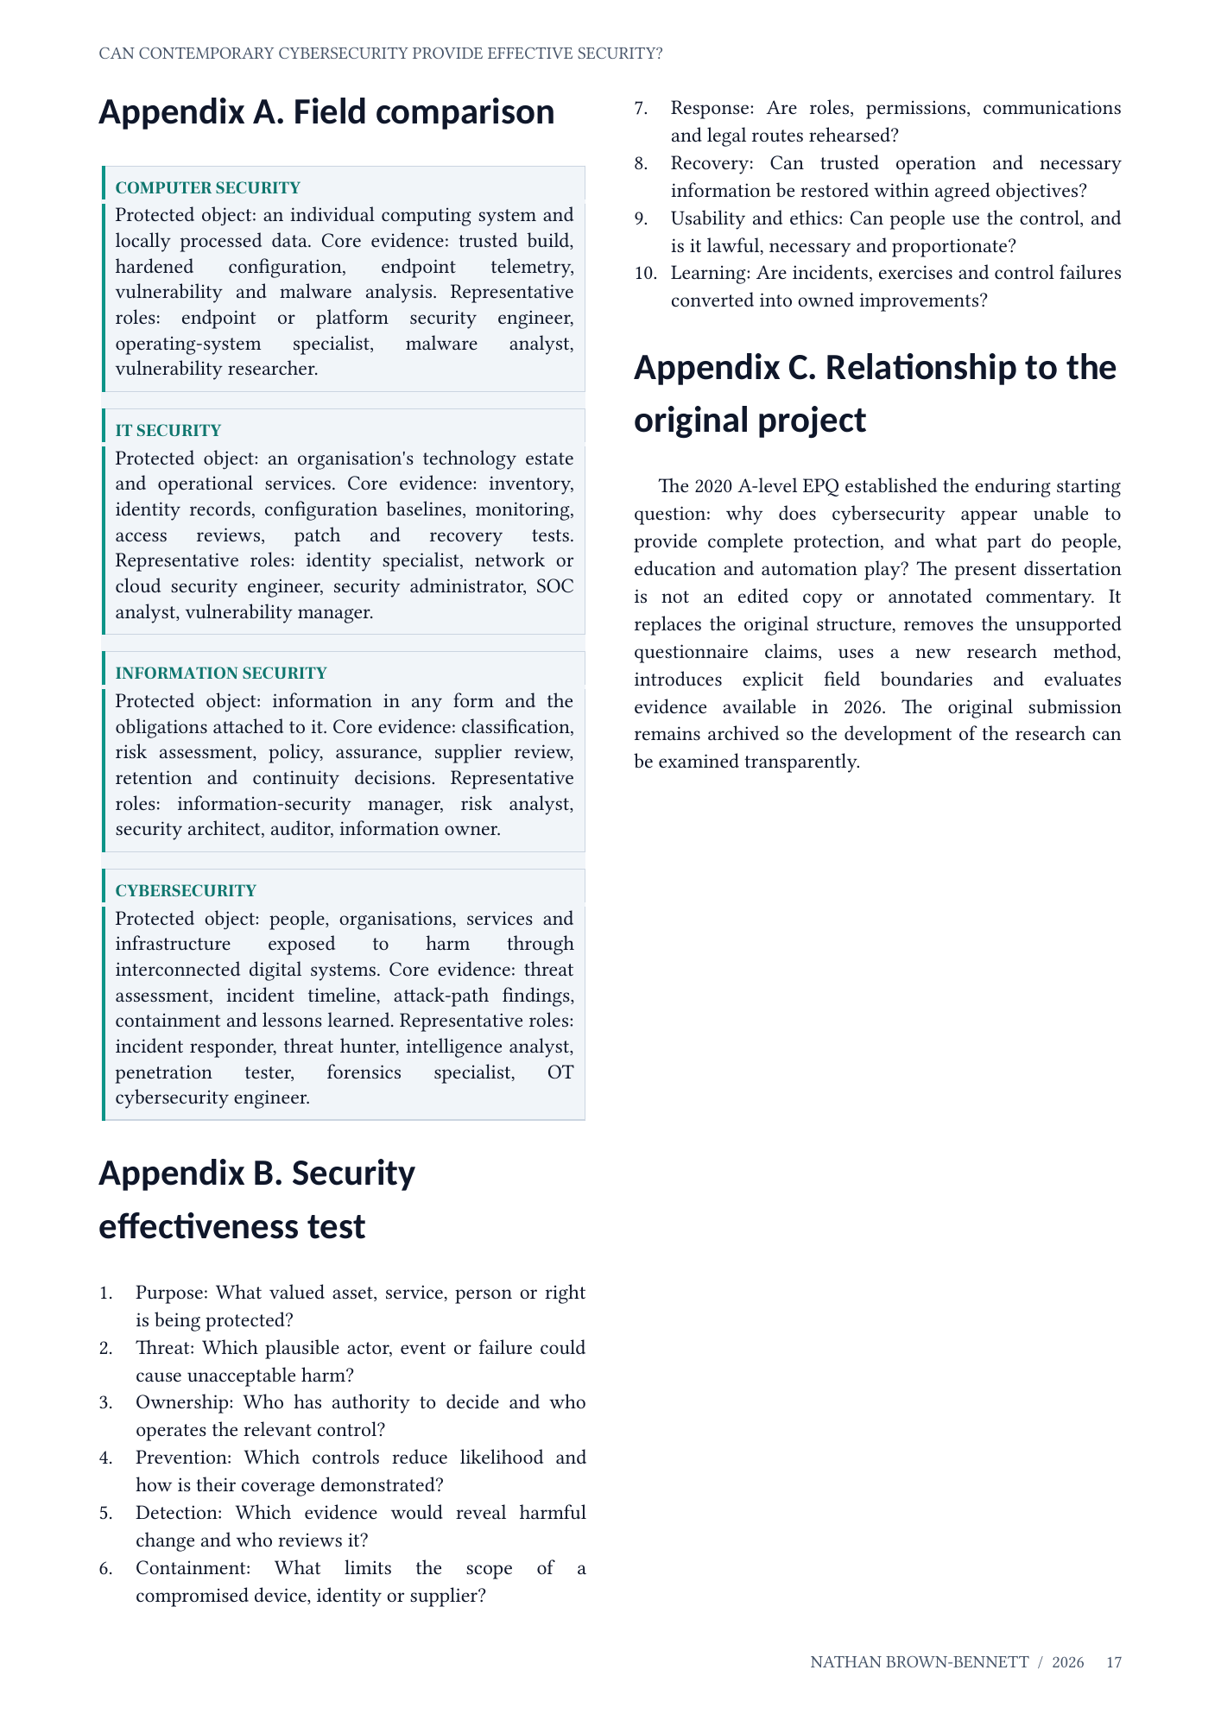
The security fields overlap—but protect different boundaries
FIELD
PRIMARY BOUNDARY
WHAT IT HANDLES
Computer security
One device or computing system
OS, software, memory, storage, local data
IT security
An organisation’s technology estate
Devices, identities, networks, cloud, applications, backups
Information security
Information in any form
Digital, paper or spoken information; confidentiality, integrity, availability
Cybersecurity
Harm through connected digital systems
Technology, information, people, services and physical processes
The labels clarify ownership. They should not create silos.
2026 DISSERTATION / APPENDIX A
von Solms & van Niekerk (2013); NIST CSF 2.0
4
Notes:
Define the protected boundary first. The same incident can cross all four fields.

Slide 5
Roles are organised around outputs—not universal job titles
FIELD
TYPICAL ROLES
ACCOUNTABLE OUTPUTS
Computer
Endpoint / platform engineer OS specialist · malware analyst
Hardened builds · patch baselines endpoint controls · findings
IT
Security analyst · IAM specialist network / cloud security engineer
Managed access · architecture monitoring · backup · recovery
Information
Security manager · risk specialist governance lead · asset owner
Classification · risk treatment policy · assurance · audit evidence
Cyber
SOC analyst · incident responder threat intel · pentest · AppSec
Threat-led defence · detection containment · testing · improvement
Small organisations may combine every duty in one IT role; larger organisations may split one duty across several teams.
5
Notes:
A title alone does not prove the scope. Ask what the role owns, can change and must evidence.

Slide 6
One stolen credential creates four connected questions
Scenario: a staff laptop is compromised through a stolen cloud credential.
COMPUTER
IT
INFORMATION
CYBER
Was the endpoint patched, hardened and able to isolate activity?
How were the identity, device, network and cloud service administered?
Which records were exposed, how sensitive were they, and what duties follow?
What was the connected attack path, wider harm, containment and recovery?
Clear handoffs close the gaps: technical evidence → access revocation → impact assessment → coordinated containment and learning.
6
Notes:
Use the scenario to show overlap without collapsing the fields into synonyms.

Slide 7
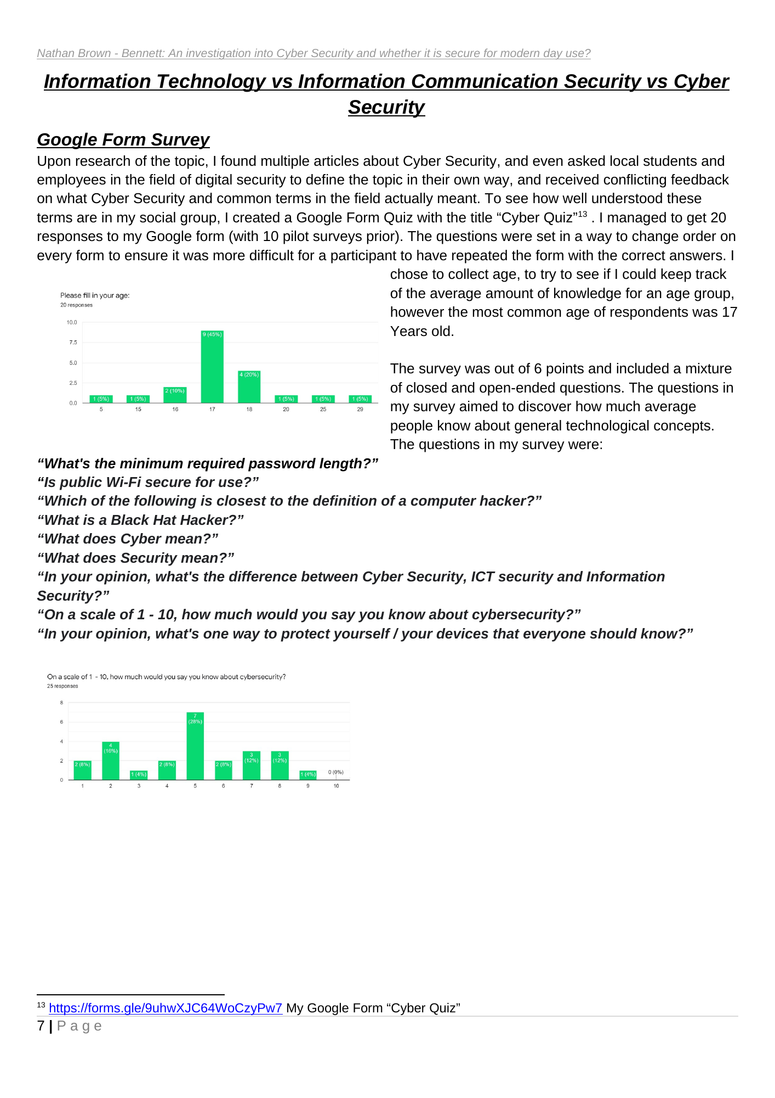
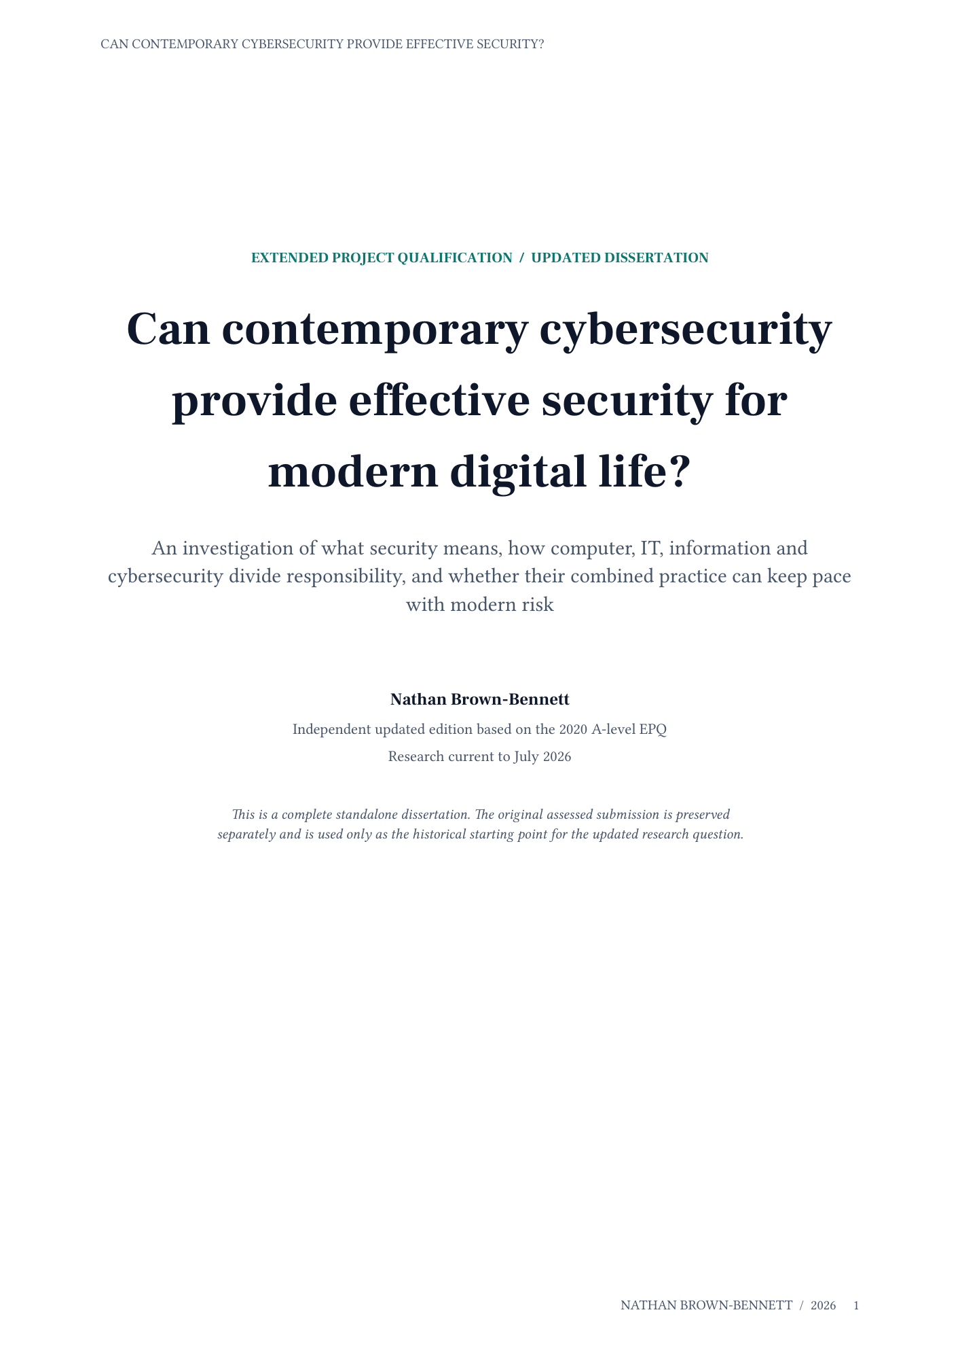
The original instinct was useful; the diagnosis needed work
WHAT SURVIVED
WHAT CHANGED
• Perfect security is not operational • Public understanding matters • Automation is necessary at scale • Security connects technology and society
• Breaches do not prove defence is useless • “Human error” signals system design • AI augments accountable professionals • The survey was exploratory
2020 submission
2026 standalone dissertation
7
Notes:
Be reflective rather than dismissive. Show development in judgement and methodology.

Slide 8
The real gap is adoption—not a binary score
Exposure is widespread. Governance and preparation remain inconsistent.
43%
UK businesses identifying a breach or attack
204
nationally significant incidents handled by the NCSC
30%
businesses completing a cyber-risk assessment
25%
businesses with a formal incident-response plan
Attack prevalence measures exposure and detection—not the absence of defensive value.
DSIT & Home Office, Cyber Security Breaches Survey 2025/2026; NCSC Annual Review 2025
8
Notes:
Explain the survey caveat: unidentified and undisclosed incidents mean prevalence is not a complete count.

Slide 9
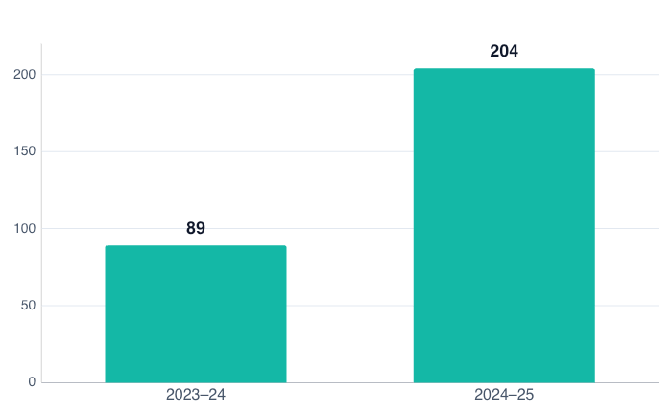
Nationally significant incidents rose sharply
2.3×
more nationally significant incidents handled than the previous year
Pressure increased—but the NCSC also states that many more attacks fail than succeed, and prepared organisations recover better.
NCSC Annual Review 2025. Categories and reporting are not a complete census.
9
Notes:
Use the increase to establish urgency, then immediately avoid the false conclusion that every incident means all defence failed.

Slide 10
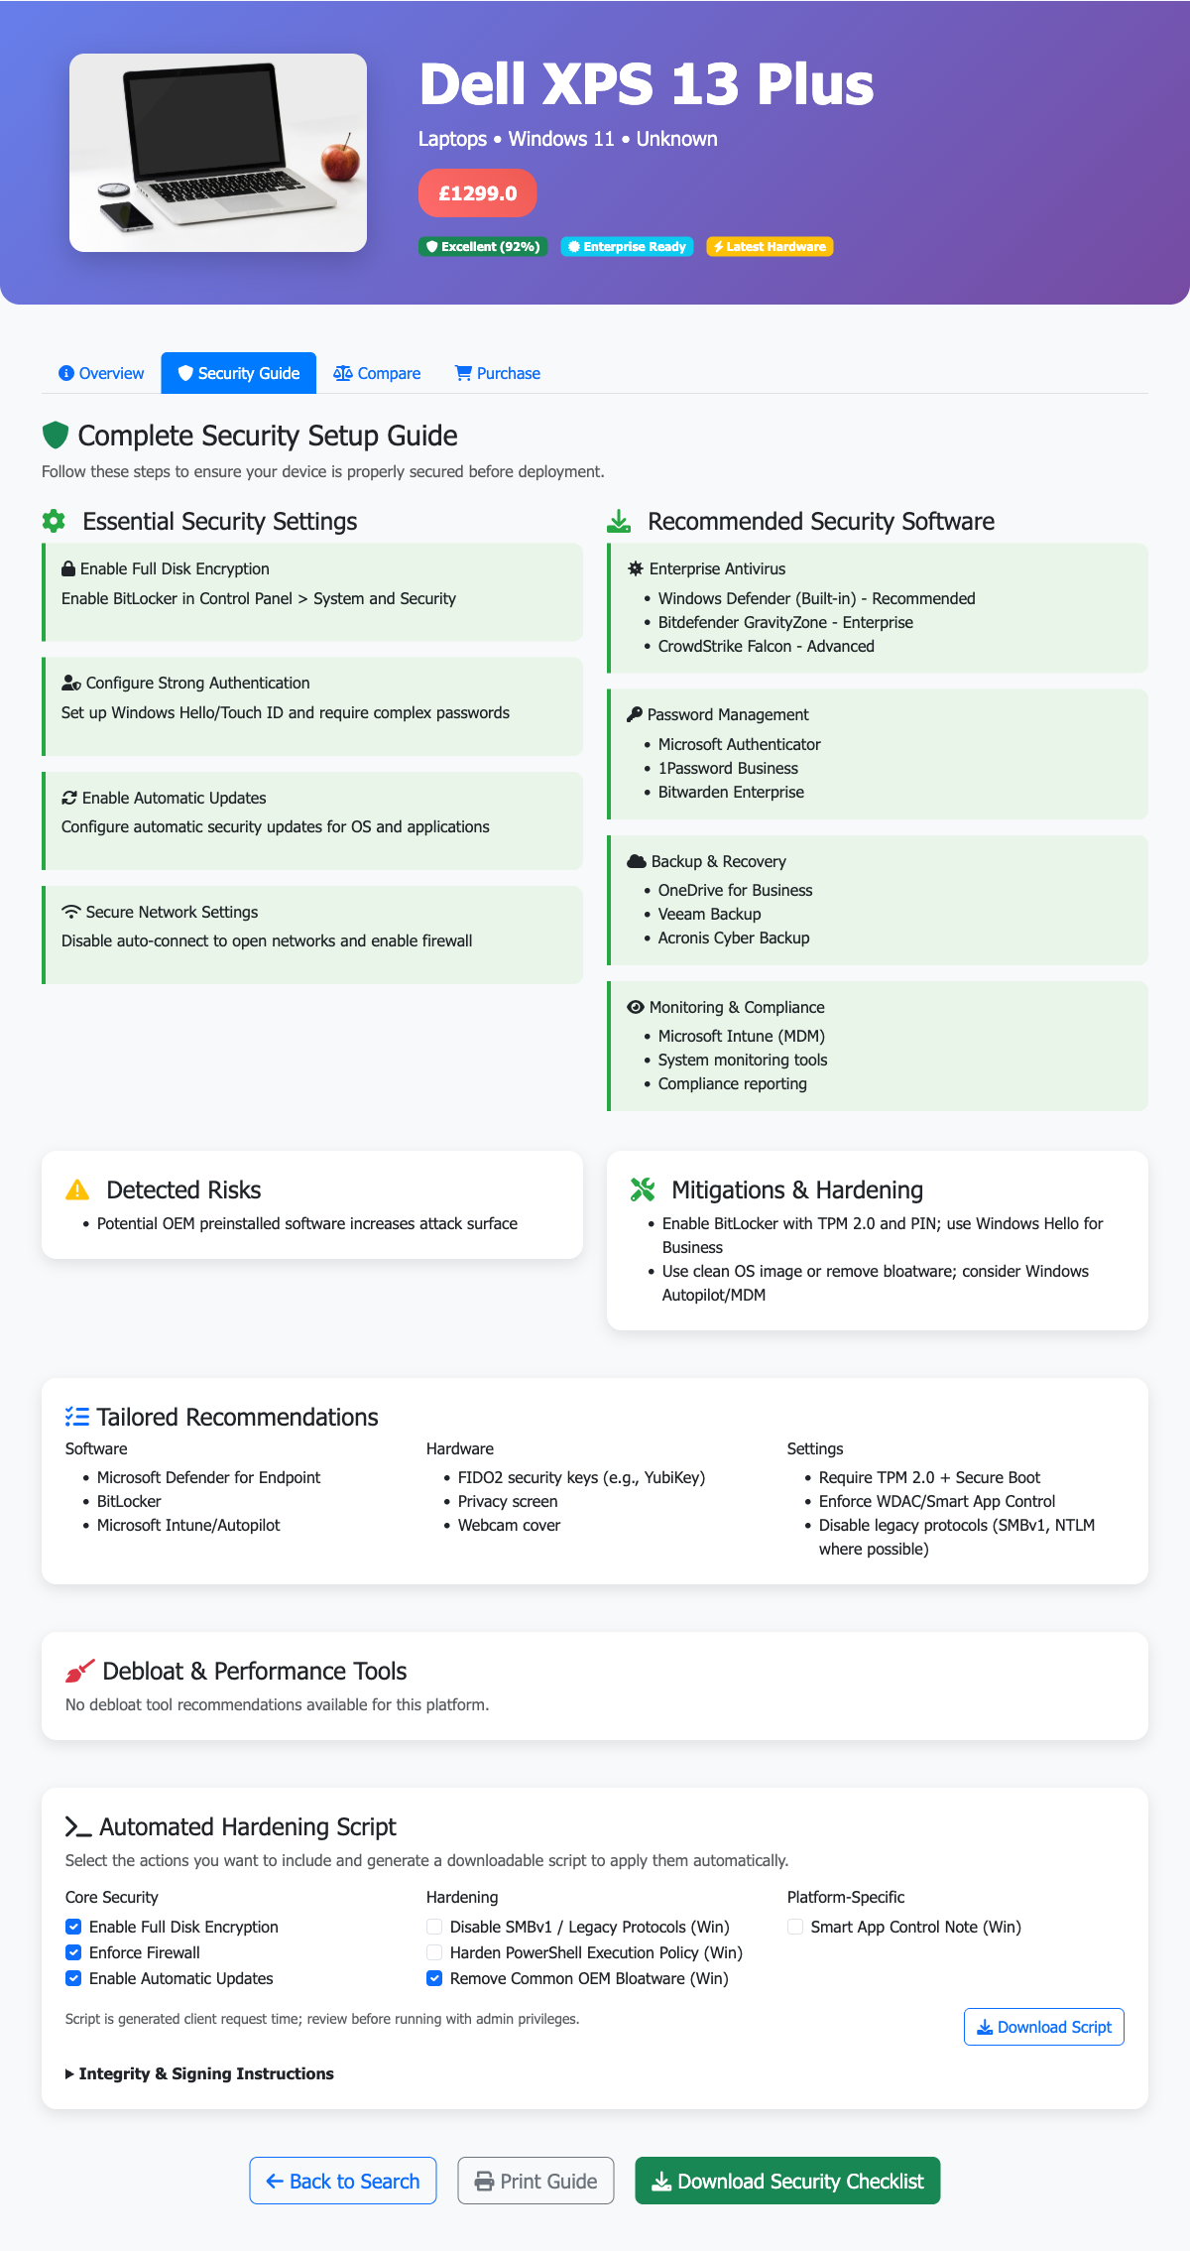
A mistake is a design signal—not the end of the analysis
If one ordinary action can create catastrophic harm, examine the architecture around it.
REDUCE PRIVILEGE
One account should not expose everything.
USE SAFER DEFAULTS
Secure setup should be the easy path.
MAKE REPORTING SAFE
Early honesty should reduce harm—not trigger fear.
DESIGN RECOVERY
Contain failure and restore trusted operation.
Training matters. It is not a patch for an unsafe product.
CURRENT PRODUCT ARTEFACT / TAILORED SECURITY GUIDE
NCSC secure-by-design guidance; Herley (2009)
10
Notes:
The revised work does not deny mistakes. It widens responsibility to defaults, permissions, interfaces, incentives and recovery.

Slide 11
AI changes both attack and defence—not accountability
DEFENCE
ATTACK
NEW SYSTEM RISK
Triage alerts Inspect code Summarise threat intelligence Spot unusual patterns
Scale convincing content Automate reconnaissance Search for weaknesses Accelerate intrusion steps
Training data Model behaviour Sensitive integrations Over-trust in outputs
Accountable people use automation with evidence, audit trails, realistic testing and a way to challenge the result.
NIST AI RMF 1.0 and Generative AI Profile; NCSC ML security principles
11
Notes:
Replace the old person-versus-machine framing with accountable augmentation.

Slide 12
Effective cybersecurity connects six continuous functions
GOVERN
IDENTIFY
PROTECT
Own risk, priorities and suppliers
Know assets, dependencies and threats
Reduce likely harm with usable controls
DETECT
RESPOND
RECOVER
Know when something changes
Contain, decide and communicate
Restore trusted service and learn
The test is not whether a control exists. It is whether people can use it, failure is contained, and the organisation can demonstrate that it works.
NIST Cybersecurity Framework 2.0
12
Notes:
Govern was added explicitly in CSF 2.0. Security is an enterprise decision, not only a technical team activity.

Slide 13
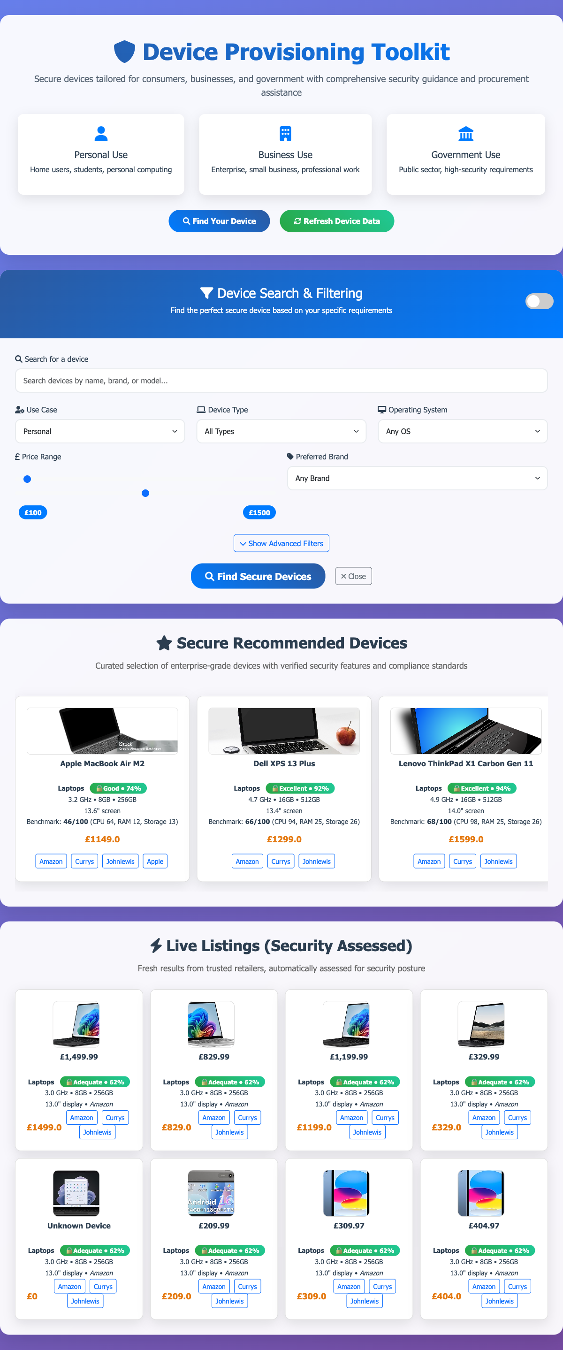
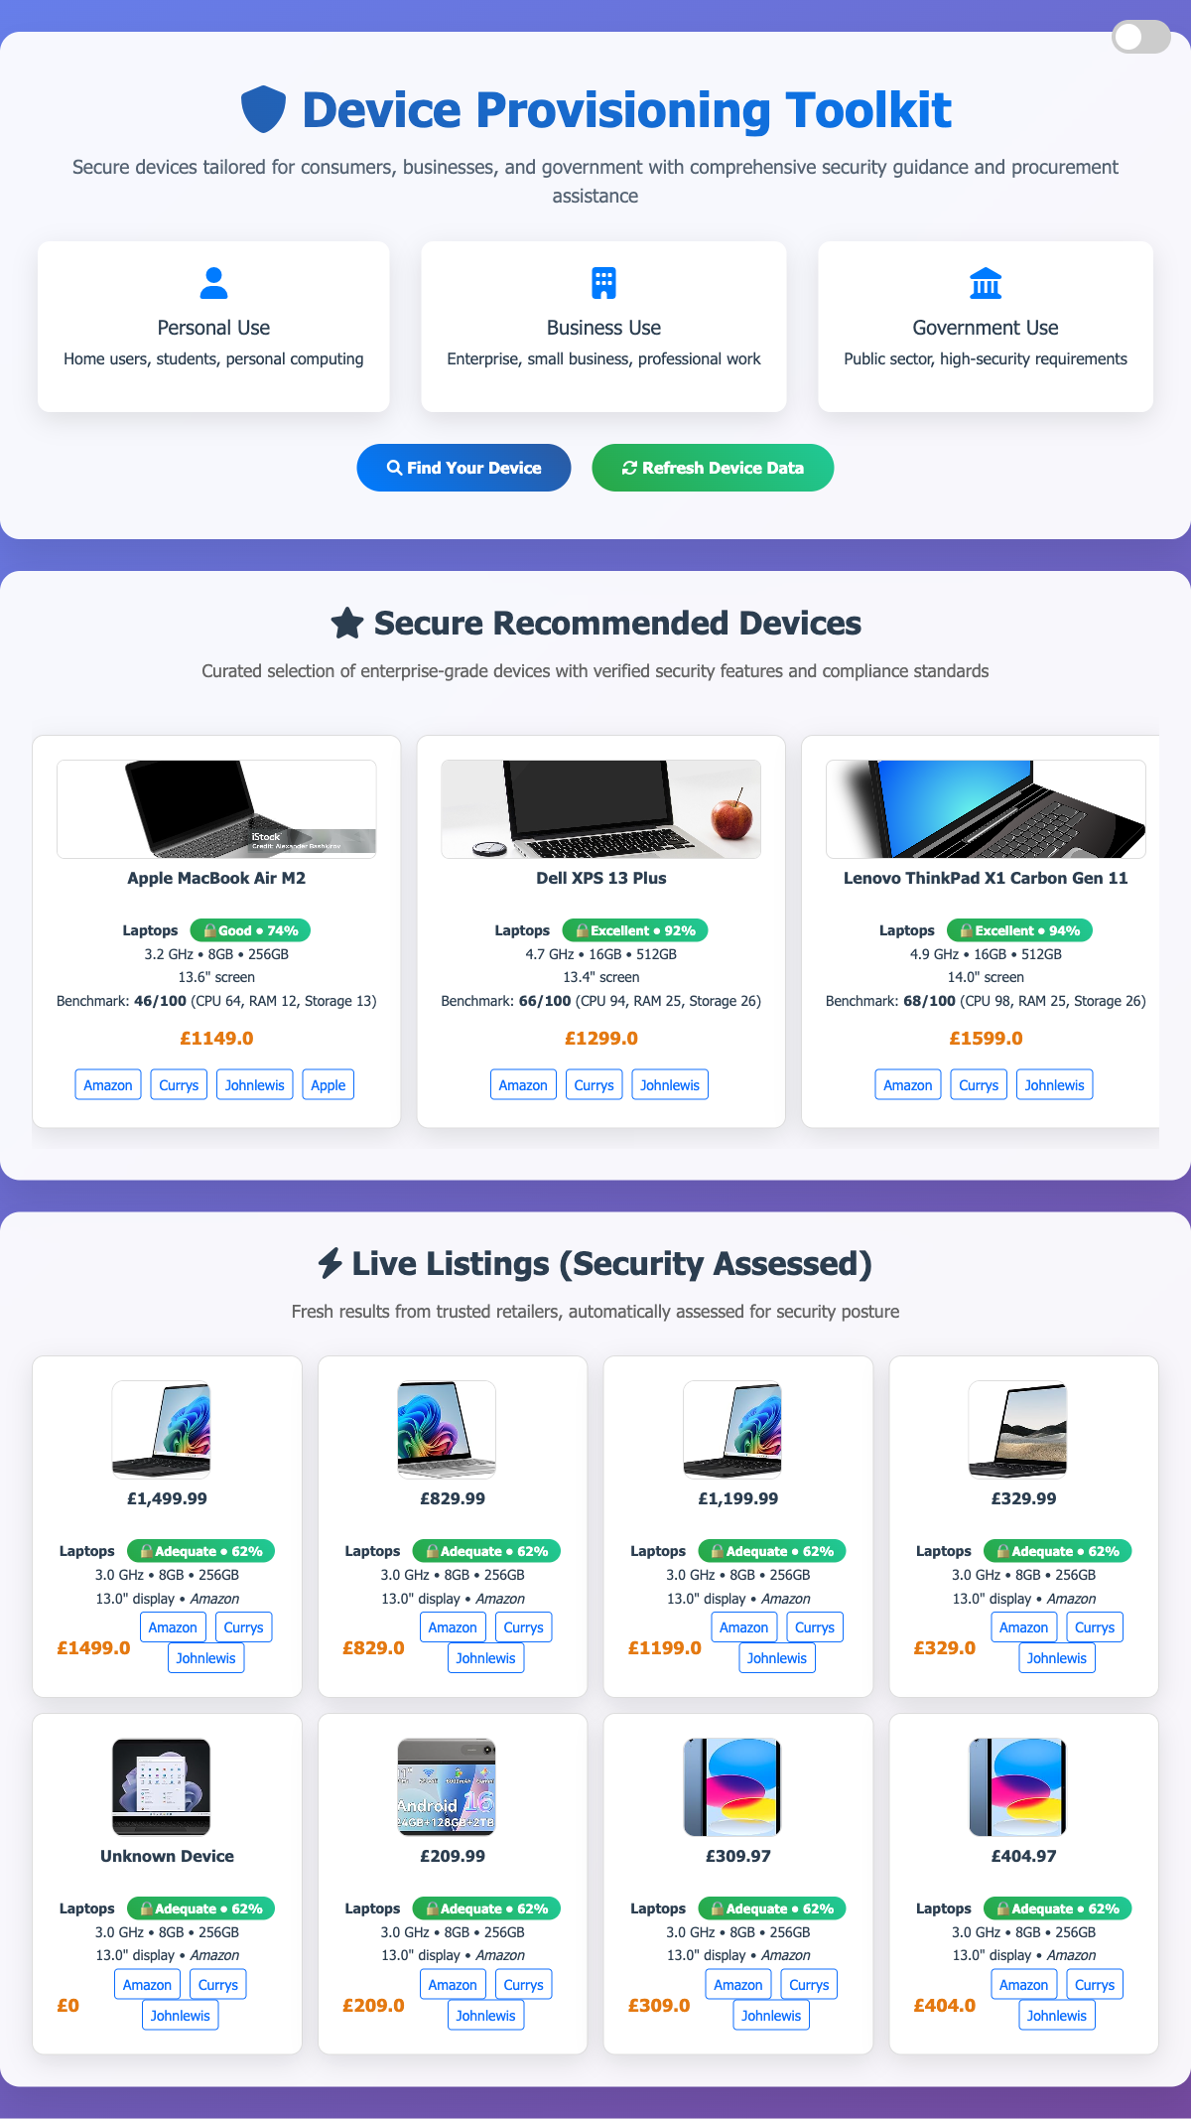
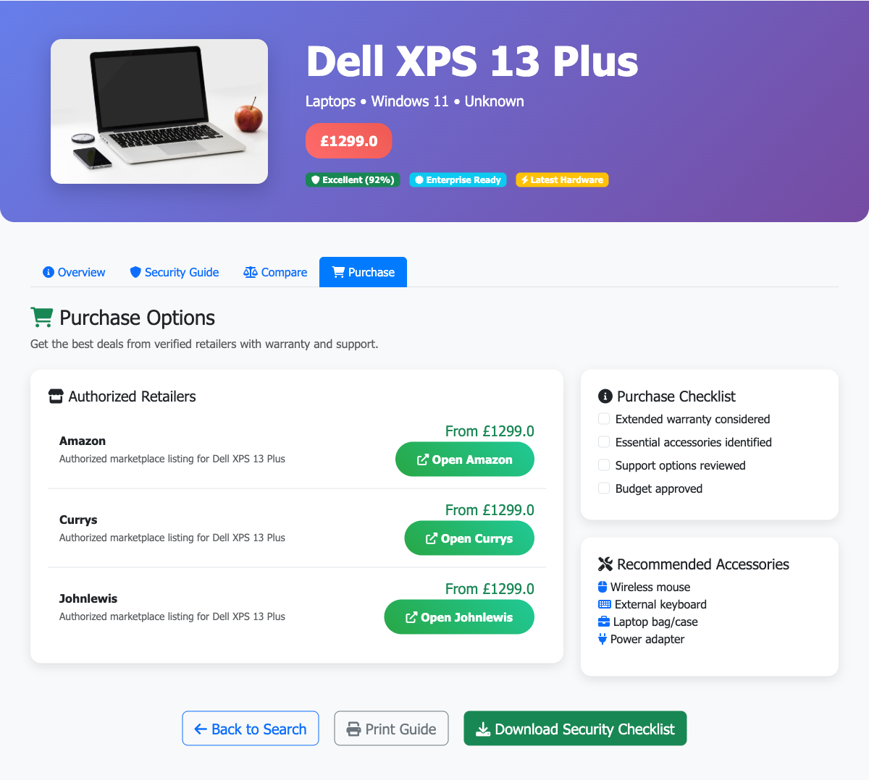
The research became a safer decision workflow
The toolkit turns research into a visible sequence: find a need, inspect evidence, then act on the decision.
1 / DISCOVER
2 / COMPARE
3 / ACT
Search and establish the requirement.
Review relevant devices and evidence.
Purchase or harden with an auditable next step.
13
Notes:
Use real current screens. State that this is a research prototype and generated guidance requires review.

Slide 14
THE 2026 ANSWER
Cybersecurity can keep pace—when it is continuous, governed, usable and designed for recovery.
Next: “How do we decide what we provide?” and the Device Provisioning Toolkit
14
Notes:
Close by resolving the opening question, then introduce the next episode.

