Slide 1
From Student For Student Presentation
Nathan Crowley 06/07/2021

Slide 2
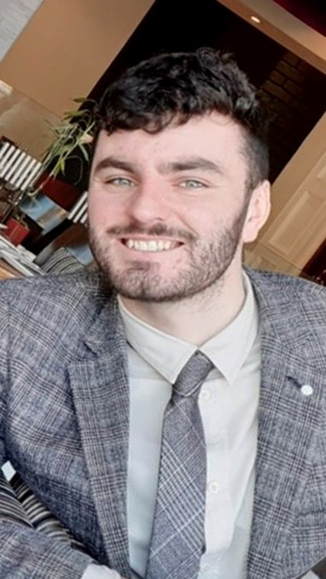
Introduction
My name is Nathan Crowley.
Currently study BSc Computer Science in University College Cork.
Recently completed third year with a First-Class Honours.

Slide 3
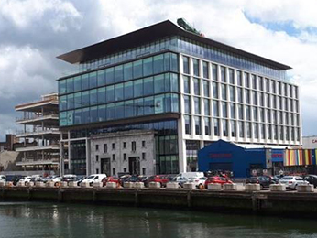
Clearstream Department
Started with Clearstream on the 22nd March 2021.
Employed as an IT intern – developer working with IFS IT Vestima Prime department.
Enjoyable experience with friendly and helpful staff.

Slide 4
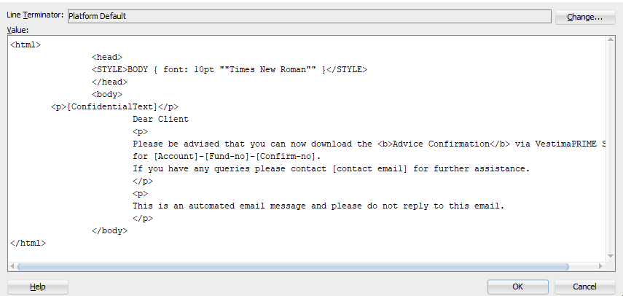

What I have done so Far
SQL & Java/XML
SQL script to update a database of automated emails with a placeholder ‘[Confidential Text]’.
Updated Java and Xml code inside JCCS to replace the placeholder with the given text inside the Xml.
DML/DDL checks to ensue the cutover ran successfully.

Slide 5
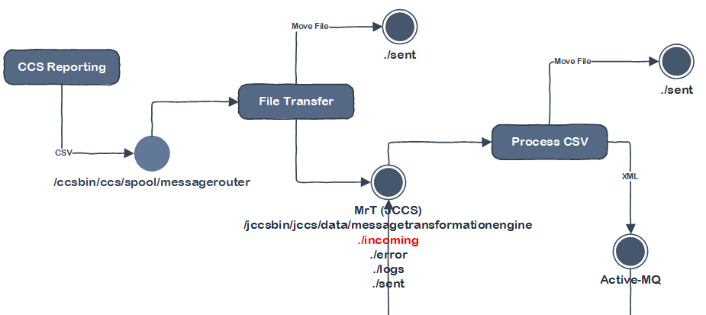
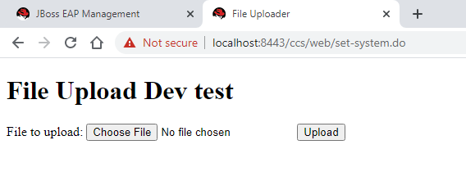
What I have done so Far
Java Servlet/JSP file uploader to MR.T
Tasked with speeding up the process of file uploads directory to MR.T.
MR.T stands for MessageTransformationEngine and is part of JCCS.
HTML form with file input & servlet used for processing.
Learnt about deploying to DEV & the Commit process.

Slide 6
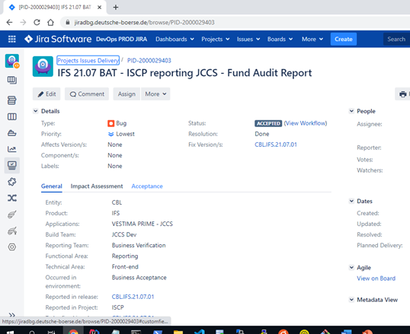
What I have done so Far
JIRA
Shown the JIRA ticketing system used to designate tasks to members of the development team.
Given task of updating Java code and responding to the JIRA ticket issued to me.
Learnt the JIRA process on how to handle & respond to tickets.

Slide 7
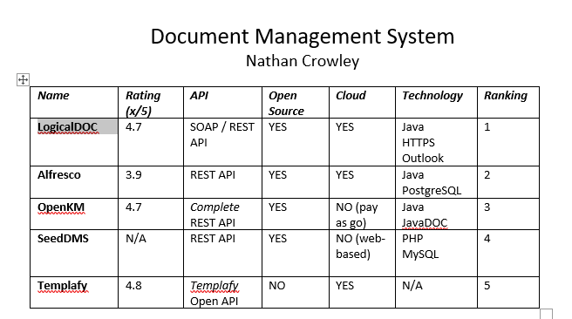
What is to come
Document Management System Research
Given list of requirements research the best DMS for the team.
List top 5 DMS’s & matrix to showcase advantages and disadvantages.
Proof of Concept
Realising the research completed on the best Document Management System.
Developing a standalone APP to host the top DMS found from my research.
Interact with DMS through API and ensuring that the DMS is suitable to the team and has the correct functionality.

Slide 8
What I have enjoyed
All staff have been very friendly and very welcoming.
Every Friday the development team has a Fun Friday Quiz.
I hosted the Quiz on my third week and it was a great way to get involved.

Slide 9
What could improve
The company has a great working environment and company culture.
A suggestion would to have a direct contact for new incoming interns to get set up as quickly as possible, especially with remote work.
The team were very helpful with setting me up but at times when they have large workloads it was difficult to contact the team complete some set up tasks.

Slide 10
Thank you for your time
If there are any Questions I would be happy to hear.
Thank you for taking the time to listen to my presentation enjoy the rest of your day !!

