Slide 1
CHALLENGE OPERATING
SOFTWARE
TEAM NAME: NIGHTS WATCH
SAKTHINATHAN J
VIKAS K
SANKARA SUBRAMANIAN
BIRINTHA
SHALINI SURESH

Slide 2
ABSTRACT
In 21st century computer has become inevitable and everything in this world is now digitalized, within fraction of seconds we are able to send Megabytes of data from one part of the world to another, but physically challenged people are not in the position to use this technology, therefore they struggle in today modern world where everything is digitalized. So, we use speakers to convey what is showing in the monitor for the blind people, eye ball tracking for handicap people etc., so we came up with a solution ChaOS which is an interface between the computer and human.
How it works? The user can use their finger gesture, eye ball to control the mouse action and voice for keyboard input, we use sophisticated convolution neural networks for detecting the gesture and eye ball tracking and voice processing for keyboard inputs and at every menu. For gesture detection and eye ball tracking, we use webcam present in the computer to capture the real time feed of the user and feed into posture detection model and eye ball tracking model respectively for detection of gesture and eye ball tracking and match the gesture with appropriate command for execution. Voice recognition model is used for processing the voice input. After processing it’s sent into a back end script which emphasis on executing the respective command for the processed output. Thus anyone physically challenged or a normal person now can operate a computer with or without the old physical peripherals.

Slide 3
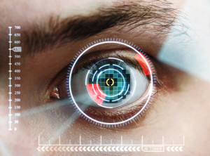
INNOVATIVE ASPECTS
Normal person can easily secure their laptops by using finger print scanners, passwords. But it is difficult for the physically challenged people so we have used ideology of capturing the finger print as an image and then scanning them so they secure their laptops.
By using the gesture recognition they can move the mouse pointers to their desired location and it will be easy for them to access the files.
Eye recognition is useful for handicaps, if they wink their eye one time a file will be clicked once, else if its twice then the file will be clicked twice.
People who have paralysis, lost limbs can use keyboard through voice recognition.

Slide 4

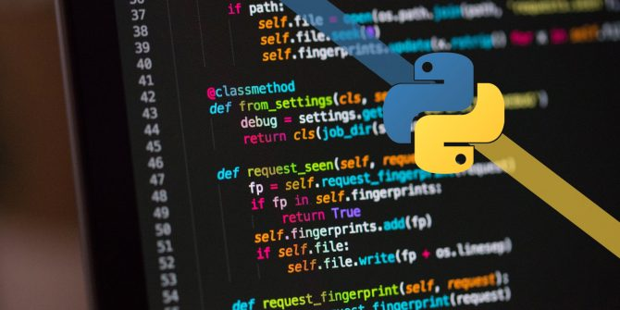
REQUIREMENT ANALYSIS
HARDWARE REQUIREMENTS:
Webcam
Personal computer
SOFTWARE REQUIREMENTS:
Python
OpenCV

Slide 5
FACE RECOGNITION
Capturing real time video using Web-Camera focusing pupil of eye .
Processing the individual image frame.
Converting frame of pupil to grey scale image.
Conversion of the detected image into a binary image.
Detecting eye movement using OpenCV .
Required actions are performed according to face and eye movement.

Slide 6
GESTURE RECOGNITION
A basic gesture input device is the word processing tablet.
In the system, two dimensional hand gestures are sent via an input device to the computer’s memory and appear on the computer monitor.
These symbolic gestures are identified as editing commands through geometric modeling techniques.
The command are then executed, modifying the document stored in computer memory.
Gestures are represented by a view-based approach, and stored patterns are matched to perceived gestures using dynamic time warping.
System identifies natural hand gestures unobtrusively with a data-glove, it is more intuitive to use than a standard mouse or stylus control system

Slide 7
TEXT SUMMARY
People who suffer with dyslexia, may find difficult read the context that consist more than 10 paragraphs. We have made easy for them to read the context without any difficulties.
We have developed a module, using natural language processing which has a weighted dictionary which ranks the words according to the weightage and summary the whole context into shorter one.
USE CASE: This prototype can be used in schools where special children find difficult to learn and understand long context.
It can also be used by normal people to make their job simpler and easier.

Slide 8
SOCIAL RELEVANCE
Efforts are being taken to create a more accessible environment for the visually impaired. Text-to-speech can help to describe emoji from pictures. This could possibly serve as a digital eye.
For people with dyslexia who find it difficult, go through the documents which consists of many paragraphs, can be compressed and made into a shorter summary.
For the person who suffer to use their hands for operating the computers, will be benefited by using the technology of eye tracking.

Slide 9
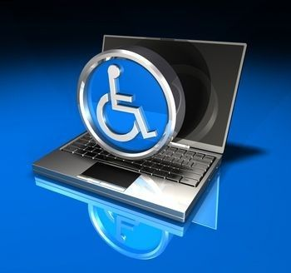
LIMITATIONS
Gesture recognition will recognize only up to certain range, it will detect only when the person is stable, near and still.
Eye recognition will be difficult to recognize if the person’s eye ball is not still.
Using keyboard for people who have paralysis, lost limbs will difficult.
“LIMITIONS ARE NOT A FULL STOP IT’S JUST A NEW
WAY OF APPROCHING AND SOLVING ISSUES”

Slide 10


Slide 11


