Slide 1

When the application is loading it would display this icon:
The app is made for the fictional school Miskatonic University from the writings of H. P. Lovecraft.
This icon is integrated into the corner of the app toolbar and notifications.
The icon is used with permission from the author.

Slide 2
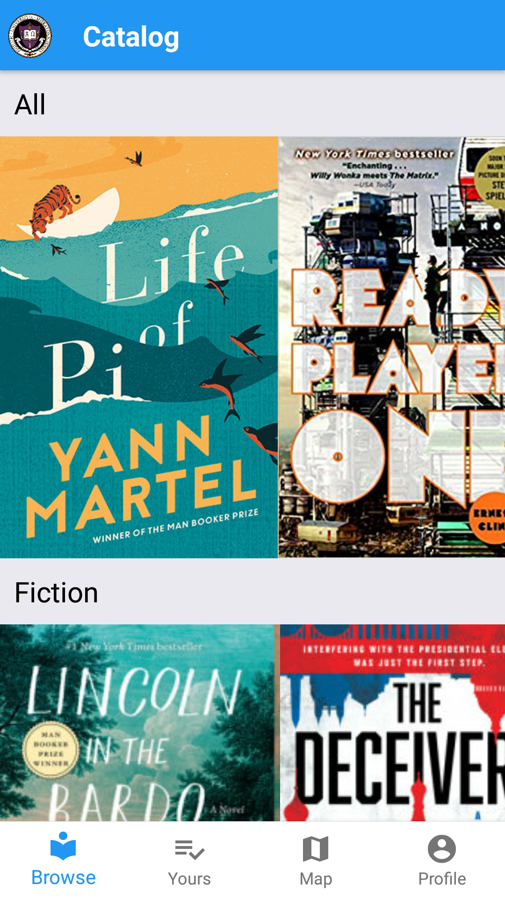
When you first open the application it will bring you to the catalog page:
The navigation is based off the bottom tabs and actually clicking on the books. The peers that this have been tested on have understood without any trouble.

Slide 3
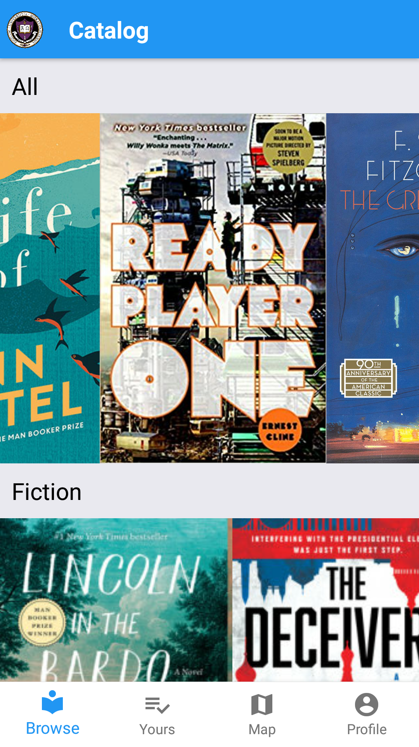
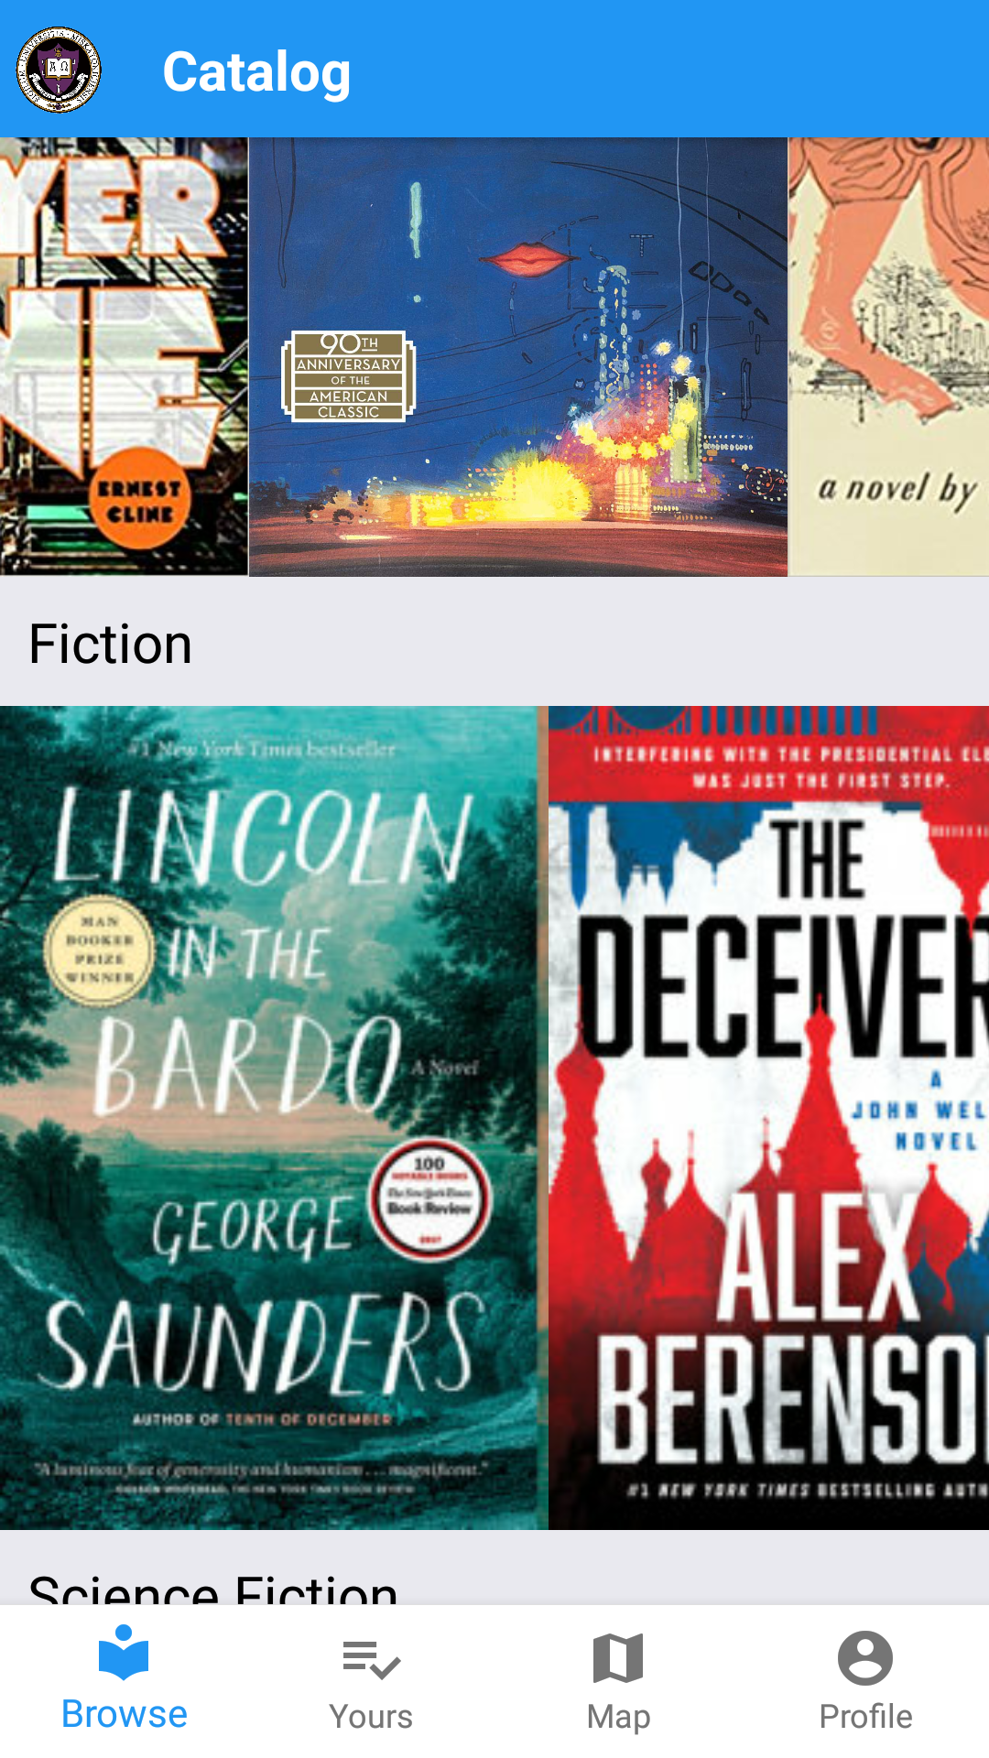
Each list in the catalog is scrollable vertically and horizontally
Horizontal Scroll
Vertical Scroll

Slide 4
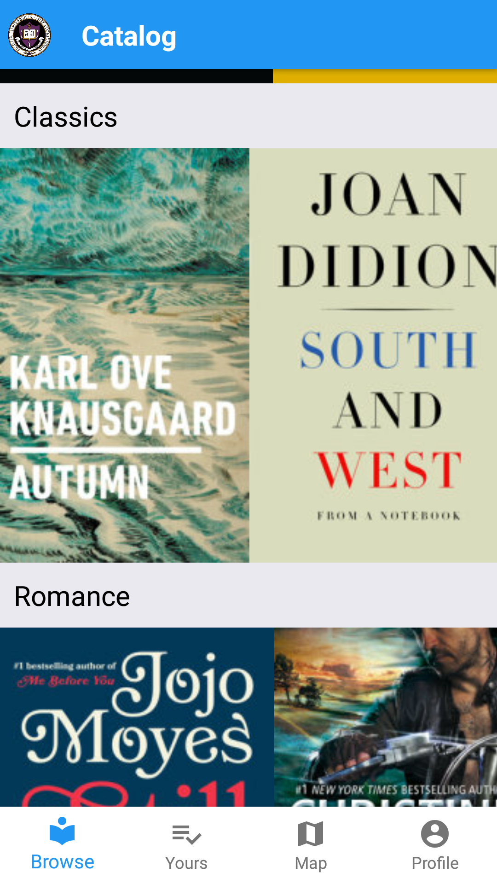
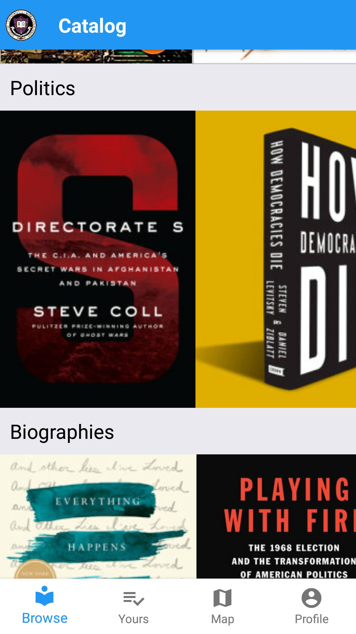
The books are organized by tags, ranging from Suspense to Social issues

Slide 5
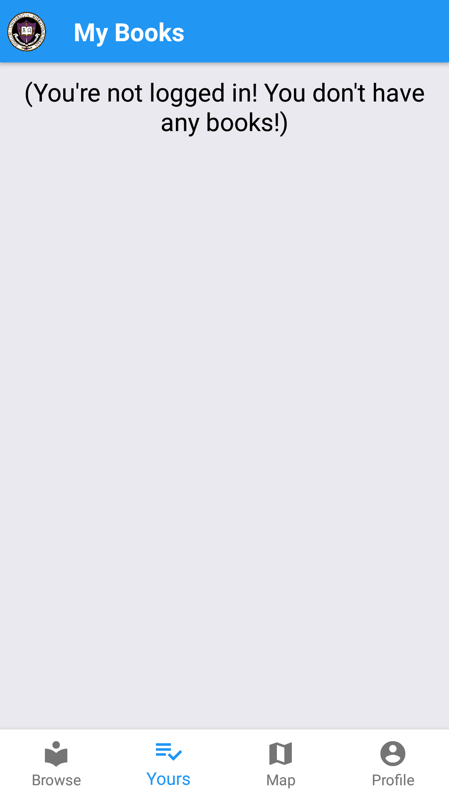
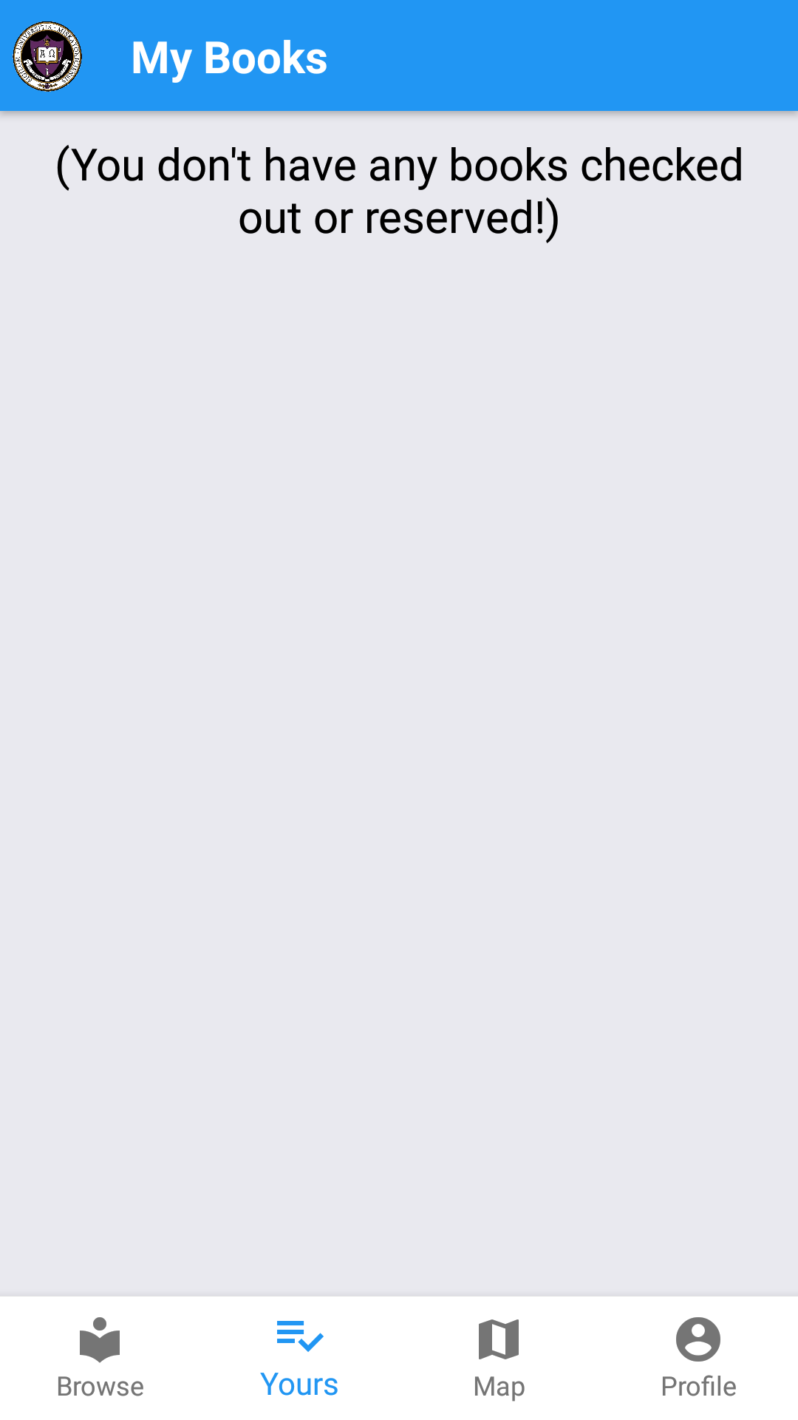
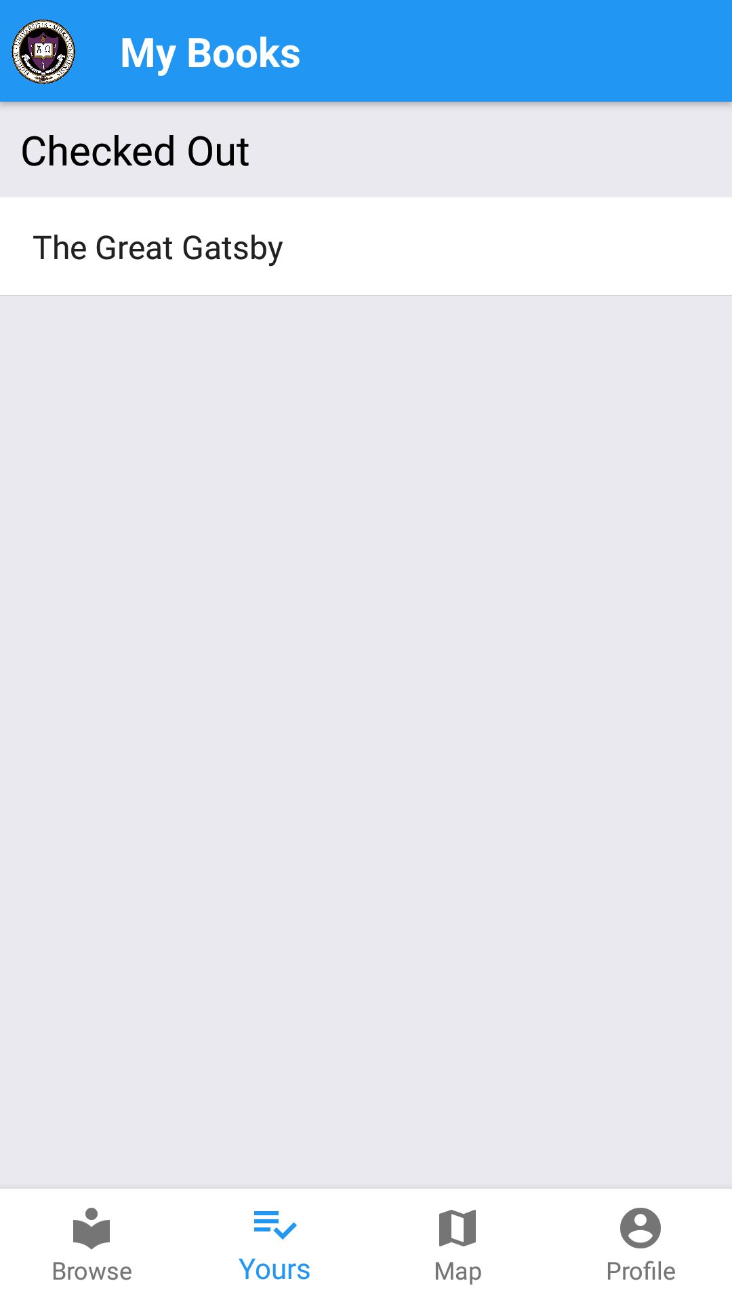
The second tab is My Books. It contains any books you have reserved or checked out.
Viewing while not
logged in
Viewing without any
books checked out
Viewing with a book
checked out

Slide 6
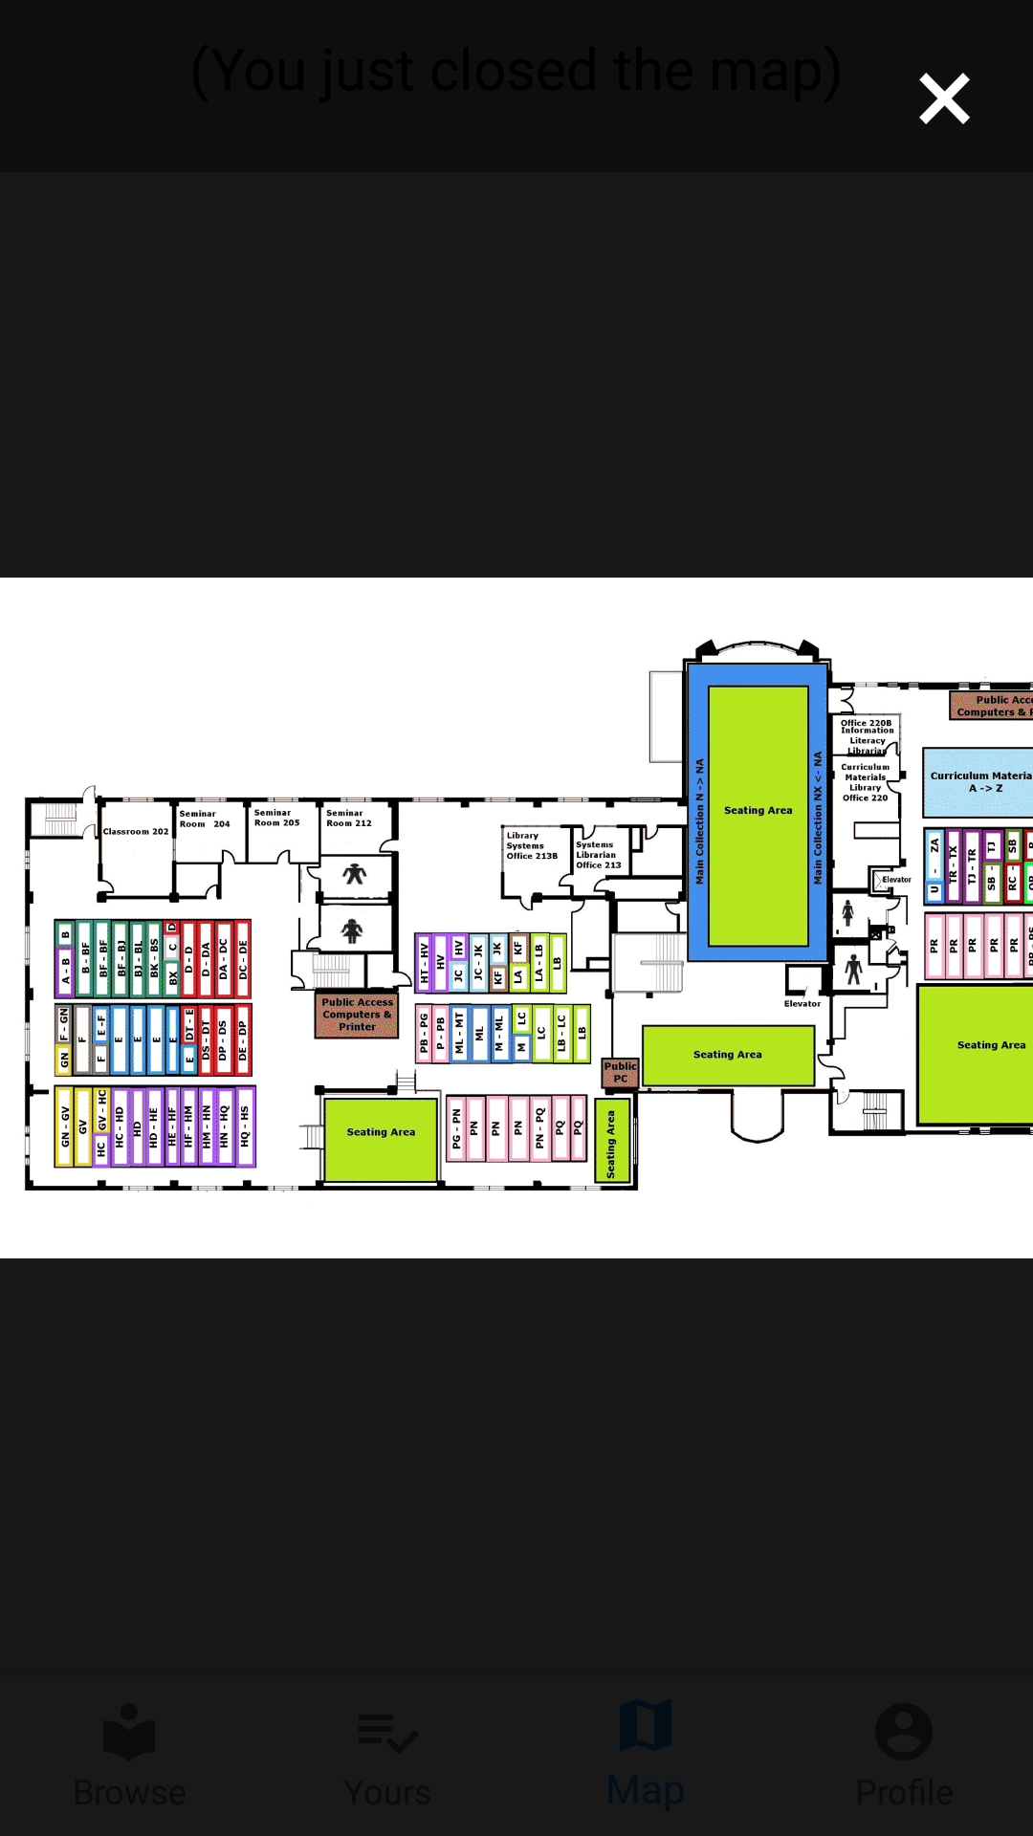
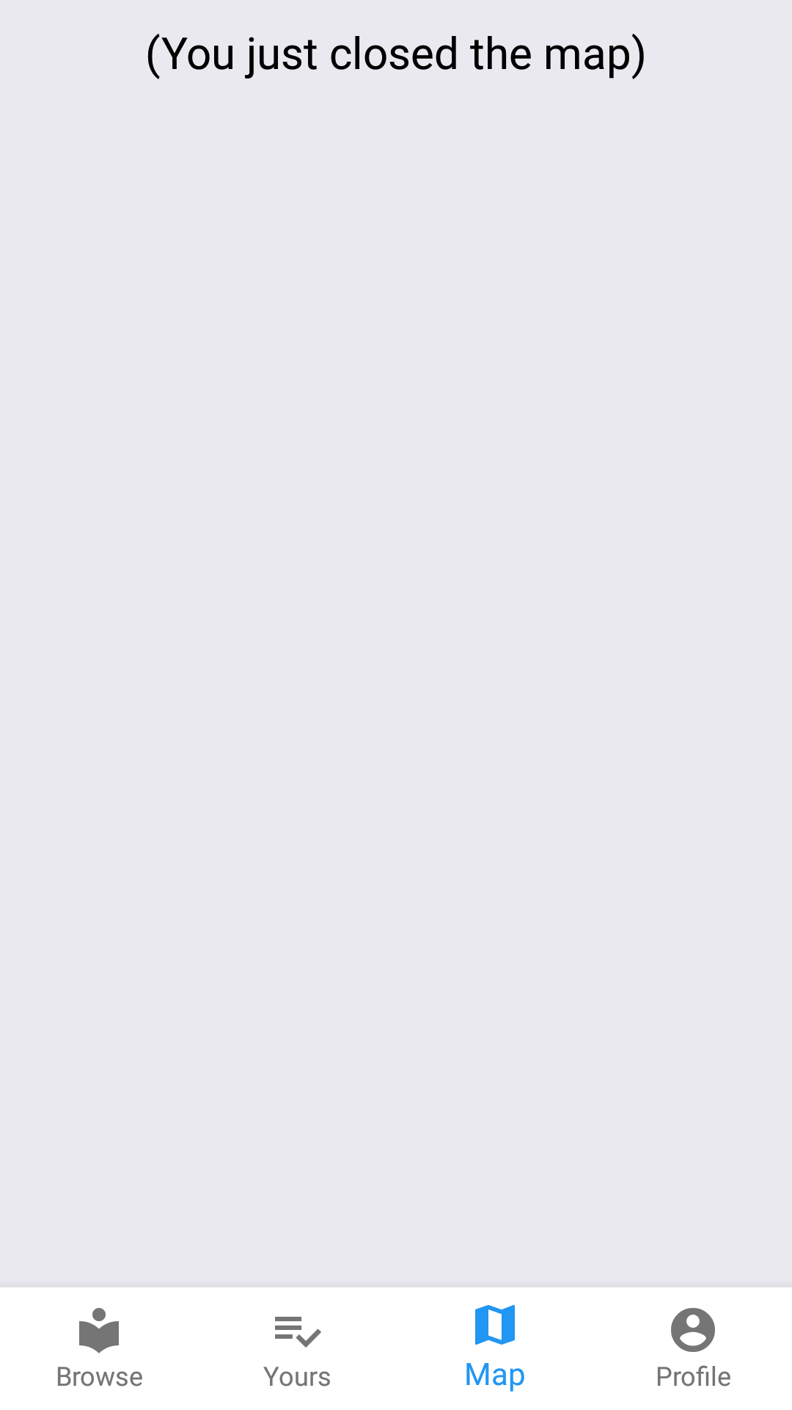
The third tab is the map of the school library.
Immediate view when
third tab is pressed
View when map is
closed

Slide 7
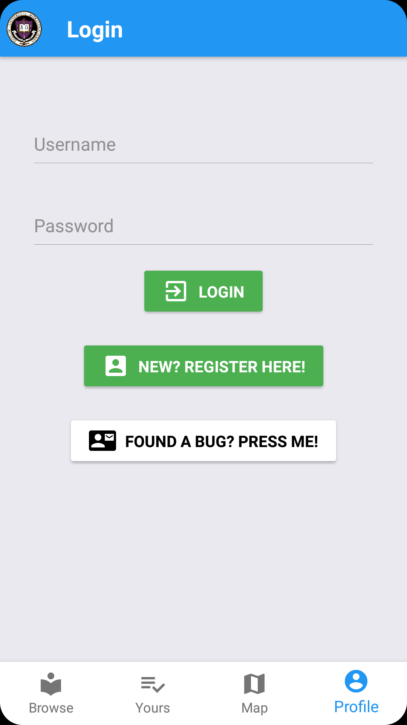
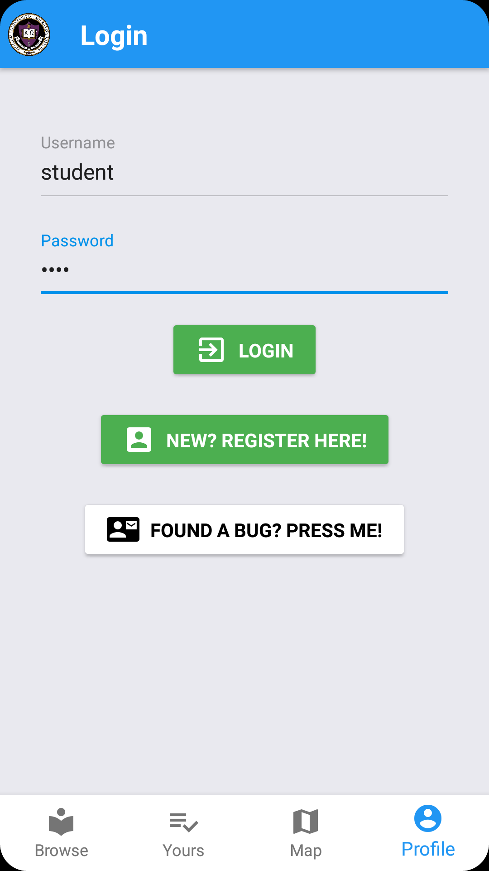
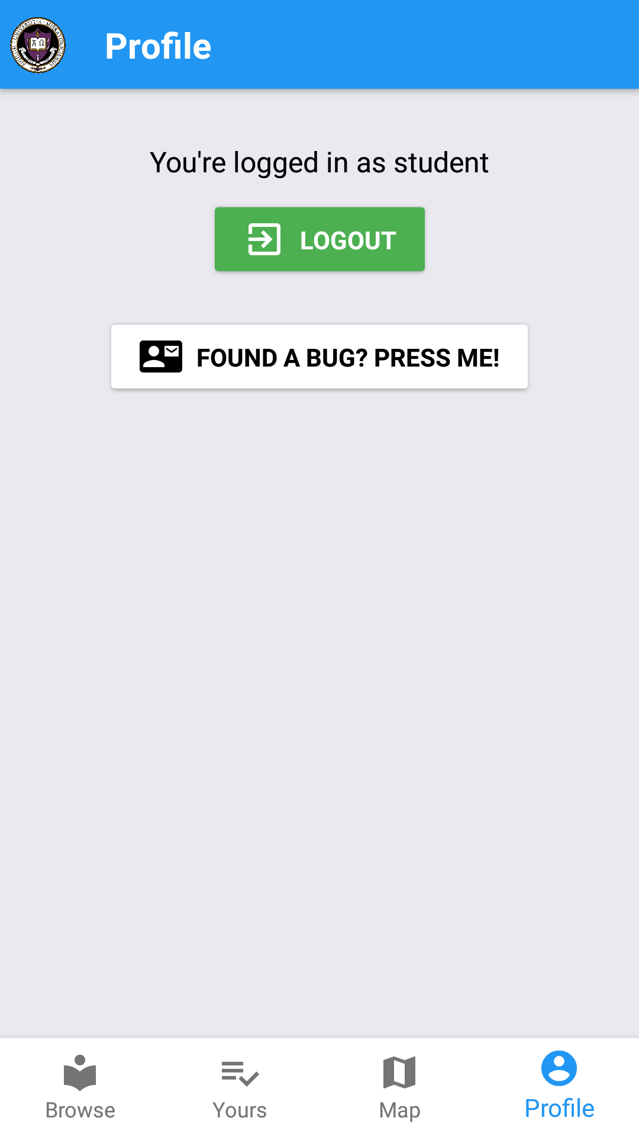
The last tab is the Profile/Login page
Logged out
Logged in

Slide 8
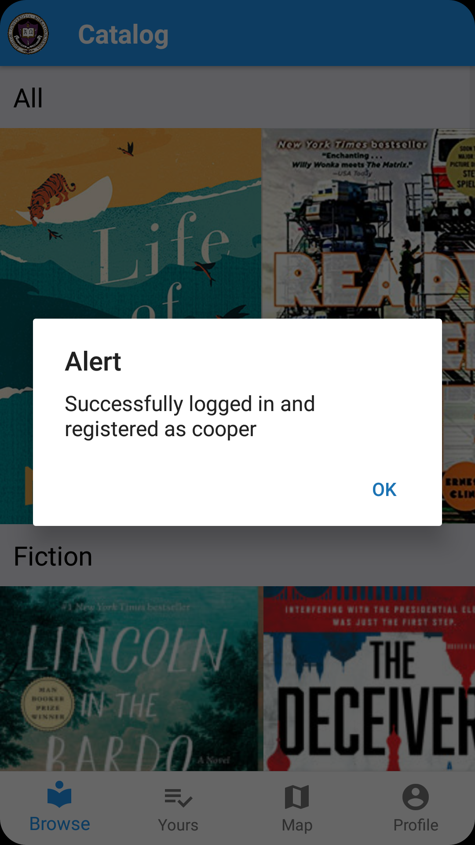
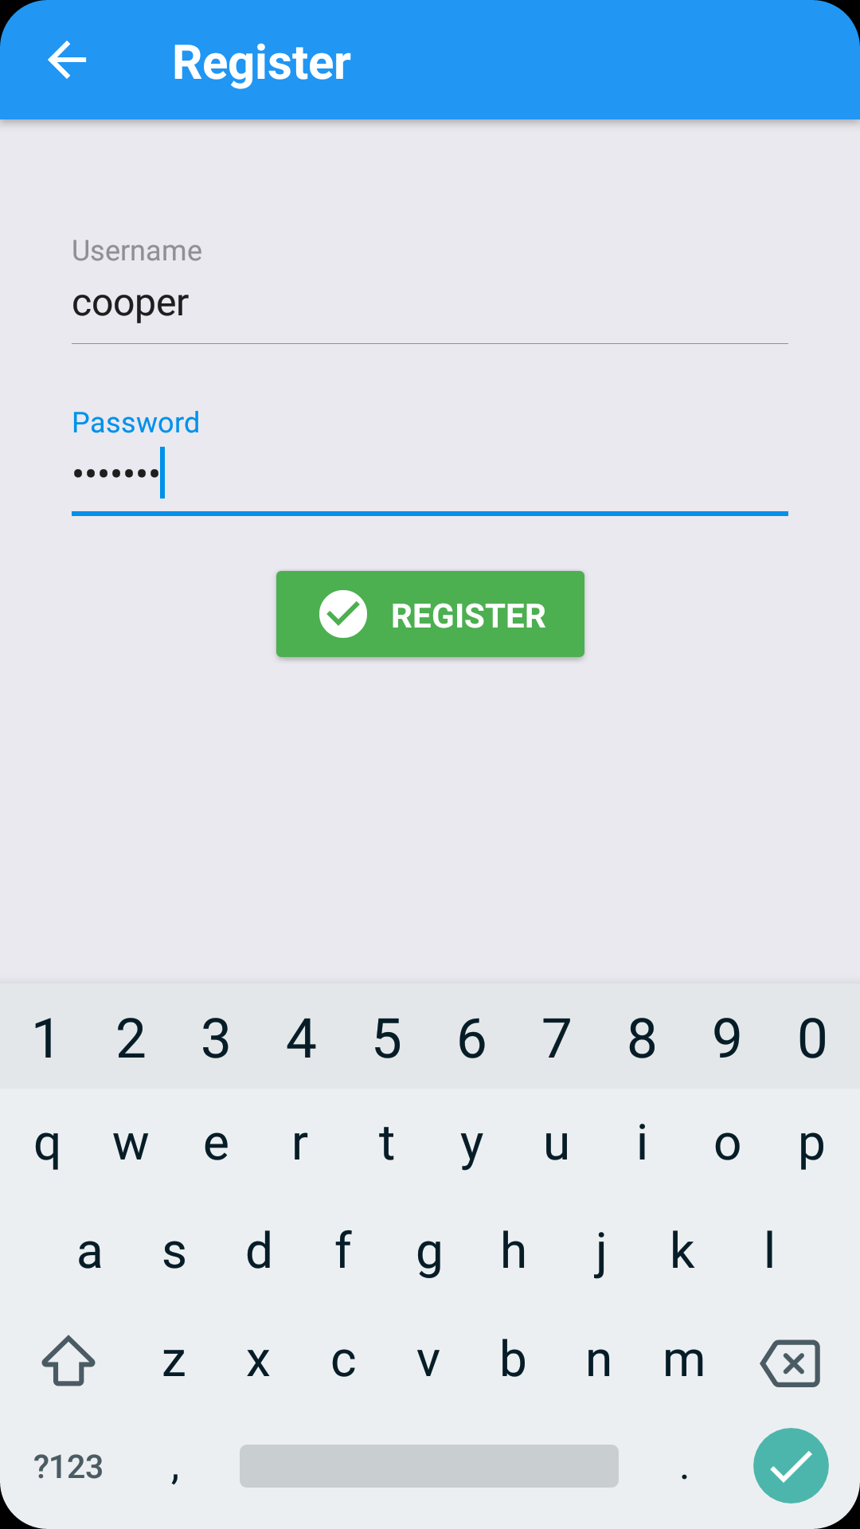
Profile/Login page
Opens up new
window to
register new user

Slide 9
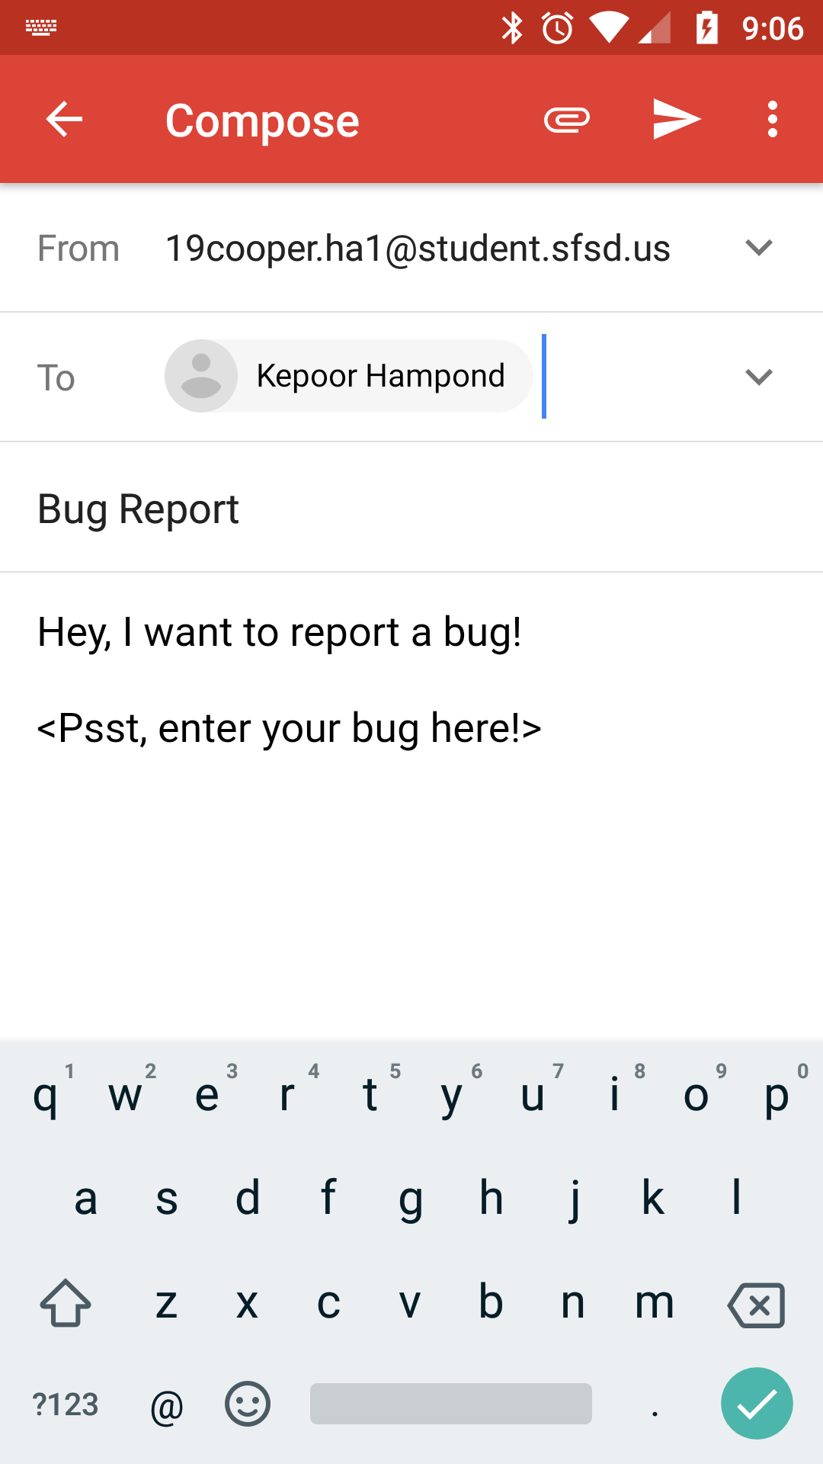
Profile/Login page
User
Me
Bug reporting system opens
user’s email client with an
email addressed to me
Logged in

Slide 10
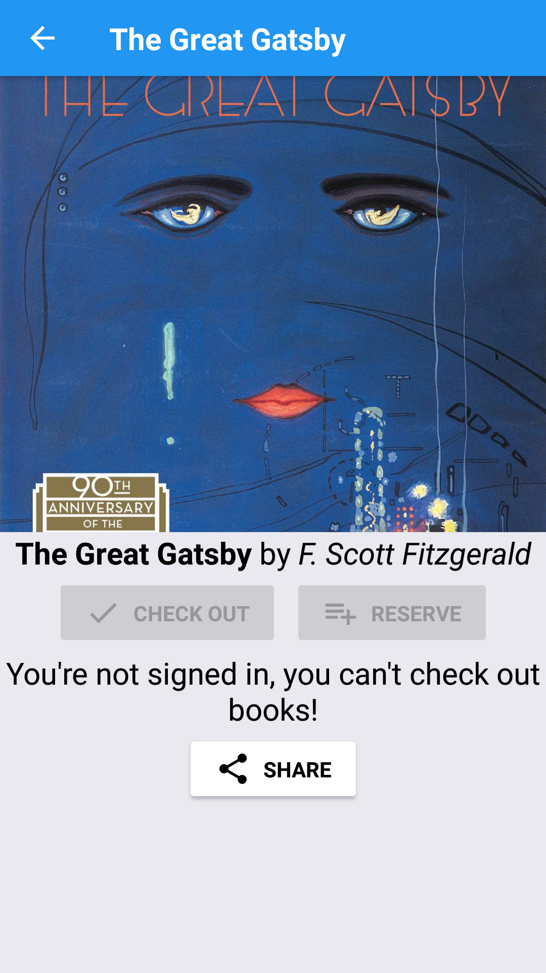
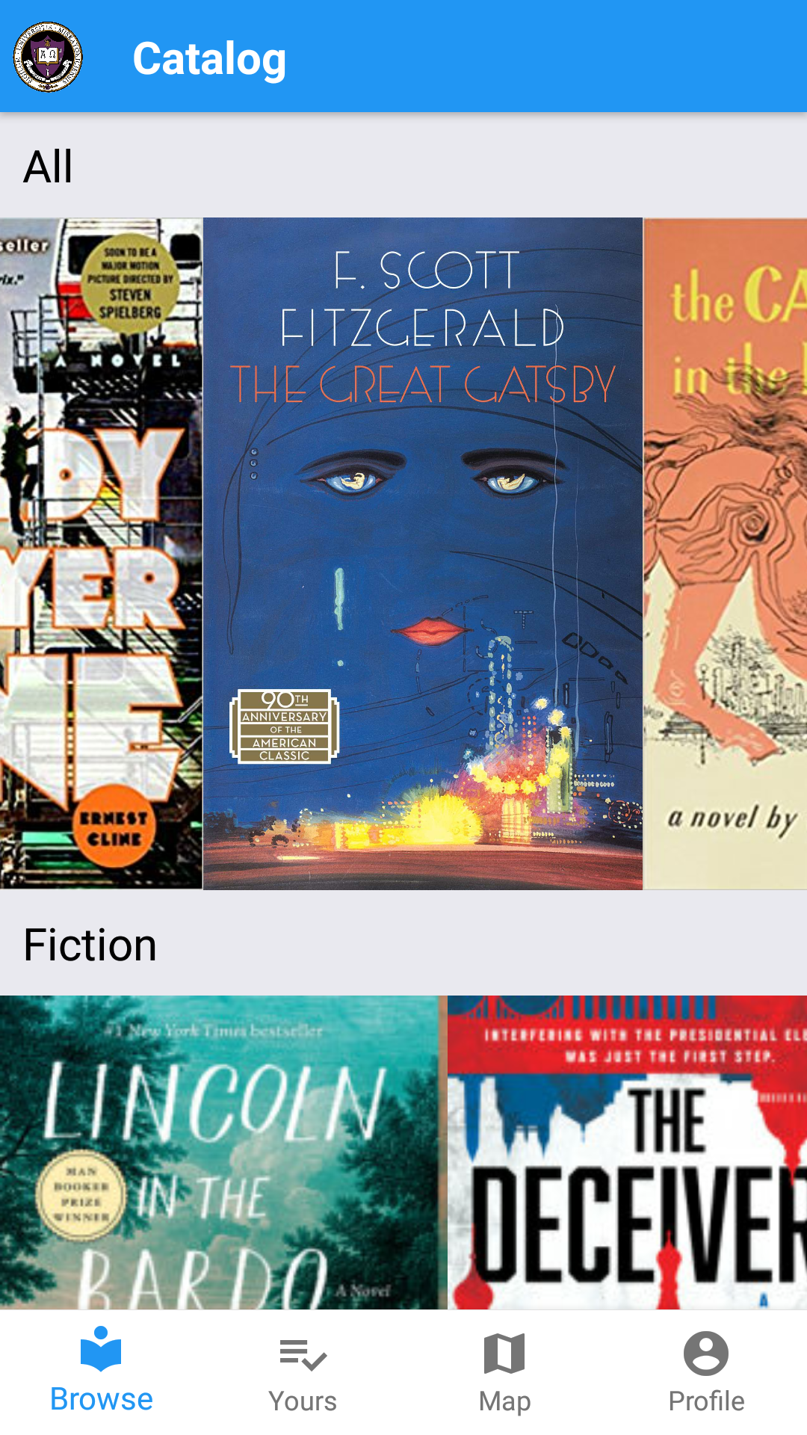
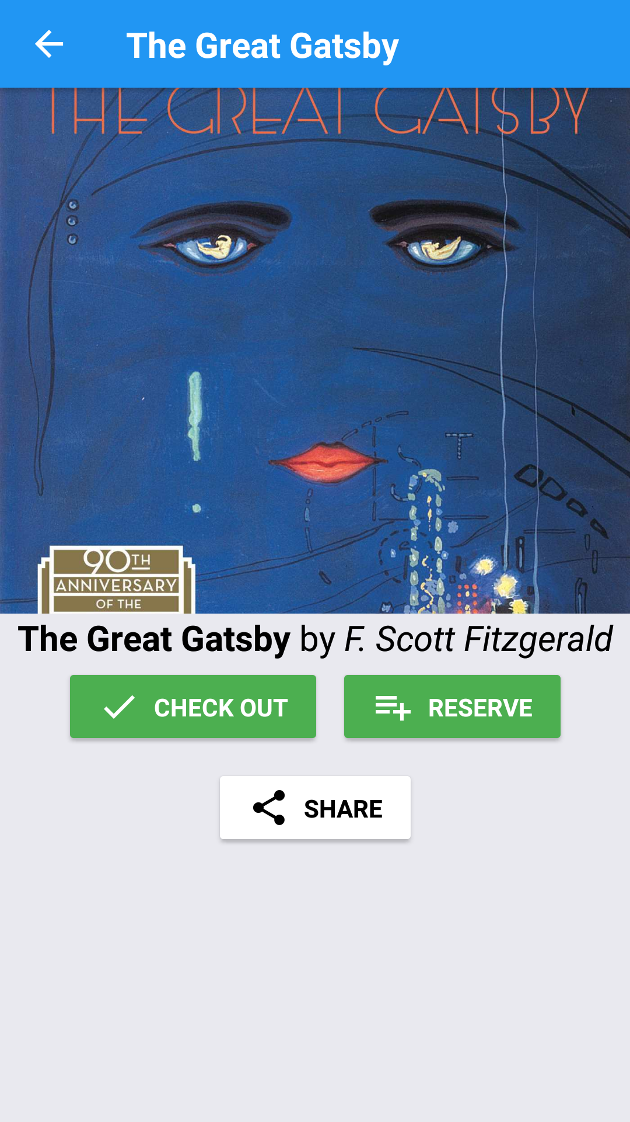
Check Out Page
While logged out.
While logged in.
Pressing a book in the catalog

Slide 11
My Books
You can also view the checkout
page from My Books

Slide 12
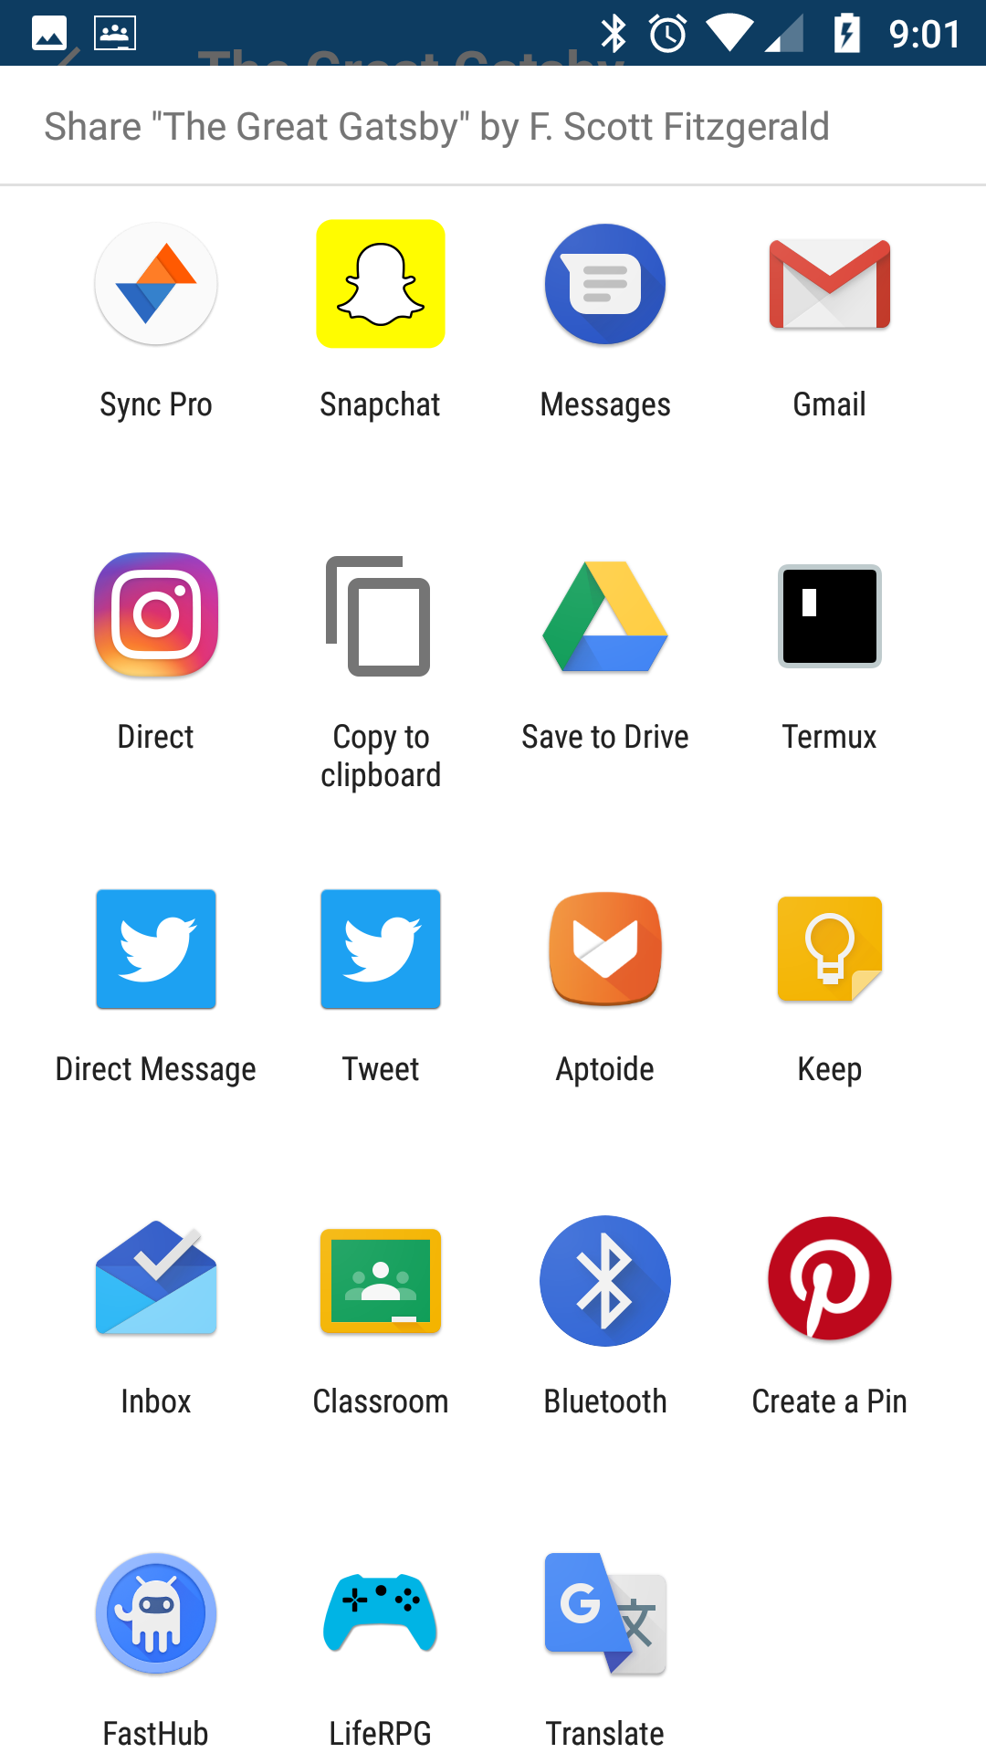
Check Out Page
Direct integration with social media,
Google applications, and just about
anything you have installed on your
phone
Pressing a book in the catalog

Slide 13
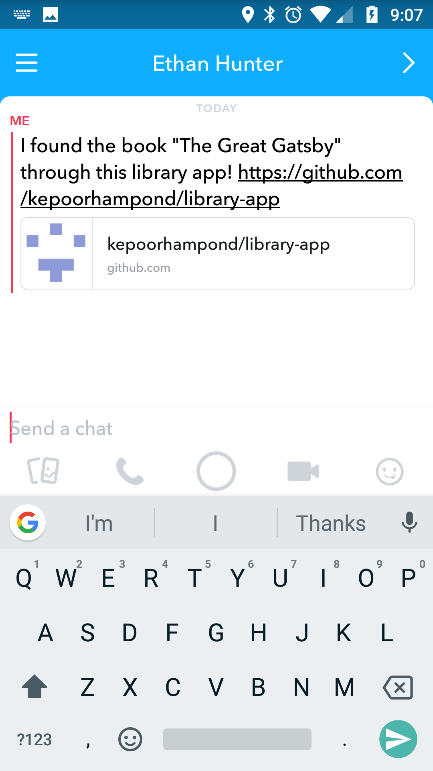
Check Out Page
Automatic formatting
Exporting through the share button

Slide 14
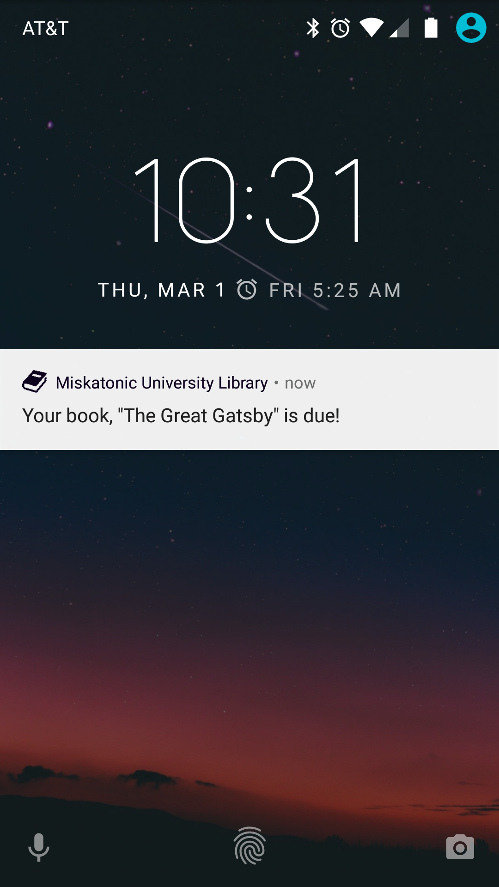
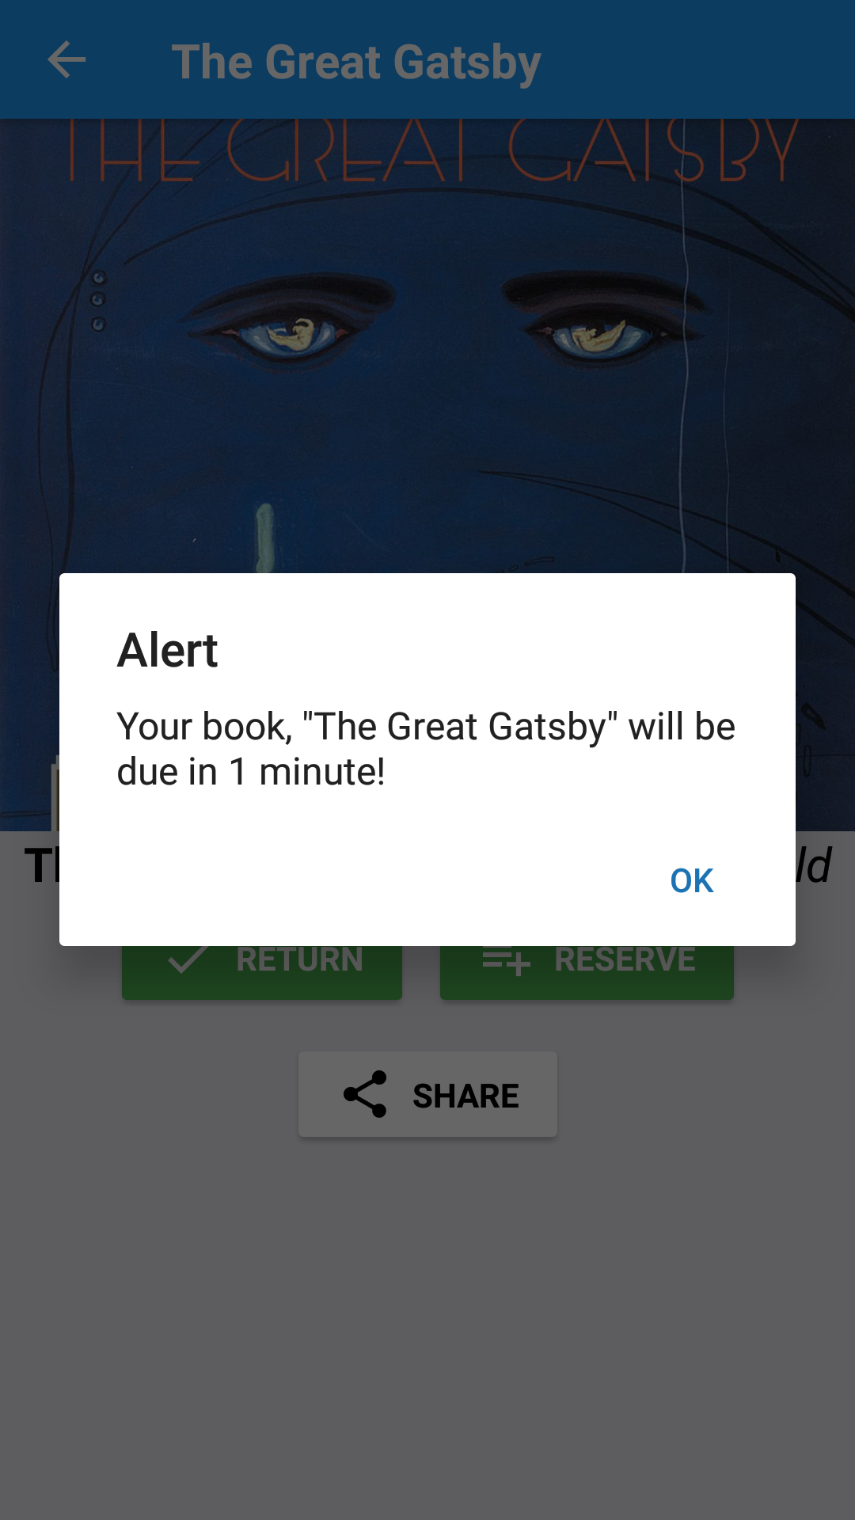
Check Out Page
For testing and display purposes, the
book is only checked out for 1 minute.
After 1 minute, the user is sent a
notification telling them their book
is due.
Check out book

