Slide 1
Clustering of Brokers
July 18th, 2016

Slide 2
Research Question
What interesting results can result from clustering brokers based on different metrics?
Method: Apply various clustering algorithms in combination with a multitude of metrics

Slide 3
Metrics
2 main groups of metrics are used:
Sector
Used to cluster via portion of purchases/sells of each sector in a given period of time
QMV – Quoted Market Value
Split into 2 sub-metrics; average QMV for purchased stocks, and average QMV for sold stocks,

Slide 4
Method
The Method used consists of first applying k-means clustering and splitting the groups into subsets, and then applying hierarchal clustering.
The data used is intraday trading data compounded over 10 random days in 2015.

Slide 5
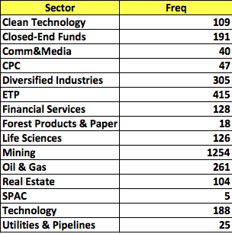
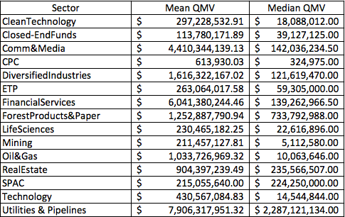

Summary Statistics for QMV

Slide 6
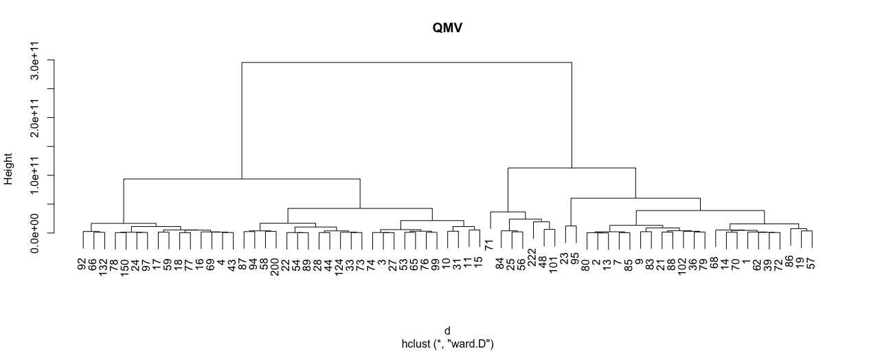



Clustering all Brokers by QMV
Brokers that fall on the Right tend to trade stocks with greater QMV
Brokers that fall on the left tend to trade stocks with smaller QMV

Slide 7


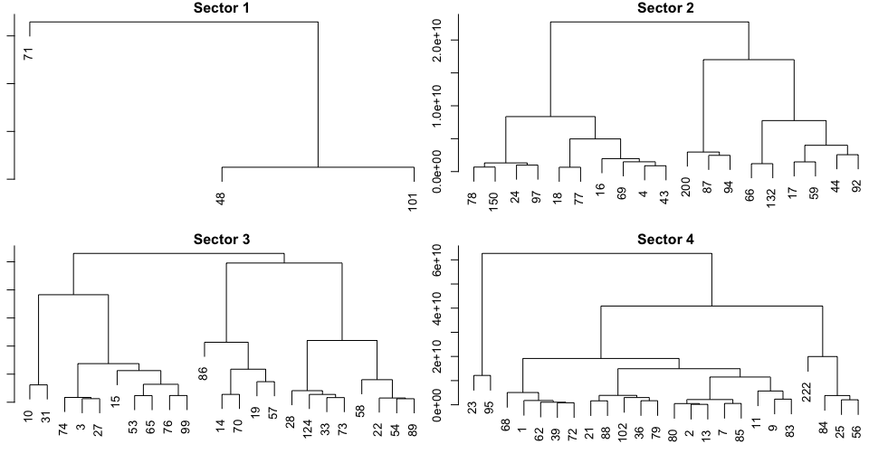




QMV with K-means followed by H-clustering
Cluster 1: Outliers, mostly trade stocks with large QMV
Cluster 2: Trades stocks with QMV near average
Cluster 3: tends to trade stocks below average QMV
Cluster 4: tends to trade stocks above average QMV

Slide 8
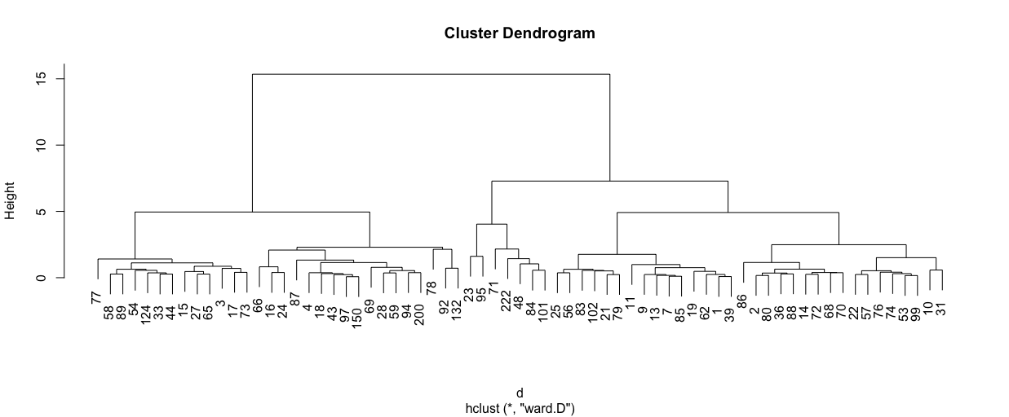



Combining Sectors and QMV
QMV tends to show a less definitive pattern

Slide 9
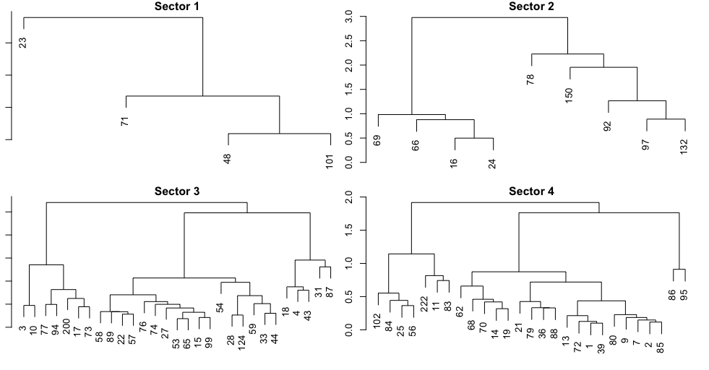




Combo with Clusters
Outliers, tending to trade very large QMV
Cluster 2: Trades smaller QMV’s

Slide 10
Results
K-means followed by Hierarchal tends to do an interesting job of clustering brokers.
Augmenting clustering by QMV by adding Sectors leads to some changes, but not many dramatic changes, ~ 78% stayed within the same sector.
This is somewhat expected, as QMV is correlated with Sector.
The results shown are different from the results given when clustering broker just by size.

Slide 11
Research Question
How to cluster Brokers according to sectors?
Analysis:
Nb of sectors: 15
Nb of brokers: 85 (72 brokers >100 trade days)
Tool: K-means

Slide 12
Distribuition of trades for sectors.

Slide 13
Distribuition of trades for sectors (2015)

Slide 14
Centroids based on Trades Sector Distribuition (2015)

Slide 15
Traders’ Behaviours
Sector | Qty in May | Qty brokers held in Dec
Oil & Gas | 8 | 3
Mining | 6 | 2
Financial Serv. | 10 | 2
Div. Ind | 12 | 2
Total | 36 | 9
75% of the brokers changed of cluster (this example).
During an only day, some brokers invested more than 80% in an only sector and changed the sector after 6 months.
The distribuition of the centroids also change every day.

Slide 16
But ...
the traders’ behaviours change among the days.
But some traders change their behaviours together.
Cluster 1: 93% of days in the same cluster (min = 87%)
 | Name | Volume (2015)
1 | RBC Capital Markets | 218,892,926,097
2 | TD Securities Inc | 246,534,898,355
3 | Barclays Capital Canada Inc | 24,165,214,315
4 | UBS Securities Canada Inc | 41,420,419,443
5 | Instinet Canada Ltd | 84,296,044,275
6 | generic | 535,186,026,461
7 | CIBC World Markets Inc | 501,144,449,342
8 | Credit Suisse Securities | 57,450,353,318
9 | Merrill Lynch Canada Inc | 99,452,871,523
10 | Morgan Stanley Canada Ltd | 97,356,027,641

Slide 17
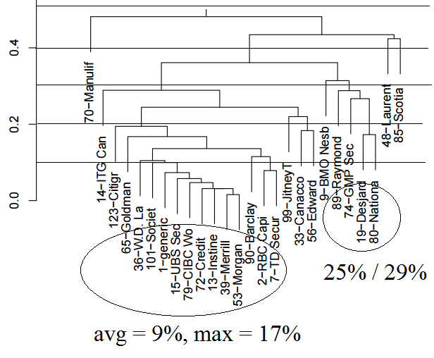
Days in different clusters (%)

Slide 18
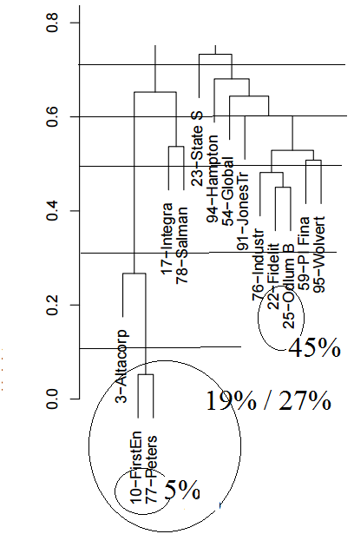
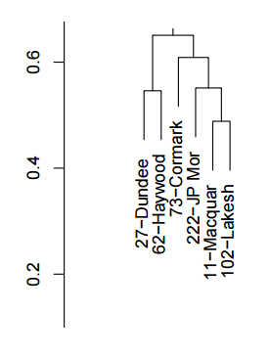
Days in different clusters (%)

Slide 19
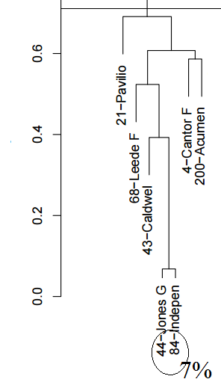
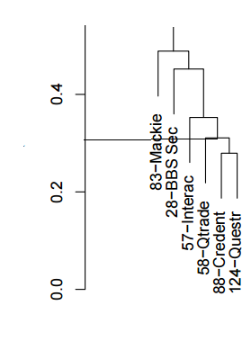
Days in different clusters (%)

Slide 20
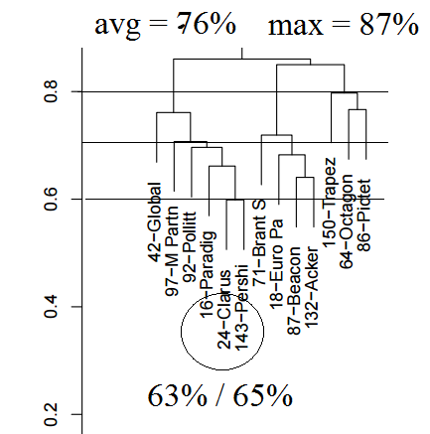
Days in different clusters (%)

