Slide 1
High-Frequency Trading
May 31st 2016

Slide 2
Low-latency trading Journal of Financial Markets (2013)
Cited by 400 (scholar.google.ca)
Among the 1% most cited (according to Essential Science Indicators).
Joel Hasbrouck (Stern SchoolofBusiness)
GideonSaarb (School of Management, Cornell University)

Slide 3
High-Frequency Trading
Types of HFT:
Agency algorithms: provide liquidity to big volume orders.
Based on historical estimates of price impact and execution probability across multiple trading venues
Proprietary algorithms.
Goal: profit
More diverse and more difficult to concisely characterize.

Slide 4
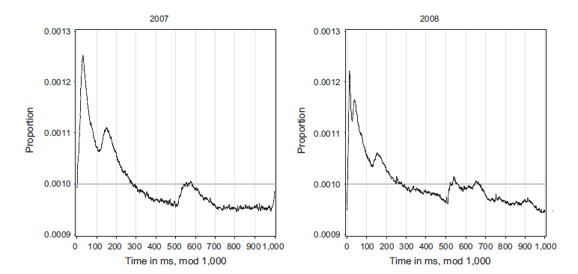
Distribution of Arrival Messages to Market
1 sec
Inside each second
Expected:
uniformly distributed

Slide 5
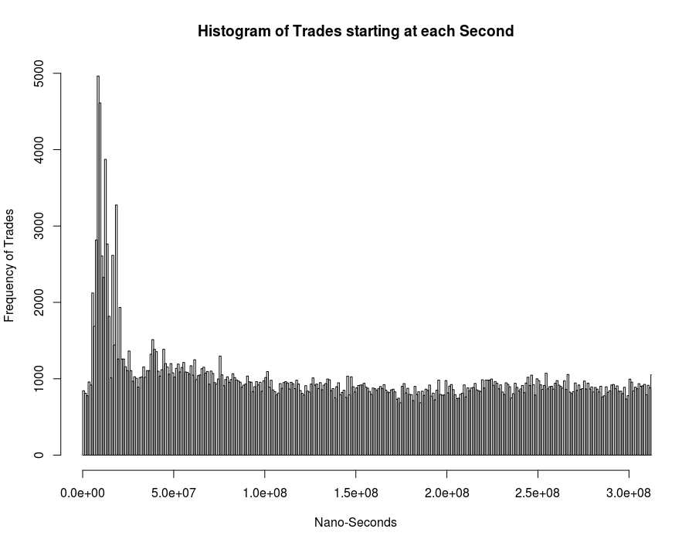
TMX Distribuition (inside each second)

Slide 6
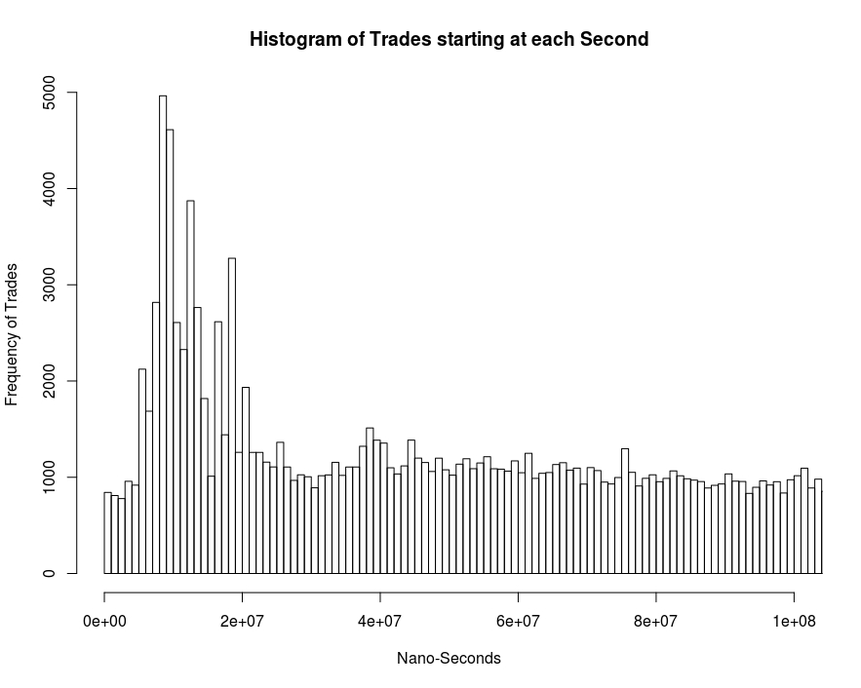
TMX Distribuition (inside each second)

Slide 7
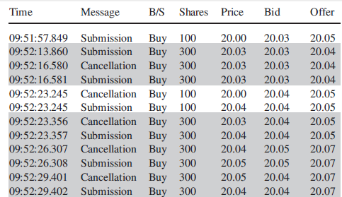
Figure from Hasbrouck et al.
Obs: No Broker Info
TMX didn’t sent us those info.

Slide 8
Number of Trades for Broker (TMX file)
Case Study : December 4th 015
There are 70 active brokers.
Most Active Brokers
Least Active Brokers
All Stocks
TD
Broker ID | Nb. of Trades
1 | 426,389
79 | 405,533
7 | 126,151
2 | 106,363
53 | 106,188
Broker ID | Nb. of Trades / TD
1 | 6,932
79 | 6,704
7 | 2,881
9 | 2,624
2 | 1,535
Broker ID | Nb. of Trades
92 | 22
71 | 22
55 | 12
86 | 12
150 | 4

Slide 9
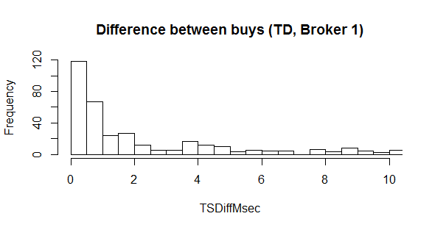
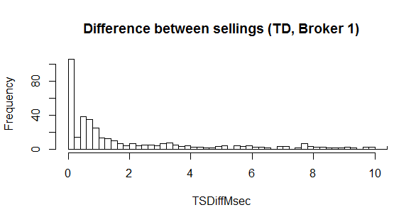
Stock: TD – Broker 1 (TMX file)
1716 buys / day
1900 sellings / day
Dec 3rd 2015

Slide 10
Quality Market
Quality Market:
Spread: time-wieghted avg quoted spread;
Effective Spread: avg spread (quote midpoint) for marketable orders;
Near Depth: time-wieghted avg nb of shares in the book;
High Low: highest midquote – lowest midquote (%).

Slide 11
High-Frequency Trading
Questions to be investigated:
effects of HFT on Market Quality :
spreads and short-term volatility declines during normal market conditions.
opposite effect during times of extremely high market volatility

Slide 12
High-Frequency Trading
Questions to be investigated:
HFT’s strategies
Are HFT’s profitable?
Effetcs of HFT’s restriction:
Volatility
Stocks Exchanges
Effect of Structural Delays in Order Processing;

Slide 13
High-Frequency Trading (regulation)
National Instrument 23-103 (Canada)
Electronic Trading and Direct Electronic Access to Marketplaces:
The legislation requires users of automated order systems to ensure that their use of the systems “does not interfere with fair and orderly markets,” to test their systems at least annually, to acquire sufficient knowledge of their systems to “identify and manage the risks associated with the use of [the systems],” and to be able to immediately halt their systems if necessary.

Slide 14
High-Frequency Trading
Proposal
Analysis
Initial
Analysis
TMX presentation
No Enouth Data
no priority
Wait for New Data
Waiting...

