Slide 1
Cluster of Brokers
July 4th 2016

Slide 2
Research Question
Do any interesting results come about from clustering brokers using evolutionary clustering or k-means clustering techniques?
Method:
Apply multiple algorithms to subsets of brokers with fixed metrics, and analyze the results.

Slide 3
What Is Clustering?
Clustering is the act of grouping observations based on similarities of characteristics (we will refer to characteristics as “metrics”).
Hierarchal clustering:
Single-time clustering: calculates clusters based on closest neighbours, for a given time period (in our case a 2-week period).
Evolutionary K-means clustering:
Clustering algorithm that incorporates history to build the clusters over multiple time periods, and then uses hierarchal clustering to group based on the cluster numbers.

Slide 4
Metrics
5 primary metrics were used for clusters; 2 buy-side metrics, 2 sell-side metrics, and 1 universal metric.
Buy-side metrics:
Number of transactions where that firm bought (in a given time-frame)
Liquidity of purchases: The number of times that stock was traded that day.
Sell-side metrics:
Number of transactions where that firm bought (in a given time-frame)
Liquidity of purchases: The number of times that stock was traded that day.
Average value of each transaction: (Price/share) x volume.

Slide 5
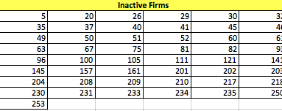
Summary Statistics
There are 125 firms listed on the TSX.
Of these 125, 49 were completely inactive over the observed period.

Slide 6
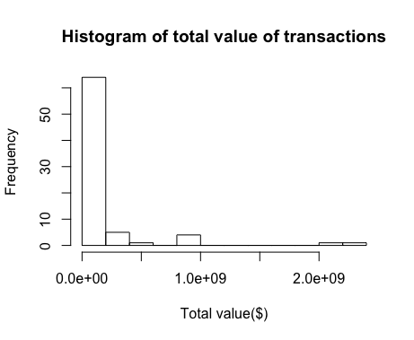
Summary Statistics (Cont’d)
Of the remaining 71 firms, their was a clear right skew in the total activity (measured by the sum of the values of each transaction).
To optimize the effectiveness of the clustering algorithms, we subset the active brokers based on large similarities.

Slide 7
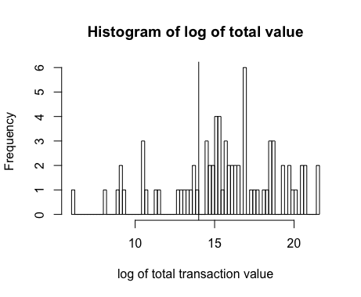
Summary Statistics (Cont’d)
2 additional subsets were created. One subset was for relatively inactive firms (20 total), and the other subset was for consistently active firms (51 total).

Slide 8
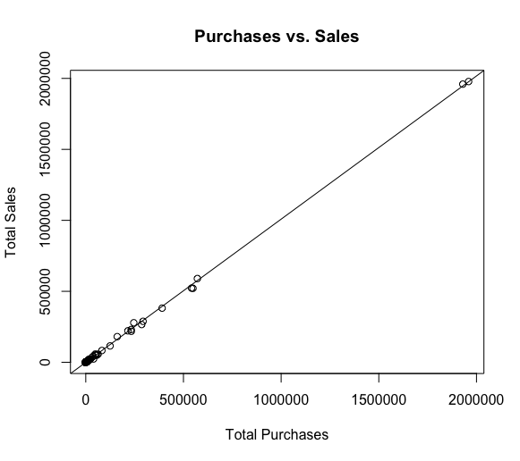
Summary Statistics (Cont’d)
> From least squares regression for a given firm:
Sales = 1.009*Puchases – 64.5
> This means that for every additional 1009 purchases a firm makes, we‘d expect the number of sales the same firm makes to increase by 1000.

Slide 9
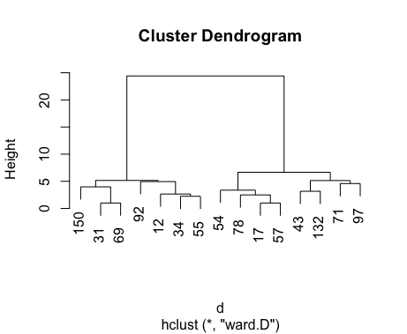


Evolutionary Clustering of Mildly Traded Brokers:
Smaller value traders
Larger value traders

Slide 10
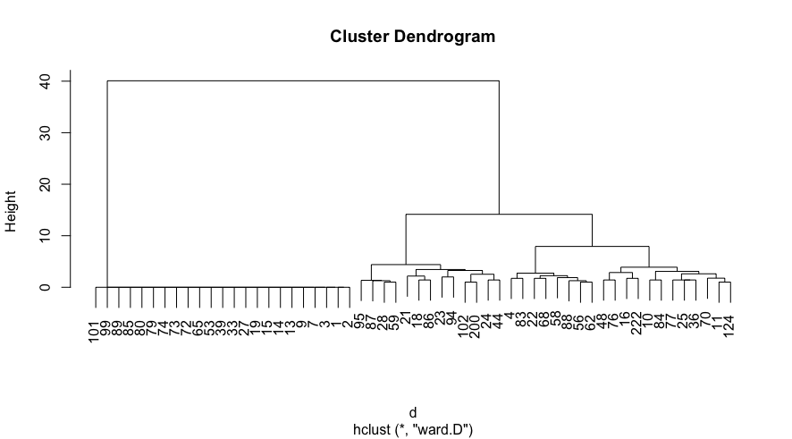


Highly active Firms

Slide 11
Results
Evolutionary Clustering is useful for separating Firms into general groups, but falls short of differentiating closest neighbours.

Slide 12
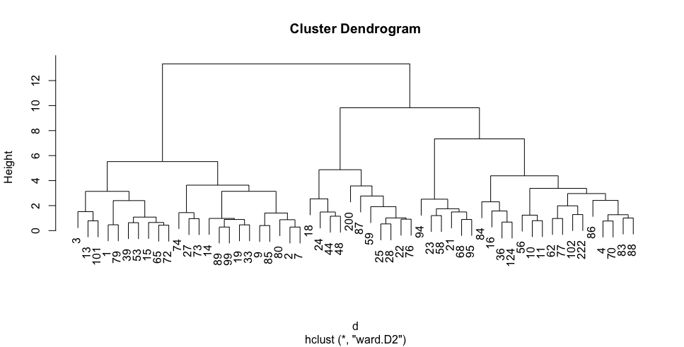



Hierarchal Clustering

Slide 13
Results
Hierarchal Clustering Does a good job of grouping with closest neighbour, but falls short in terms of general grouping.

Slide 14
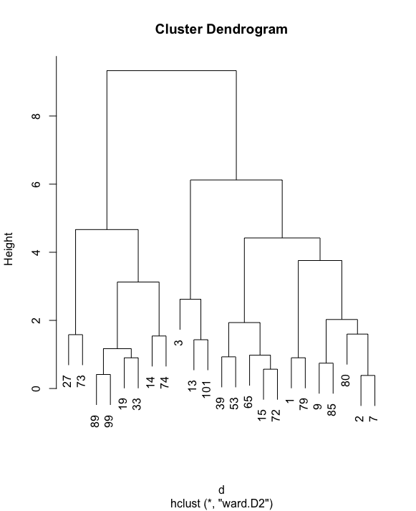



Combination (Evolutionary, followed by Hierarchal)

Slide 15
Results
Both Clustering Algorithms have different strengths.
Optimally, we found evolutionary clustering should be applied first in order to do general grouping. Followed up with hierarchal clustering, neighbours can predicted with good accuracy.

Slide 16
Questions
What metrics for clustering are you most interested in?
What products do you currently market to your clients?

Slide 17
Research Question
How to cluster Brokers according to sectors?
Analysis:
Data used: Trading data from Jan/2015 (21 days)
Nb of sectors: 14
Nb of brokers: 81 (7 traded less than10 days)
Tool: K-means

Slide 18
There are 5 big clusters

Slide 19
Oil & Gas Cluster

Slide 20
Mining Cluster

Slide 21
Real Estate Cluster

Slide 22
Technology Cluster

Slide 23
Conclusion
Some traders are concentrated at specific sectors, but not consistently over each day.
A better analysis can be done with Trader IDs:
The broker behaviour can depend on the specific traders;
A trader can be using more than one broker;
New Research Question (future):
How to compare the broker behaviours inside each cluster?
How to subdivide the cluster with 53 traders?

