Slide 1
Cluster of Brokers
July 18th 2016

Slide 2
Research Question
How to cluster Brokers according to sectors?
Analysis:
Nb of sectors: 15
Nb of brokers: 85 (72 brokers >100 trade days)
Tool: K-means

Slide 3
Distribuition of trades for sectors.

Slide 4
Distribuition of trades for sectors (2015)

Slide 5
Centroids based on Trades Sector Distribuition (2015)

Slide 6
Traders’ Behaviours
Sector | Qty in May | Qty brokers held in Dec
Oil & Gas | 8 | 3
Mining | 6 | 2
Financial Serv. | 10 | 2
Div. Ind | 12 | 2
Total | 36 | 9
75% of the brokers changed of cluster (this example).
During an only day, some brokers invested more than 80% in an only sector and changed the sector after 6 months.
The distribuition of the centroids also change every day.

Slide 7
But ...
the traders’ behaviours change among the days.
But some traders change their behaviours together.
Cluster 1: 93% of days in the same cluster (min = 87%)
 | Name | Volume (2015)
1 | RBC Capital Markets | 218,892,926,097
2 | TD Securities Inc | 246,534,898,355
3 | Barclays Capital Canada Inc | 24,165,214,315
4 | UBS Securities Canada Inc | 41,420,419,443
5 | Instinet Canada Ltd | 84,296,044,275
6 | generic | 535,186,026,461
7 | CIBC World Markets Inc | 501,144,449,342
8 | Credit Suisse Securities | 57,450,353,318
9 | Merrill Lynch Canada Inc | 99,452,871,523
10 | Morgan Stanley Canada Ltd | 97,356,027,641

Slide 8
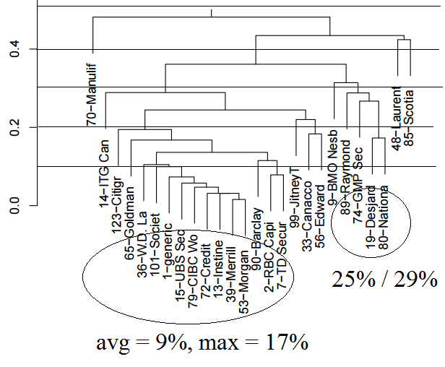
Days in different clusters (%)

Slide 9
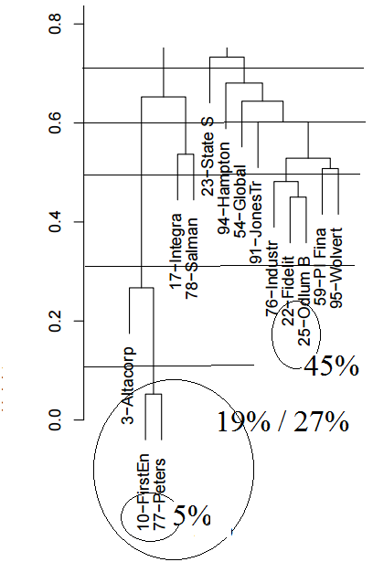
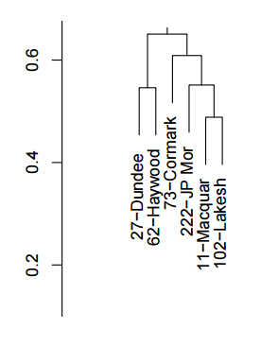
Days in different clusters (%)

Slide 10
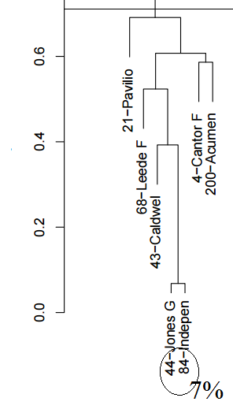
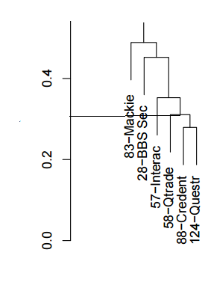
Days in different clusters (%)

Slide 11
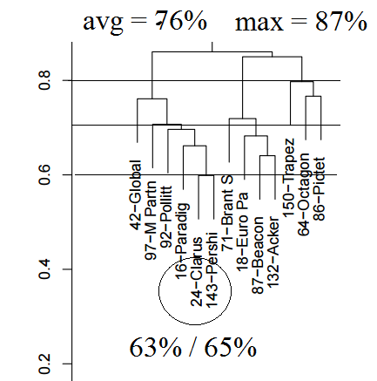
Days in different clusters (%)

