Slide 1
Clustering of Brokers – A Closer Look
August 8th 2016

Slide 2
Recap
The Initial Research Question was:
How Can We Cluster Brokers?
Method:
Clustering brokers based on the portion of their trades (in value) in each sector.
Tools:
K-means was applied and then used to group the brokers into clusters.
Following this, hierarchal clustering was used to cluster brokers based on the amount of time they were clustered with other brokers.

Slide 3
Handling The Issue
Observations from previous presentation:
Brokers’ behaviour changes throughout the year. As a result, brokers tend to change clusters throughout the year.
Some brokers remain together, even when they change clusters.
2 separate Approaches were used:
The first approach involves looking at specific instances of dates where anomalies happened.
The second approach involves a look at the instances on a larger scale, to understand what happens when these shifts occur.

Slide 4
First Approach: Research Questions
Why do some brokers cluster together some of the time but not all the time?
Why do some brokers switch clusters together?

Slide 5
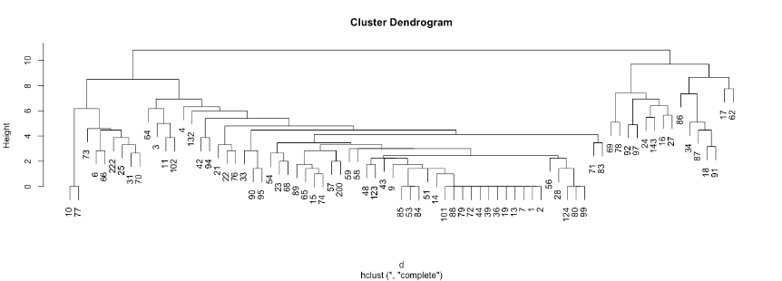
Focus
The Focus will be on firms 90 & 95

Slide 6
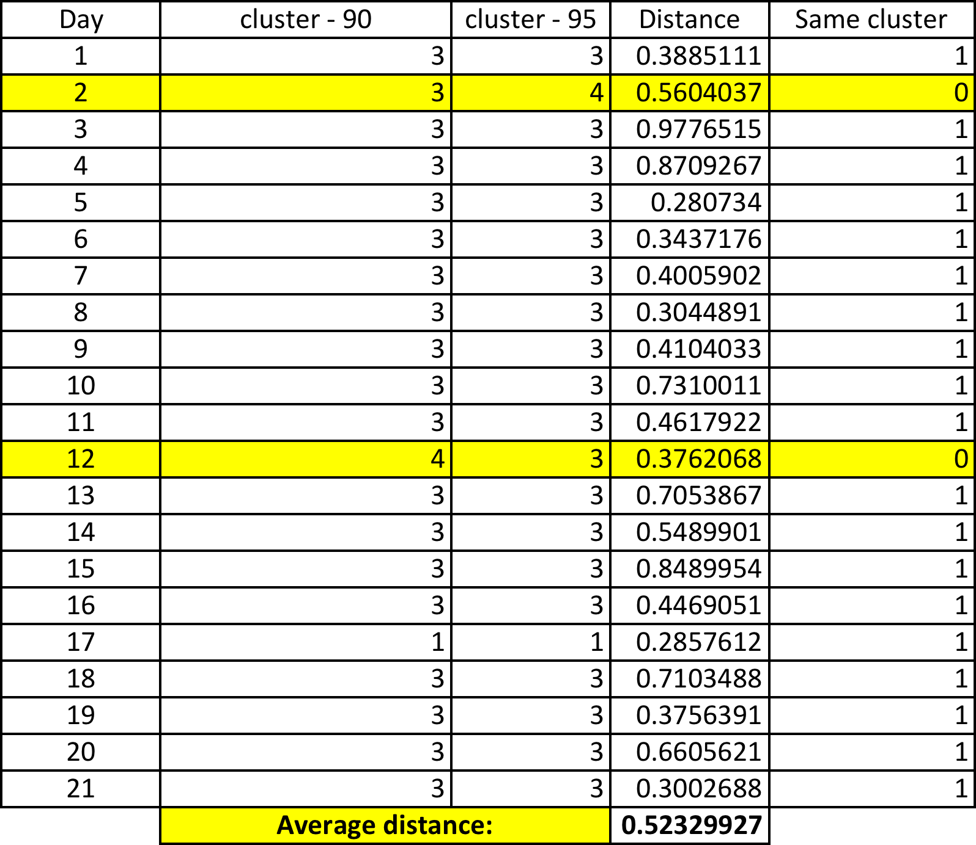
Firms 90 & 95
Days Together: 19/21 ~ 91%

Slide 7
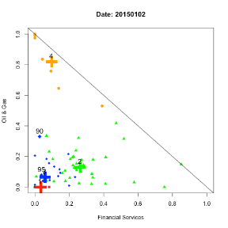
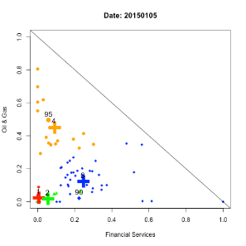
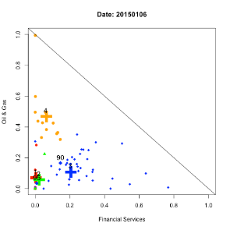
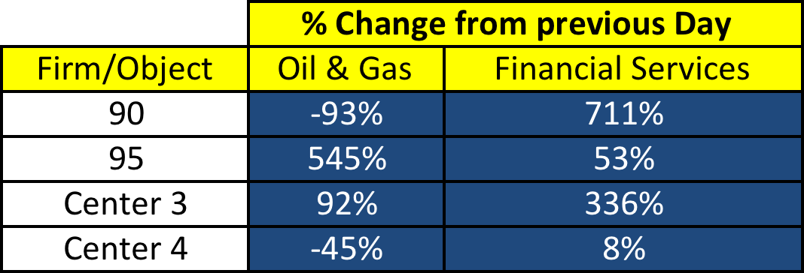
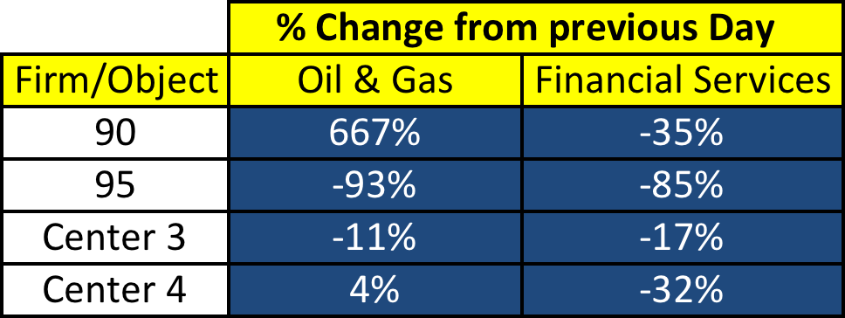
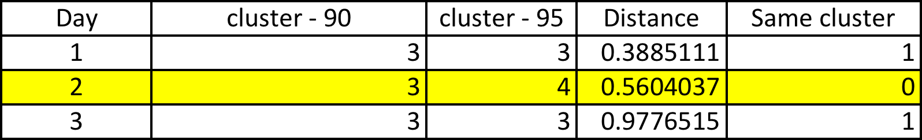
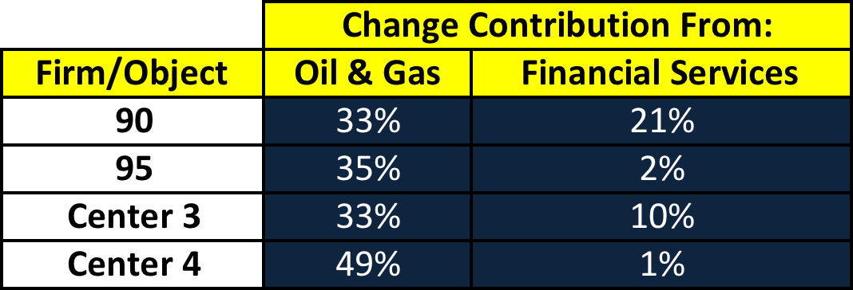
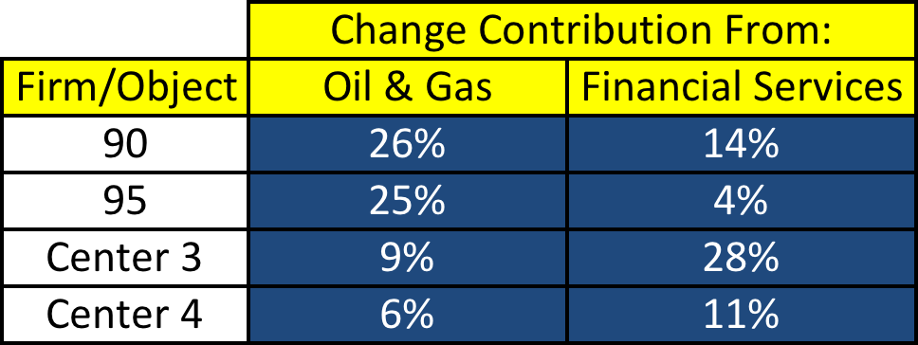
Days 1,2 and 3
Day 1
Day 2
Day 3
Distance: 0.39
Distance: 0.56
Distance: 0.97

Slide 8
(Hypothesized) Results
An abundance of media and new information was released:
‘Oil, European Inflation Rattle Markets While Euro Hits a 9-year low’
‘It was announced that U.S- Stocks Funds rose 7.6% in 2014’
Advisers’ Forecasts Shared Different Sentiments Regarding Oil & Gas
‘Oil Down 6% from Previous Week’
‘’ are all articles archived from the Wall Street Journal (WSJ)
An abundance of new information became available between January 2nd and January 5th.
Firms could have acted differently on this information, which could explain the shift in clusters.
As well, January 2nd was a banking holiday in some countries.

Slide 9
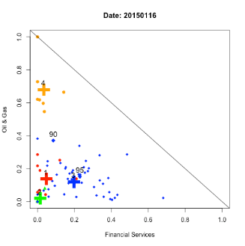
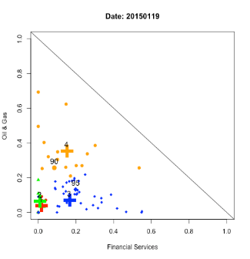
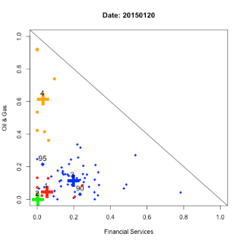
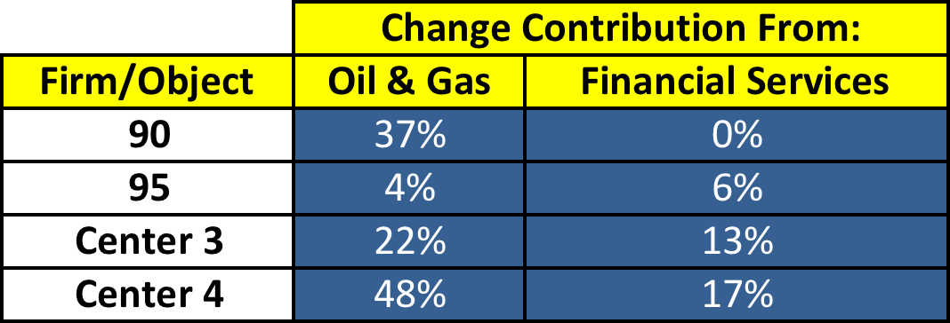
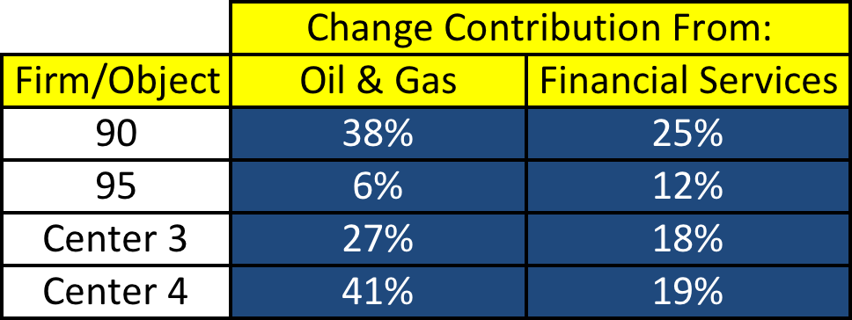
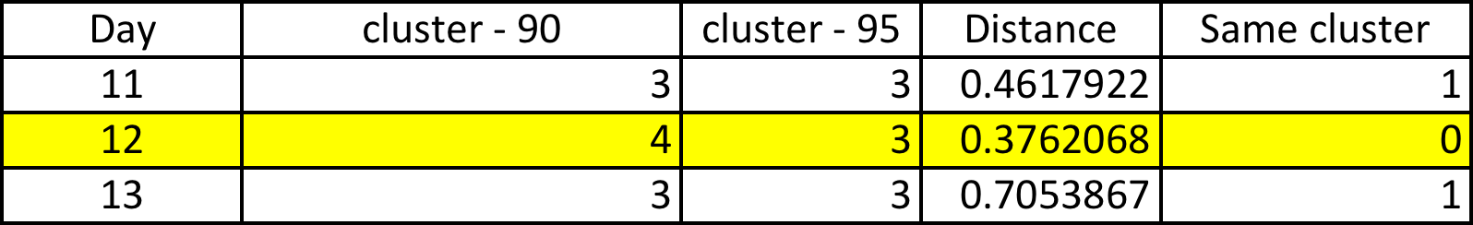

Days 11, 12, and 13
Day 11
Day 12
Day 13
Distance: 0.46
Distance: 0.38
Distance: 0.71

Slide 10
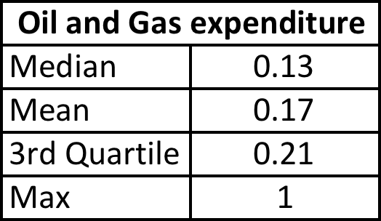
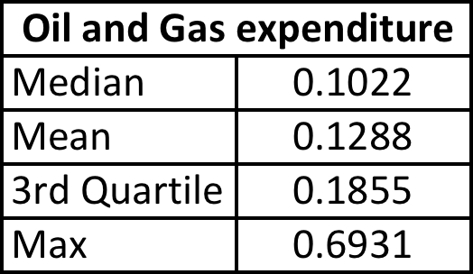
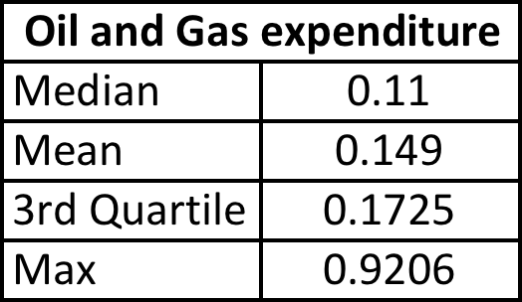
Days 11, 12, and 13
Day 11
Day 12
Day 13

Slide 11
(Hypothesized) Results
Firms that typically invest a large portion in Oil & Gas tended to decrease that investment on January 19th.
K-means centers are usually very susceptible to extreme values. Once these values became not as extreme, the center moved in and firm 90 switched clusters as a result, even though firm 90’s positions did not change very much (0.11 delta).
Because of this, broker 90 was absorbed into cluster 4, even though it only slightly changed position from the previous day.
No Significant financial news that day, Oil & Gas index was relatively steady as well.

Slide 12
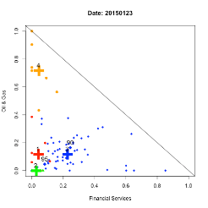
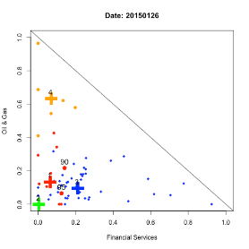
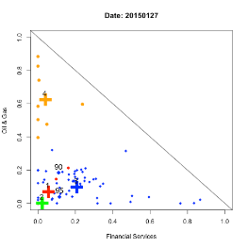
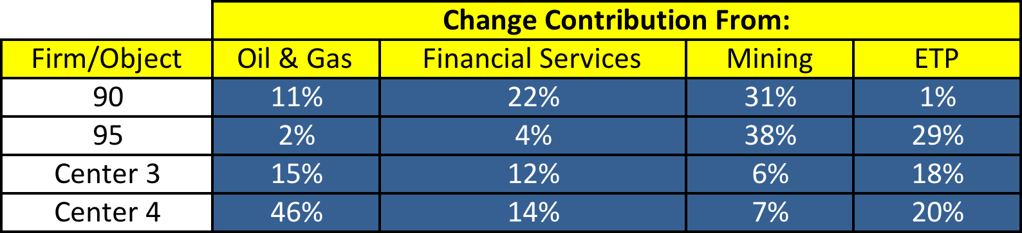
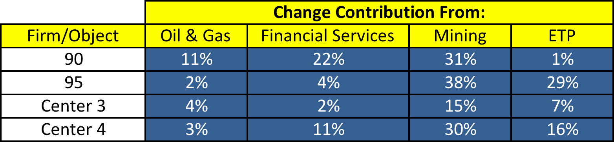
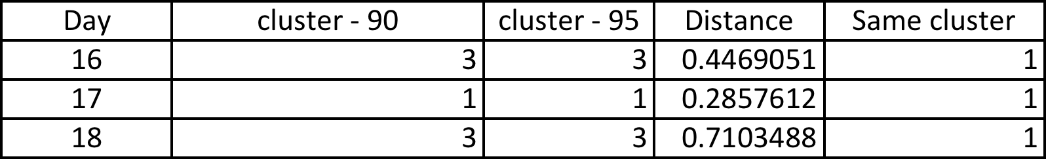
Changing Clusters in Pairs
Day 16
Day 17
Day 18
- Might be useful to look at it from an ETP/Mining perspective

Slide 13
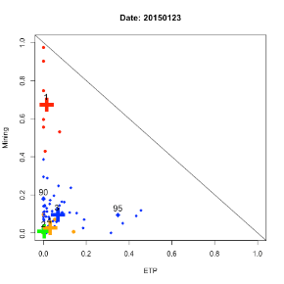
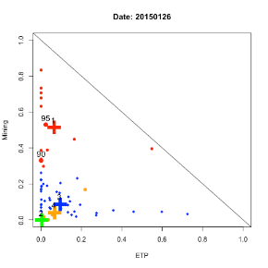
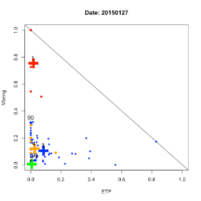
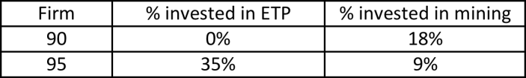

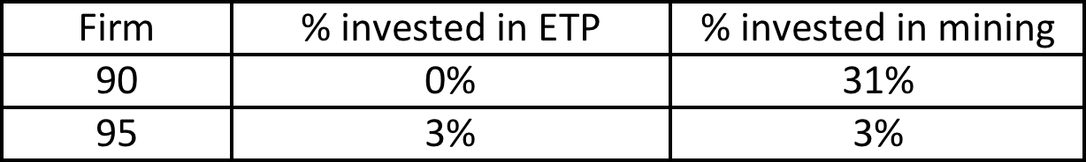
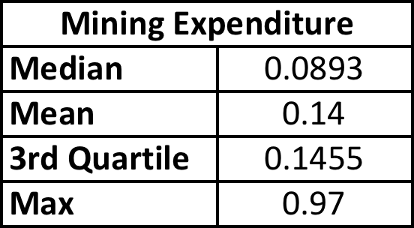
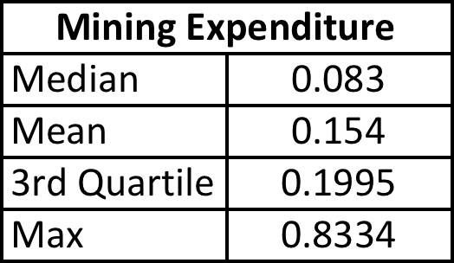
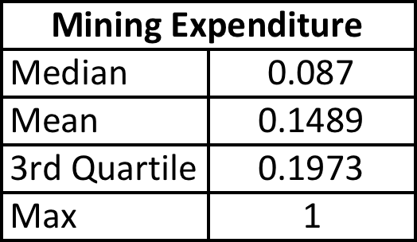
Changing Clusters in Pairs
Financial Services and Oil & Gas do a poor job of illustrating the clusters in this case – mining & ETP seems more adequate.
Day 16
Day 17
Day 18

Slide 14
(Hypothesized) Results:
From day 16 to day 17 there was a large shift in the cluster 1 centroid. This shift was primarily due to firms which usually invest an extremely large portion in Mining, reducing that investment on day 17.
Also on day 17, firm 95 drastically increased their investment in mining, and firm 90 slightly increased there’s.
This led to centroid 1 falling closer to the origin, and firms 90 & 95 moving closer to the centroid leading to the shift in the cluster.

Slide 15
Conclusion
In general, there are 3 main scenarios which can cause erratic behaviour in terms of changing clusters
New information; Brokers/Clients acting differently based on new information.
Changing statistical landscape; Other firms changing their behaviour, leading to changing center locations.
A combination of the above, in general it tends to be this case.

Slide 16
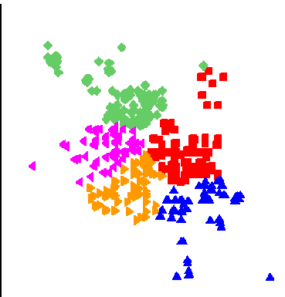
Second Approach: Some Brokers Remained Together
Different days, distinct clusters based on trade distribution.
Day 1
Day 2
!
Brokers were clustered by the number of days remained together.

Slide 17
Algorithms Used:
K-means Algorithm:
Each day brokers were clustered into 5 groups based on the sector to which they traded on that day.
Using hierarchal clustering algorithm:
The brokers were again clustered based on number of days they remained together, No matter whether they were in the same cluster or not.

Slide 18
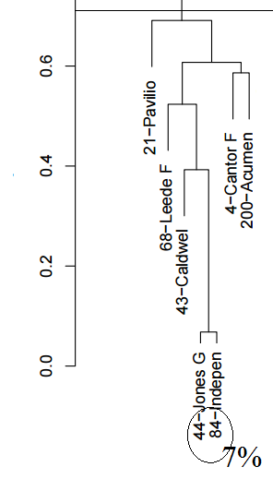
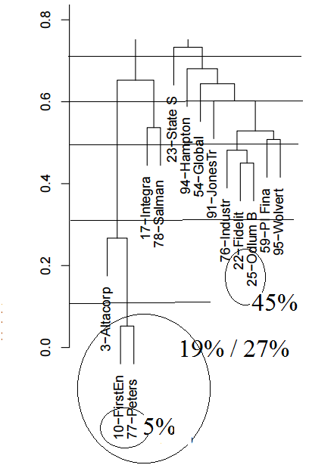
Clustering according to number of days together
Days in different clusters (%)

Slide 19
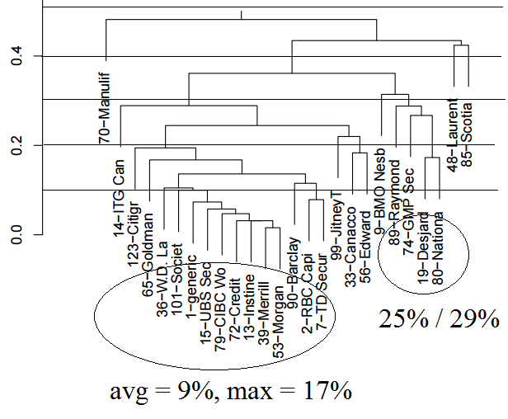
Clustering according to number of days together
Days in different clusters (%)

Slide 20
Why Were The Brokers in the Same Cluster?
93% of period

Slide 21
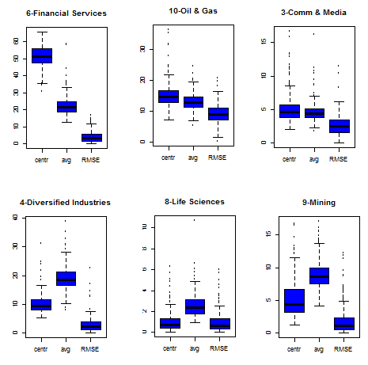
44 - Jones Gable & Company Ltd 84 - Independent Trading Group
‘Error’

Slide 22
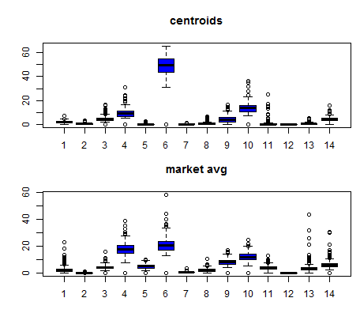
44 - Jones Gable & Company Ltd 84 - Independent Trading Group

Slide 23
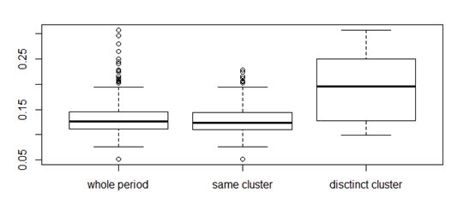
What happens when the brokers are in different clusters?
44 - Jones Gable & Company Ltd 84 - Independent Trading Group
RMSE (Root Mean Square Error)

Slide 24
Example #2: Why are the brokers in the same cluster?
95% of period

Slide 25
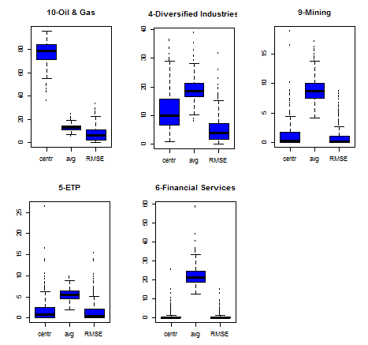
10 - FirstEnergy Capital Corp 77 - Peters & Co. Ltd

Slide 26
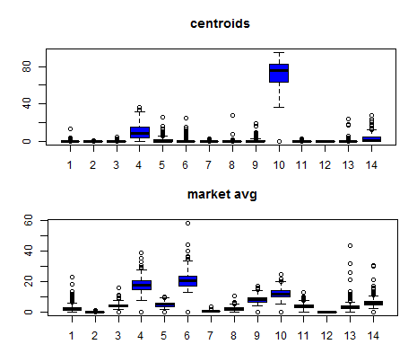
10 - FirstEnergy Capital Corp 77 - Peters & Co. Ltd

Slide 27
Example #3: Why are the brokers in the same cluster?
2015
95% of period together (average);
90% of period (min)

Slide 28
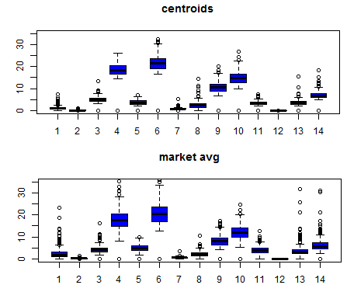
Comparing the behavior between cluster and market average

Slide 29
Conclusion
For brokers in the same cluster:
The trade distribution by sector did not change so much along the period;
Some brokers concentrated their trades in specific sectors;
Next Steps:
Analyze the behavior of all brokers;
Try to make associations between them (horizontal analysis);
Go deeper (vertical analysis);

Slide 30
Thanks For Listening

