Slide 1
Excel training
October 2016

Slide 2
Introduction
Agenda
Introductions
Shortcuts and navigation of the worksheet
Formatting and data checking
Sumifs, countifs, logical arguments
How to use offsets
Index, matches
Pivot Tables
Pivot Charts
Best practice spread sheeting
Questions

Slide 3
Keyboard shortcuts
Moving Around
Ctrl Home | Go to top of worksheet
Ctrl End | Go to end of worksheet
Ctrl ⬇ | Accelerate down to end
Ctrl PgDn | Go to next worksheet (Right)
Ctrl PgUp | Go to previous worksheet (Left)
Ctrl Tab | Flip between Excel workbooks
Selecting
Shift ⬇ | Highlight in direction of arrow
Shift Ctrl ⬇ | Highlight everything until the end
Shift Ctrl * | Selects a contiguous area
Ctrl A | Selects a contiguous area
Shift Spacebar | Selects an entire ROW
Ctrl Spacebar | Selects an entire COLUMN
Setting up the workbook
Ctrl N | New Workbook
Ctrl W | Close Workbook
Ctrl S | Save
Alt F A | Save As
Alt P S P | Page Setup
Ctrl P | Print
Formatting Cells
Ctrl 1 | Format Cells
Alt O E | Format Cells
Shift Ctrl I | 44:00
Shift Ctrl @ | 12:00 AM
Shift Ctrl # | 13-Feb-00
Shift Ctrl $ | $44.00
Shift Ctrl % | 4400%
Shift Ctrl & | Borders on outside area
Inserting, Deleting or Changing
Shift Ctrl + | Copy or Cut
Ctrl - | Paste
Alt E A F | Clear all formats
Alt E A A | Clear all numbers and formats
Alt H E | Clear and see choices
Alt H F S | Change font size
Alt H O R | Rename sheet
Shift Ctrl _ | Remove all borders
Copying and Pasting
Ctrl C or X | Copy or Cut
Ctrl V | Paste
Alt E S T | Pastes the format
Alt E S V | Pastes the values
Alt E S F | Pastes formulas
Alt E S N | Paste data validation
Alt E S M F | Multiply a range
Ctrl D | Fill down
Ctrl R | Fill right
Undoing and Adjusting
Ctrl Z | Undo
Ctrl Y | Repeat
Alt O R E | Change row Height
Alt O C W | Change column width
Alt O C A | Auto adjust column width
Additional Shortcuts
Alt W Q | Zoom
Ctrl F | Find
Alt I N D | Name manager
Alt M M D | Name a selected rage
Alt H | Create a link
Additional Shortcuts
F4 | Anchors a formula reference when in edit mode
Alt = | Auto Sum
Notes:
Ones used all the time
Navigation:
CTRL Home
CTRL end
CTRL down/up/right/left arrow
CTRL page up/down
Selection
CTRL SHIFT up/down
Paste special
ALT E S
Open example workbook
Once open no more mouse use until I say!
Answer the five questions on the ‘keyboard shortcuts’ sheet

Slide 4
Simple functions
Sum, Average, Product
Self explanatory, perform a basic calculation based on the array entered
Count and CountA
CountA Returns the number of cells which are not empty
COUNT returns the number of cells which contain a number (not text or other things)
Max, Min
Returns the maximum and minimum values in an array

Slide 5
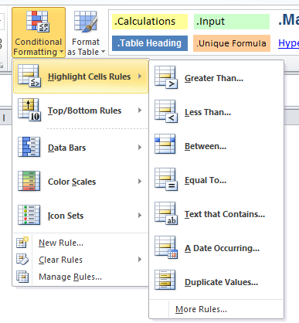
Conditional formatting
Ribbon -> Data -> Data Validation (Alt + H + L)
Allows presentation of data in a meaningful way
Can quickly help understand a data set
Notes:
Visual way of reading data – easily shows up the values which fit a set criteria
Explain how can be cool using visuals on slide, mostly in Excel workbook example
Show how to go across whole range of data

Slide 6
Sumif, countif etc
Simple functions which rely on logic
SUMIF(range, criteria, sum range)
Used to calculate the total of a set of numbers based on one given criteria
Criteria can be based on the data or external to the sum range
SUMIFS(sum range, range 1, criteria 1, range 2, criteria 2, …)
Used to calculate the total of a set of numbers based on multiple criteria
COUNTIF(range, criteria)
Counts how many of the values in the given range meet one criteria
AVERAGEIF(range, criteria, average range)
Works in the same way as SUMIF, but returns the average instead of the sum
Notes:
Really useful!
Many applications and most formulas now have an “if” attachment at the end of them
Mention that also have countifs and averageifs
Talk through the use of “>”&G9 etc. as a criteria, cannot just use >G9

Slide 7
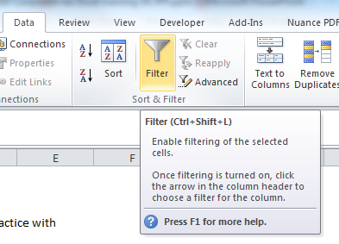
Filtering data
A useful way to quickly understand the data in a column
Can be used to hide rows based on the desired value in a column
To apply a filter:
Select the table headings
Data -> Filter (Alt+A+T)
Use the drop down menu now on the column headings selected
Practice on the Index, Match example
Notes:
Useful way to check as well
Mention F11 as a good way to check data for potential outliers

Slide 8
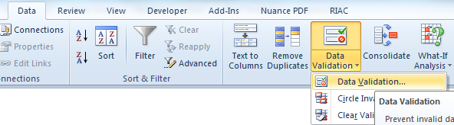
Data Validation
Data validation is a good
tool which can be used to
restrict which values can be entered in to a cell.
Restricting values that can be entered make it a lot easier to control inputs in to a model.
Click Data (or Alt -> A)
Click Data Validation (Alt -> A -> V-> V)
From here you can select which restrictions you would like to add to a cell (only positive, only integers, only a range)

Slide 9
Logic functions
IF(logical test, value if true, value if false)
Allows the value in one cell to be based on the value in another
Logical tests are something which will return TRUE or FALSE
AND(logical test 1, logical test 2, …)
Will return TRUE only if all the logical tests return a TRUE value
OR(logical test 1, logical test 2, …)
Will return TRUE if any of the logical tests return a TRUE value
IFERROR(value, value_if_error)
Returns the “value_if_error” entered if the value is an error
Notes:
Pick on attire in the room
Or other real life examples to bring to life
Then use an Excel example to bring home the point
In the same workbook

Slide 10
Offset
Formula explanation
Offset('Starting cell', offset rows, offset columns, How many rows is the data set?, How many columns is the data set?)
Offset to manipulate
Can be used in order to reference a cell a defined distance away from another cell
i.e. Offset (A1,2,0), offsets A1 2 rows down so it will contain the value in A3
Offset(A1,2,3) offsets A1 2 rows down and 3 rows across so will give the value in D3

Slide 11
Offset
Formula explanation
Offset('Starting cell', offset rows, offset columns, How many rows is the data set?, How many columns is the data set?)
Offset to define a range
Can be used to define the size of a range.
i.e. Offset(A1,0,0,5,1), will return the values in cells A1,A2,A3,A4 and A5
Offset (A1,0,0,1,3) will return the values in cells A1,B1 and C1
Great for summing to the bottom of a data set when the number of rows or columns is known, which is easy with the counts we have already learnt!
No more filling sum formulas down to the bottom of the range when new data is added

Slide 12
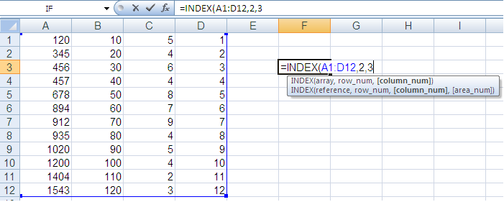
Index
INDEX(array, row number, column number)
Used to return the entry in any row and column within a rectangular array of numbers
To illustrate, the formula INDEX(A1:D12,2,3) would return the entry in the second row and third column of the array A1:D12. This entry is the one in cell C2

Slide 13
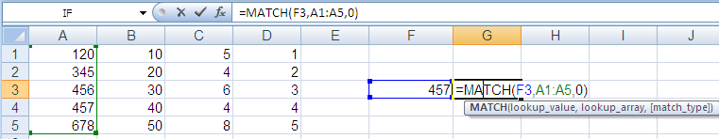
Match
Match(lookup value, lookup array, match type)
Searches for a specified item and returns its relative position in a range
Combined with INDEX can be used an upgraded version of VLOOKUP / HLOOKUP
To illustrate, the formula MATCH(F3,A1:A5,0) would return the position of the number in cell F3 if it is found in the range A1:A5. In this instance, 457 is the fourth entry
Notes:
Talk about VLOOKUPs here and why they are bad!
Vlookup requires unique in left hand column, match allows you to go both ways in a table
Insert a column and volatile hit
Match does not matter where the column is

Slide 14
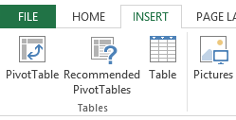
Pivot Tables
Useful to aggregate large amounts of data without transforming or modifying the data
All columns need a heading
Remove subtotals / totals from data
All data needs to be selected then go to Insert -> Pivot Table (Alt + N + V)
When source data changes the pivot table needs to be refreshed. It won't automatically update.
Notes:
Talk about VLOOKUPs here and why they are bad!
Vlookup requires unique in left hand column, match allows you to go both ways in a table
Insert a column and volatile hit
Match does not matter where the column is

Slide 15
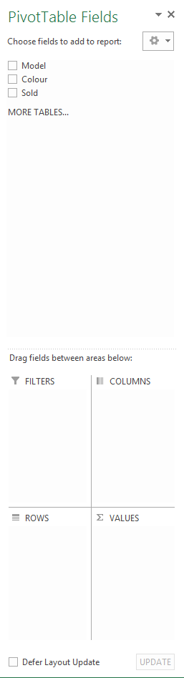
Pivot Tables (continued)
Drag the fields into here that you want to slice the columns by
These are the column headings of the data selected to pivot
Drag the fields into here that you want to slice the rows by
These are the column headings of the data selected to pivot. To be dragged into the quadrants below.
Drag the fields into here that you want to be calculated
Notes:
Talk about VLOOKUPs here and why they are bad!
Vlookup requires unique in left hand column, match allows you to go both ways in a table
Insert a column and volatile hit
Match does not matter where the column is

Slide 16
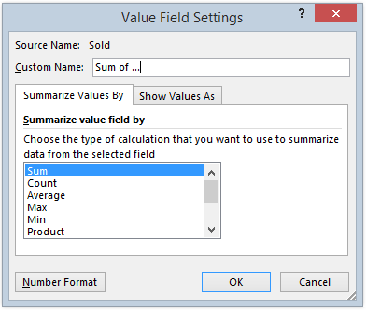
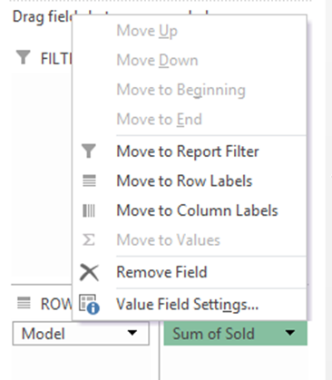
Pivot Tables (continued)
Change type of data aggregation…
In “Values” section, right click on field to select “Value Field Settings…”
Select type of field summary
Notes:
Talk about VLOOKUPs here and why they are bad!
Vlookup requires unique in left hand column, match allows you to go both ways in a table
Insert a column and volatile hit
Match does not matter where the column is

Slide 17
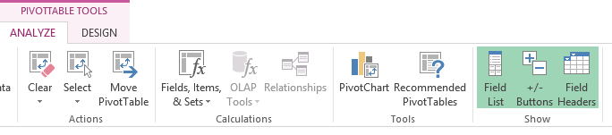
Pivot Charts
Act as a normal chart although they change with the pivot table
Chart Types | Possible Use
Column or Bar | These chart type are used to compare values across categories. For example, they could compare the populations of different countries.
Line or Area | Lines are perfect for showing trends such as sales or employment figures. An area chart is basically a line chart with the area below the line filled in.
Surface | The surface chart plots trends in two dimensions. You could use this to plot departmental sales figures over time. The chart then shows you the trends between departments, as well as the sales trends over time.
Pie | Shows proportion, such as the sales figures from different departments that make up a total.
Scatter and Bubble | Scatter diagrams are used to display the relationship between two variables. For example, you could research the age and value of a series of cars, and plot the values you find. You could also investigate the height and weight relationship of a group of people. The bubble chart is a scatter chart with a third set of values that determine the size of the bubble marker.
Notes:
Talk about VLOOKUPs here and why they are bad!
Vlookup requires unique in left hand column, match allows you to go both ways in a table
Insert a column and volatile hit
Match does not matter where the column is

Slide 18
Workbook/sheet layout
Make it clean
Don’t make someone else think
Section breaks
Formatting across multiple sheets
Totals at the top of the data not the bottom
Consistency
Notes:
Also mention efficiency and accuracy

Slide 19
Other hints
Google is always great for any problem you may be having
Excel help can be used to understand formulae
If you think there is a better or quicker way to do something, you’re probably right
Don’t be afraid to ask for help

