Slide 1
APS360 -Team 62 Presentation
Nathan Jones - Priscilla Deng - Sadra Tonekaboni - Sean Llera

Slide 2
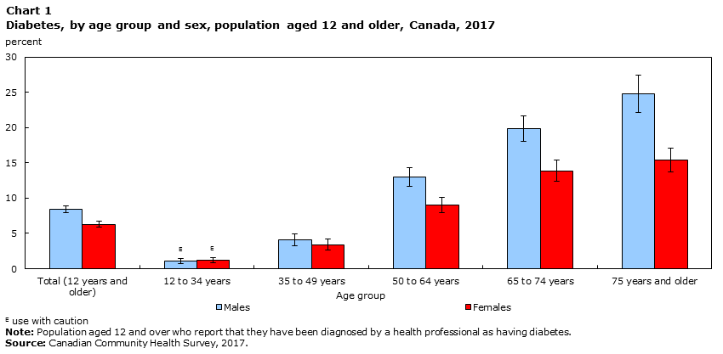
Our Project
From Statistics Canada: https://www150.statcan.gc.ca/n1/pub/82-625-x/2018001/article/54982-eng.htm

Slide 3
Data

Slide 4
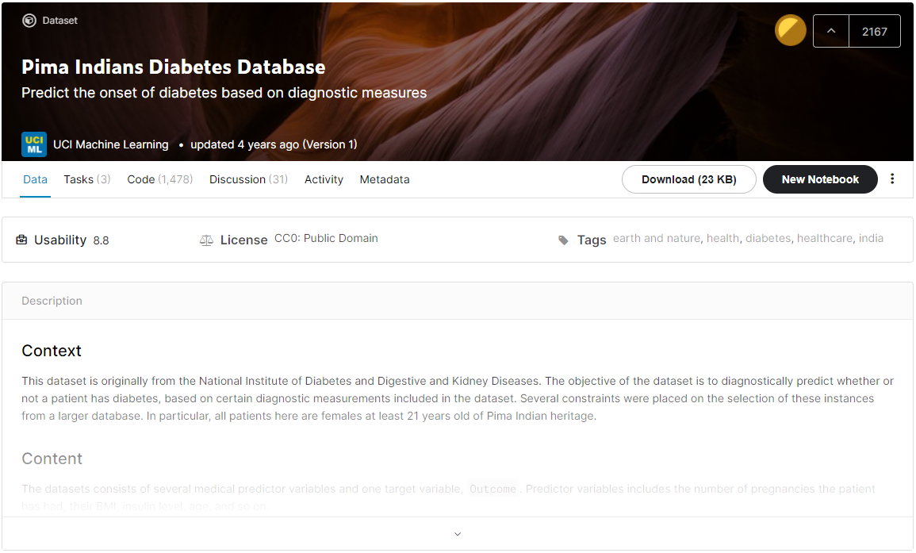
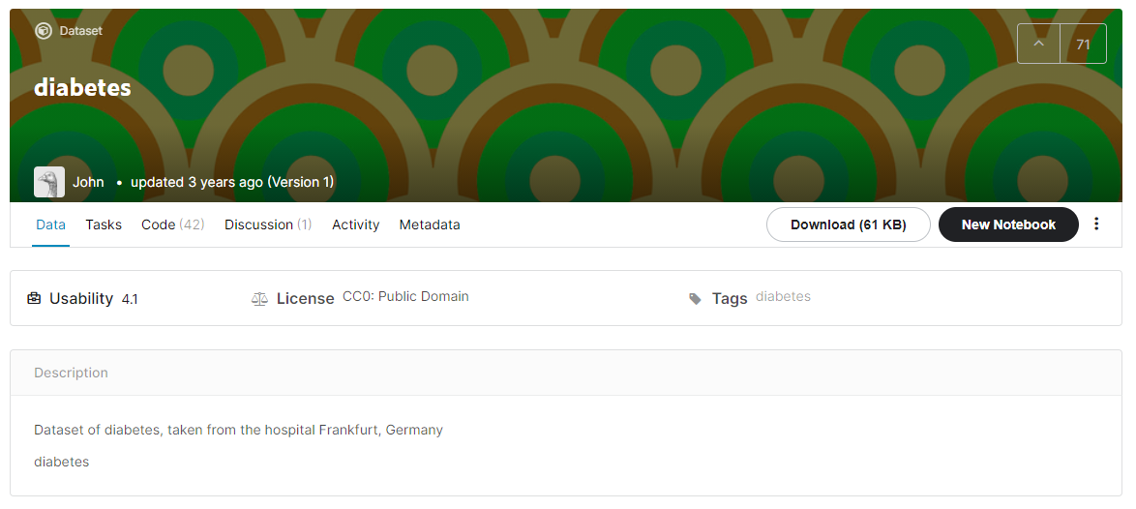
Sources

Slide 5
Details
Constraints: Females that are at least 21 years old.
Inputs:
Number of Pregnancies
Glucose Concentration Levels (2 hours after glucose administration)
Diastolic Blood Pressure [mm Hg]
Triceps Skin Fold Thickness [mm]
Insulin Levels (2 hours after glucose administration) [mm U/ml]
Body Mass Index
Diabetes Pedigree Function (likelihood of diabetes based on family history)
Age
Output:
Patient has diabetes (1) or does not have diabetes (0)

Slide 6
Data Processing

Slide 7
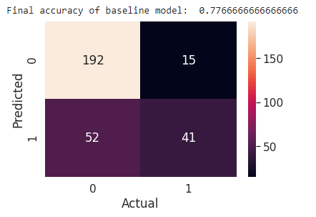
Original Dataset Problems
Small Dataset (2000 entries)
Unbalanced
(Almost 2x more non-diabetic than diabetic entries)
Resulted in many false positives and not many true positives
Confusion matrix based on baseline results on original dataset

Slide 8
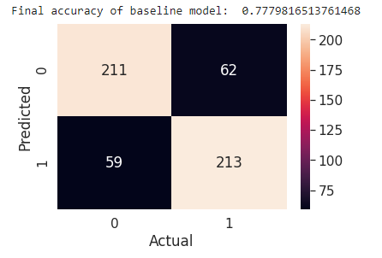
Solutions
Combine datasets from Kaggle
Resulted in 2768 entries
Duplicate diabetes entries
as done in Lab 5
Resulted in many more true positives
Resulted in 3632 entries
Confusion matrix based on baseline results on balanced dataset

Slide 9
Model

Slide 10
Demonstration

Slide 11
Results

Slide 12
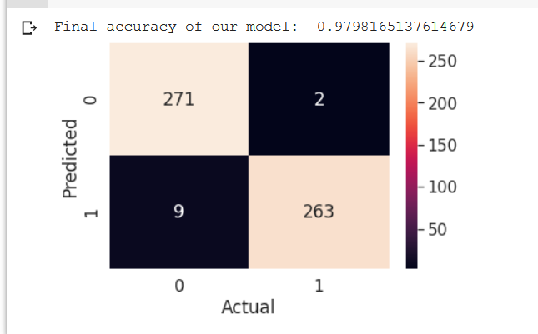
Quantitative Results

Slide 13
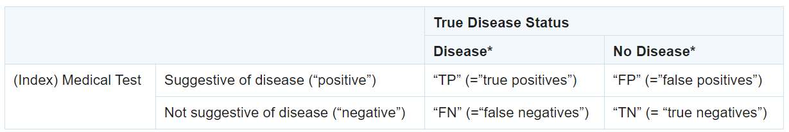

Quantitative Results
Sensitivity of our model: 0.99245
Specificity of our model: 0.9678
https://www.ncbi.nlm.nih.gov/pmc/articles/PMC4975285/

Slide 14
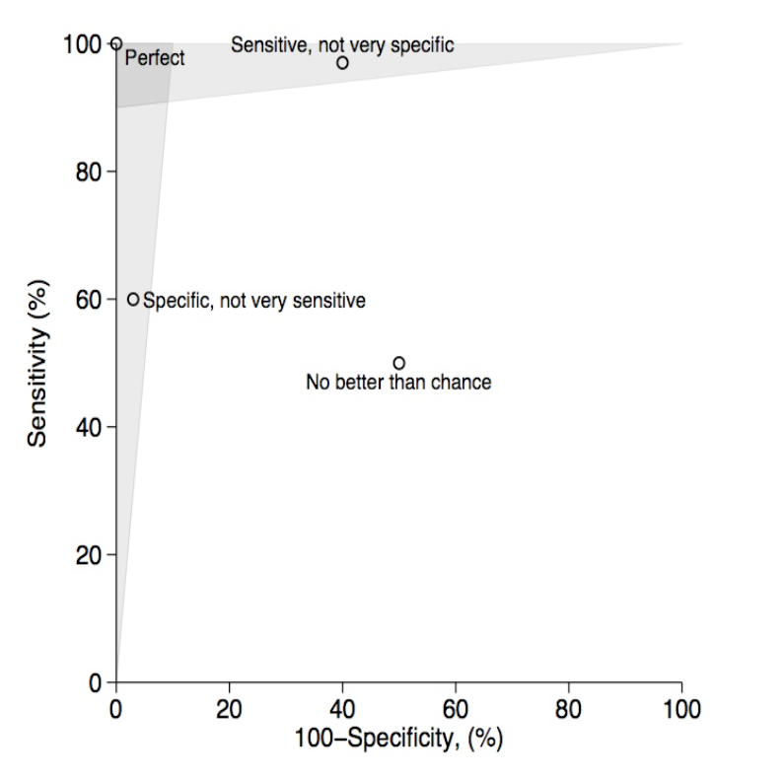
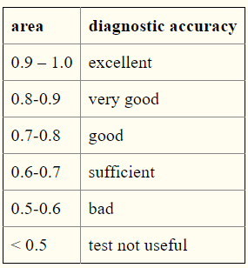
Quantitative Results
Area under our graph: 0.9801
https://effectivehealthcare.ahrq.gov/products/test-performance-metrics/appendixes

Slide 15
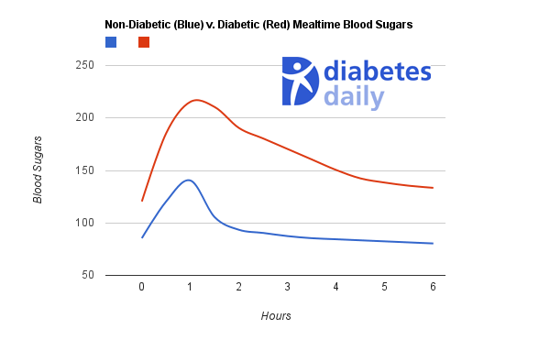
Qualitative Results
https://www.diabetesdaily.com/learn-about-diabetes/understanding-blood-sugars/is-my-blood-sugar-normal/

