Slide 1
Analyzing the effect of age and co-housing with animals on gut microbiome diversity
By Nathan Kolbow
In collaboration with Matthew F. Warren, PhD and Federico Rey, PhD from the Rey Lab, Department of Bacteriology, UW-Madison

Slide 2
SELEVER
Women’s Poultry Program to Improve Income and Nutrition
Five-year program in Burkina Faso
Our data comes from this study

Slide 3
The Goal of SELEVER
Controlled experimental study
Help improve diets at key stages of life
Educate communities on good dietary practices
Improved access to and training on value chain services

Slide 4
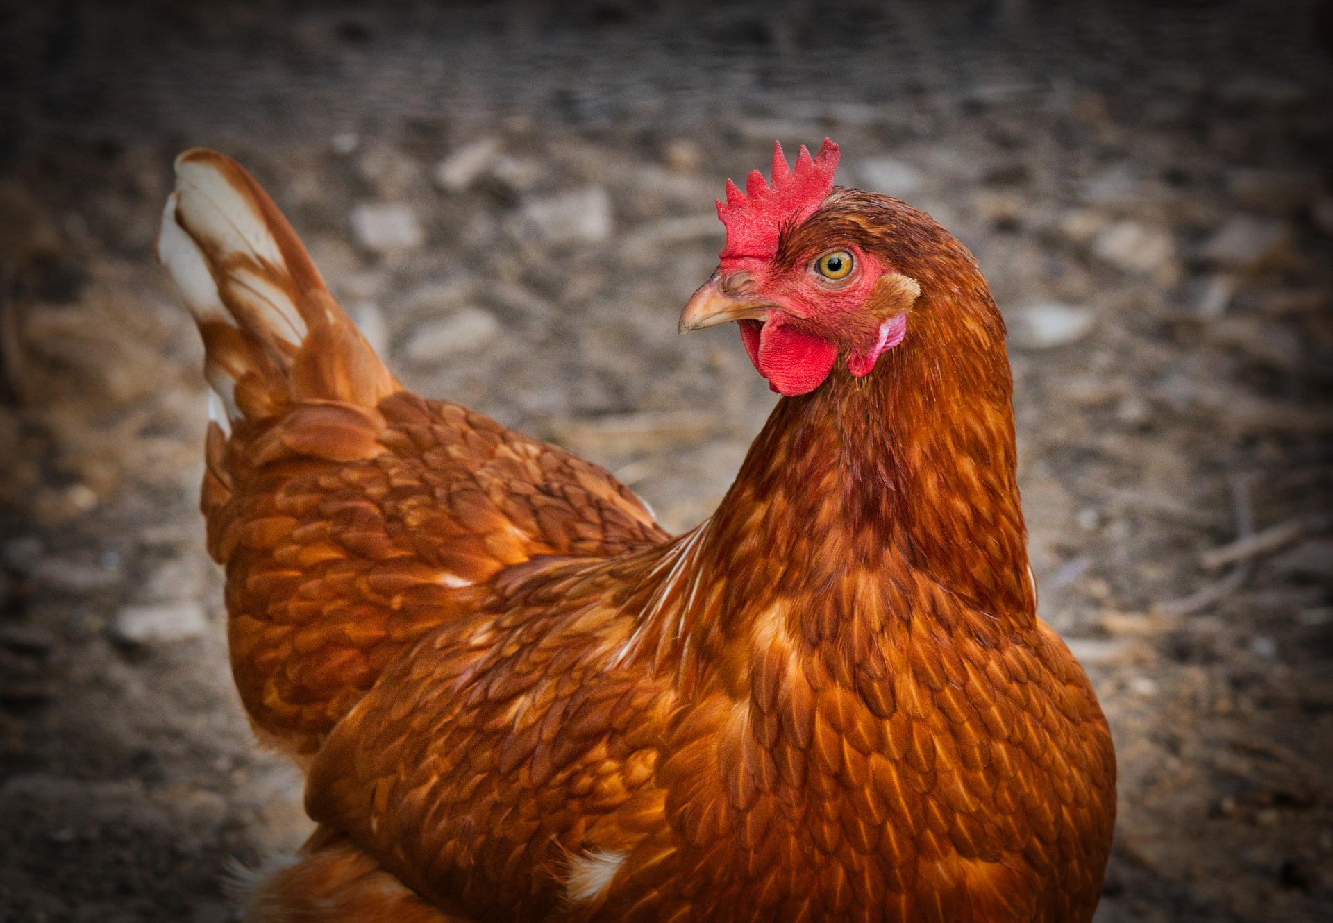
Burkina Faso
West African country, population 22 million
One of the world’s least developed countries [1]
Livestock are a fundamental part of their economics
Very low dietary diversification; implications [2]:
Almost half of women are anemic
Child stunting rate: 35%
Child wasting rate: 16%
Child anemia: 88%

Slide 5
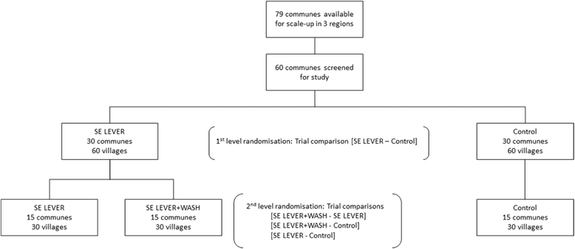
Experimental Design
Key point: random effects for regions, communes, and villages
Gelli, A., Becquey, E., Ganaba, R. et al. Improving diets and nutrition through an integrated poultry value chain and nutrition intervention (SELEVER) in Burkina Faso: study protocol for a randomized trial. Trials 18, 412 (2017). https://doi.org/10.1186/s13063-017-2156-4

Slide 6
Experimental Design
3 regions, 44 communes, 87 villages total
Fewer than expected due to non-responses
Gelli, A., Becquey, E., Ganaba, R. et al. Improving diets and nutrition through an integrated poultry value chain and nutrition intervention (SELEVER) in Burkina Faso: study protocol for a randomized trial. Trials 18, 412 (2017). https://doi.org/10.1186/s13063-017-2156-4

Slide 7
Our Data
Pre-intervention, baseline data
Collected by researchers who visited these villages
Gut microbiome alpha diversities for children 24-59 months old
Lots of metadata for the children

Slide 8
The Metadata
General info: child age, height, weight
Household: total siblings, parents’ age/education, etc.
Cleanliness: garbage visible, feces visible, parents visibly dirty
Livestock: total chickens, donkeys, sheep, etc. owned

Slide 9
Project Questions
How does gut microbiome diversity change with age?
How does co-housing with animals affect gut microbiome diversity?

Slide 10
Alpha Diversity
Representing gut microbiome diversity 3 ways:
Shannon entropy
Faith’s Phylogenetic Diversity (PD)
Total observed taxa in each sample
All related, but capture slightly different information

Slide 11
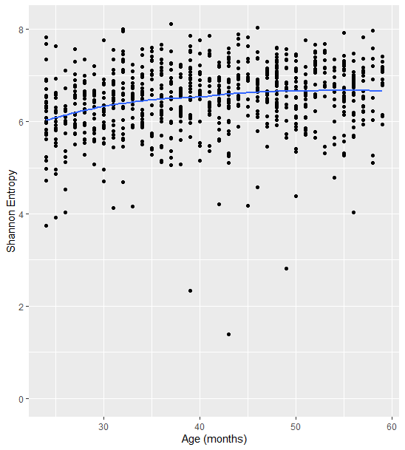
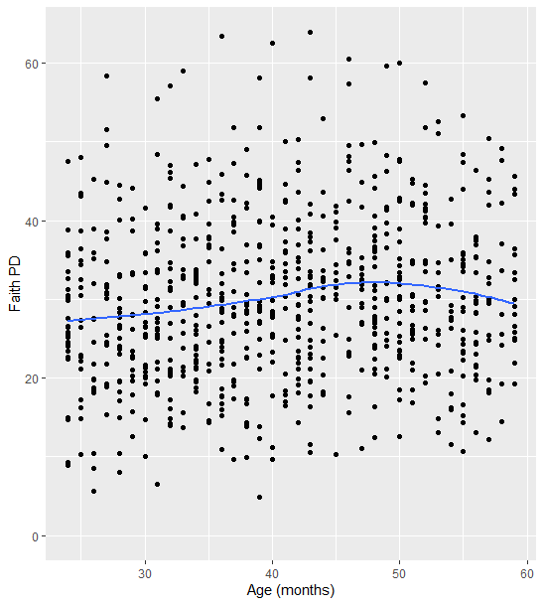
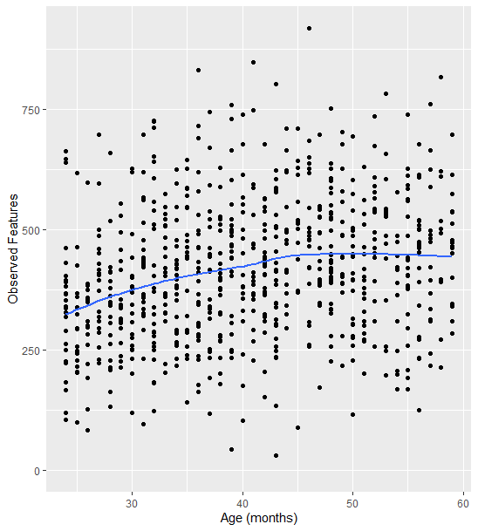
Diversity vs Age

Slide 12
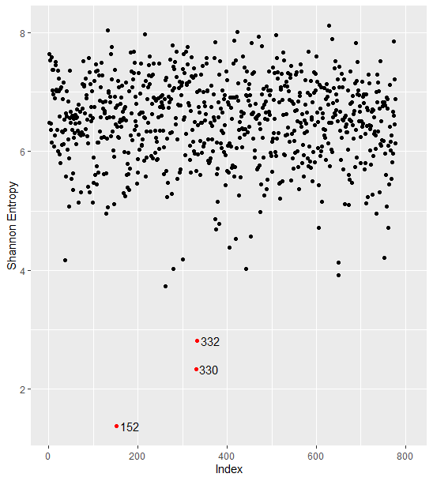
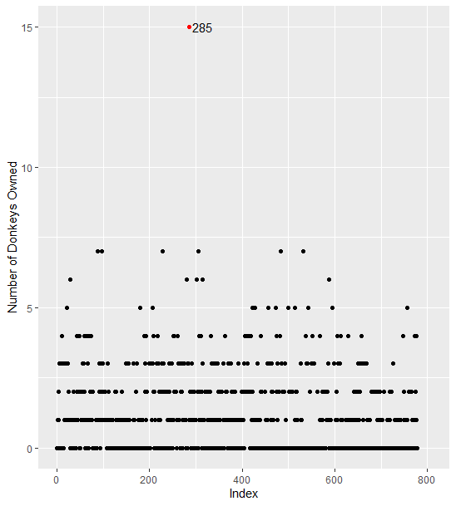
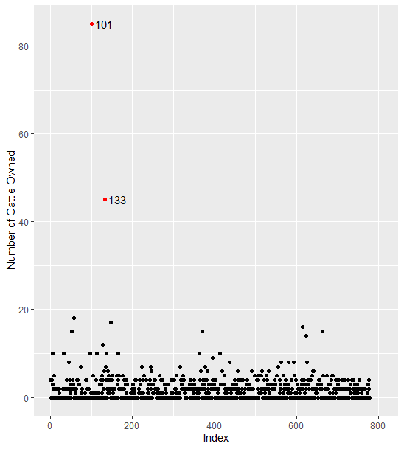
Outliers & Highly Influential Points

Slide 13
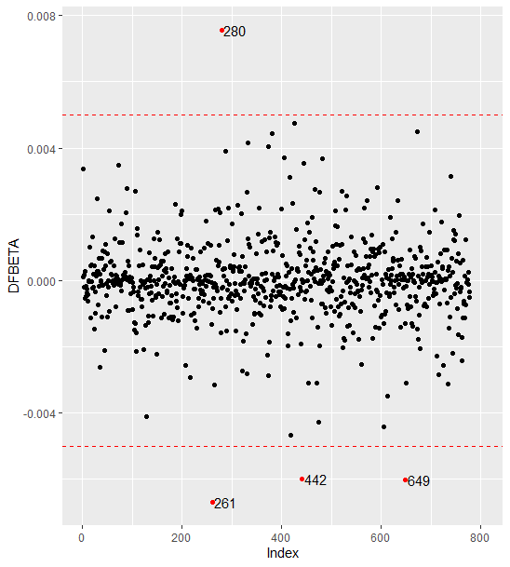
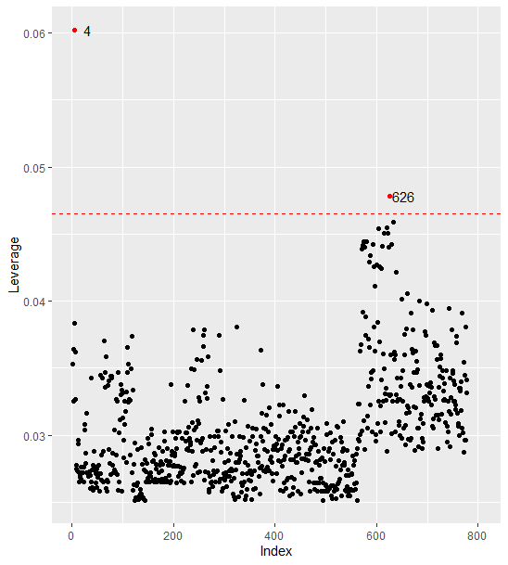
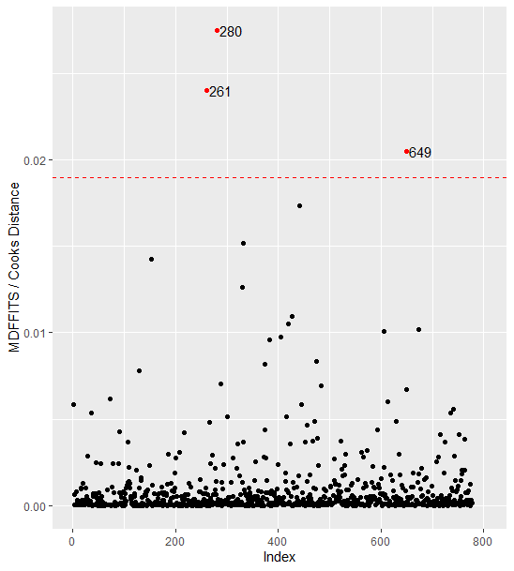
Outliers & Highly Influential Points
Notes:
Very clearly outliers for Shannon entropy & observed features, but they end up being very influential points for faith’d PD as well
These points had nothing out of the ordinary in the other covariates, so obvious to remove them

Slide 14
Variable Selection Methods
Decision trees
Stepwise mixed-effects models
Lasso with mixed-effects
Looking at fixed ranges of age

Slide 15
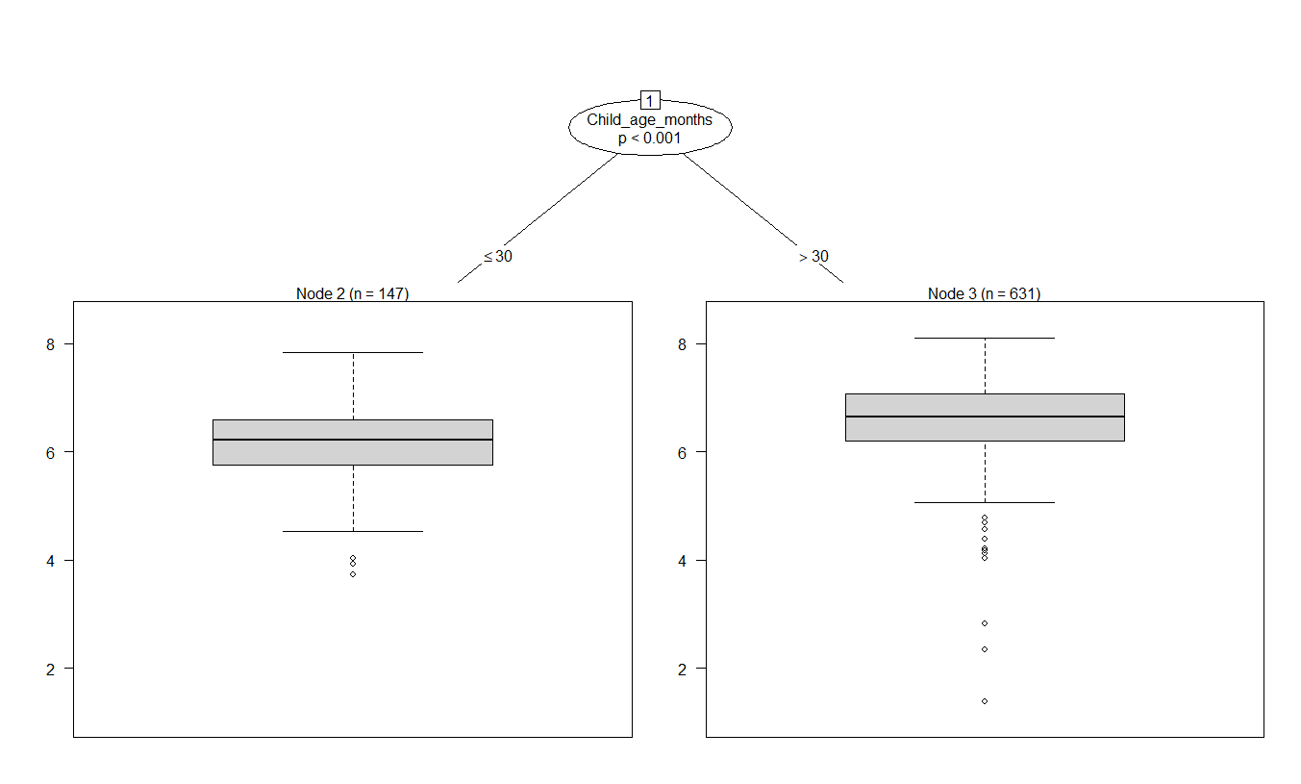
Decision Trees
Only ever selects age

Slide 16
Stepwise Mixed-Effects Models
Variance stabilizing transformations:
Shannon entropy^2
Sqrt(Faith’s PD)
Observed features^(2/3)
Notes:
The importance of removing outliers/influential points was VERY clear here

Slide 17
Stepwise Mixed-Effects Models
Before removing outliers/highly influential points:
Age and age^2 are significant
Number of poultry, cattle, donkeys, etc. are ALL significant
After removing these points:
Shannon entropy: age, age^2, resident commune
Observed features: age, age^2, village
Faith’s PD: age
Coefficients all agree in direction
Notes:
The importance of removing outliers/influential points was VERY clear here

Slide 18
Lasso with Mixed Effects
Cross-validation for λ with BIC
Non-zero coefficients:
Shannon entropy: age and age^2
Observed features: age and age^2
Faith’s PD: none

Slide 19
Fixed Age Range Analysis
Sliding window approach:
Select an age “width” (e.g. 6 months)
Select a step size (e.g. 3 months)
Analyze with ages in the window, then step the window
Stepwise lmer/Lasso variable selection
Age:
24 25 26 27 28 29 30 31 32 33 34 35 36 37 38 39 40 41 42 43 44 45 46 47 48 49 50 51 52 53 54 55 56 57 58 59

Slide 20
Fixed Age Range Analysis
Sliding window approach:
Select an age “width” (e.g. 6 months)
Select a step size (e.g. 3 months)
Analyze with ages in the window, then step the window
Stepwise lmer/Lasso variable selection
Age:
24 25 26 27 28 29 30 31 32 33 34 35 36 37 38 39 40 41 42 43 44 45 46 47 48 49 50 51 52 53 54 55 56 57 58 59

Slide 21
Fixed Age Range Analysis
Sliding window approach:
Select an age “width” (e.g. 6 months)
Select a step size (e.g. 3 months)
Analyze with ages in the window, then step the window
Stepwise lmer/Lasso variable selection
Age:
24 25 26 27 28 29 30 31 32 33 34 35 36 37 38 39 40 41 42 43 44 45 46 47 48 49 50 51 52 53 54 55 56 57 58 59

Slide 22
Fixed Age Range Analysis
Results:
Nothing is consistently selected
When variables are selected in a window, p-values are weak (>0.01)

Slide 23
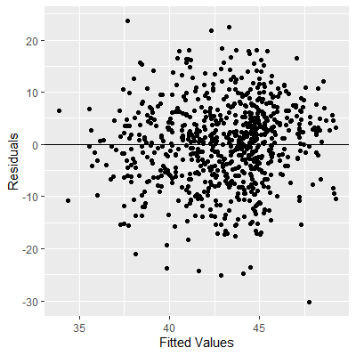
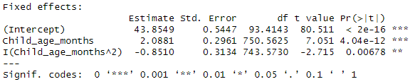


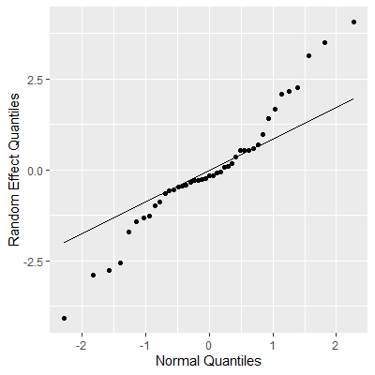
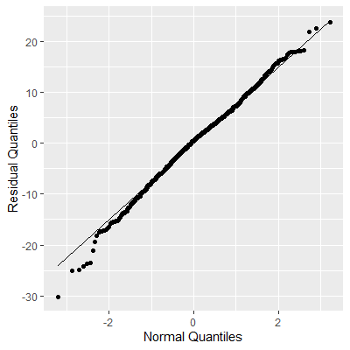
Final Models (Shannon Entropy)

Slide 24
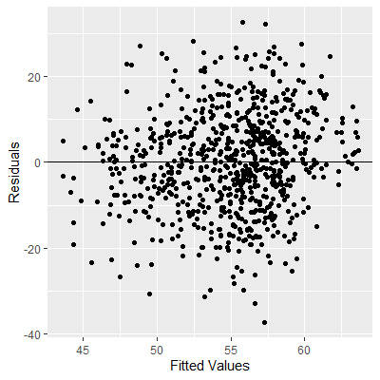
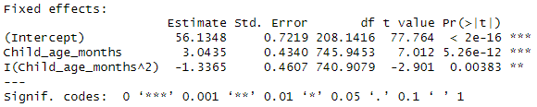


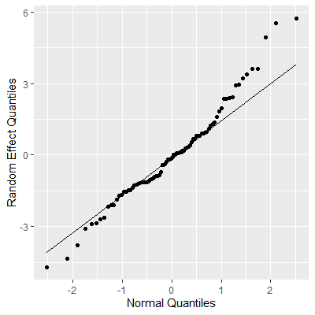
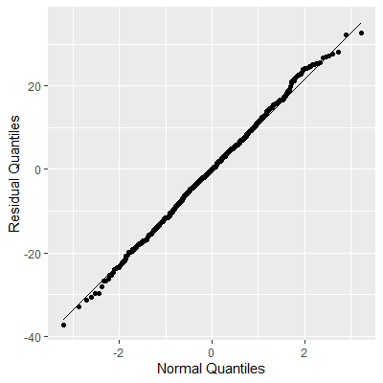
Final Models (Observed Features)

Slide 25
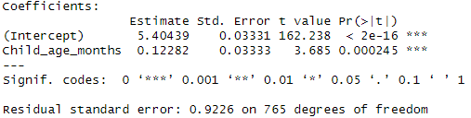
Final Models (Faith’s PD)

Slide 26
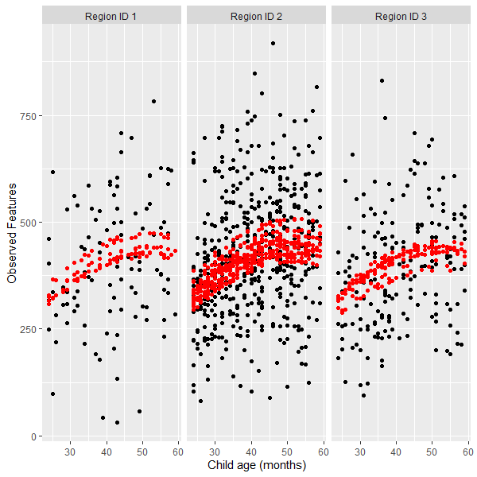
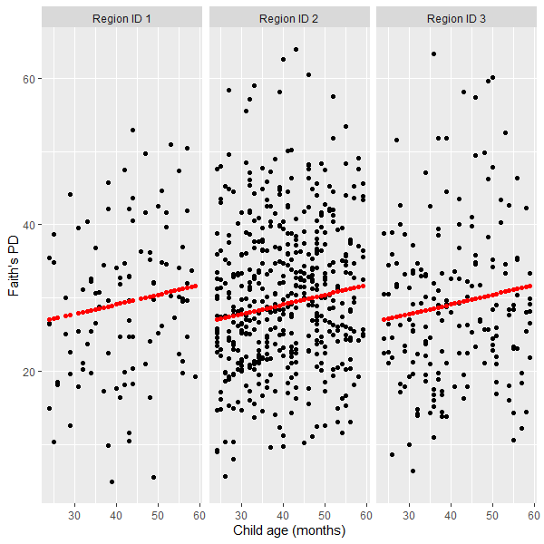
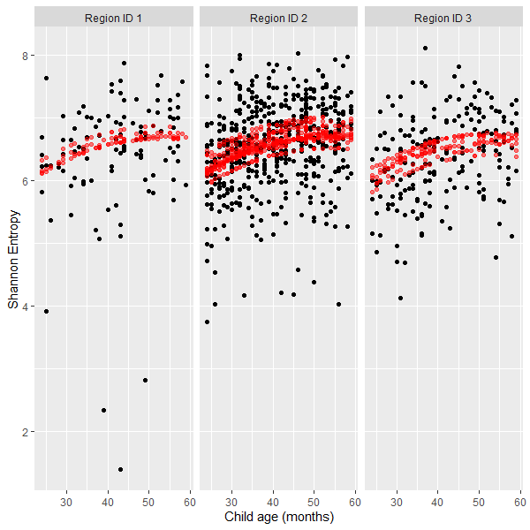
Examining Fits

Slide 27
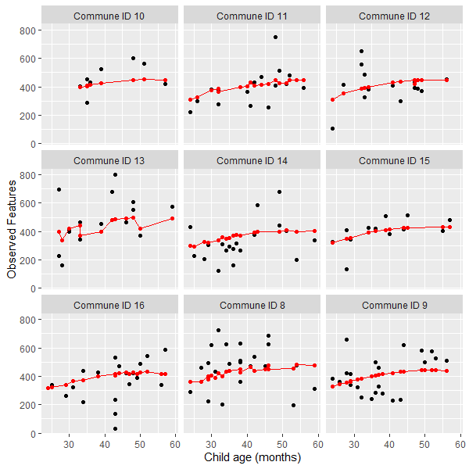
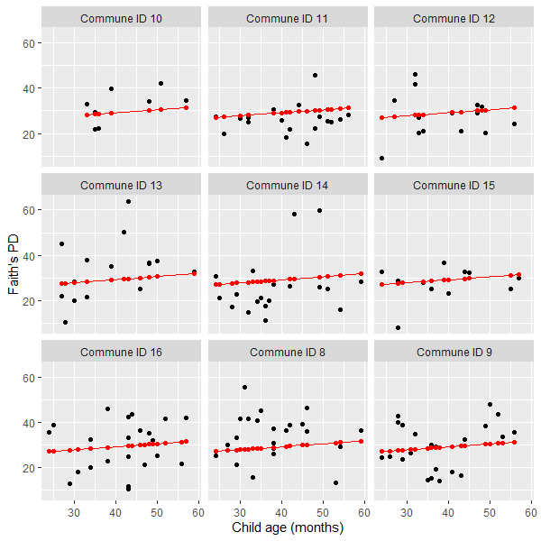
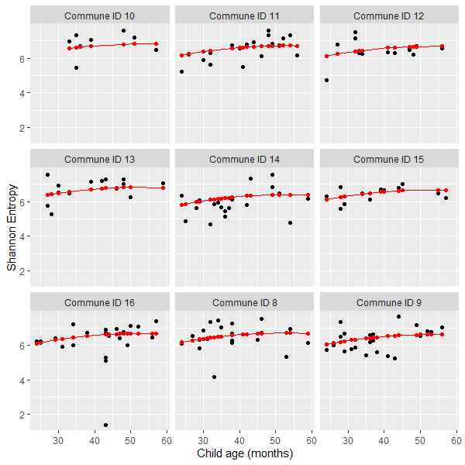
Examining Fits

Slide 28
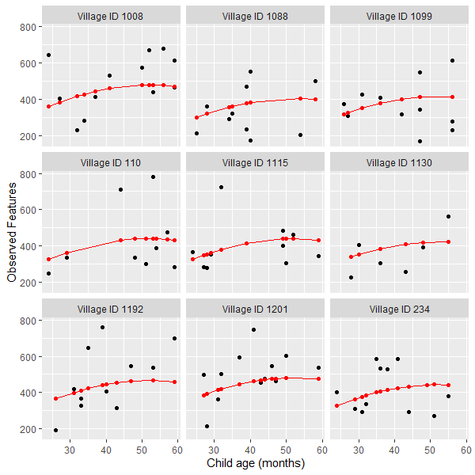
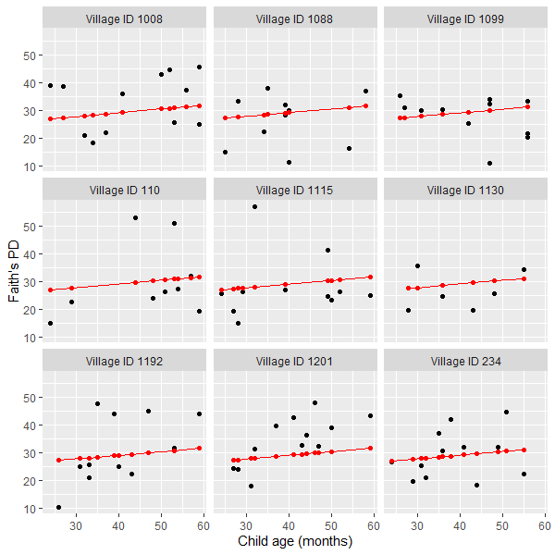
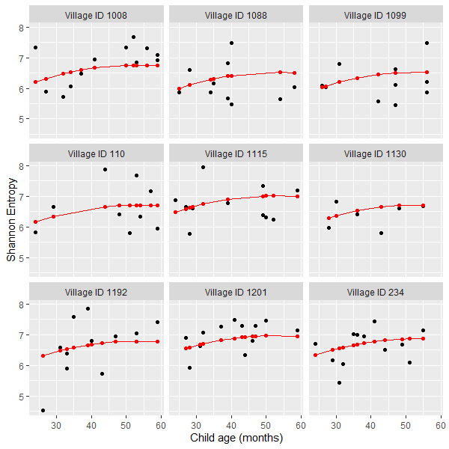
Examining Fits

Slide 29
Conclusions
Gut microbiome diversity increases with age and seems to level off at about 50 months old
Gut microbiome diversity cannot be accurately modeled with the given metadata
The effect of co-housing with animals cannot be determined
Due to observational nature of study and very few individuals with 0 animals

