Slide 1

PROJET S8-TIC Banque en ligne
Members:
AMGHAR Zakaria
BENJILANY Boubeker
DJAMEN Yann
HE Junyang
TCHAPTCHET Ursula
Supervisors:
Faouda BOUZBOUZ (Customer)
Christine ROUECHE (Coach)
Sebastien SERAIS (Technical supervisor)

Slide 2
PLAN
INTRODUCTION
DESCRIPTION
GENERAL ARCHITECTURE
CUSTOMER’S CONSTRAINTS
CONCLUSION

Slide 3

DESCRIPTION
Context
PROJET S8
The information system of an online bank

Slide 4

DESCRIPTION
Goals:
Upgrade our technical skills
Learn team working
Discover and work in the Agile scrum method
Lead a project from start to finish
Work rapidly and efficiently in an autonomous way

Slide 5
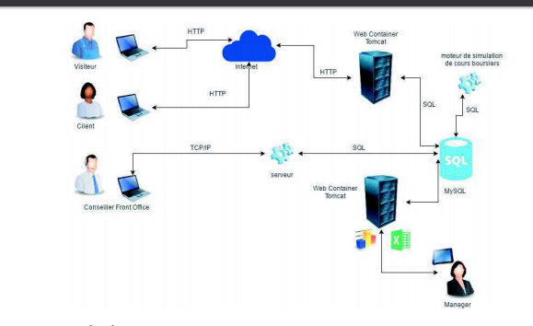
GENERAL ARCHITECTURE
Web server
Thin client
Data base
Heavy client
Server intermediate for advisor application
Thin client

Slide 6








CUSTOMER’S CONSTRAINTS
Technologies used

Slide 7
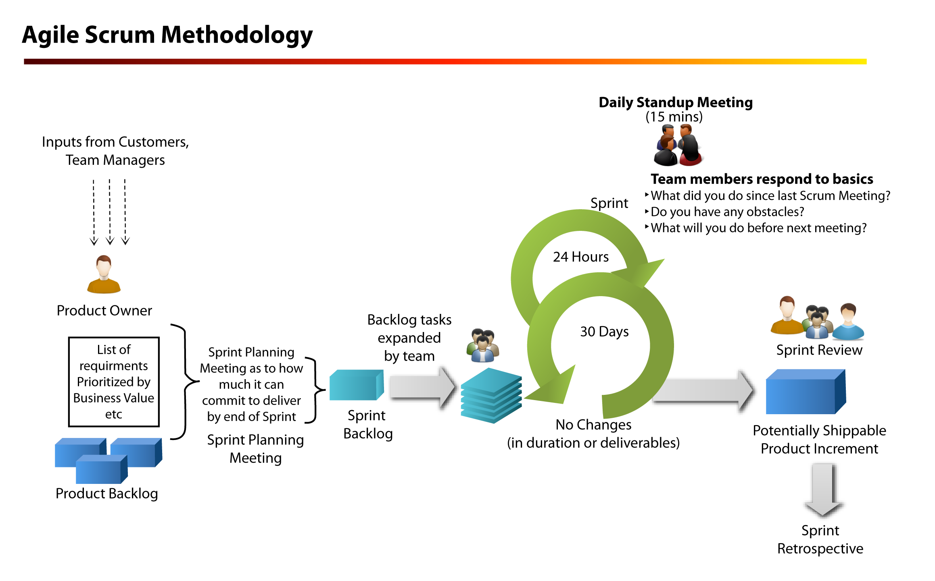
CUSTOMER’S CONSTRAINTS
Agile scrum methodology
7 days

Slide 8
CONCLUSION
Bilan
Difficultés rencontrées
Apports du projet
Points d’amélioration

Slide 9
Thank you for your attention!

