Slide 1

PROJET S8-TIC Banque en ligne
Members:
AMGHAR Zakaria
BENJILANY Boubeker
DJAMEN Yann
HE Junyang
TCHAPTCHET Ursula
Supervisors:
Faouda BOUZBOUZ (Customer)
Christine ROUECHE (Coach)
Sebastien SERAIS (Technical supervisor)

Slide 2
PLAN
INTRODUCTION
DESCRIPTION
GENERAL ARCHITECTURE
CUSTOMER’S CONSTRAINTS
CONCLUSION

Slide 3

DESCRIPTION
Context
PROJET S8
The information system of an online bank

Slide 4

DESCRIPTION
Goals:
Upgrade our technical skills
Learn team working
Discover and work in the Agile scrum method
Lead a project from start to finish
Work rapidly and efficiently in an autonomous way

Slide 5
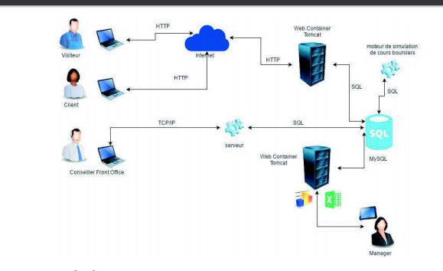
GENERAL ARCHITECTURE
Web server
Thin client
Data base
Heavy client
Server intermediate for advisor application
Thin client

Slide 6









CUSTOMER’S CONSTRAINTS
Technologies used
Notes:
As we see in the general architecture, our client has impose some technologies that we must use. For the database, we use MySql which is a lightweight opensource database management system, and of cause we have chosen MySql workbench to develop and manage our database. Our client has also impose Apache Tomcat as a web server and container, so we have to use Java as the programming language for Tomcat server, including Java standard edition and the enterprise edition, and then we have chosen Eclipse J2EE version as integrated development environment. For version control, we use git, and we chose Bitbucket to store our git repository because they offer free private repository. In order to avoid using git with the traditional command line, we use SourceTree which offer a graphical user interface to use git. Finally we use Trello for Scrum.

Slide 7
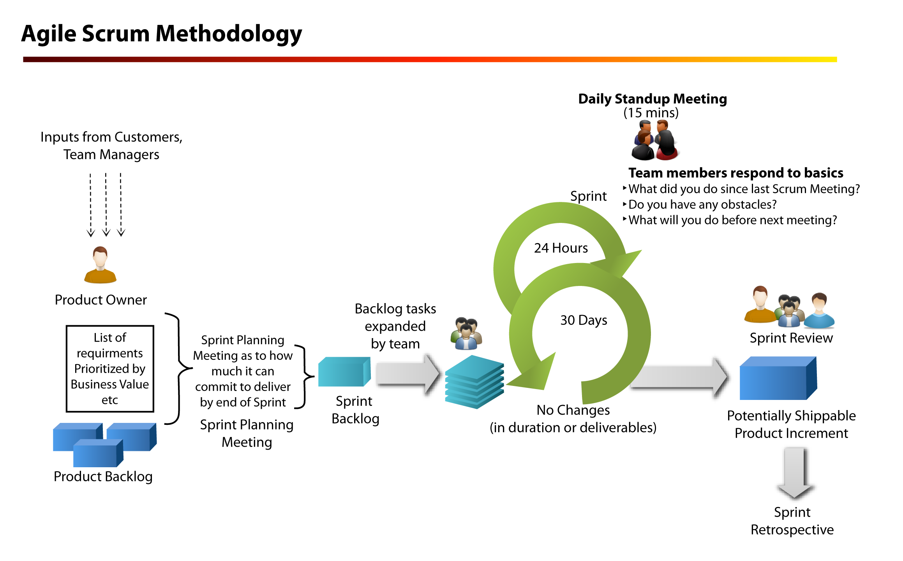
CUSTOMER’S CONSTRAINTS
Agile scrum methodology
7 days
Notes:
Scrum is a agile development method. We first made a product backlog with our client, it contains a list of user story that we have to accomplish during the development, in 5 sprint. For each sprint we have 7 day. We first make a to do list in the sprint backlog, and every day during a sprint we develop, at the end of a sprint we show our deliverable product to our client in order to get feed back. And we start the next sprint.

Slide 8
CONCLUSION
Summary
Difficulties encountered
Contributions of the project
Improvement points

Slide 9
Thank you for your attention!

