Slide 1
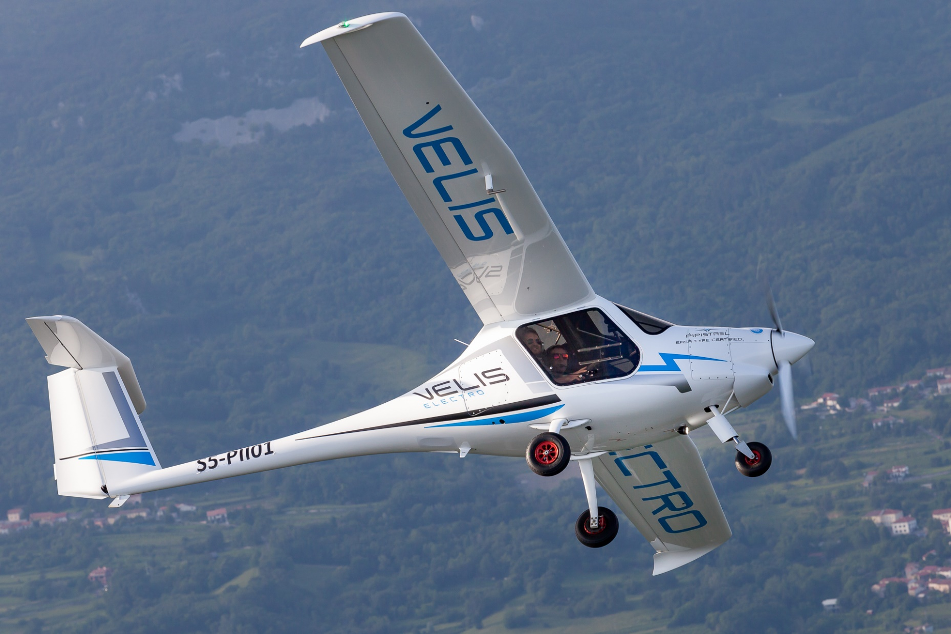
Take0ff Power And Energy Performance
Nathan Lu
Management Engineering

Slide 2
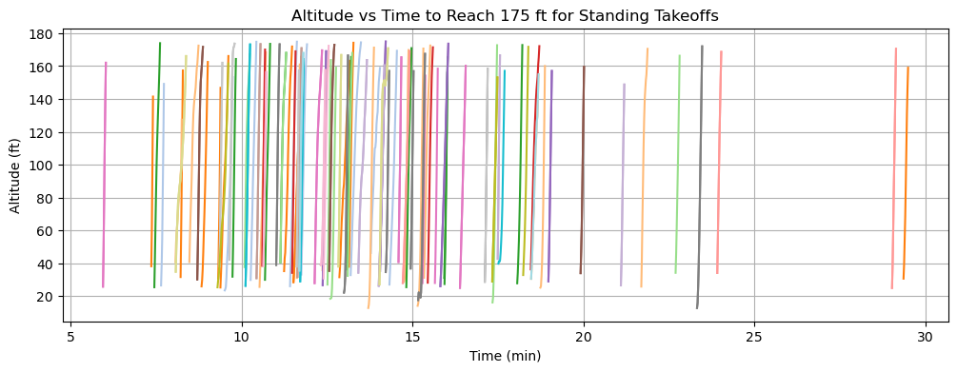
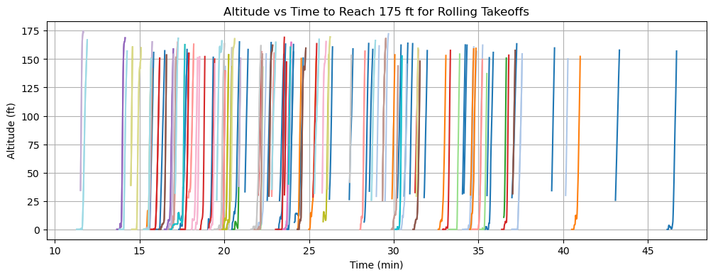
Updates From Last Meeting
Included all previous flight data instead of flights from this spring.
Successfully filtered out standing vs rolling stages.
  Completely reworked calculation algorithms.
    Significantly improved accuracy and eliminated irregular altitude discrepancies, effectively removing the need for theoretical calculations that might be inaccurate due to other parameters.

Slide 3
Steps In Data Cleaning
Using the cumulative takeoff dataframe I initially created, I classified each takeoff by analyzing the previous value. If the previous value was greater than the current index, the previous index would be marked as the endpoint of the previous takeoff, and so on.
From the collected indexes, I am able to classify each takeoff and find the time it takes from the start to the end of the takeoff run.
Using the slope, I can determine the time it takes reach a certain altitude and energy based off average power.

Slide 4
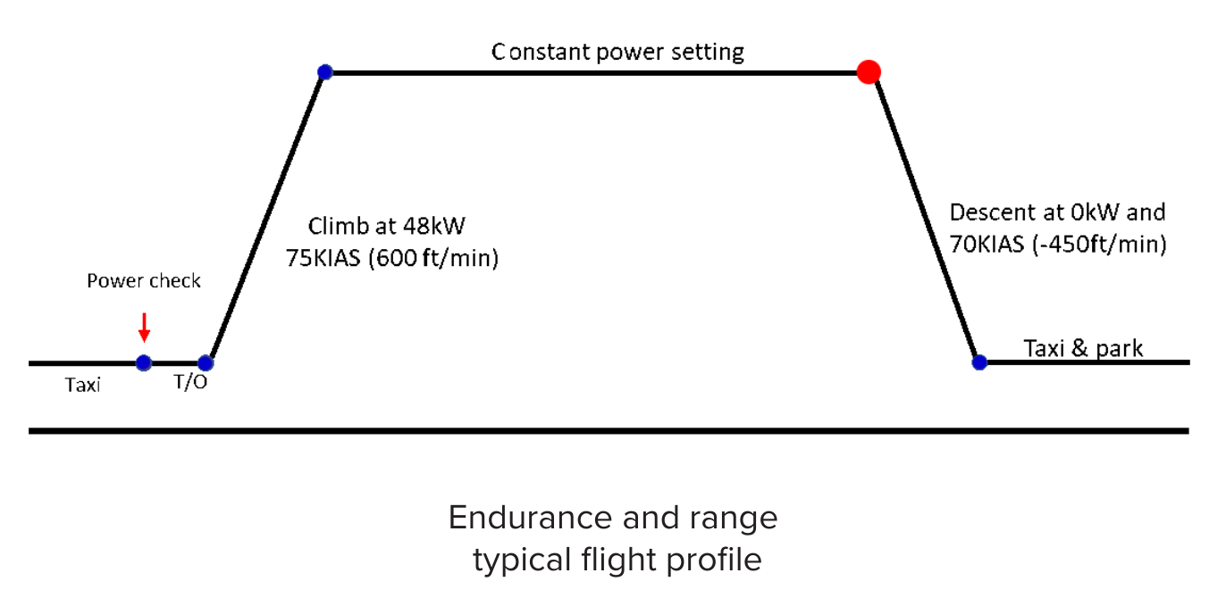
Questions Addressed
How do various power settings affect the climb rate?
  We want a relatively high correlation value (0.6+)
  We want the lowest change of increased time to reach altitude per drop in power (kW).
Any experimental difference between standing and rolling takeoff?
  Theoretical states a 1% difference.
How do other factors affect the performance?
  Weather.
  Battery State of Health.

Slide 5
Standing Power Performance
Measured to 175 ft, 300 ft, and 900 ft Altitude

Slide 6
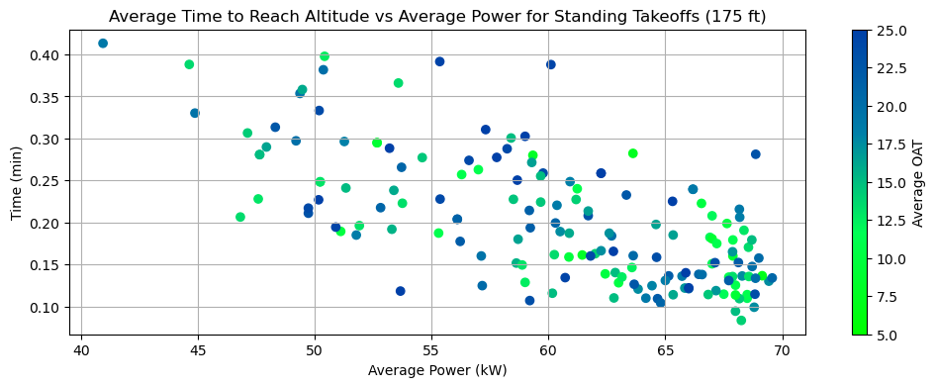
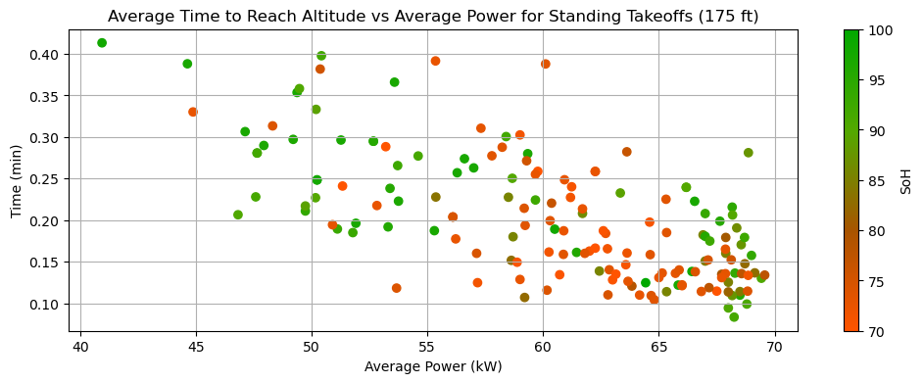
Standing Power Performance (175 ft)
Slope (LIN) | R (LIN) | Slope (EXP) | R (EXP)
-0.007445 | -0.680604 | -0.035744 | -0.671812
General
OAT (°C) | Slope (LIN) | R (LIN) | Slope (EXP) | R (EXP)
5-10 | -0.009360 | -0.782930 | -0.045455 | -0.772004
10-15 | -0.006997 | -0.717365 | -0.034320 | -0.716656
15-20 | -0.007989 | -0.773154 | -0.037093 | -0.730215
20-25 | -0.007401 | -0.591081 | -0.036478 | -0.618482
SoH (%) | Slope (LIN) | R (LIN) | Slope (EXP) | R (EXP)
90-100 | -0.006609 | -0.715013 | -0.030993 | -0.713039
80-90 | -0.005101 | -0.528959 | -0.026059 | -0.500578
70-80 | -0.008577 | -0.594062 | -0.041304 | -0.586845

Slide 7
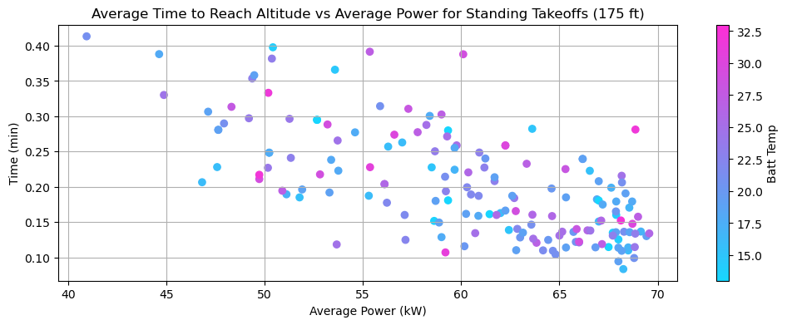
Standing Power Performance (175 ft)
Slope (LIN) | R (LIN) | Slope (EXP) | R (EXP)
-0.007445 | -0.680604 | -0.035744 | -0.671812
General
Batt T (°C) | Slope (LIN) | R (LIN) | Slope (EXP) | R (EXP)
13-18 | -0.006876 | -0.666106 | -0.033788 | -0.682898
18-23 | -0.007359 | -0.730265 | -0.035258 | -0.681672
23-28 | -0.008584 | -0.740539 | -0.040331 | -0.737145
28-33 | -0.004341 | -0.376279 | -0.021748 | -0.402458

Slide 8
Findings
    (Performance is in climb rate as power decreases)
Moderate negative linear correlation between the time it takes to reach 175 ft and average power
Strong correlation when grouped by OAT
  Temperatures 5-10°C yielded the worst performance
  10-25°C had slight variations but negligible.
Weaker but moderate correlation between SoH differences
  Battery health ranges from 70-80% performed the worst compared to 80-100%
Battery Temperatures had a moderately strong correlation to performance
  Data from 28-33°C had a weaker but moderate correlation.
  Higher battery temperatures (23-28°C) had the worst performance but not a significant difference compared to temperatures from 13-23°C

Slide 9
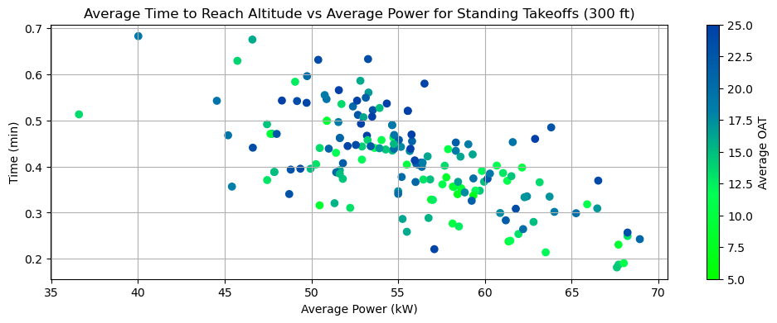
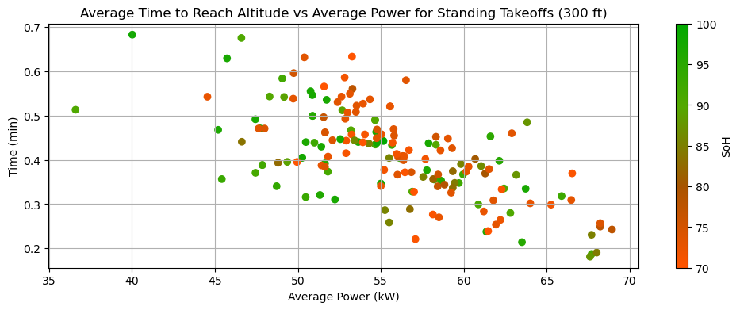
Standing Power Performance (300 ft)
Moderately strong correlation
  Temperatures from 15-25°C yielded the best performance
Moderately strong correlation
  90-100% SoH had a smaller change in time compared to lower SoH, thus the best performer.

Slide 10
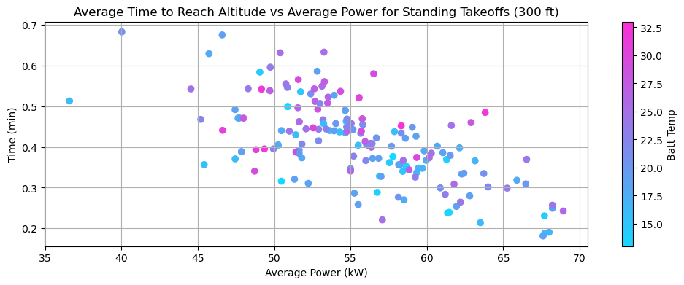
Standing Power Performance (300 ft)
Strong correlation with battery temperatures from 13-28°C
  28-33°C had a weak correlation
  Temperatures from 13-23°C performed the best

Slide 11
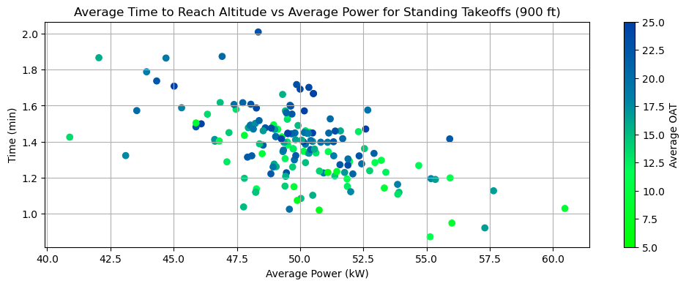
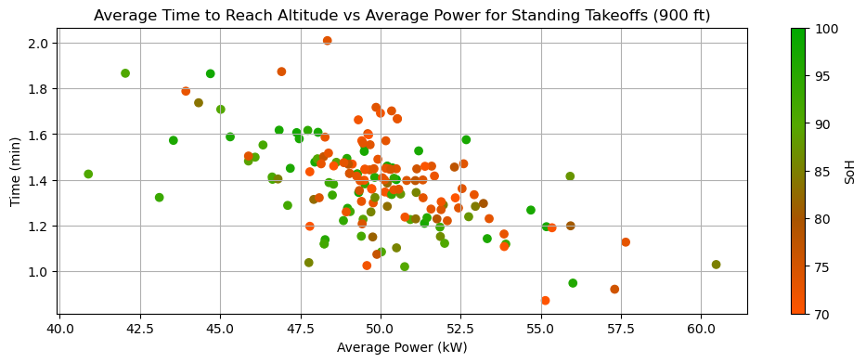
Standing Power Performance (900 ft)
blank
blank

Slide 12
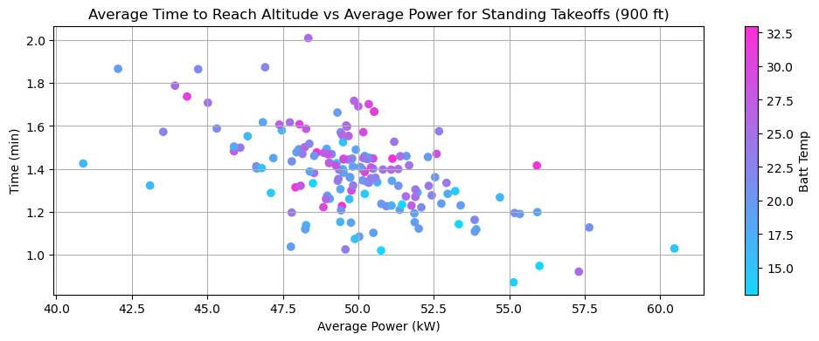
Standing Power Performance (900 ft)
blank

Slide 13
Standing Energy Performance
Measured to 175 ft, 300 ft, and 900 ft Altitude

Slide 14
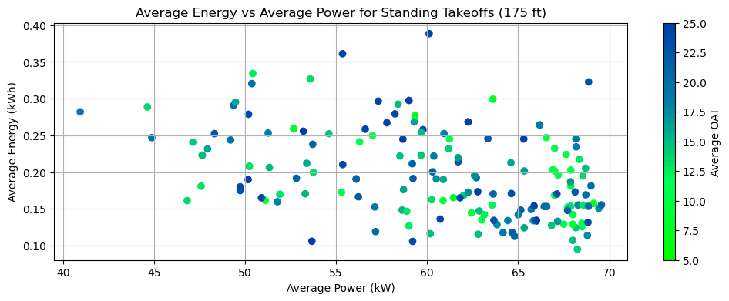
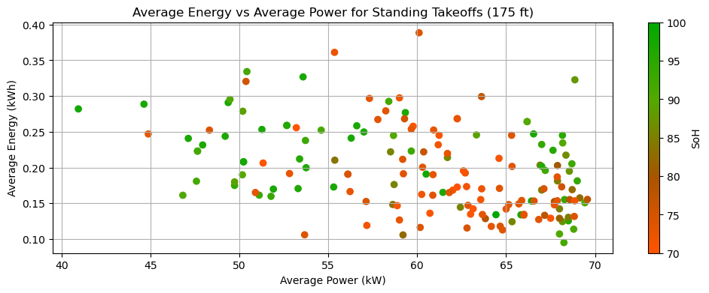
Standing Energy Performance (175 ft)
Slope (LIN) | R (LIN) | Slope (EXP) | R (EXP)
-0.003597 | -0.416161 | -0.018458 | -0.423739
General
OAT (°C) | Slope (LIN) | R (LIN) | Slope (EXP) | R (EXP)
5-10 | -0.005842 | -0.596316 | -0.028908 | -0.610373
10-15 | -0.003302 | -0.455694 | -0.017066 | -0.454462
15-20 | -0.003669 | -0.494353 | -0.019389 | -0.488648
20-25 | -0.003891 | -0.364342 | -0.019589 | -0.389206
SoH (%) | Slope (LIN) | R (LIN) | Slope (EXP) | R (EXP)
90-100 | -0.002545 | -0.385904 | -0.013531 | -0.404271
80-90 | -0.001769 | -0.203373 | -0.009445 | -0.205874
70-80 | -0.005076 | -0.403532 | -0.024304 | -0.391656

Slide 15
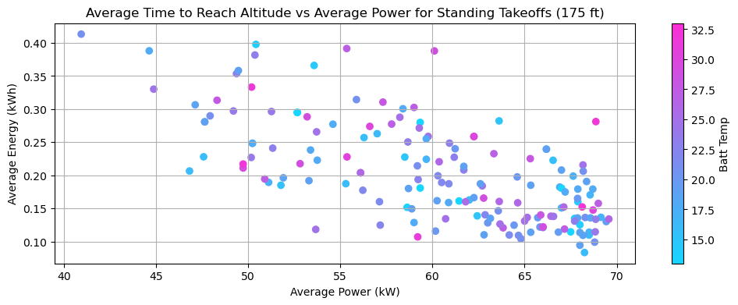
Standing Energy Performance (175 ft)
Slope (LIN) | R (LIN) | Slope (EXP) | R (EXP)
-0.003597 | -0.416161 | -0.018458 | -0.423739
General
Batt T (°C) | Slope (LIN) | R (LIN) | Slope (EXP) | R (EXP)
13-18 | -0.003221 | -0.402904 | -0.016552 | -0.414904
18-23 | -0.003309 | -0.440261 | -0.017771 | -0.426855
23-28 | -0.004741 | -0.532111 | -0.023088 | -0.527871
28-33 | -0.000637 | -0.058584 | -0.004747 | -0.095295

Slide 16
Findings
    (Performance is in energy consumption as power decreases from 0-175 ft)
Moderately weak correlation for average energy consumption vs average power
  This seems to be the case with all energy data
  Points are more spread out and show a slight negative correlation
Low-Moderate correlation based on OAT
  Temperatures from 5-10°C had the worst performing flights while data from 10-25°C had similar performance
Battery SoH had a low correlation on performance data
  State of health values from 70-80% performed significantly worse than values from 80-100% health
Weak moderate correlation between battery temperature and energy
  Temperatures from 23-28°C had the greatest change of energy consumption (worst performer)
  28-33°C had very little correlation and 13-23°C had similar performance

Slide 17
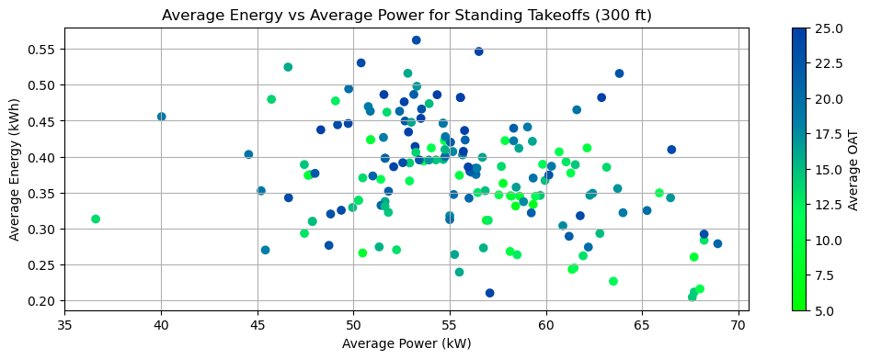
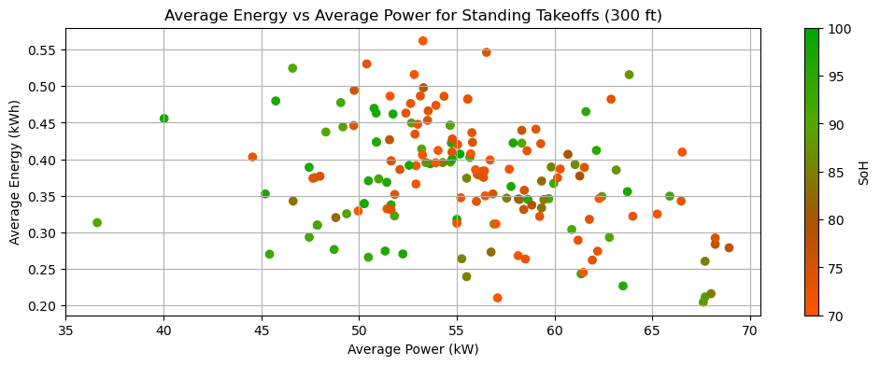
Standing Energy Performance (300 ft)
blank
blank

Slide 18
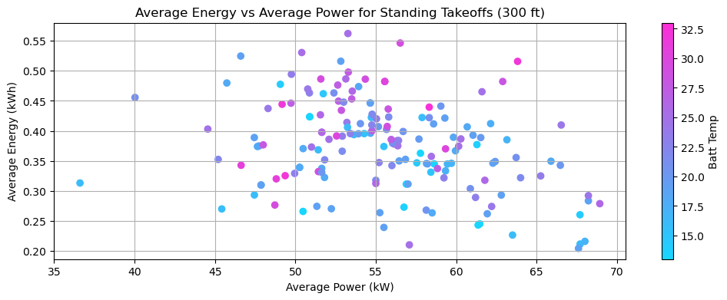
Standing Energy Performance (300 ft)
blank

Slide 19
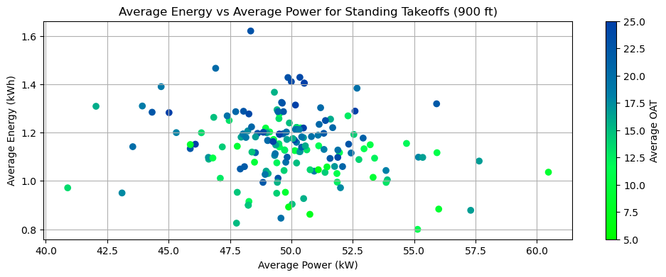
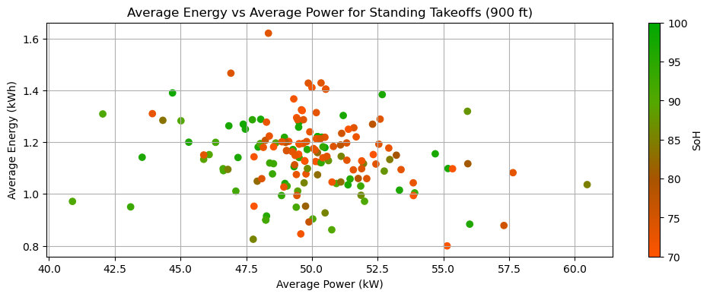
Standing Energy Performance (900 ft)
blank
blank

Slide 20
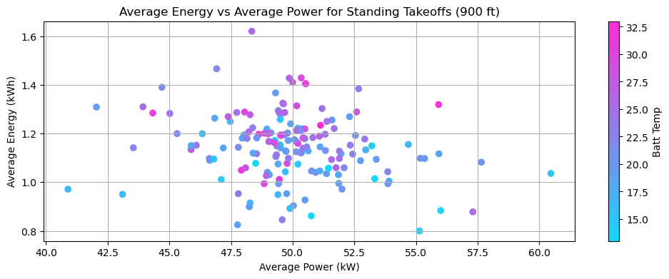
Standing Energy Performance (900 ft)
blank

Slide 21
Rolling Power Performance
Measured to 175 ft, 300 ft, and 900 ft Altitude

Slide 22
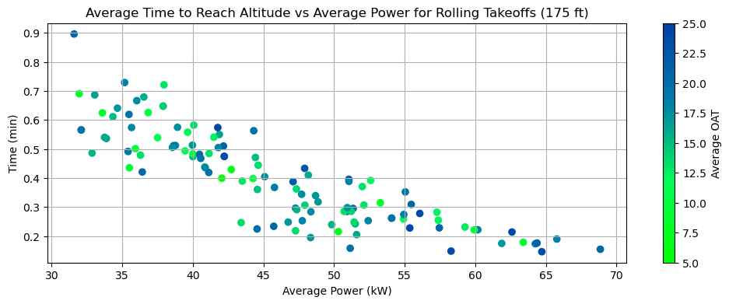
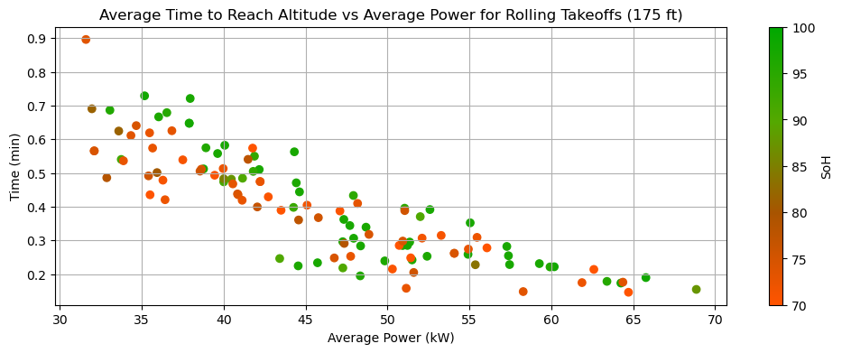
Rolling Power Performance (175 ft)
Slope (LIN) | R (LIN) | Slope (EXP) | R (EXP)
-0.015490 | -0.858512 | -0.041981 | -0.878347
General
OAT (°C) | Slope (LIN) | R (LIN) | Slope (EXP) | R (EXP)
5-10 | -0.014743 | -0.910509 | -0.040058 | -0.939934
10-15 | -0.017018 | -0.816248 | -0.042112 | -0.822308
15-20 | -0.016075 | -0.874691 | -0.042886 | -0.881729
20-25 | -0.014925 | -0.838583 | -0.042900 | -0.876831
SoH (%) | Slope (LIN) | R (LIN) | Slope (EXP) | R (EXP)
90-100 | -0.016843 | -0.836518 | -0.043505 | -0.842735
80-90 | -0.013932 | -0.961432 | -0.040638 | -0.991695
70-80 | -0.016123 | -0.876310 | -0.043432 | -0.889345

Slide 23
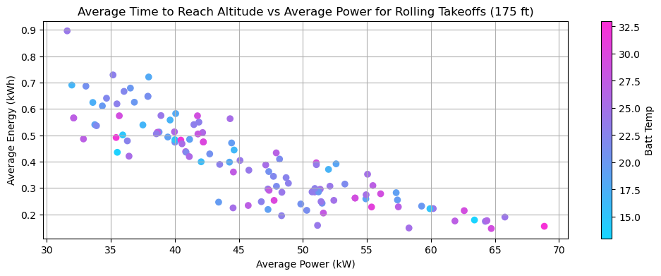
Rolling Power Performance (175 ft)
Slope (LIN) | R (LIN) | Slope (EXP) | R (EXP)
-0.015490 | -0.858512 | -0.041981 | -0.878347
General
Batt T (°C) | Slope (LIN) | R (LIN) | Slope (EXP) | R (EXP)
13-18 | -0.013545 | -0.921968 | -0.037079 | -0.948761
18-23 | -0.018996 | -0.861186 | -0.045261 | -0.859241
23-28 | -0.014408 | -0.820089 | -0.040598 | -0.837261
28-33 | -0.013210 | -0.922959 | -0.041305 | -0.939316

Slide 24
Findings
    (Performance is in climb rate as power decreases from 0-175 ft)
Very strong exponential negative correlation when analyzing rolling takeoff performance
When grouped by OAT, the strong correlation still stands
  Very minimal differences however when comparing different temperatures
Strong correlation as well when grouping by battery health
  Negligible variances between different health status
Battery temperature also has a strong correlation
  Slight variances with temperatures from 13-18°C performing the best but could be considered insignificant
These low variability values are caused by the data points being tight altogether

Slide 25
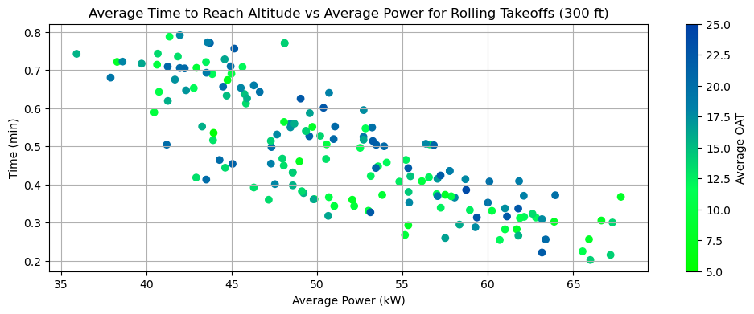
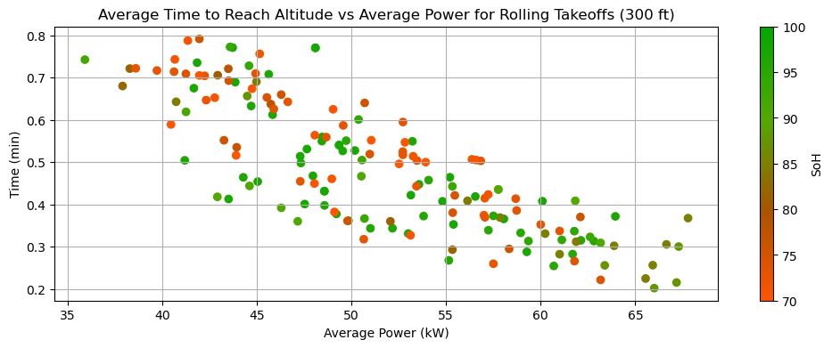
Rolling Power Performance (300 ft)
blank
blank

Slide 26
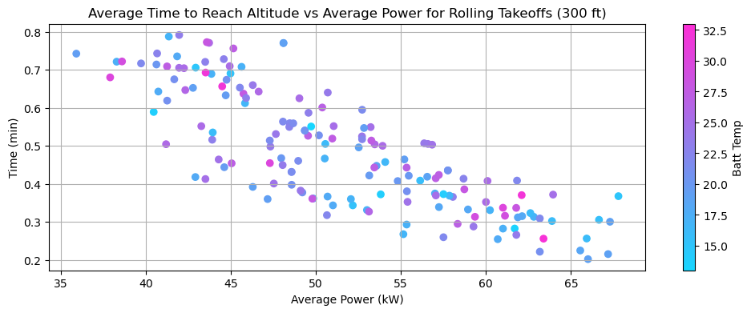
Rolling Power Performance (300 ft)
blank

Slide 27
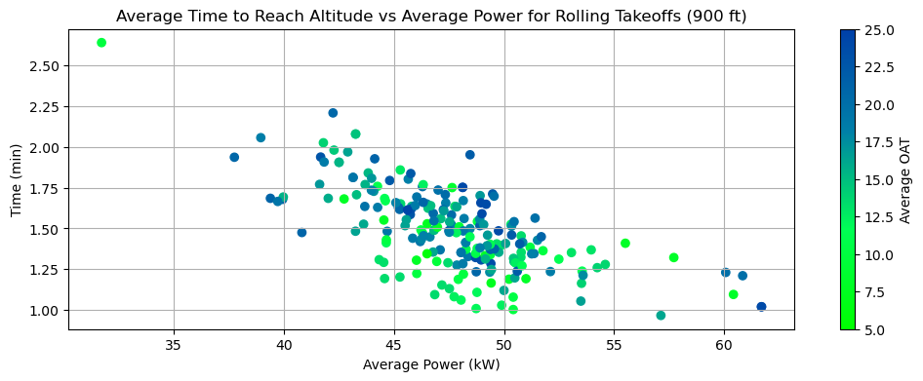
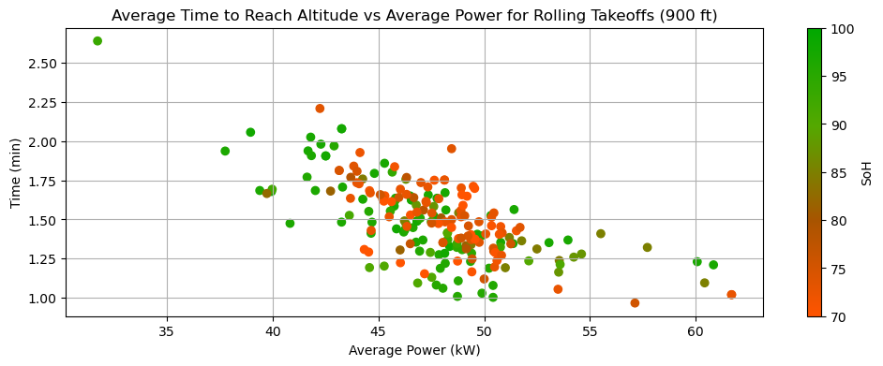
Rolling Power Performance (900 ft)
blank
blank

Slide 28
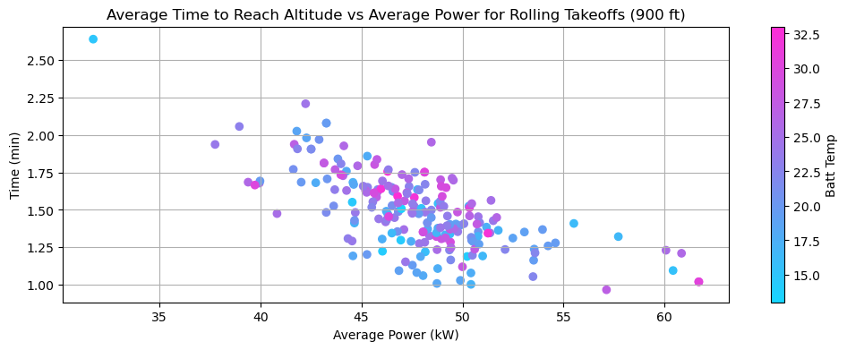
Rolling Power Performance (900 ft)
blank

Slide 29
Rolling Energy Performance
Measured to 175 ft, 300 ft, and 900 ft Altitude

Slide 30
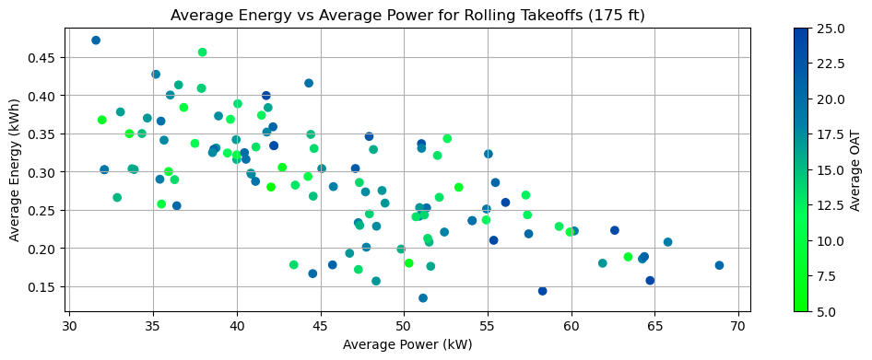
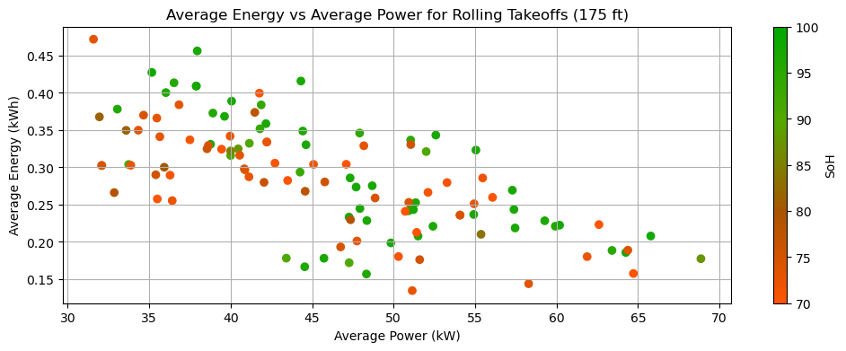
Rolling Energy Performance (175 ft)
Slope (LIN) | R (LIN) | Slope (EXP) | R (EXP)
-0.005563
General
OAT (°C) | Slope (LIN) | R (LIN) | Slope (EXP) | R (EXP)
5-10 | -0.004887 | -0.785536 | -0.018296 | -0.790179
10-15 | -0.006358 | -0.617323 | -0.020625 | -0.584001
15-20 | -0.005606 | -0.674827 | -0.020812 | -0.673030
20-25 | -0.006140 | -0.714707 | -0.022659 | -0.696524
SoH (%) | Slope (LIN) | R (LIN) | Slope (EXP) | R (EXP)
90-100 | -0.006677 | -0.671051 | -0.022528 | -0.683844
80-90 | -0.005110 | -0.961351 | -0.019934 | -0.973786
70-80 | -0.005492 | -0.688052 | -0.021071 | -0.636339

Slide 31
Rolling Energy Performance (175 ft)
Slope (LIN) | R (LIN) | Slope (EXP) | R (EXP)
-0.005603 | -0.674480 | -0.020522 | -0.670059
General
Batt T (°C) | Slope (LIN) | R (LIN) | Slope (EXP) | R (EXP)
13-18 | -0.004118 | -0.740751 | -0.015496 | -0.763703
18-23 | -0.006756 | -0.668542 | -0.022652 | -0.648171
23-28 | -0.005100 | -0.601253 | -0.019264- | -0.589458
28-33 | -0.005426 | -0.792189 | -0.021276 | -0.809196

Slide 32
Findings
    (Performance is in energy consumption as power decreases from 0-175 ft)
Moderately strong correlation between energy consumption and rolling takeoff power averages
OAT is moderately strong in correlation
  Data has low variance when classified with different outside temperatures
Average Energy also has a moderately strong correlation
  Low variance as well when comparing SoH values
Moderate correlation with battery temperatures
  Temperatures from 13-18°C performed slightly better compared to temperatures from 18-33°C

Slide 33
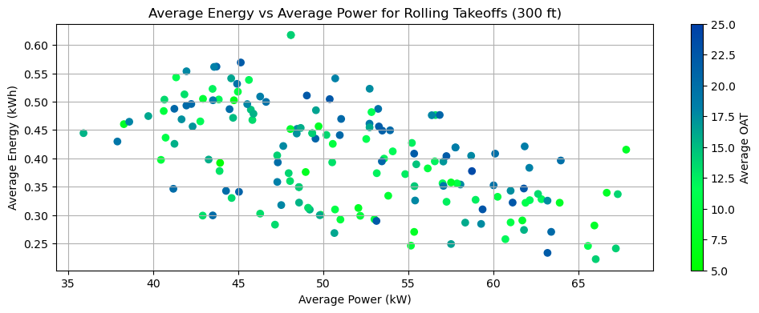
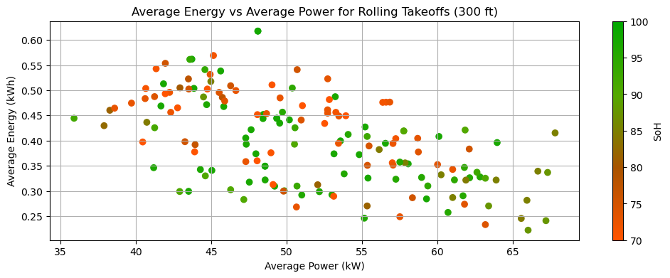
Rolling Energy Performance (300 ft)
blank
blank

Slide 34
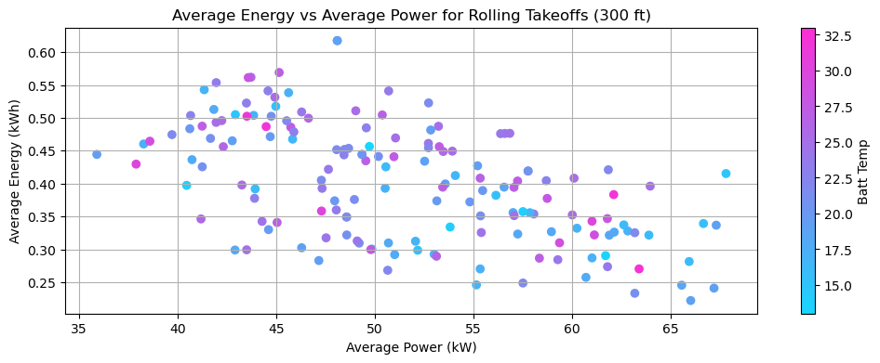
Rolling Energy Performance (300 ft)
blank

Slide 35
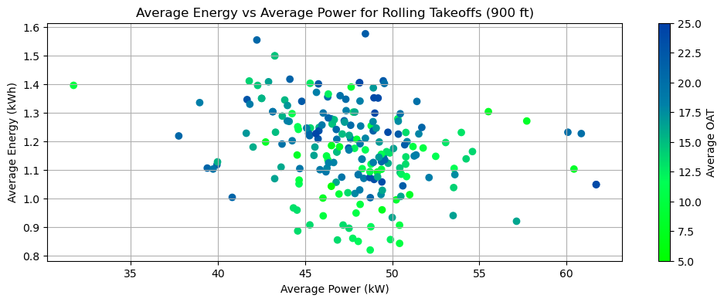
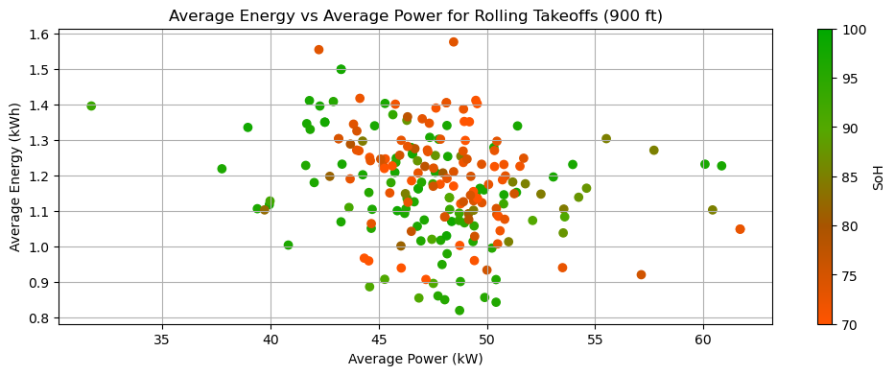
Rolling Energy Performance (900 ft)
blank
blank

Slide 36
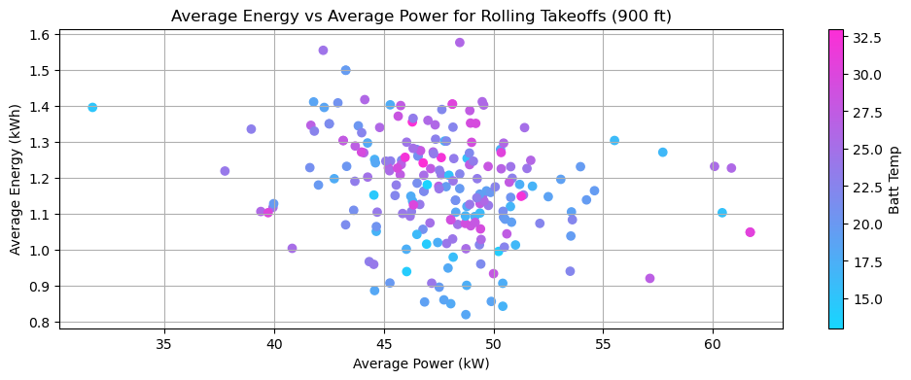
Rolling Energy Performance (900 ft)
blank

Slide 37
Conclusions/Insights
    (Performance is in climb rate as power decreases from 0-175 ft)
How do various power settings affect the climb rate?

Slide 38
Questions To Ask
Other parameters to consider?
How can we calculate efficiency?
  How much should each parameter be weighted?
    Time below a certain altitude
    Battery Strain
    Battery Discharge

