Slide 1
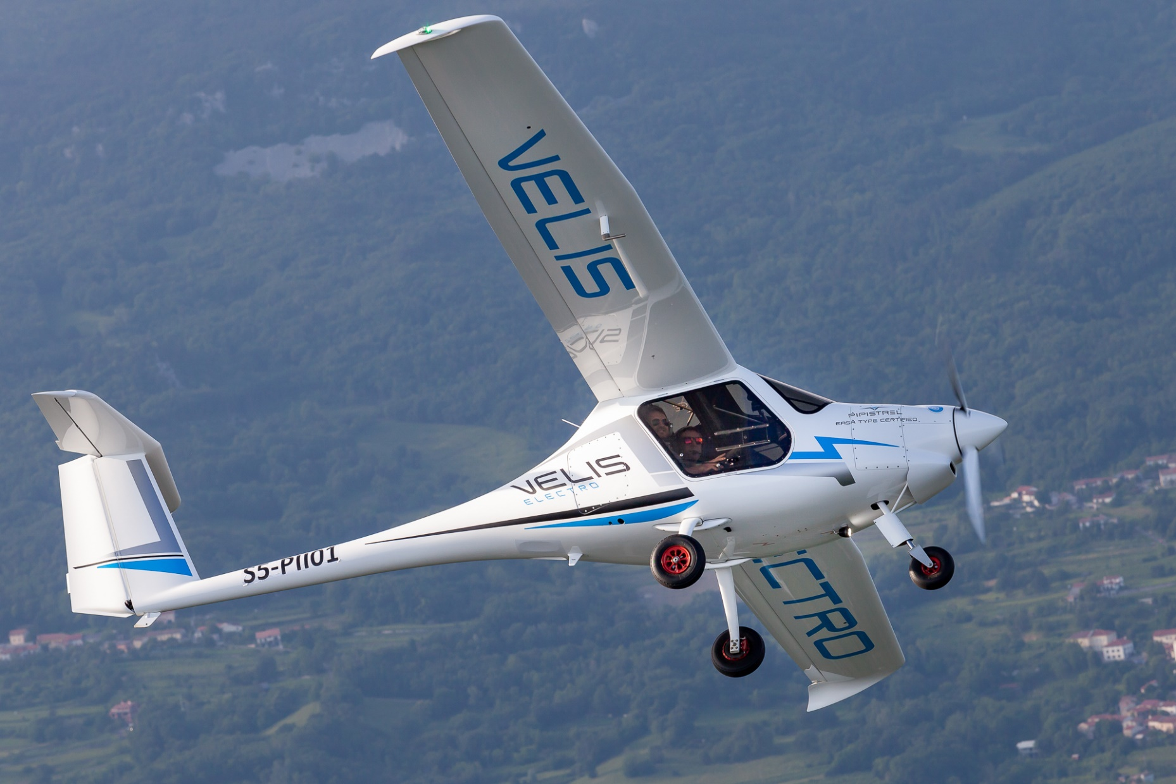
Take0ff Power Performance
Nathan Lu
Management Engineering

Slide 2
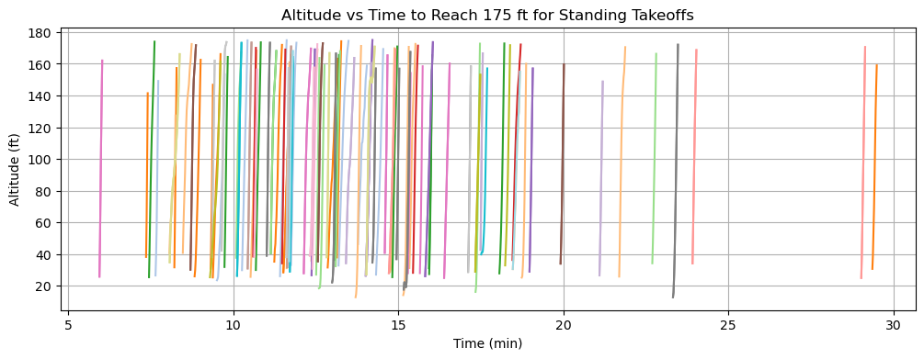
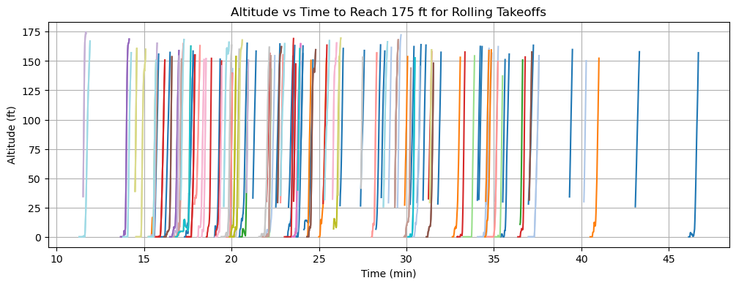
Updates From Last Meeting
Included all previous flight data instead of flights from this spring.
Successfully filtered out standing vs rolling stages.
  Completely reworked calculation algorithms.
    Significantly improved accuracy and eliminated irregular altitude discrepancies, effectively removing the need for theoretical calculations that might be inaccurate due to other parameters.

Slide 3
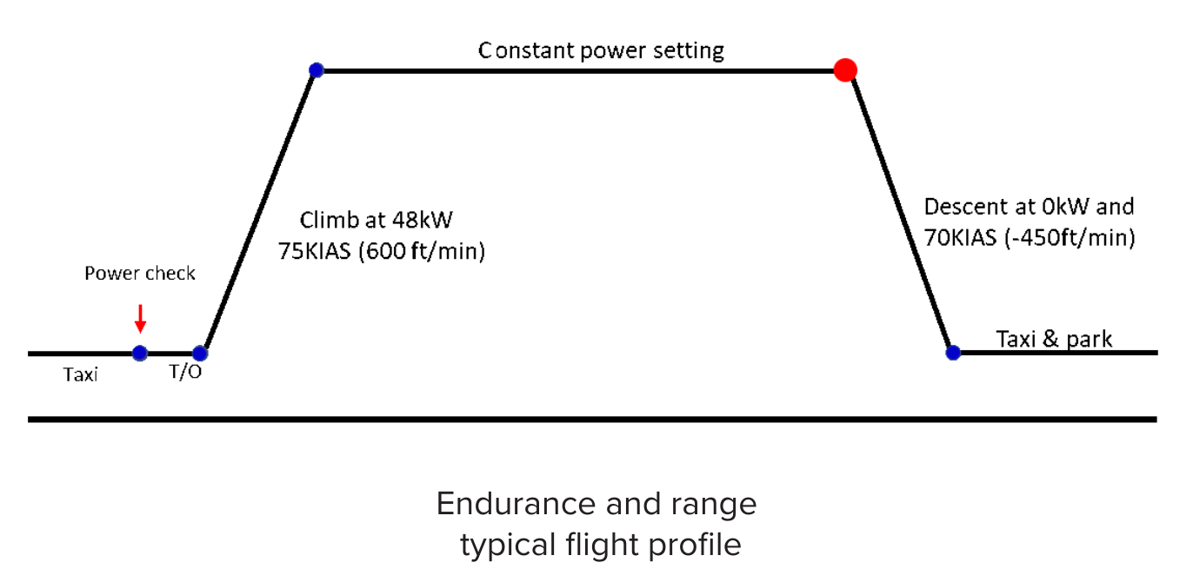
Questions Addressed
How do various power settings affect the climb rate?
  We want a relatively high correlation value (0.6+)
  We want the lowest change of increased time to reach altitude per drop in power (kW).
Any experimental difference between standing and rolling takeoff?
  Theoretical states a 1% difference.
How do other factors affect the performance?
  Weather.
  Battery State of Health.

Slide 4
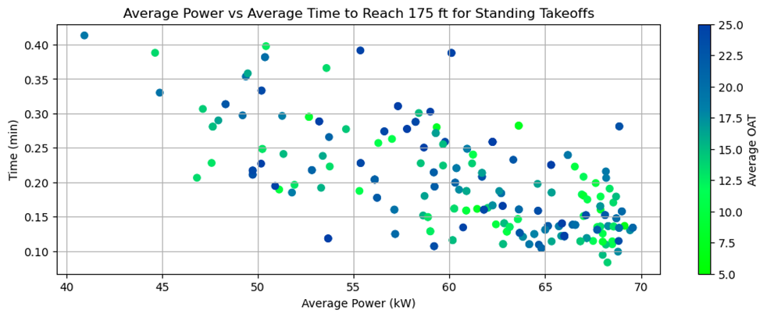
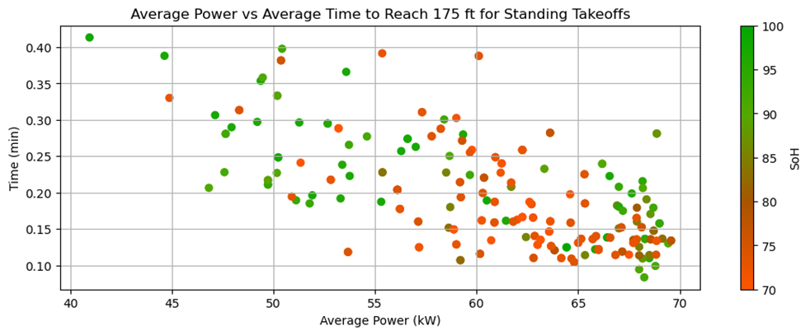
Standing Power Performance
Slope (LIN) | R (LIN) | Slope (EXP) | R (EXP)
-0.007389 | -0.650544 | -0.035668 | -0.641037
General
OAT (°C) | Slope (LIN) | R (LIN) | Slope (EXP) | R (EXP)
5-10 | -0.008753 | -0.681354 | -0.042606 | -0.677562
10-15 | -0.007070 | -0.707369 | -0.034903 | -0.705166
15-20 | -0.008187 | -0.754837 | -0.038436 | -0.705557
20-25 | -0.007195 | -0.595755 | -0.035300 | -0.620713
SoH (%) | Slope (LIN) | R (LIN) | Slope (EXP) | R (EXP)
90-100 | -0.008381 | -0.577545 | -0.040597 | -0.569728
80-90 | -0.004913 | -0.511825 | -0.024495 | -0.485803
70-80 | -0.006610 | -0.723060 | -0.031168 | -0.723756

Slide 5
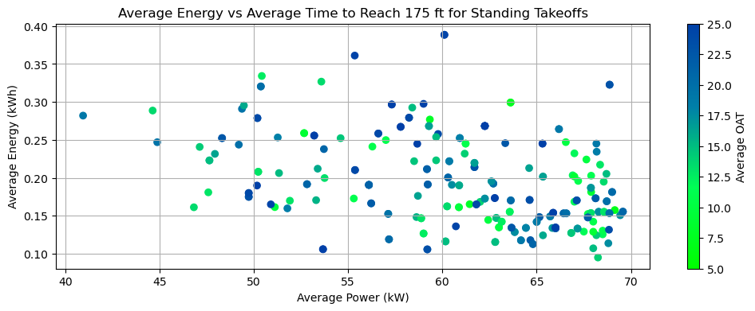
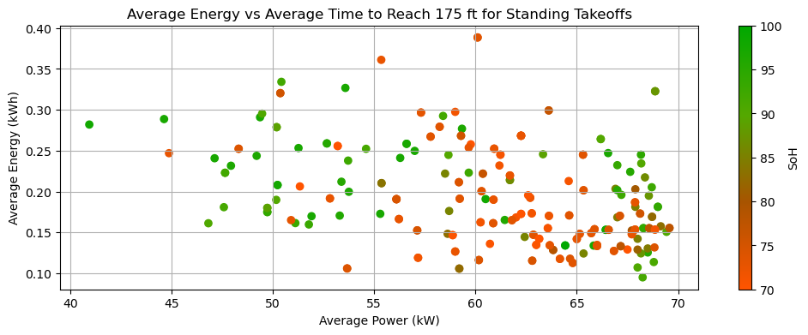
Standing Energy Performance
Slope (LIN) | R (LIN) | Slope (EXP) | R (EXP)
-0.003630 | -0.392704 | -0.018469 | -0.396884
General
OAT (°C) | Slope (LIN) | R (LIN) | Slope (EXP) | R (EXP)
5-10 | -0.005215 | -0.465362 | -0.026065 | -0.490332
10-15 | -0.003425 | -0.454303 | -0.017685 | -0.450199
15-20 | -0.003960 | -0.488985 | -0.020798 | -0.475051
20-25 | -0.003655 | -0.357397 | -0.018404 | -0.381791
SoH (%) | Slope (LIN) | R (LIN) | Slope (EXP) | R (EXP)
90-100 | -0.004992 | -0.391203 | -0.023741 | -0.375354
80-90 | -0.001404 | -0.163117 | -0.007750 | -0.174030
70-80 | -0.002616 | -0.402291 | -0.013751 | -0.418215

Slide 6
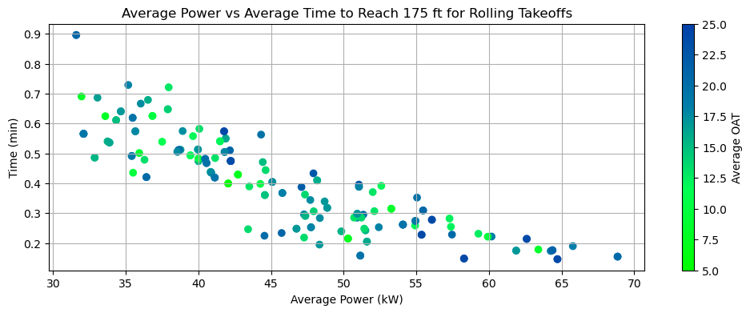
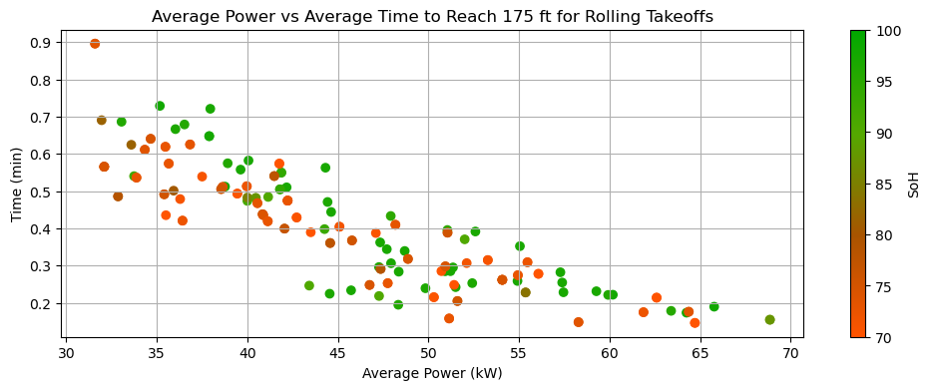
Rolling Power Performance
Slope (LIN) | R (LIN) | Slope (EXP) | R (EXP)
-0.015320 | -0.865176 | -0.042202 | -0.887132
General
OAT (°C) | Slope (LIN) | R (LIN) | Slope (EXP) | R (EXP)
5-10 | -0.015476 | -0.898187 | -0.041462 | -0.919672
10-15 | -0.017035 | -0.816349 | -0.042391 | -0.825305
15-20 | -0.015934 | -0.879035 | -0.042733 | -0.879076
20-25 | -0.015278 | -0.867554 | -0.043761 | -0.908234
SoH (%) | Slope (LIN) | R (LIN) | Slope (EXP) | R (EXP)
90-100 | -0.016214 | -0.875706 | -0.043741 | -0.889651
80-90 | -0.013513 | -0.964767 | -0.040538 | -0.992152
70-80 | -0.016969 | -0.839226 | -0.043930 | -0.845315

Slide 7
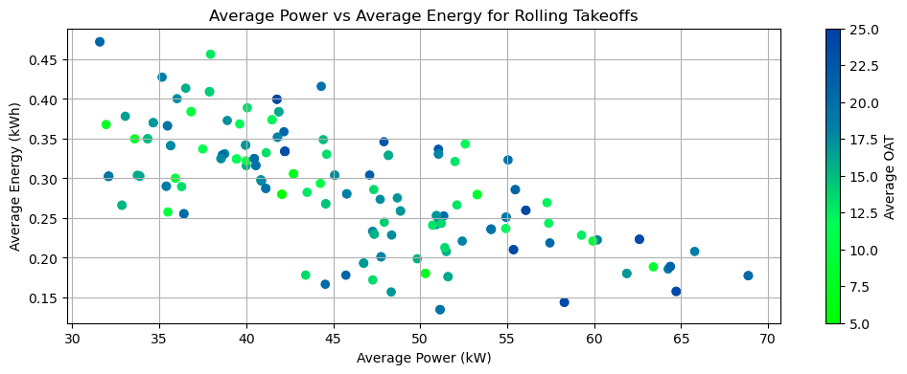
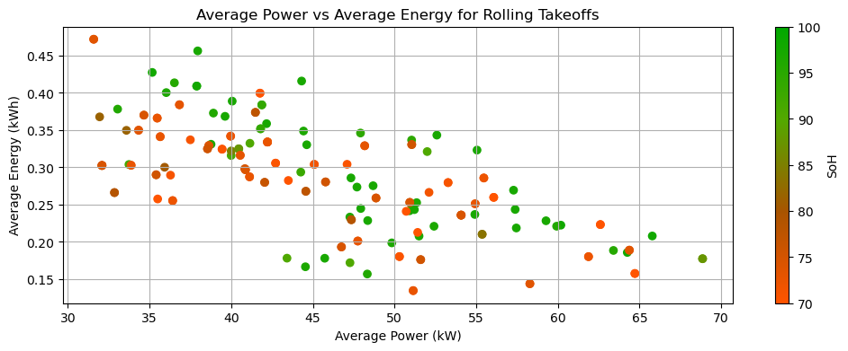
Rolling Energy Performance
Slope (LIN) | R (LIN) | Slope (EXP) | R (EXP)
-0.005563 | -0.688301 | -0.020764 | -0.687857
General
OAT (°C) | Slope (LIN) | R (LIN) | Slope (EXP) | R (EXP)
5-10 | -0.005286 | -0.754894 | -0.019595 | -0.749307
10-15 | -0.006399 | -0.619447 | -0.020913 | -0.591063
15-20 | -0.005388 | -0.661668 | -0.020385 | -0.659300
20-25 | -0.006329 | -0.772040 | -0.023468 | -0.761170
SoH (%) | Slope (LIN) | R (LIN) | Slope (EXP) | R (EXP)
90-100 | -0.005572 | -0.691328 | -0.021395 | -0.687763
80-90 | -0.005120 | -0.966242 | -0.020160 | -0.977075
70-80 | -0.006796 | -0.677349 | -0.022972 | -0.643708

Slide 8
Conclusions/Insights
    (Performance is in climb rate as power decreases from 0-175 ft)
How do various power settings affect the climb rate?
  Standing Climb vs. Rolling Climb:
    The climb rate is significantly affected by power setting in both scenarios, with rolling climbs showing a more pronounced impact (strong linear/exponential increase) compared to standing climbs (weaker linear increase).
    Linearly, rolling climbs are 0.003769 minutes faster per kW compared to standing climbs.
  Temperature Influence:
    Temperature has a moderate correlation on climb performance in standing takeoffs, with temperatures around 20-25°C yielding the best performance, and lower temperatures (5-10°C) resulting in slightly poorer performance. Rolling takeoffs had little to no impact from varying outside temperatures.
  State of Health Impact:
    Low impact from SoH differences in both standing and rolling takeoffs in regard to performance and energy consumption.
  Energy Consumption:
    The relationship between energy consumption and power setting varies with low correlation in standing takeoff data. In rolling takeoffs, the power setting value had a moderate negative linear relationship with higher power settings consuming less total energy with a lump of values from 45-52 kW also consuming low energy.

Slide 9
Questions To Ask
Other parameters to consider?
How can we calculate efficiency?
  How much should each parameter be weighted?
    Time below a certain altitude
    Battery Strain
    Battery Discharge

