Slide 1
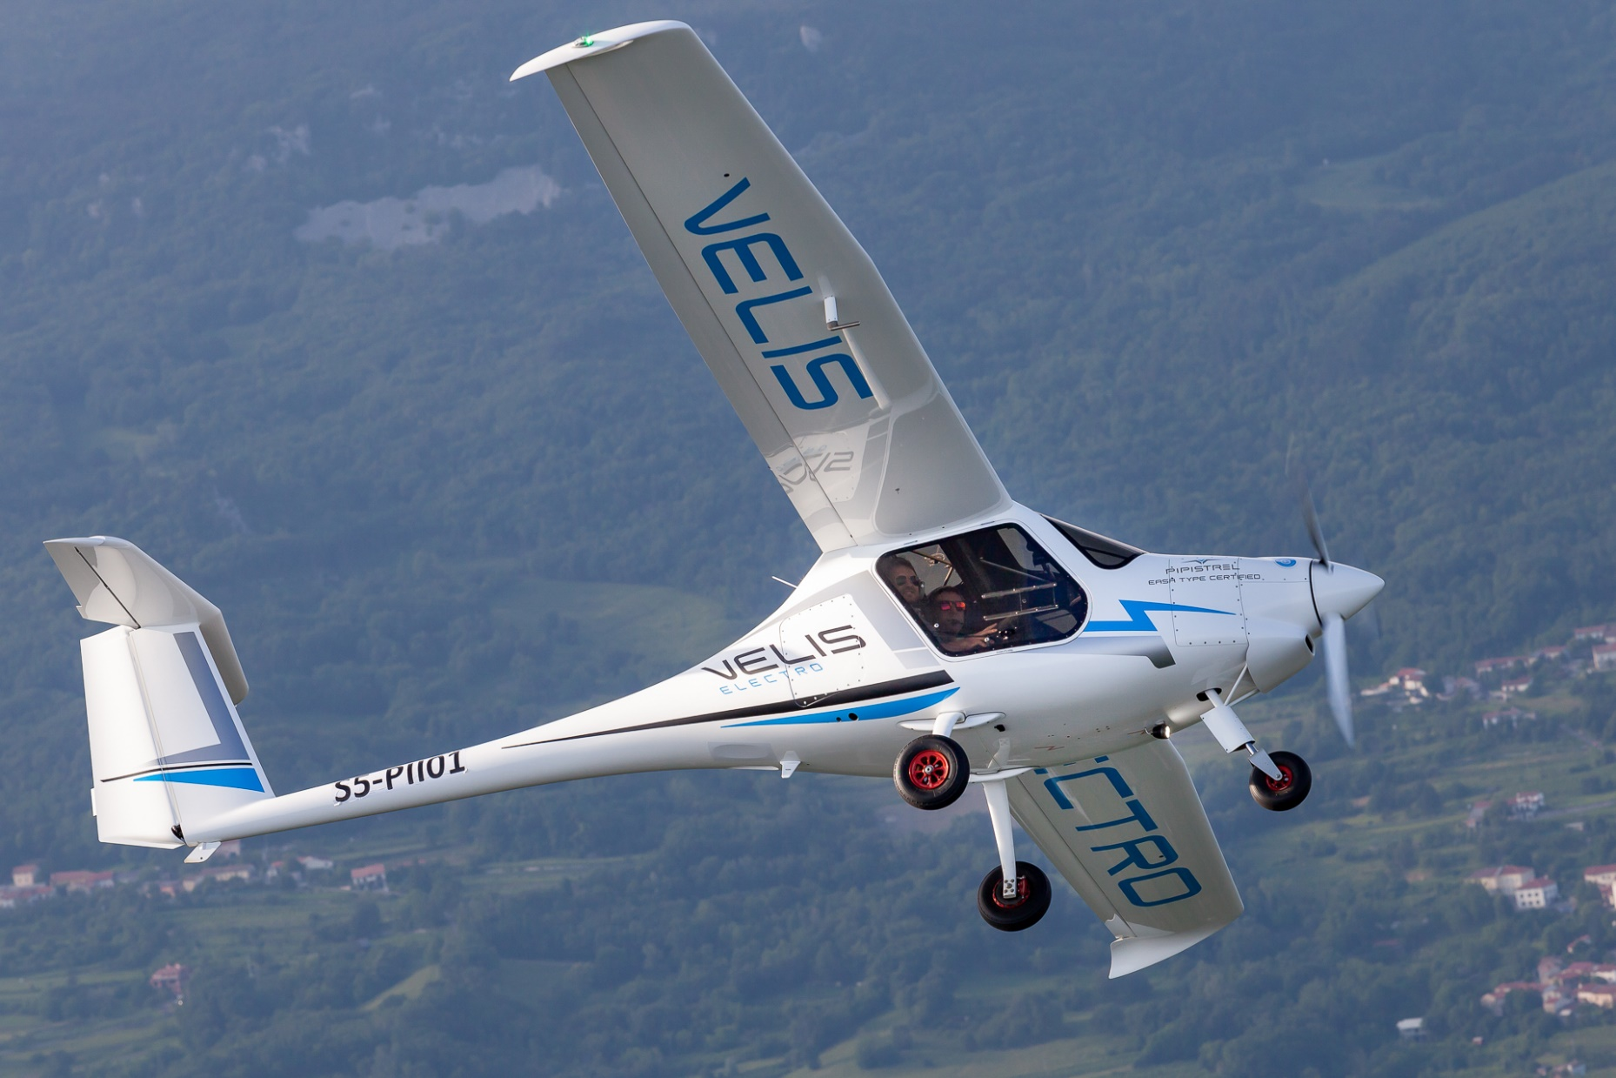
Take0ff Energy Consumption
Nathan Lu
Management Engineering

Slide 2
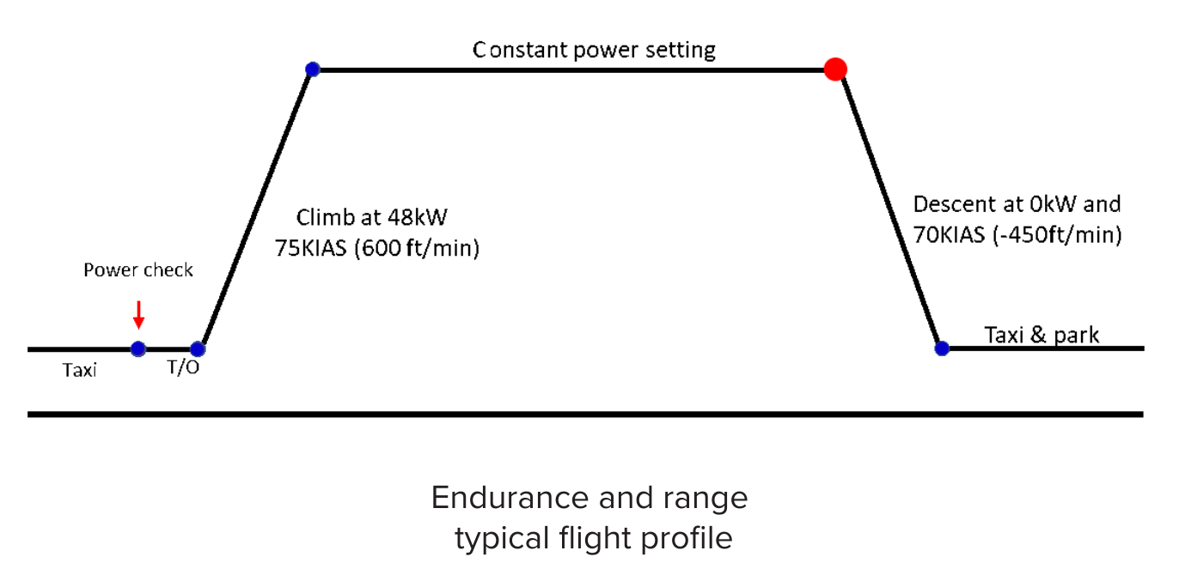
Questions Addressed
What is the best measure of energy consumption and battery usage?
  Change in battery state of charge?
  Average power?
  Average energy?
How do different takeoff power settings affect battery consumption?
  Which is more efficient?
    Higher power setting
    Lower power setting

Slide 3
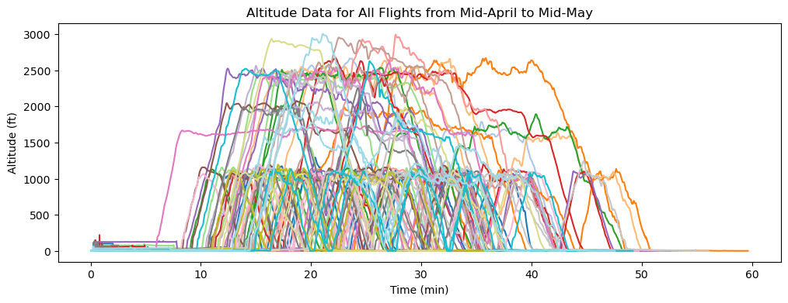
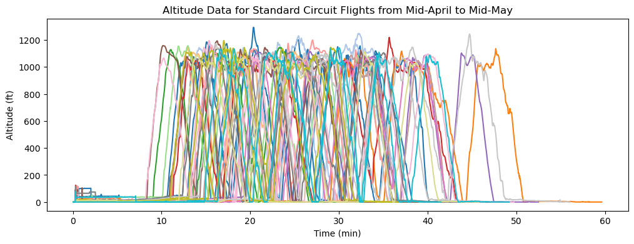
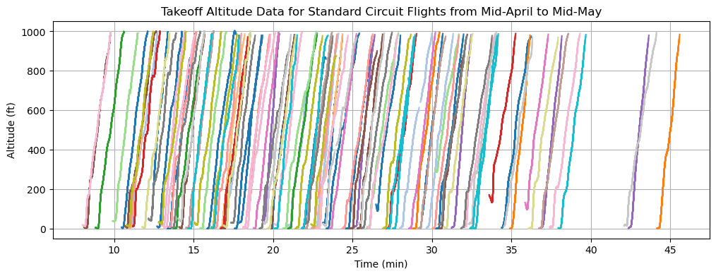
Filtering The Takeoff Stages
First Stage Filtering
  Filtered out non-circuit standard flights
    Any flight with a ground altitude height above 1200 ft
Second Stage Filtering
  Filtered out non-climbing data
    Measured by calculating the slope of two cells 20 apart and making sure the slope is over a certain threshold.
      If it falls under the threshold, the cells in between are included in the dataset.
      This allows for more consistent data being included

Slide 4
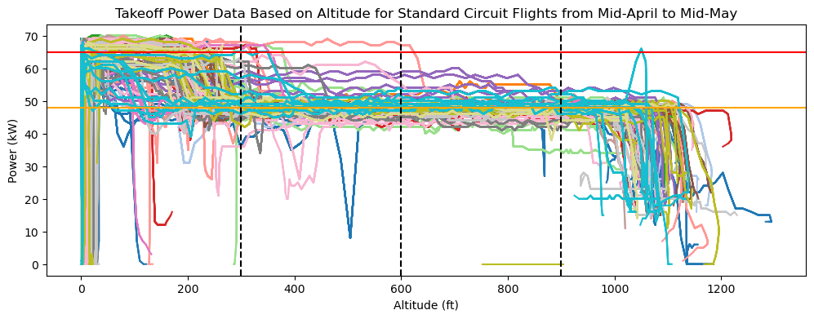
Power Setting Based on Altitude
Main Altitude Stages
  Initial Takeoff (0-300 ft)
    Typical Power Setting: 65 kW
  1st Climbing Stage (300-600)
    Typical Power Setting: 48 kW
  2nd Climbing Stage (600-900)
    Typical Power Setting: 48 kW

Slide 5
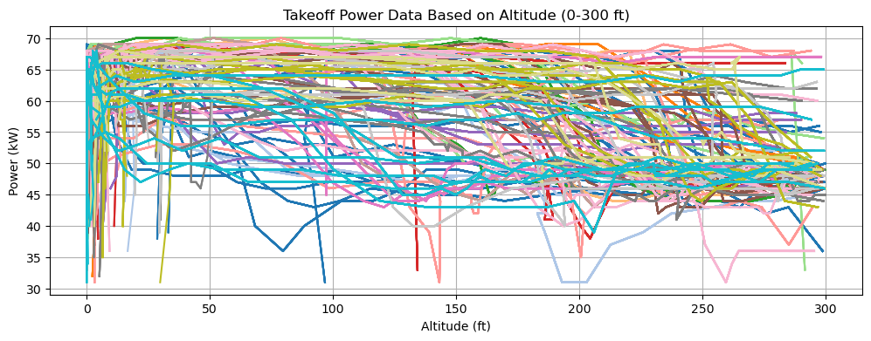
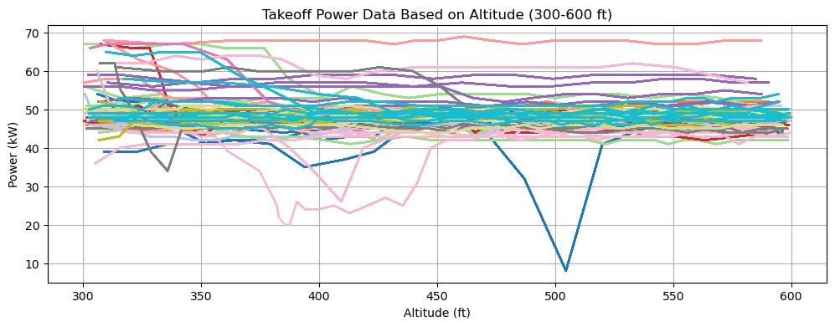
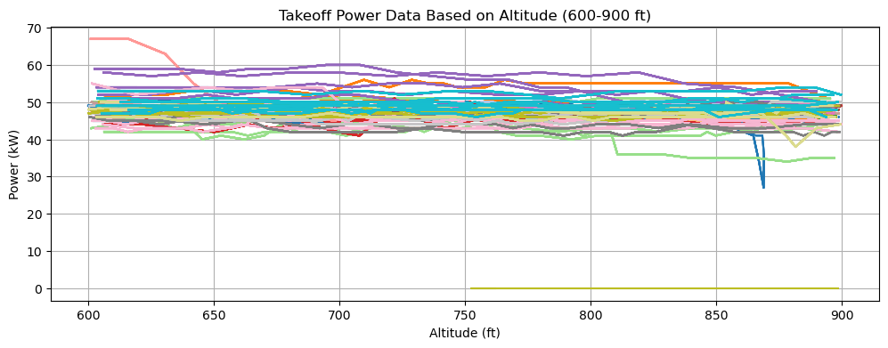
Power Separation
Main Altitude Stages
  Initial Takeoff (0-300 ft)
    Average Power Setting: 54.544 kW
  1st Climbing Stage (300-600)
    Typical Power Setting: 48.388 kW
  2nd Climbing Stage (600-900)
    Typical Power Setting: 47.642 kW

Slide 6
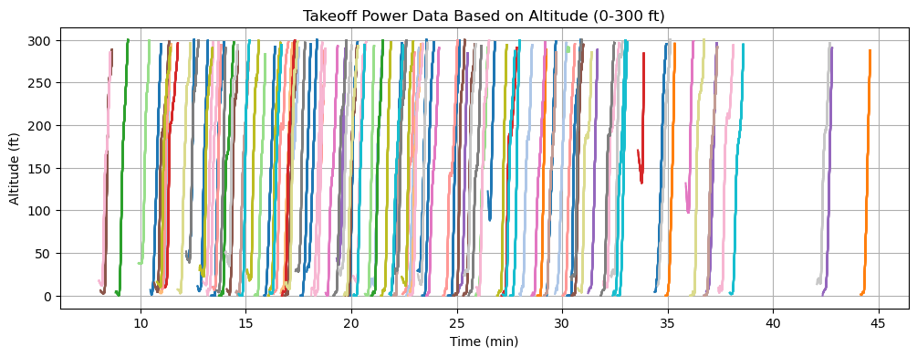
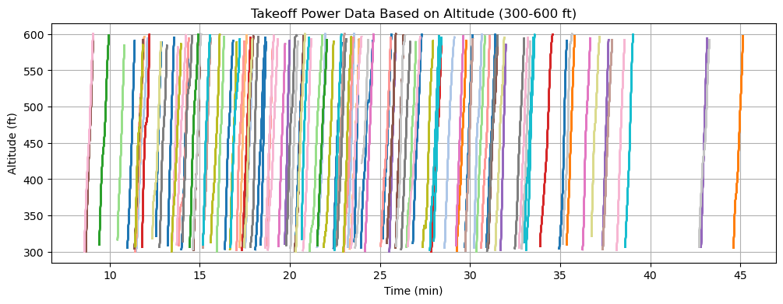
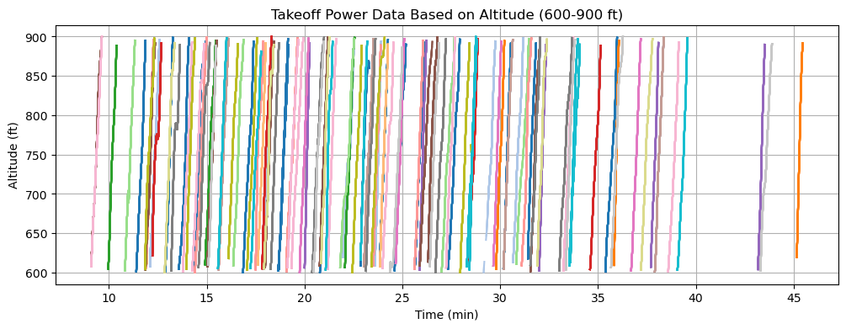
Separating the Takeoff Stages
Main Altitude Stages
  Initial Takeoff (0-300 ft)
    Average Time to climb 300ft: 0.459 min
  1st Climbing Stage (300-600)
    Average Time to climb 300ft: 0.464 min
  2nd Climbing Stage (600-900)
    Average Time to climb 300ft: 0.476 min

Slide 7
Average Energy Consumption
Main Altitude Stages
  Initial Takeoff (0-300 ft)
    Average Energy Consumption: 0.417 kWh
  1st Climbing Stage (300-600)
    Average Energy Consumption: 0.374 kWh
  2nd Climbing Stage (600-900)
    Average Energy Consumption: 0.368 kWh
  Total Consumption: 1.169 kWh per takeoff
    At 75% SoH: 6.285% dSoC

Slide 8
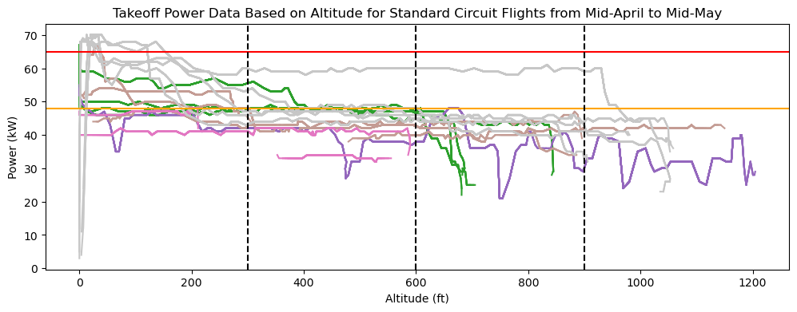
Average Energy Consumption (Vancouver)
Main Altitude Stages
  Initial Takeoff (0-300 ft)
    Average Energy Consumption: 0.353 kWh
  1st Climbing Stage (300-600)
    Average Energy Consumption: 0.404 kWh
  2nd Climbing Stage (600-900)
    Average Energy Consumption: 0.418 kWh
  Total Consumption: 1.176 kWh per takeoff
    At 75% SoH: 6.323% dSoC
Note:
Significantly less data points compared to Waterloo,
Vancouver has a lower takeoff power-setting but slightly longer takeoff stage durations
  Initial Stage
    0.419 min per 300 ft, 50.607 kW
  1st Climb Stage:
    0.538 min per 300 ft, 45.25 kW
  2nd Climb Stage:
    0.572 min per 300 ft, 43.884 kW
Waterloo is currently starting trials with 50 kW for initial takeoff power setting

Slide 9
Questions Addressed
What is the best measure of energy consumption and battery usage?
  Change in battery state of charge?
    Average Energy: kW
      Does not get effected from battery SoH, universal for any battery
How do different takeoff power settings affect battery consumption?
  Which is more efficient (High vs Low Power Setting)?
    Both provide very similar discharge and energy consumption rates, despite varying power and stage duration
    A lower power setting would be more optimal to minimize strain in the battery, theoretically reducing battery SoH degradation

